Slide 1
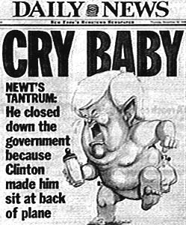
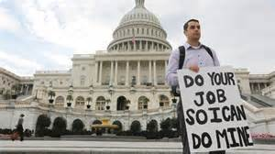
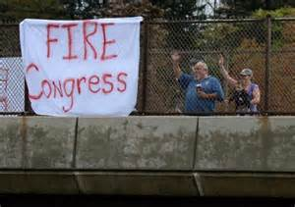
1996
Government Shutdown
The House of Representatives, led by Newt Gingrich (R), and President Clinton (D) agrued over apportionments which caused the government's budget to be delayed. The delay closed most "non-essential" US government offices for several weeks to start off 1996.

Slide 2
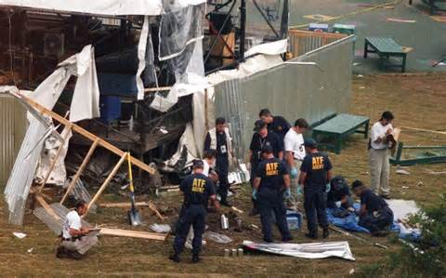
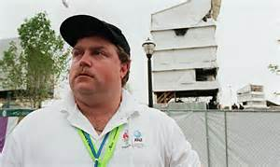
1996
Atlanta Olympics bombing - Centennial Park
The Centennial Olympic Park bombing during the 1996 Summer Olympics in Atlanta happened on July 27. The explosion killed 1 and wounded 111 others (1 person died of a heart attack). Security guard Ricard Jewell discovered the bomb and began to evacuate the area before it went off. He later became the FBI's main target during its investigation but was cleared of any wrong doing. Eric Rudolph was arrested in 2003 for the bombing and 3 other bombings (anti-abortion, anti-gay)

Slide 3
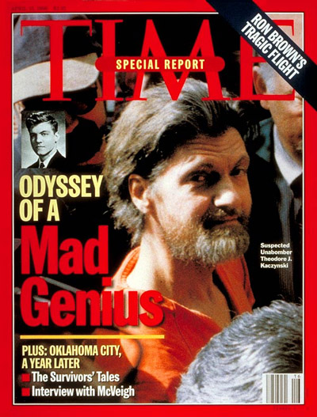
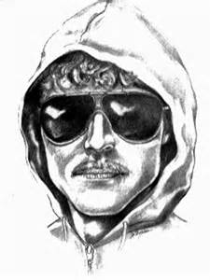
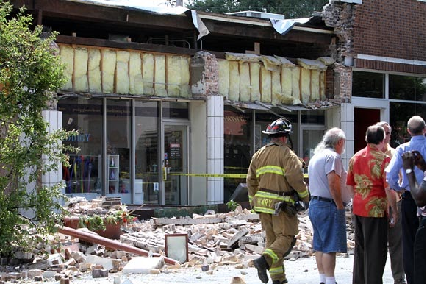
1996
Unabomber arrested
Ted Kaczynski was arrested after mailing 16 bombs between 1978 and 1995, killing 3 and wounding 23 others. He was anti-industrialization and modern technology.

Slide 4
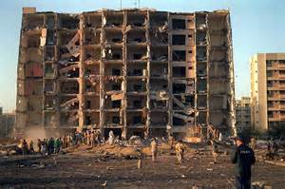
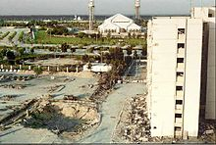
1996
Khobar, Saudi Arabia military attack
Khobar Towers was used as housing for military personal when ,in June, a truck bomb exploded killing 19 US servicemen and wounding 498 soliders.

Slide 5
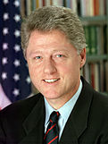
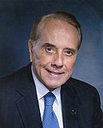
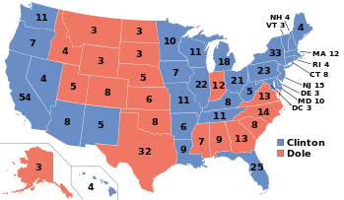
1996
Clinton Re-elected
Bill Clinton defeats Bob Dole, becoming the 1st Democrat to be re-elected since FDR. Clinton was able to overcome broken promises from his first election by the strengthening economy and anger at Congress

Slide 6
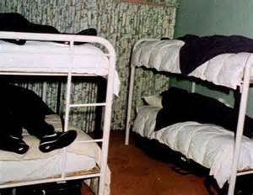
1997
Heaven's Gate
Heaven's Gate was an American UFO religious cult based in San Diego. In March, 39 members committed suicide in order to join an alien space craft they thought was traveling behind the Hale-Bopp Comet.

Slide 7
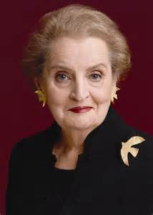
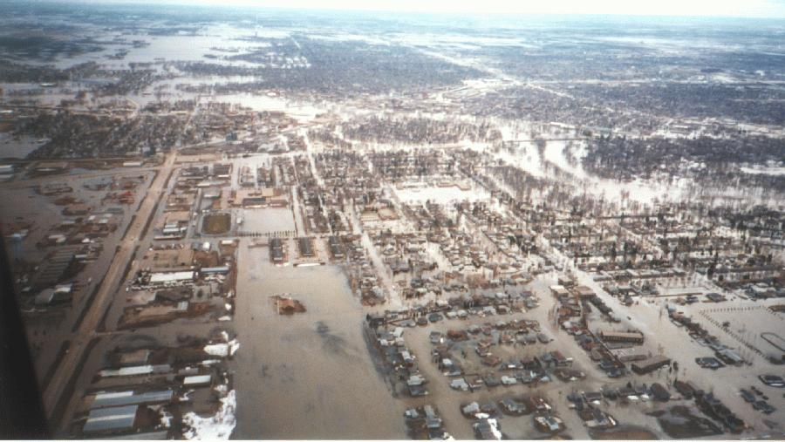
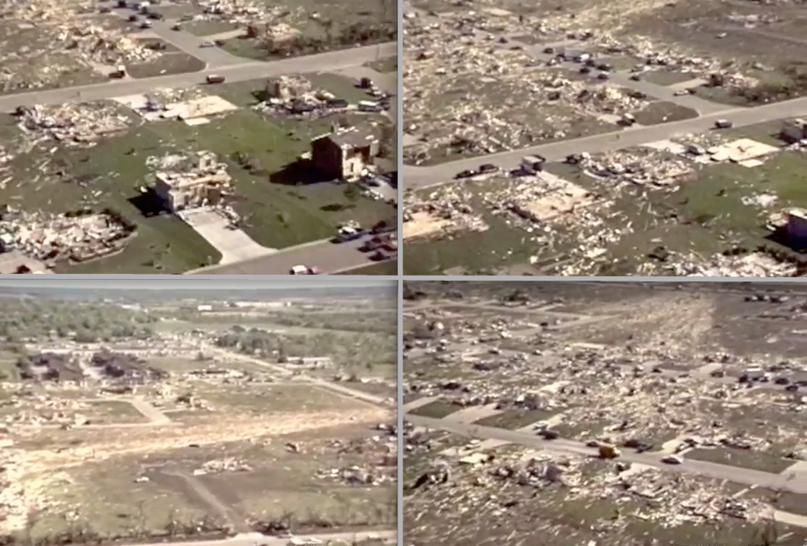
1997
Madeleine Albright becomes the first women to be Secretary of State
Red River Flood in North Dakota and Minnesota cause $3.5 billion in damages
F5 tornado kills 27 people in Jarrell, Texas

Slide 8
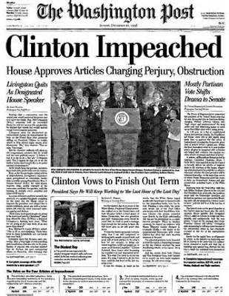
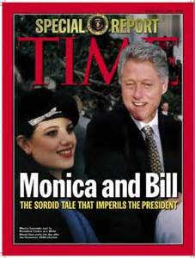
1998
Clinton's Impeachment
Clinton was investigated during the beginning of his 1st term for improper campaign funding while Governor of Arkansas through the Whitewater Development Company. During the investigation, matters unrelated to Whitewater became public – specifically sexual harassment claims and sexual affairs.
Impeachment was started in December of 1998 against President Clinton on two chargers – perjury and obstruction of justice.
Impeachment failed to get a 2/3’s majority vote but damaged the administration for the rest of his term.

Slide 9
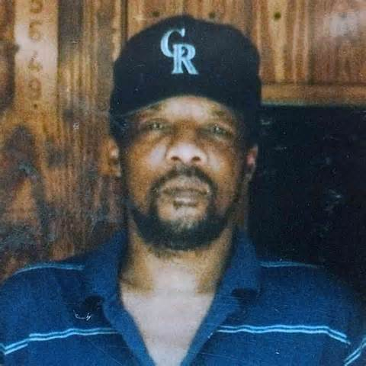
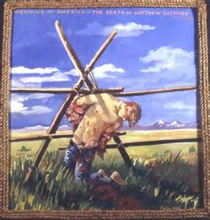
1998
Hatred Highlighted
James Byrd Jr. was an African-American who was murdered by 3 white supremacists by being assaulted and dragged behind a truck for 3 miles
Matthew Sheppard was a student at the University of Wyoming who was beaten, tortured, and left to die tied to a fence outside of Laramie, Wyoming because of his sexual preference
Both acts of violence led to the expansion of the Federal Hate Crimes Act

Slide 10
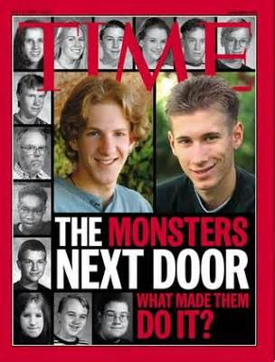
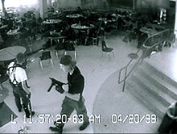
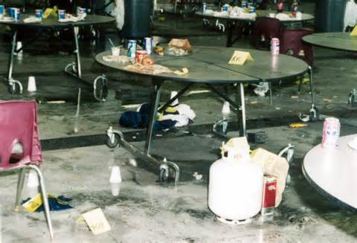
1999
Columbine High School Massacre
Shooting that occurred in Columbine, Colorado on April 20th by 2 students that killed 13 people (not including the shooters who committed suicide) and injured 21 others. The shooters had numerous weapons, a diversionary fire bomb, a bomb rigged to a car, a bomb in the cafeteria, and 99 other explosive devices.
This event was not the first school shooting or the last but it had the most impact on school policies and security

Slide 11
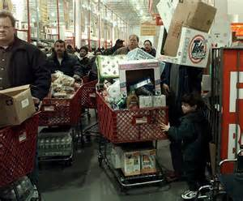
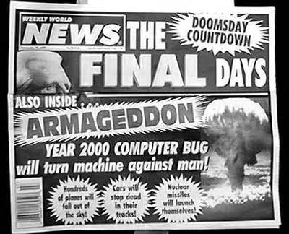
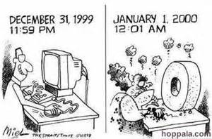
1999
Y2K Scare
AKA: Year 2000 problem, Y2K problem, the Millennium bug, the Y2K bug, or Y2K.
It was a problem for electronic/computer systems which resulted from the practice of abbreviating a four-digit year to two digits. This made year 2000 indistinguishable from 1900. The fear was that computer systems would crash because of this error causing technology to fail.

Slide 12
2000
Bush, Gore, and Florida
Very close election that came down to one state: Florida. TV stations first predicted Gore to win Florida (and the Presidency) but later changed to “ too close to call”, then to Bush, and then back to “too close to call”.
Bush was declared the winner on the day after the election by a few thousand votes. The thin margin triggered an automatic recount which shrunk Bush’s victory to only a few hundred votes.
Democrats sued for a manual recount based on voting irregularities (butterfly ballot) and the fact that the governor of Florida, Jeb Bush, was George’s brother.
The Supreme Court ended the manual recount on a 5-4 decision based on the lack of uniform standards violated the equal protection of voters. (Hanging Chad)
Bush wins the electoral vote despite have less popular votes

Slide 13
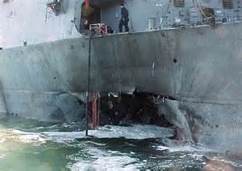
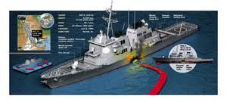
2000
USS Cole
Al-Qaeda suicide attack against a US Navy Destroyer while it was harbored in the port of Aden in Yemen. 17 sailors were killed and 39 others were injured. This event changed the "rules of engagement" for the military and was an indication of the growing threat of al-Qaeda

Slide 14
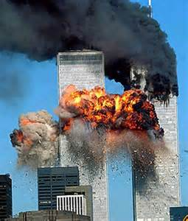
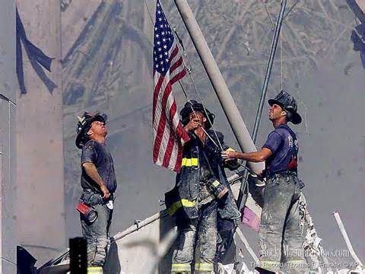
2001
September 11, 2001
A series of coordinated terrorist attacks by Al-Qaeda that targeted New York City and Washington DC. Attackers hijacked 4 airplanes, crashing 2 into the World Trade Center, 1 into the Pentagon, and 1 crashed in Pennsylvania after a struggle between the hijackers and passengers. The attacks killed 2,996 people (including 19 hijackers) and caused at least $10 billion in property and infrastructure damage.
Effects include a temporary closing of US air space, the War on Terror, Homeland Security Act, USA Patriot Act

Slide 15
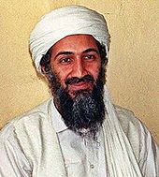
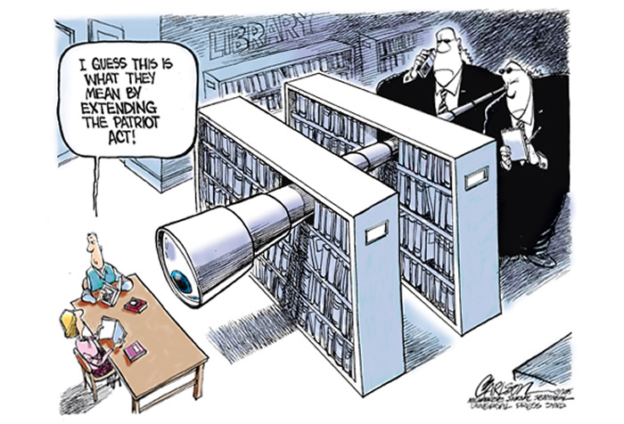
2001
Impact of September 11, 2001
The War on Terror focused on Osama bin Laden and al-Qaeda (responsible for 9/11), the Taliban in Afghanistan, and any country that sponsors terrorist activities (Iraq, Chad, Libya).
TSA – Transportation Security Agency created to protect security at US airports
Department of Homeland Security created to keep the US secure from all threats
USA Patriot Act, 2001 – expanded the government’s powers to protect citizens. Used to collect information, imprison suspected terrorists, detain and search with less “cause”, and monitor peoples activities.

Slide 16
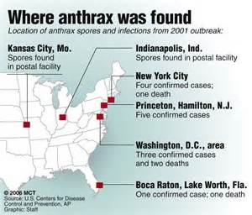
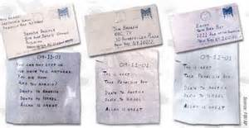
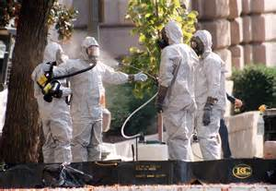
2001
Anthrax Attacks
2 weeks after 9-11, letters containing anthrax spores (deadly poison) were mailed to several news media offices and 2 US Senators, killing 5 and infecting 17 others.
At first the attacks were rumored to be linked to al-Qaeda but no evidence supported that. FBI investigation eventually led to a military researcher named Bruce Ivins. Ivins will commit suicide in 2008 when he finds out that the FBI is about to bring charges.

Slide 17
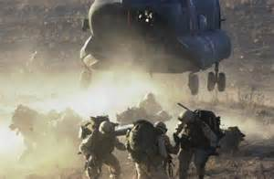
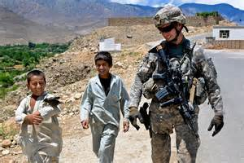
2001
War in Afghanistan
In October, the US and Great Britain invaded Afghanistan after the Taliban government refused to "hand over" Osama Bin Laden. The Taliban had just taken over during a Civil War that started in 1996. The war became an UN action by the end of 2001 and a NATO action in 2003. By 2003, 43 countries were in Afghanistan. In 2011, Osama Bin Laden was killed in Pakistan. In December 2014, NATO officially ended its role in Afghanistan and most countries had pulled out their troops or were in the processes of doing so. As of 2015, their are still 10 countries that still have soldiers in Afghanistan.

Slide 18
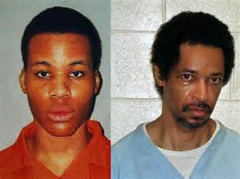
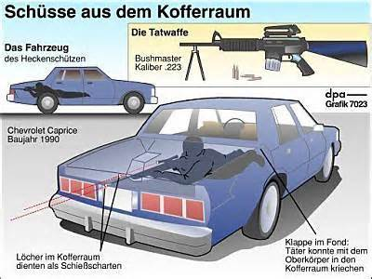
2002
DC Sniper
John Allen Muhammad and Lee Boyd Malvo (17) shot 13 people, killing 10, in a 3 week spree. The two previously killed 4 and wounded 7 others in Washington, Arizona, Texas, Louisiana, Alabama, Georgia, and Maryland earlier in the year. The reason for the shootings has been debated. Theories include: distraction from intended target, ex-wife; "jihad"; kidnap children and extort money from the government; and terrorism - goal was to "shut things down" across the US

Slide 19
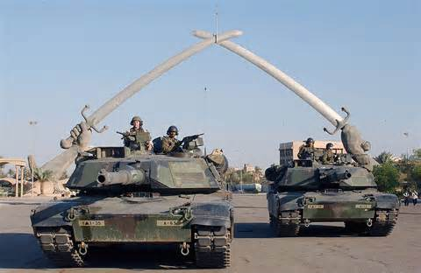
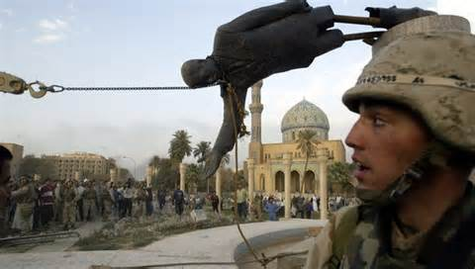
2003
War in Iraq
Began with the fear that Iraq, led by Saddam Hussein, was provide terrorists with biological, chemical, or even nuclear weapons - "weapons of mass destruction" (WMD's). After some international inspections, the US gave Hussein 48 hours to leave Iraq or face invasion. The invasion began in March. The government quickly collapsed and Hussein was captured later that year and sentenced to death in 2006. In 2005, Iraq held elections and became the first Arab democracy in the Middle East. Since then, the government has not been able to stop internal fighting

Slide 20
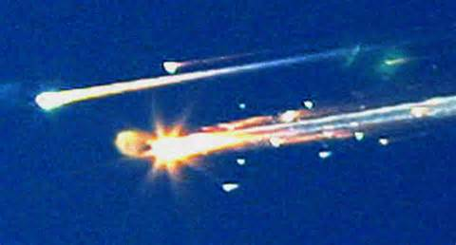
2003
Space Shuttle Columbia disaster
Columbia disintegrated over Texas and Louisiana as it reentered the Earth's atmosphere in February, 2003, killing all 7 crew members. Caused was determined to be damage to the heat shield on the left wing. This damaged occurred at launch when a piece of foam insulation broke off from the external fuel tank and hit the wing. The damage, if known about before reentry, could not have been fixed from space.

Slide 21
2003
Human Genome Project
Its an international scientific research project whose goal is to determine the sequence of chemical base pairs that make up DNA, and identify and map all of the genes of the human genome. The project was proposed in 1984, started in 1990 and declared complete in 2003.
Benefits may be tremendous. Genetic tests can determine who might be predisposed to certain issues like cancer. There might even be the possibility of manufacturing "cures" to element such issues in the future.

Slide 22
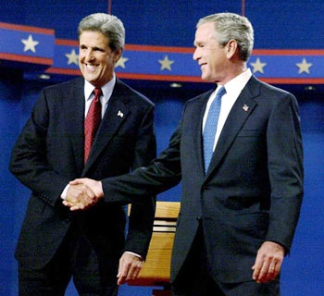
2004
2004 Election
George W Bush vs John Kerry
Bush's margin of victory in the popular vote was the smallest ever for a reelected incumbent president. (Bush actually lost the popular vote in 2000)
Bush's key to victory was his appearance to be focused on national security and the war on terrorism.

Slide 23
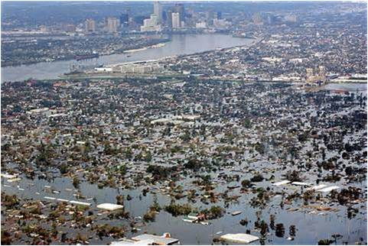
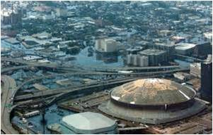
2005
Hurricane Katrina
Category 5 (strongest level), 3rd most intense ever to hit the US, 5th deadliest (could have been worse if 80% of New Orleans and the Gulf Coast region had not been evacuated), Most damaging at over $108 billion
Most damage occurred in New Orleans where the levees failed and flooded the city, trapping 20,000 people at the Superdome

Slide 24
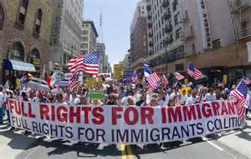
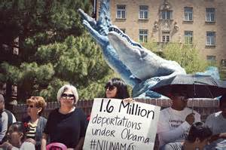
2006
Immigration Protests
Millions of people participated in protests over a proposed change to U.S. immigration policy that would raise penalties for "illegal immigration" and classify undocumented immigrants and anyone who helped them enter or remain in the US as felons.
Most of the protests not only sought a rejection of this policy, but also a comprehensive reform of the country's immigration laws that included a path to citizenship for all undocumented immigrants.

Slide 25
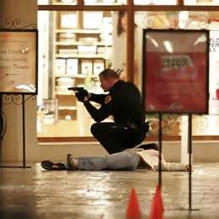
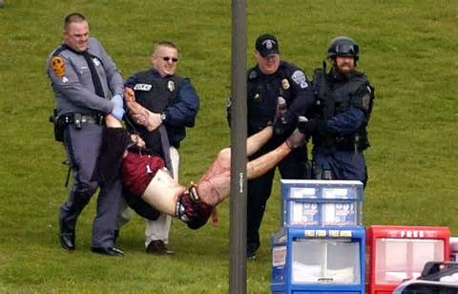
2007
Public Violence
*Trolley Square shooting (February) in Salt Lake City, Utah. Suljman Talovic (19) killed 5 people before being killed by police.
*Ward Parkway Shopping Center (April) in Kansas City, Kansas. David Logsdon killed 3 people and wounded 3 before police killed him.
*Westroads Mall shooting (December) in Omaha, Nebraska. Robert Hawkins (19) killed 8 people and wounded 4 others before he shot himself.
*Virginia Tech Massacre (April) in Blacksburg, Virginia. Seung-Hui Cho shot 49 people, killing 32 before he shot himself.

Slide 26
2008
Financial Crisis
Worst since the Great Depression
Housing Crisis caused by low interest rates to stimulate the economy in 2000 increased the number of buyers and raising prices. Overbuilding led to lower prices around 2007 and the rising of interest rates cause many foreclosures. Business became to fail when mortgages and other investments began to lose money creating the recession. In 2008, the federal government spent over $700 billion to buy distressed investments and fund failing banks, brokerage houses, insurance, and investment groups.

Slide 27
2008
Election of 2008
Barack Obama vs John McCain
Major difference was the support of the war in Iraq and Afghanistan.
Another major factor was Obama’s use of social media.
Barack Obama is the 1st African-American US President

Slide 28
2009
Sonia Sotomayor and Michael Jackson
Sonia Sotomayor was appointed to the Supreme Court by President Obama.
She is the 1st person of Hispanic heritage to serve on the Supreme Court
Michael Jackson died in June of a heart attack caused by misusing prescription drugs.
He was a global figure for his music and dance, often call the "King of Pop"

Slide 29
2009
Fort Hood Shooting
In November a mass shooting at
Fort Hood, Texas killed 13 and wounded
32 others. Major Nidal Malik Hasan was
found guilty of the shooting and was
sentenced to death. Reasons for the shooting have been
controversial. It was ruled as work place violence
because Hasan did not want to redeploy to
Afghanistan but others look at Hasan's belief at the
immoral killings of Muslims at the hands of the US
soldiers.

Slide 30
2010
Affordable Care Act
The Affordable Care Act, or Obama Care was passed in March and represents the most significant regulatory overhaul of the US healthcare system since Medicare/Medicaid in the 1960s.
It is an attempt to increase the quality and affordability of health insurance, to increase the number of people covered, and reduce the overall cost of health care.
The program is still being fought over. Most parts were upheld by the Supreme Court in 2012

Slide 31
2010
WikiLeaks
WikiLeaks is an international journalistic organization which publishes secret information. Although the website began in 2006, it was in 2010 when it made "history".
It published 76,900 secret government documents on the Afghanistan and Iraqi Wars, some of which had names of embedded personal and other "top secret" information.

Slide 32
2010
Times Square Car Bomb Plot
The Times Square Car Bomb plot was a terrorist attack in New York City that was foiled when 2 street vendors saw the car "smoking" and alerted the police. The bomb had ignited but failed to explode, saving hundreds of people. Faisal Shahzad was arrested for the crime and it was discovered that he had been trained in Pakistan and ordered to commit the crime by the Taliban.

Slide 33
2011
Space Shuttle Progam Ends
The Space Shuttle program lasted from 1972 (concept) to August 2011. 1st flight of the reusable space craft was in 1981 and it marked a large leap forward in the Space Program.
The program suffered two major loses: 1986 Challenger explosion and 2003 Columbia re-entry break up
The next stage of space exploration has been moved to private companies and secret military programs

Slide 34
2011
Osama Bin Laden Killed
Osama Bin Laden, the founder and leader of al-Qaeda was killed in a CIA/Naval Seal operation on May 2.
He was found to be hiding in a compound in Abbottabad, Pakistan, less than a mile from the country's military academy.
The operation was secret, Pakistan was not even told of it, and because it took place in a non war zone, the Seal team had to be temporarily reassigned to the CIA.
Bin Laden's body was buried at sea within 24 of being killed

Slide 35
2012
2012 Election
Barack Obama vs Mitt Romney
Campaigns focused on Health Care, The wars in Afghanistan and Iraq, and economic recovery
Obama wins 2n

Slide 36
2012
Hurricane Sandy
Although not a extremely strong hurricane, Sandy is the 2nd most costly hurricane in US history at $65 billion. It affected 24 states and hit every state on the Atlantic seaboard. 71 people also died due to Sandy.

Slide 37
2013
Snowden Leaks
Edward Snowden was a system administrator for the CIA and an analyst for the National Security Agency when he leaked classified information to the main steam media. The leaked information revealed global surveillance programs that ran with the cooperation of telecommunication companies and European governments. Snowden is currently in "exile" in Russia.

Slide 38
2013
Boston Marathon Bombing
The bombing occurred on April 15th whe 2 pressure cooker bombs exploded killing 3 people and wounding another 264. Chechen brothers Dzhokhar Tsarnaev and Tamerlan Tsarnaev were the perpetrators. Tamerlan was killed in a shoot out with police and Dzhokhar was arrested and found guilty of the crime. Motive for the act is believed to by based on extremist Islamic beliefs and the wars in Iraq and Afghanstan.

Slide 39
2014
Ebola Scare
Ebola is a disease that effects humans and other primates.
Symptoms start usually between 2 days to 3 weeks.
Symptoms include fever, sore throat, muscular pain, headaches, the vomiting, diarrhea, and rash.
Effect ends with decreased function of the liver and kidneys and internal and external bleeding.
Death rate is between 20-90% with an average of 50% (usually in 6 to 16 days)
The 2014 West African outbreak was the largest ever recorded with 26,683 people diagnosed as of May 2015 (41% mortality rate)
This outbreak was unique in that it showed how a primarily "African" disease now has a global impact because to modern transportation.
17 people were treated outside of Africa, 4 of which died including 3 in Texas where 1 man died.

Slide 40
Same sex marriages
The issue of Same-Sex marriages in the US is
created by the federal system. The power
to preform marriages is a state power but
protection of individuals civil rights is a national
responsibility. Before 1996 there was no federal
definition of marriage but there were court
cases expanding marriage rights (age and
ethnicity). Massachusetts was the first state to allow same-sex marriages in 2003 and a total of 36 states allow marriages today. In 2013, the Supreme Court ruled it unconstitutional for the federal government to deny federal benefits of marriage to married same-sex couples, if it is recognized or performed in a state that allows same-sex marriage. The Supreme Court has consistently ruled that states can not outlaw same-sex marriages but have not ruled that it is a basic civil right that the US Constitution allows.

Slide 41
your technology
Google September 1998
Pandora January 2000
Wikipedia January 2001
Skype August 2003
Facebook February 2004
You Tube February 2005
Twitter March 2006
iPhone June 2007
Android September 2008
Pinterest March 2010
Ask.fm June 2010
Kik Messenger October 2010
Instagram October 2010
Snapchat September 2011
Vine Video June 2012
If you went back in time to the day you were born, could you even describe what your life would be like?

