Slide 1
Chapter 35
“World War Looms”

Slide 2
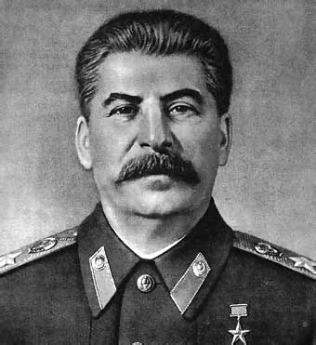
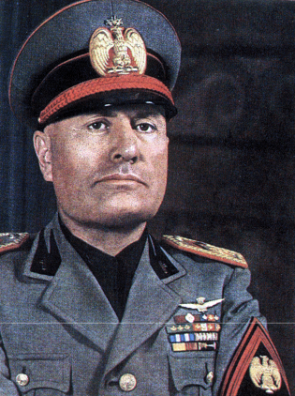
Joseph Stalin
Totalitarianism: Total complete control of government.
Benito Mussolini; Fascist government (Extreme Nationalistic government, the interests of the state are before the individual, strong leader and small group devoted to party members.)

Slide 3
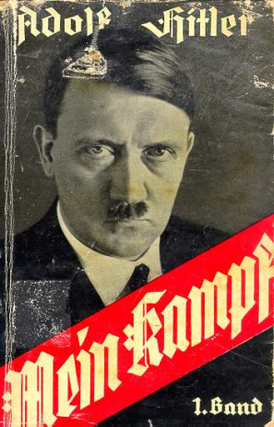
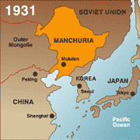
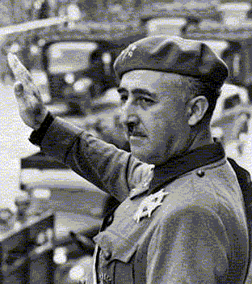
Mein Kampf (My Struggle); Basic beliefs of Nazism, extreme Nationalism, racial “purification”, Aryans are the “master race”, national expansion.
Japan Seized Manchuria
Spanish Civil War: Francisco Franco
Neutrality Acts/Isolationism: Congress passed in 1935; keep out of all wars. Outlawed arms sales or loans to nations at war.

Slide 4
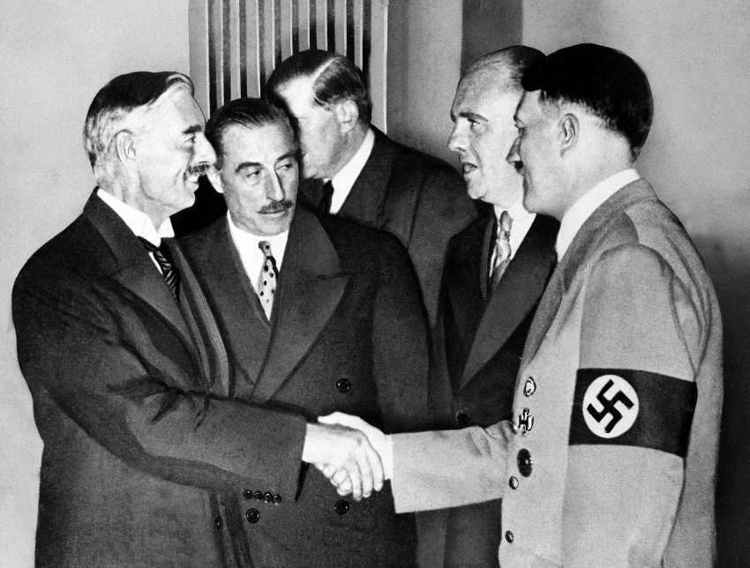
Appeasement; 1936
British Prime Minister Neville Chamberlain “appeased” Hitler by “giving” him The Rhineland. Land lost after the Treaty of Versailles WWI.
Appeasement ended when Hitler invaded Poland in 1939

Slide 5
MARCH TO WAR
JAPAN INVADES MANCHURIA
ITALY INVADES ETHIOPIA
SPANISH CIVIL WAR
HITLER’S CONQUESTS

Slide 6
HITLER BEGINS HIS MARCH TO WORLD CONQUEST LEADING TO WORLD WAR II
1935 HITLER DECLARES GERMANY WILL REARM IN VIOLATION OF THE TREATY OF VERSAILLES
MARCH 1936 HITLER SENDS GERMAN SOLDIERS TO REOCCUPY THE RHINELAND, NEXT TO FRANCE, VIOLATING THE TREATY OF VERSAILLES
MARCH 1938 HITLER TAKES OVER AUSTRIA AND TURNS IT INTO A GERMAN PROVINCE KNOWN AS OSTMARK
SEPTEMBER 1938 HITLER DEMANDS AND IS GIVEN THE STRATEGIC CZECHOSLOVAKIAN SUDETENLAND WITHOUT A FIGHT
MARCH 1939 HITLER TAKES OVER THE REST OF CZECHOSLOVAKIA
SEPTEMBER 1, 1939 HITLER INVADES POLAND
SEPTEMBER 3, 1939, BRITAIN AND FRANCE DECLARE WAR ON GERMANY AND WORLD WAR TWO BEGINS

Slide 7
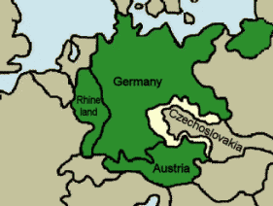
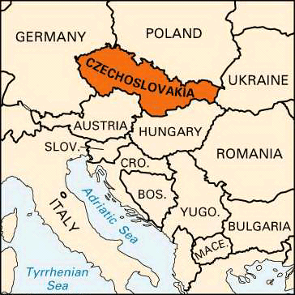
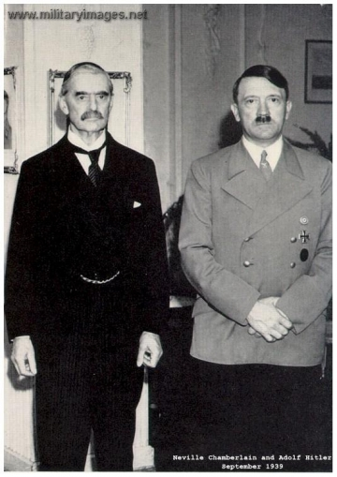
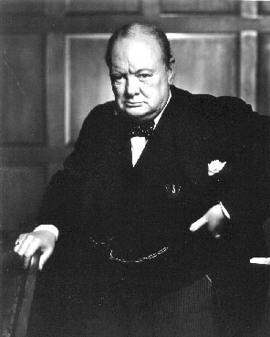
Austria; Sudetenland (Czechoslovakia).
Beginning: Neville Chamberlain
End: Winston Churchill

Slide 8
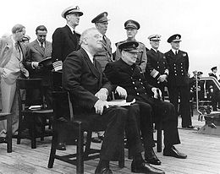
Atlantic Charter
Joint declaration released by U.S. President Franklin D. Roosevelt and British Prime Minister Winston Churchill on August 14, 1941.
26 Nations pledged to support a vision of peace after war (United Nations)

Slide 9
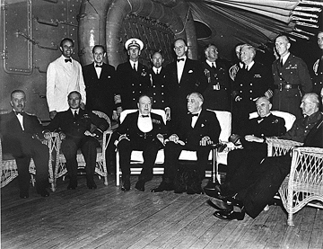
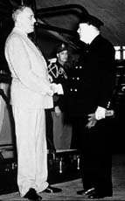
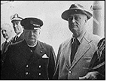
CHURCHILL AND FDR MEET AND AGREED ON THE POSTWAR WORLD: THE ATLANTIC CHARTER

Slide 10
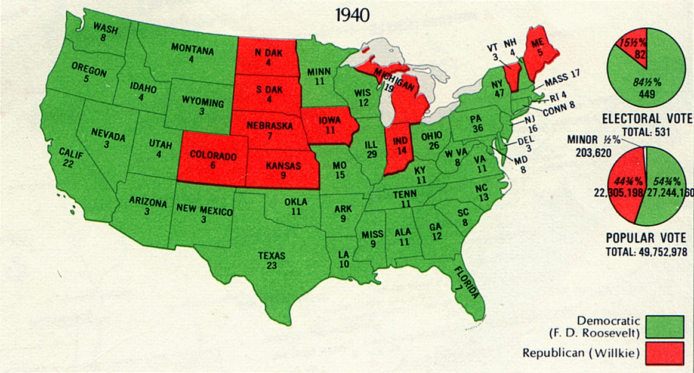
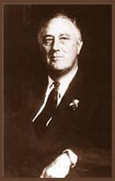
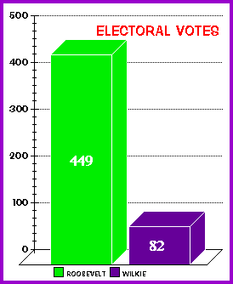
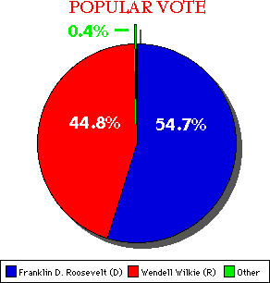
3RD TERM PRESIDENT FRANKLIN DELANO ROOSEVELT
Notes:
1940 PRESIDENTIAL ELECTION: FDR WAS REELECTED WITH THE PROMISE THAT HE WOULD NOT SEND US SOLDIERS TO FIGHT IN FOREIGN WARS. HE WAS THE FIRST AND ONLY PRESIDENT TO BE ELECTED THREE TIMES. AFTER FDR DIED CONGRESS PASSED AN AMENDMENT THAT LIMITED THE PRESIDENT TO TWO TERMS ONLY.

Slide 11
Cash and Carry- Allowed warring nations to buy US arms as long as they paid in cash and transported them in own ships.
Lend-Lease Plan- Lease arms and supplies to countries

Slide 12
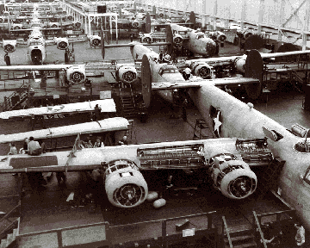
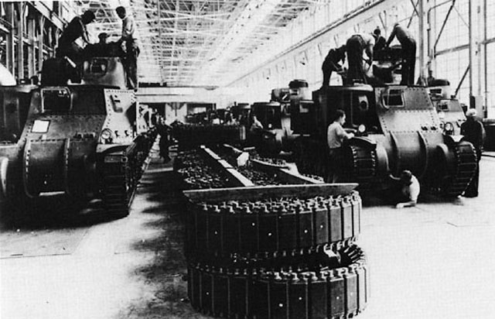
US INDUSTRY GEARS UP FOR WAR AND PRODUCES GREAT QUANTITIES OF ARMS AND EQUIPMENT FOR ALL THE ALLIES
Notes:
ARSENAL OF DEMOCRACY: CONCEPT THAT THE US WOULD SUPPLY THE WEAPONS FOR THOSE FIGHTING AGAINST HITLER AND JAPAN WHILE KEEPING ITS MEN OUT OF THE ACTUAL FIGHTING

Slide 13
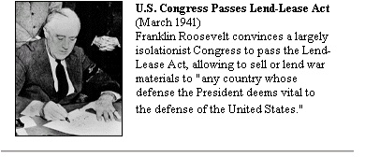
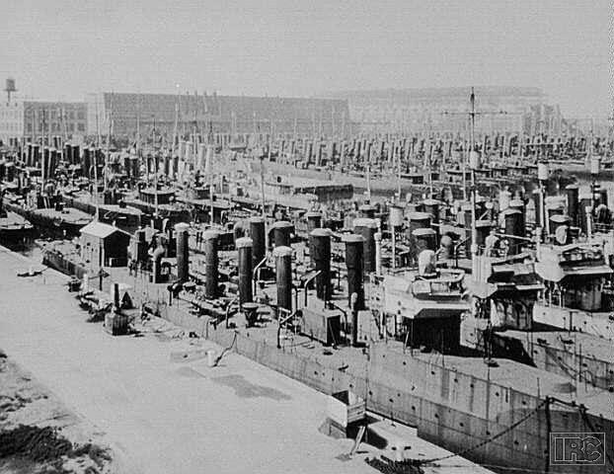
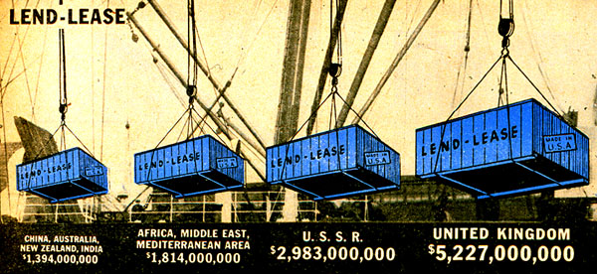
THE UNITED STATES BECAME INVOLVED BY SUPPLYING WAR MATERIALS FOR THE ALLIES
Notes:
DESTROYER DEAL: SEPT. 1940 FDR TRADED 50 US WW I DESTROYERS (SHIPS GEARED TO DESTROY SUBMARINES) FOR BRITISH BASES IN CANADA AND THE CARIBBEAN
LEND LEASE ACT: MARCH 1941, ALLOWED THE PRESIDENT TO SELL, LEND OR LEASE WAR MATERIALS TO ANY NATION WHOSE DEFENSE WAS VITAL TO US SECURITY. IN REALITY THE US GAVE WEAPONS ONLY TO THE UK AND ABANDONED NEUTRALITY.

Slide 14
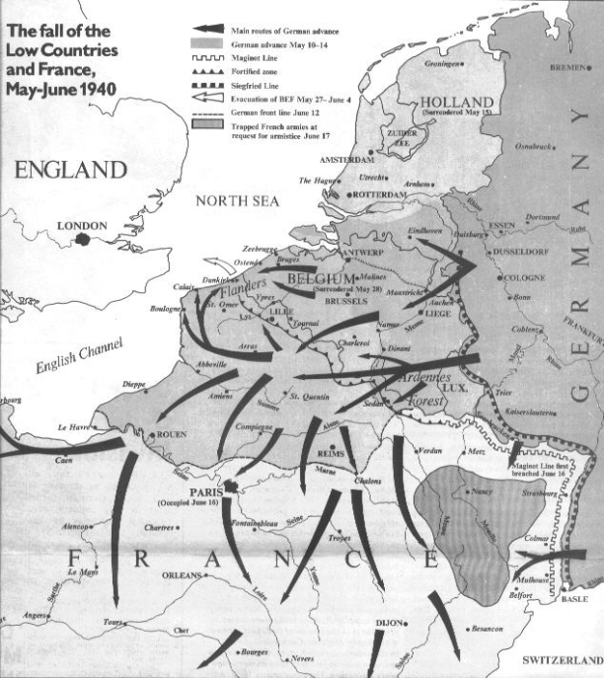
Blitzkrieg: Lightning War; Germany’s military strategy to take Paris, France then turn around to Soviet Union

Slide 15
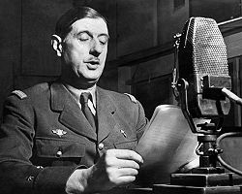
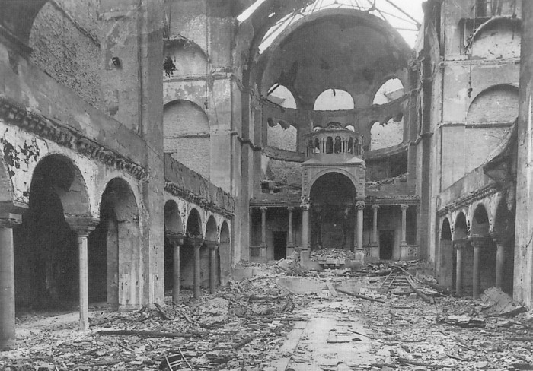
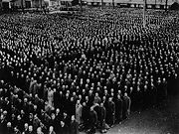
Charles de Gaulle: France’s General; set up Free French government in exile in Britain (will be President of France later in 1958)
Kristallnacht: November 9-10, 1938; “Night of Broken Glass”; storming of Jewish businesses and synagogues in Germany

Slide 16
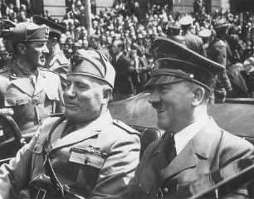
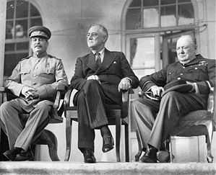
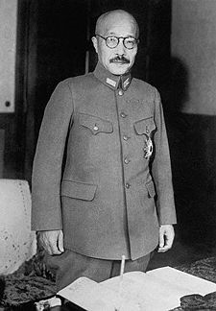
Axis Powers: Germany, Italy, and Japan
Allies: Britain, France, Soviet Union, U.S.
Tojo: Chief of staff of Japan’s army

Slide 17
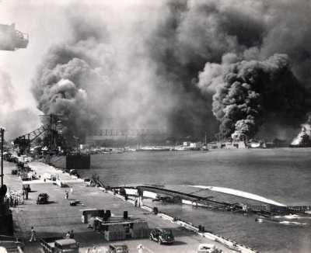
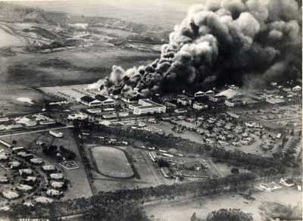
December 7, 1941; The US declared war on Japan
“A date which will live in infamy” FDR

