Slide 1
Ch. 41:1980’s and Reagan
1980 1990s

Slide 2
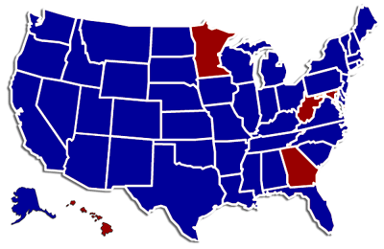
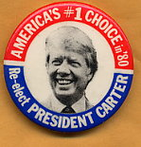
The 1980 election: Carter vs. Reagan

Slide 3
Ronald Reagan won

Slide 4
Domestic Policy
1980 election
Religious Right
“Reaganomics”
Space shuttle Columbia
Supreme Court nominees
AIDs
Martin Luther King, Jr. holiday
1984 election
Challenger
War on Drugs
Reparations
1988 election
Savings and loan crisis

Slide 5
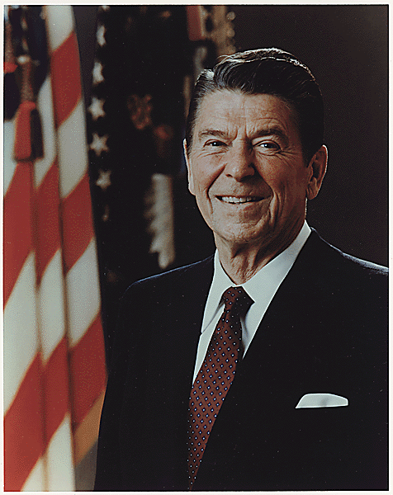
Ronald Reagan
Reaganomics or “trickle-down theory” of economics
Increased defense spending
Cut taxes
Reduced funding of social welfare programs
Tripled the debt
Iran-contra scandal
Helped end the Cold War

Slide 6
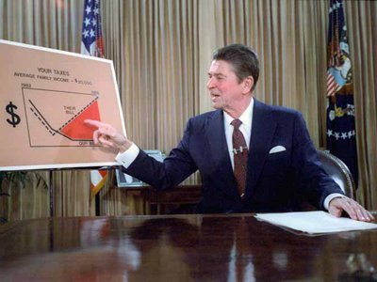
Supply-Side Economics (Reaganomics)
The Reagan administration advocated supply-side economics, arguing that tax cuts reduced government spending would increase investment by the private sector (more jobs, production, and prosperity)
Based on trickle-down theory, the idea is that with a lower tax burden and increased investment, business can produce (or supply) more, increasing employment and worker pay. (It did not work!)

Slide 7
A major success of Reagan’s economic policies was the reduction of inflation

Slide 8
Military spending increased under Reagan

Slide 9
The national debt tripled under Reagan

Slide 10
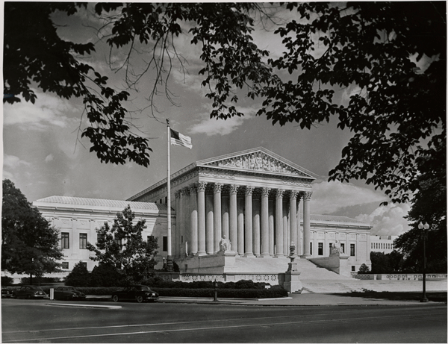
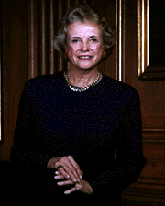
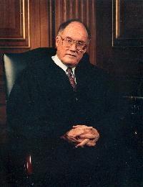
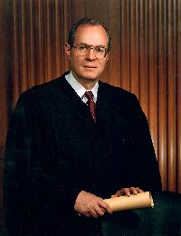
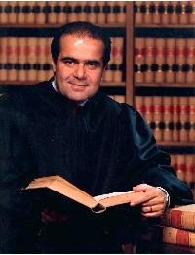
Reagan’s Supreme Court nominations
The first female Justice, Sandra Day O’Connor
September 25, 1981
William Rehnquist
Chief Justice,
September 26, 1986
Anthony Kennedy, February 18, 1988
Antonin Scalia September 26, 1986

Slide 11
Human Immuno-Deficiency Virus, HIV
Acquired Immune Deficiency Syndrome, AIDS
HIV is the virus that causes AIDS. Research suggested that HIV had "crossed over" into the human population from a particular species of chimpanzee, probably through blood contact that occurred during hunting and field dressing of the animals.
The virus has existed in the United States, Haiti and Africa since at least 1977-1978. In 1979, rare types of pneumonia, cancer and other illnesses were being reported by doctors in Los Angeles and New York. The common thread was that these conditions were not usually found in persons with healthy immune systems.
In 1982 the Centers for Disease Control and Prevention (CDC) officially named the condition AIDS (Acquired Immune Deficiency Syndrome). In 1984 the virus responsible for weakening the immune system was identified as HIV (Human Immunodeficiency Virus).
(Source: Centers for Disease Control - CDC)

Slide 12
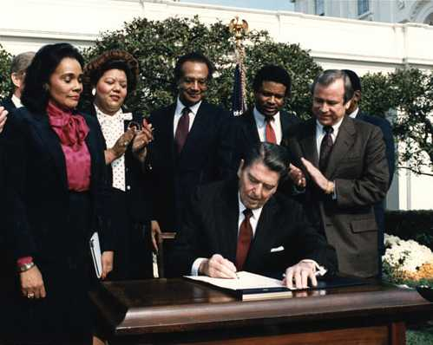
Martin Luther King, Jr. holiday was created in November, 1983 after 15 years of lobbying efforts. It was the first new federal holiday since Memorial Day was created in 1948.

Slide 13
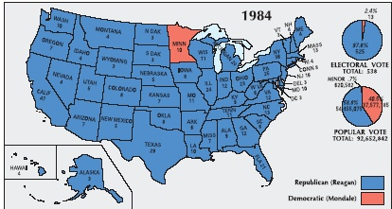
The Election of 1984
Ronald Reagan won in a landslide

Slide 14
Iran-Contra Affair
Reagan’s efforts to aid the Nicaraguan contras involved him in a serious blunder and scandal
Since 1980, Iran and Iraq had been engaged in a bloody war. Reagan’s aides came up with a plan that was kept secret from the American people
U.S. would sell U.S. antitank and antiaircraft missiles to Iran’s government for its help in freeing the Americans held hostage by a radical Arab group
In 1986, another Reagan staff member wanted to use profits from the sale of arms to fund contras in Nicaragua
Reagan denied involvement; Americans viewed him as uniformed and easily manipulated by his advisors

Slide 15
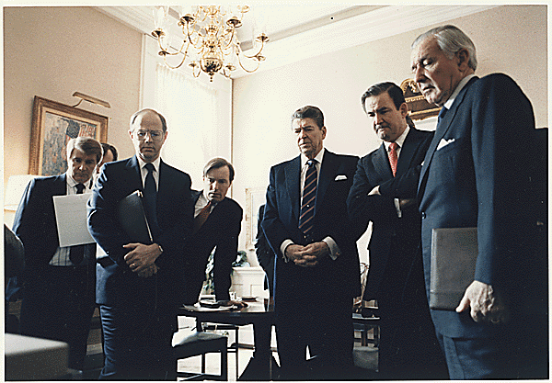
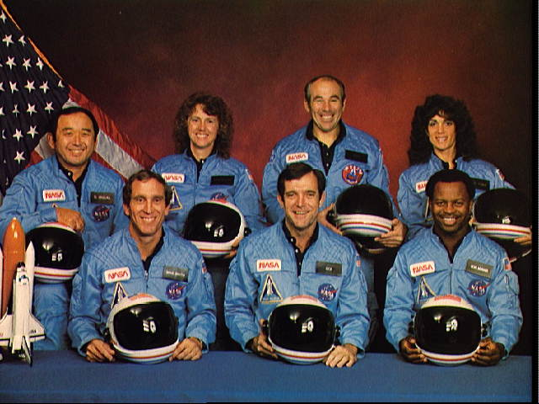
Challenger exploded
On January 28, 1986 the ship exploded soon after takeoff, killing all seven crew members, including a teacher, Christa McAuliffe. President Reagan and others watch the explosion on television.

Slide 16
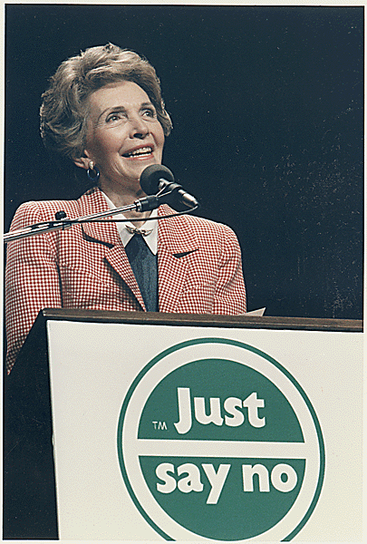
“War on Drugs”
President Nixon introduced the concept of a war against illegal drug use in the U.S. in 1971.
Reagan renewed the effort while president. He assigned Vice President Bush to a drug task force and First Lady Nancy Reagan toured the nation with her “Just say no” campaign.
In 1988 the Office of National Drug Control Policy was created as part of the Executive Office of the President.
The agency’s actions have centered around four areas: treatment, prevention, domestic law enforcement, and interdiction and international efforts.
Nancy Reagan

Slide 17
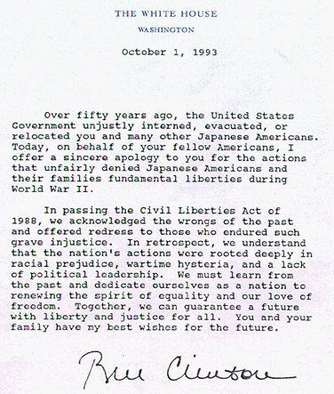
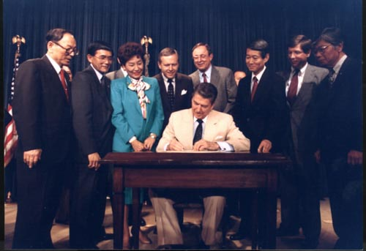
Congress approved a $20,000 reparation payment for each of the 60,000 Japanese surviving victims of the relocation centers in October of 1988.
President Reagan signed into law the Civil Liberties Act of 1988.
Apology letter sent with the checks.

Slide 18
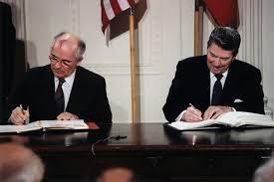
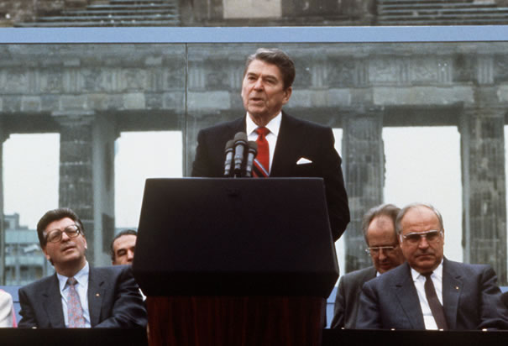
Reagan and Gorbachev

Slide 19
Glasnost- A policy that called for increased openness and transparency in government institutions and activities in the Soviet Union.
Introduced by Mikhail Gorbachev in the second half of the 1980s.
The word was frequently used by Gorbachev to specify the policies he believed might help reduce the corruption at the top of the Communist Party and the Soviet government, and moderate the abuse of administrative power in the Central Committee.
Perestroika- A political movement for reformation within the Communist Party of the Soviet Union during the 1980’s.
The literal meaning of perestroika is "restructuring", referring to the restructuring of the Soviet political and economic system.

Slide 20
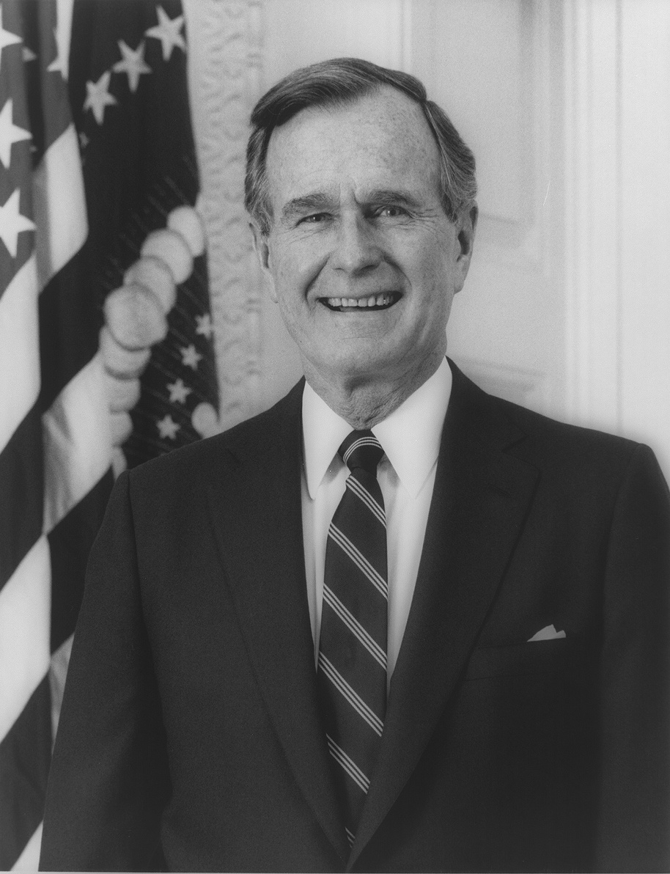
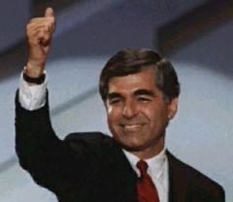
Candidates for the election of 1988
Republican Vice President George H.W. Bush
Democrat Massachusetts Governor Michael Dukakis

Slide 21
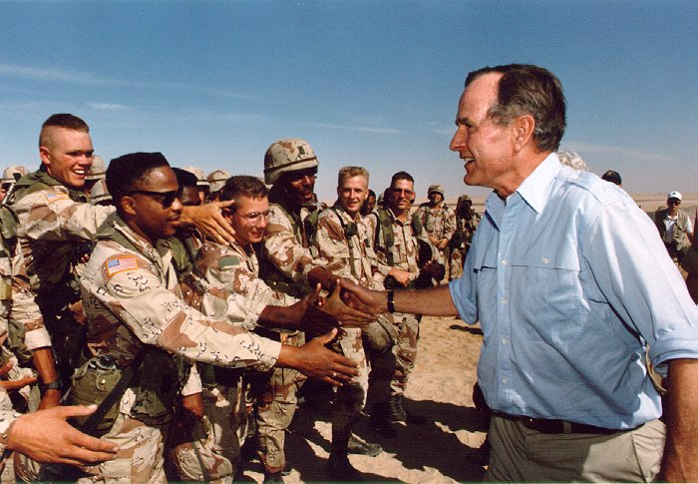
Persian Gulf War
President Bush’s hopes for a “new world order” of peace and democracy were challenged in August of 1990 by Iraq’s dictator Saddam Hussein
Iraq invaded its oil rich neighbor Kuwait and threatened Western oil sources in Saudi Arabia and the Persian Gulf
President Bush built a coalition of UN members to pressure Saddam to withdraw from Kuwait (Desert Shield)
Bush later won congressional approval for a military campaign to roll back Iraq’s act of aggression
In January of 1991 Desert Storm was launched and after 100 hours Iraq was forced to concede defeat (Bush’s approval rating hit nearly 90%)
President Bush visited American troops in Saudi Arabia on Thanksgiving Day, 1990

Slide 22
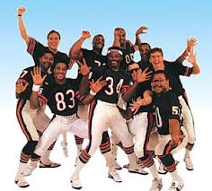
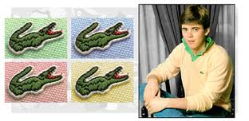
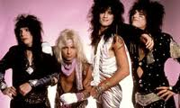
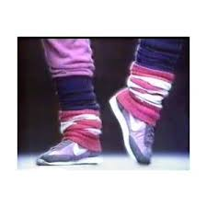
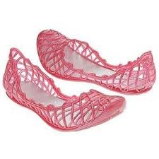
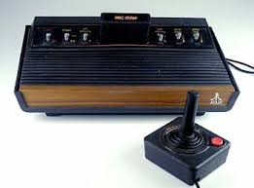
1980’s FADS

Slide 23
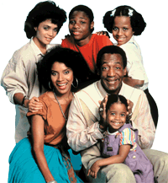
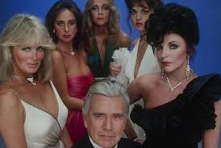
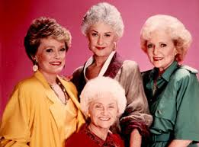
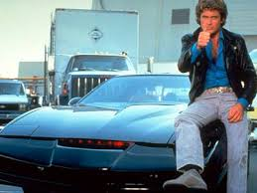
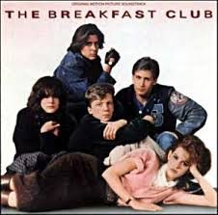
Movies and Television of the 1980’s

Slide 24
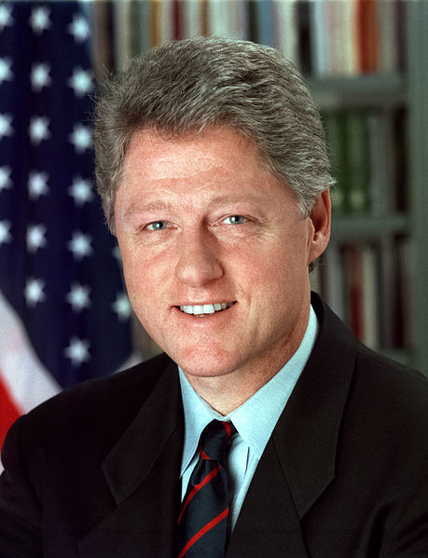
The Clinton Years, 1993-2001: Prosperity and Partisanship
During the last years of the 20th century, the U.S. enjoyed a period of unrivaled economic growth and technological innovation
The end of the Cold War allowed Americans to focus more on economic and domestic issues
Politics became more divided, bitter, and scandal-driven
President Bill Clinton

Slide 25
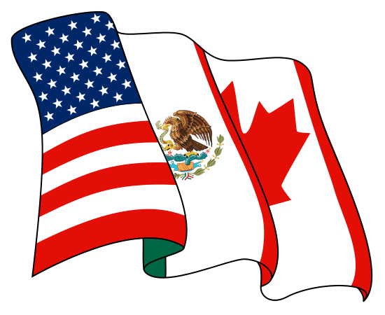
Clinton’s Early Accomplishments
Clinton also won passage of NAFTA (North American Free Trade Agreement) which set up a free-trade zone with Canada and Mexico
The U.S. Chamber of Commerce credits NAFTA with increasing US trade in goods and services with Canada and Mexico from $337 billion in 1993 to $1.2 trillion in 2011, while the AFL-CIO Union blames the agreement for sending 700,000 American manufacturing jobs to Mexico over that time.

Slide 26
Rust Belt
The Rust Belt is a term for the region in the upper Northeastern United States, the Great Lakes, and the Midwest States, referring to economic decline, population loss, and urban decay due to the shrinking of its once powerful industrial sector.

Slide 27
Sun Belt
The belt has seen substantial population growth since the 1960s due to an influx of people seeking a warm and sunny climate, a surge in retiring baby boomers, and growing economic opportunities. Also, over the past several decades, air conditioning has made it easier for people to deal with the summertime heat in the Desert Southwest. In recent years water shortages, droughts, and drug trafficking near the Mexican border have become a problem in the western region

Slide 28
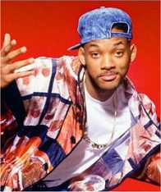
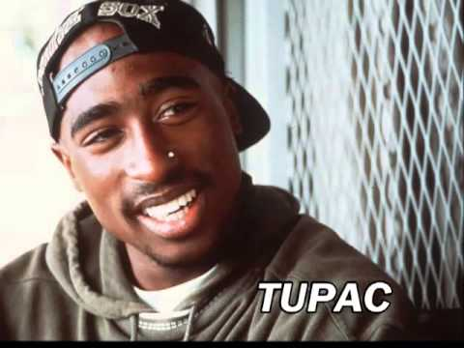
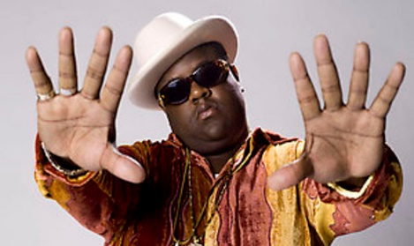
Pop Culture of the 1990s

Slide 29
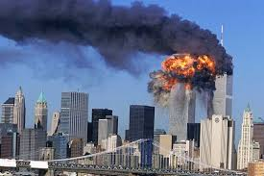
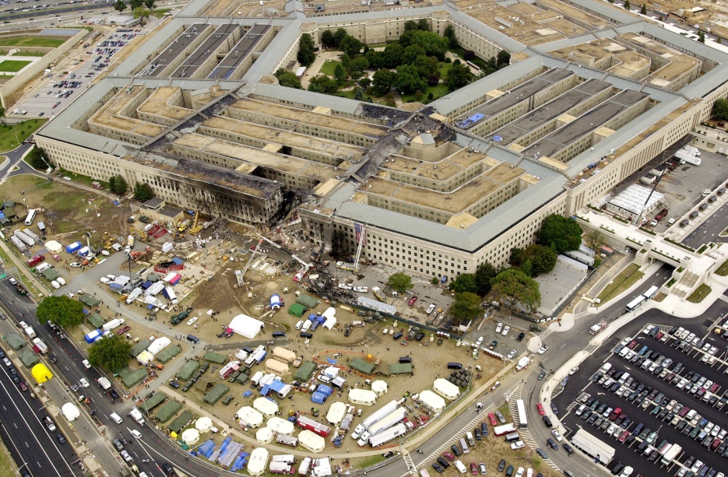
9-11-2001
War on Terrorism Begins

Slide 30
Hurricane Katrina
August 2005
Category 5 Hurricane
Levees broke in New Orleans

Slide 31
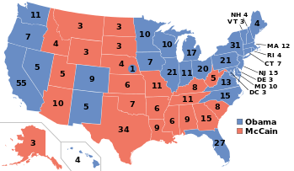
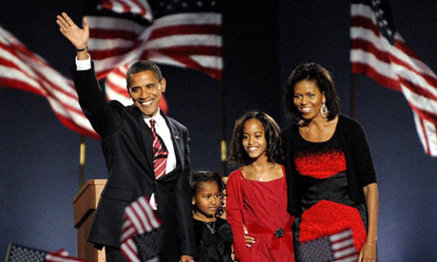
Election of 2008
Considered “full circle” of the Civil Rights Movement
First African American President
Barack Obama

Slide 32
Sonia Sotomayor
First Hispanic Supreme Court Justice
Appointed by President Obama

