Slide 1
Enter Your Name Here
Student Name
Instructions
This Digital Interactive Notebook is designed to help you better understand Age European Imperialism for World History. It includes pages on vocabulary terms, people, and key events of these periods.
On each page you will see blue text boxes where you can type responses. Simply click in the box and begin typing to provide your response. You can also add your own text boxes by clicking on the text box icon ( ). You also will need to add images to various pages. You can do this by clicking on the “Image” icon ( ) or by going to “Insert > Image” in the menu.
Each text box can also be resized using the borders so that each fits on your pages.

Slide 2
Imperialism Illustrated Vocabulary
Directions: Research each vocabulary term below and type your own definition in the 2nd column. Then look for an image that best symbolizes it and insert it in the 3rd column.
Vocabulary | Definition | Image
White Man’s Burden
East India Company
Opium War
Berlin Conference
Jewel in the Crown
Sepoy
Boxer Rebellion

Slide 3
Motives for European Imperialism
Directions: Imperialism occurs when a powerful nation takes over or dominates a weaker nation or region. In the late 1800’s, various motives prompted European nations to expand their rule over other regions. Describe the motives for each aspect of European imperialism then find and paste in a picture to represent it below. Finally, describe the effects of each at the bottom.
Economic
Political
Religious
Type your responses here…..
Type your responses here…..
Type your responses here…..
Effects of Each Motive
Type your response here…...
Type your response here…...
Type your response here…...

Slide 4
Forms of Imperialism
Directions: As European nations scrambled to claim territory around the world, different levels of control developed in different regions. After learning about the differences, describe each form of imperialism, give examples, then describe the positives and negatives for both the colonies and mother countries.
Form | Definition | Examples | Benefits | Negatives
Colony
Protectorate
Sphere of Influence

Slide 5
Perspectives on the White Man’s Burden
Directions: In 1899, British poet Rudyard Kipling wrote “The White Man’s Burden: The United States and The Philippine Islands”. After reading the poem and the background to it, explain what the “White Man’s Burden” was at the top. Then find pictures to represent Western and African/Asian leaders and describe their perspectives on it in the yellow boxes. Finally, in the box at the bottom, write what your perspective is on it today.
What is the “White Man’s Burden”?
Type your response here….
Type your response here….
My Perspective
Type your responses here…..
Western Leaders
African & Asian Leaders

Slide 6
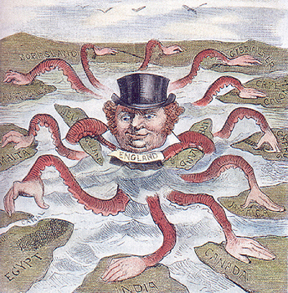
British Imperialism in India and China
Directions: It was said that, “the sun never set on the British Empire” because it was so vast. Great Britain colonized India, and had imperialist concerns with China as well. After learning about British influence in India and China, drag and drop the items to the correct side then give their significance in the blue space.
India
China
The Boxer Rebellion
Treaty of Nanking
Jewel in the Crown
The Raj
Opium War
Sepoy Mutiny

Slide 7
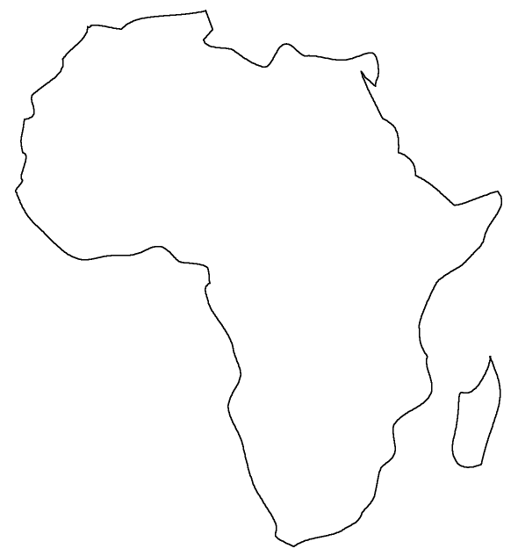
The Scramble for Africa
Directions: The “Scramble for Africa” took place at the end of the 1800’s as European nations divided up Africa amongst themselves. After reading about the Berlin Conference and how Europeans came to control Africa, drag and drop the flags to the areas in Africa those nations took over. Then describe how imperialism affected each region.
What happened at the Berlin Conference?
North Africa
Central Africa
West Africa
Eastern Africa
Southern Africa

Slide 8
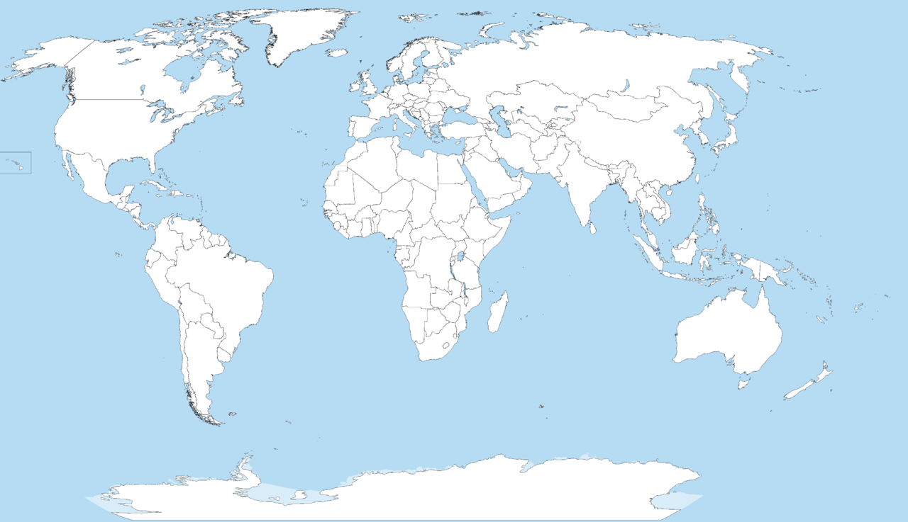
Responses to European Imperialism
Directions: Complete the boxes describing the responses of Africans as well as those in India, China, Japan, and America to European imperialism. Be sure to include specific conflicts, rebellions, laws, or other issues for each.
Asian Responses
Indian Responses
African Responses
American Responses

Slide 9
The Annexation of Hawaii
Directions: The US formally annexed Hawaii in 1898 after a struggle between business interests and the Hawaiian government that lasted years. Complete the graphic organizer below with pictures of each figure and an explanation of their role in the US annexation of Hawaii. Then describe your opinion of the annexation - was it justified? Was the US right to take Hawaii? Explain your answer at the bottom
Lili'uokalani
John Stevens
Sanford Dole
William McKinley
Type this person’s role in annexation here..
Type this person’s role in annexation here..
Type this person’s role in annexation here..
Type this person’s role in annexation here..
My Opinion on Hawaii’s Annexation
Type your opinion & analysis here

Slide 10
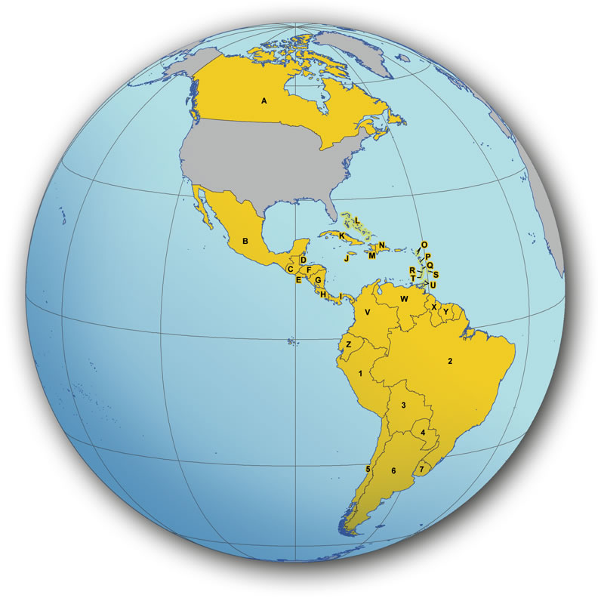
The Panama Canal has live webcams that show various spots along the canal! These can be viewed here.
The Panama Canal
Directions: The construction of the Panama Canal is one of the great building projects in history. Research the history of Panama before, during, and after the canal along with how iit was built to paste a picture of the canal and complete the graphic organizers below.
Who first attempted to build a canal? How did their attempt go?
What difficulties were faced in building the canal?
Why was a canal in Central America so important for the United States?
Click on Insert>Line then select the “Scribble” tool to draw in the route of a ship going from New York to California before the canal and then through the canal on the globe below.
What are concerns facing the Panama Canal today?

Slide 11
Timeline of the Age of Imperialism
Directions: After learning about the important people and events of the Age of European Imperialism, complete the timeline below. Drag and drop the events into the correct order and type in the year in the box along the line next to each event.
Year
The Boxer Rebellion takes place in China against foreign influence.
The First Opium War between Great Britain and China begins.
The Boer War begins with the British fighting descendants of Dutch known as Afrikaners or Boers in South Africa.
American Commodore Matthew Perry arrives in Tokyo and opens up trade with Japan.
The Berlin Conference meets to establish guidelines for European control over Africa.
The United States proposes the Open Door Policy for China.
The Sepoy Mutiny against British rule in India takes place.
Japan defeats Russia in the Russo-Japanese War.
Great Britain gains control of the Suez Canal and establishes a protectorate over Egypt.

