Slide 1
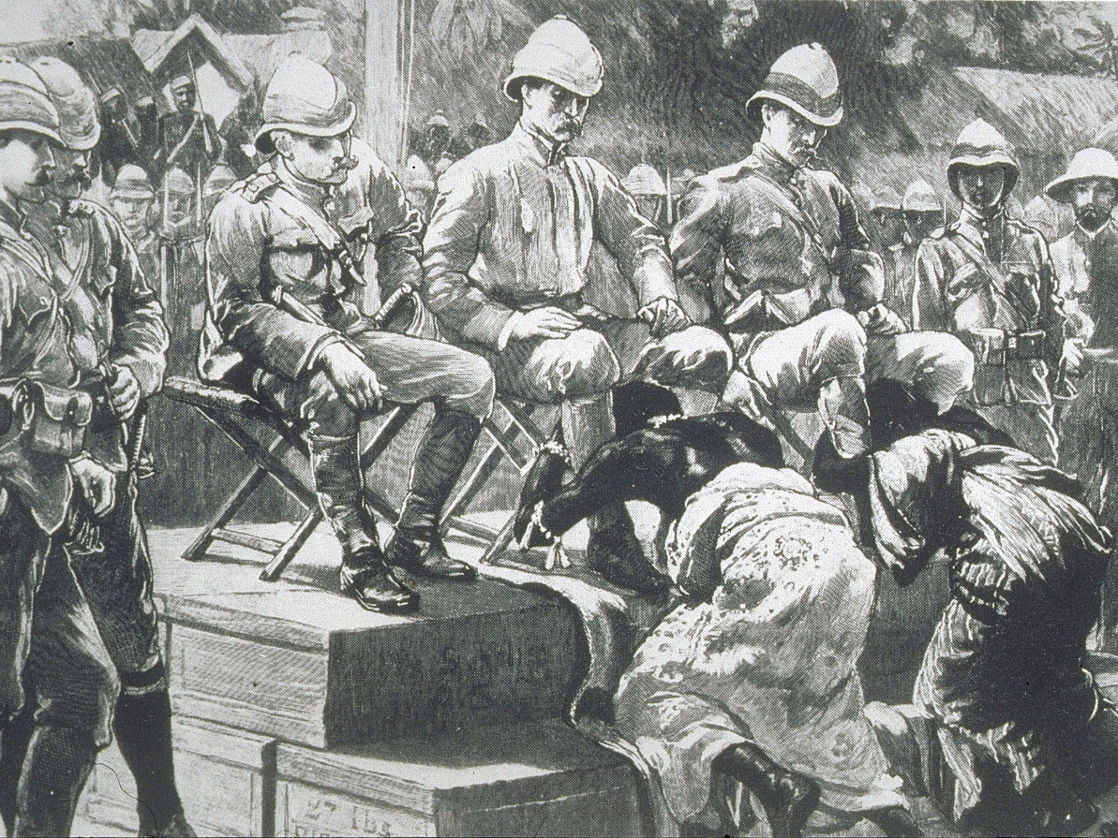

Slide 2
In the late 1800s, Europeans entered a new era of overseas expansion as they began to move into and colonize Africa.
In earlier centuries, European interest focused on the African coast as European traders set up trading posts to build trading networks on the continent.
By the late 1800’s, Europeans were seeking new territories and resources and began to take a focus on Africa.

Slide 3
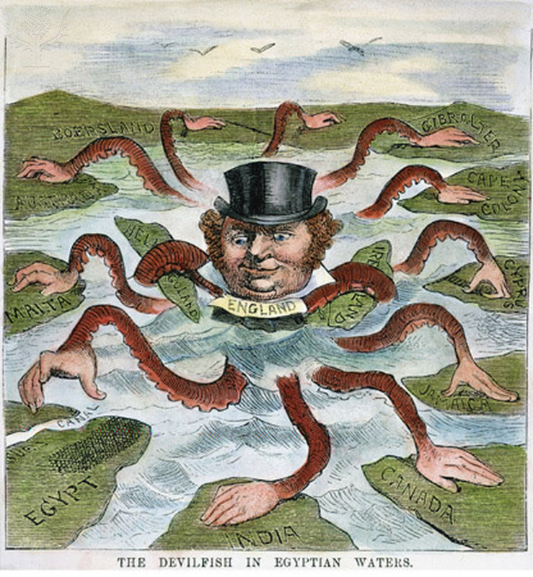
Imperialism is the domination by a country of the political, economic, or cultural life of another country or region.

Slide 4
Between 1870 and 1914 the entire continent of Africa came under control of the industrialized European nations.
Only Ethiopia and Liberia avoided coming under control of the European nations.

Slide 5
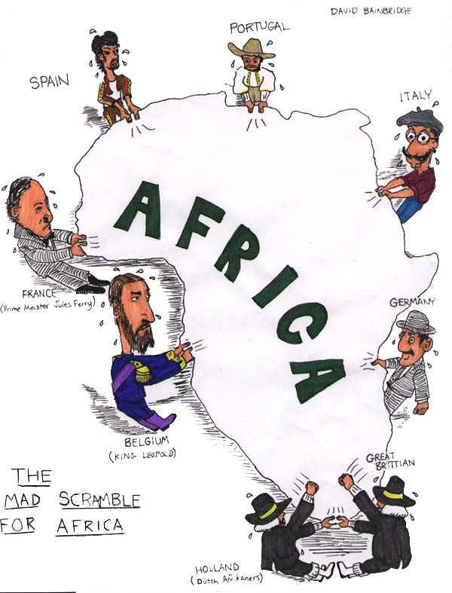
This movement of European nations into the interior of Africa is often called the “Scramble for Africa”.
This term symbolizes the competition between the European nations as they “scrambled” to capture colonies in Africa.

Slide 6
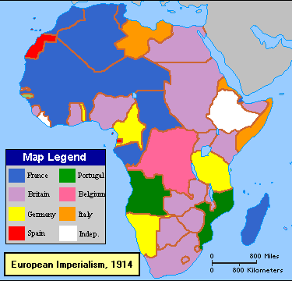
In general, the main European nations involved in the Scramble for Africa were: Britain, France, Belgium, Spain, Portugal, Italy and Germany.
Britain and France held the most territory within Africa.

Slide 7
The Scramble for Africa would nearly bring Europe to war several times, as tensions between the nations was high.
It is also often seen as one of the major causes of World War I.
The idea that the European nations became angered over territory in Africa and it help contribute to the crisis in Europe during the outbreak of World War One.

Slide 8
European nations exerted their control over Africa in many ways.
A “colony” is a possession that the imperial power controls directly.
A “sphere of influence” is a region in which the imperial power claims exclusive trading. The local government usually controls all other matters.
A “protectorate” is a country that that has its own government but its policies are controlled by the imperial power.

Slide 9
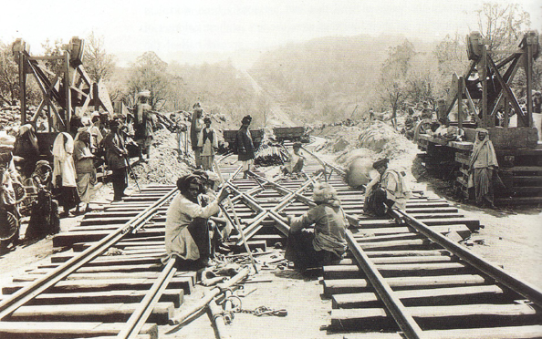
Europe was motivated to imperialize Africa for several reasons.
Nationalism was a major contributor to imperialism as the European nations viewed it as a means of increasing their prestige and power around the world.
Rivalries between the European nations contributed as each tried to seize territory and prevent a rival from expanding into the region.

Slide 10
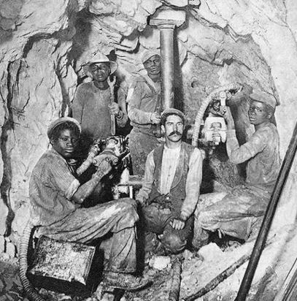
Economics also played a large role.
Africa offered a fresh supply of raw materials for the European powers to exploit in their factories.
The European nations saw Africa as an excellent opportunity to increase their own wealth and prosperity.

Slide 11
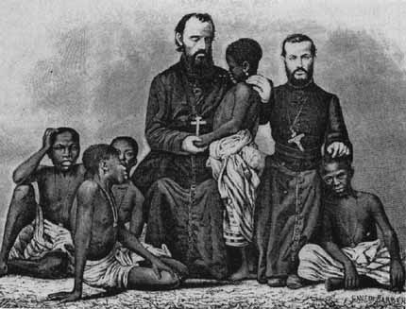
Many Europeans wanted to spread their religious beliefs and therefore saw the imperialism of Africa as an opportunity to expand the Christian faith.

Slide 12
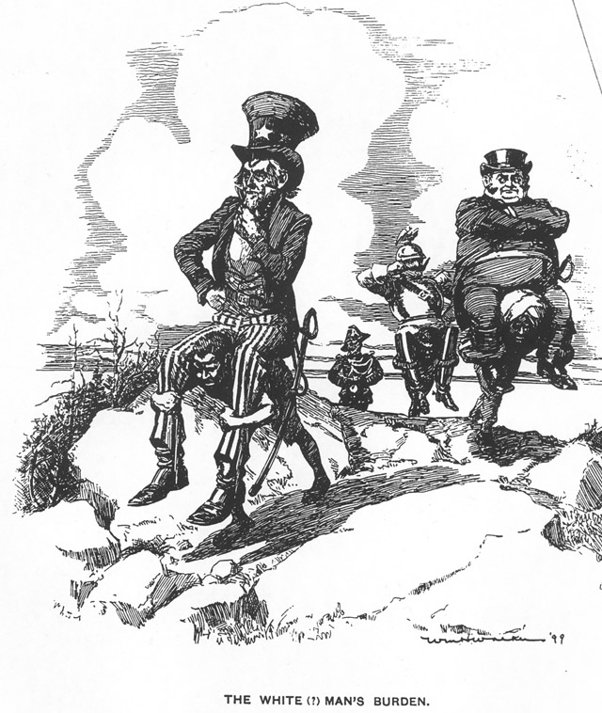
As well, many European believed in the superiority of the “white” race and believed that it was the “white man’s burden” to bring western civilization to the rest of the world.
It was based on the philosophy of Social Darwinism, which argued that in nature only the strongest survived. Europeans applied this believed that it was natural for strong nations to conquer weaker nations.

Slide 13
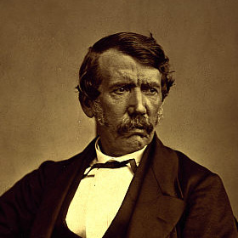
Europe began moving to the interior of the African continent through a series of explorations.
Perhaps the most famous explorer of this time was David Livingstone.
British physician and missionary
He spent many years setting up missions in Central Africa.

Slide 14
Generally speaking, Europe had difficulty moving into the interior of Africa before 1870 due to diseases and African resistance.
Malaria and Yellow Fever
As European interest in Africa grew, European doctors began searching for cures to these diseases.

Slide 15
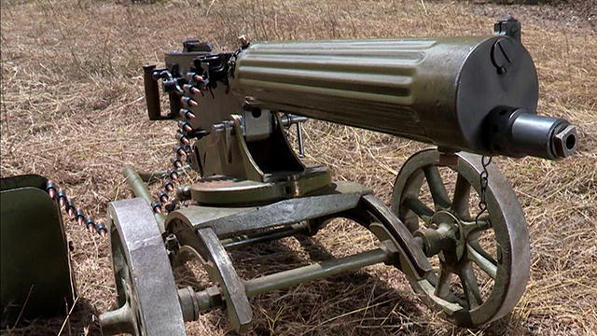
Once cures or remedies were found for these African diseases and with the advent of improvement in weapons technology, European began to move into the interior of Africa.
Rifles and the Maxim Machine Gun

Slide 16
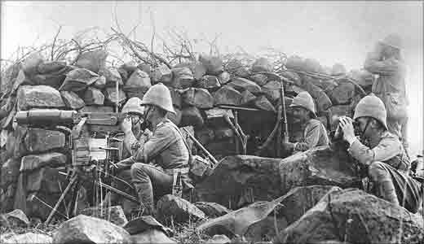
European imperialism would have a profound impact on Africa and the African people.

Slide 17
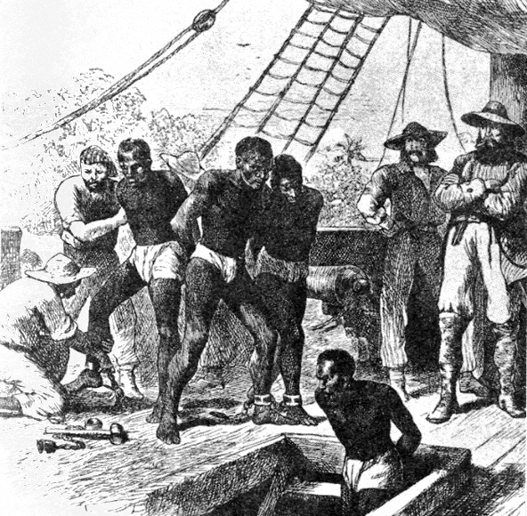
An event which had a profound effect on Africa was the Atlantic Slave Trade.
The Slave Trade would begin in the mid-15th century, reach its peak in the 18th century and conclude near the end of the 19th century.
Approximately 12 million Africans were put on slave ships, sailed across the Atlantic Ocean and sold into slavery.

Slide 18
For European merchants, a reliable work force was needed in the New World in order to work plantations.
Africans were an excellent choice (from a European perspective) to act as slave labor in the New World, because they usually were experienced with the work required (farming and keeping cattle), they were used to a tropical climate and resistant to tropical diseases.

Slide 19
The enslavement of Africans and the resulting Atlantic Slave Trade would result in the “trade triangle” between the Americas, Europe and Africa.
European traders would export manufactured goods (metal tools, textiles, tobacco, beads, etc.) to the societies of west coast Africa in exchange for African slaves.

Slide 20
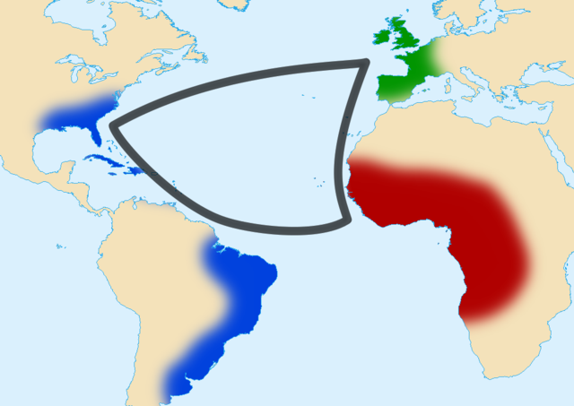

Slide 21
Next, the African slaves were put aboard European slave ships and taken to the Americas to be sold for huge profits.
Here the slaves would be put to work on plantations in order to harvest raw materials.
The final stage of the “trade triangle” involved European traders taking the harvested raw materials from the plantations back to Europe where they would be processed into goods in European factories.

Slide 22
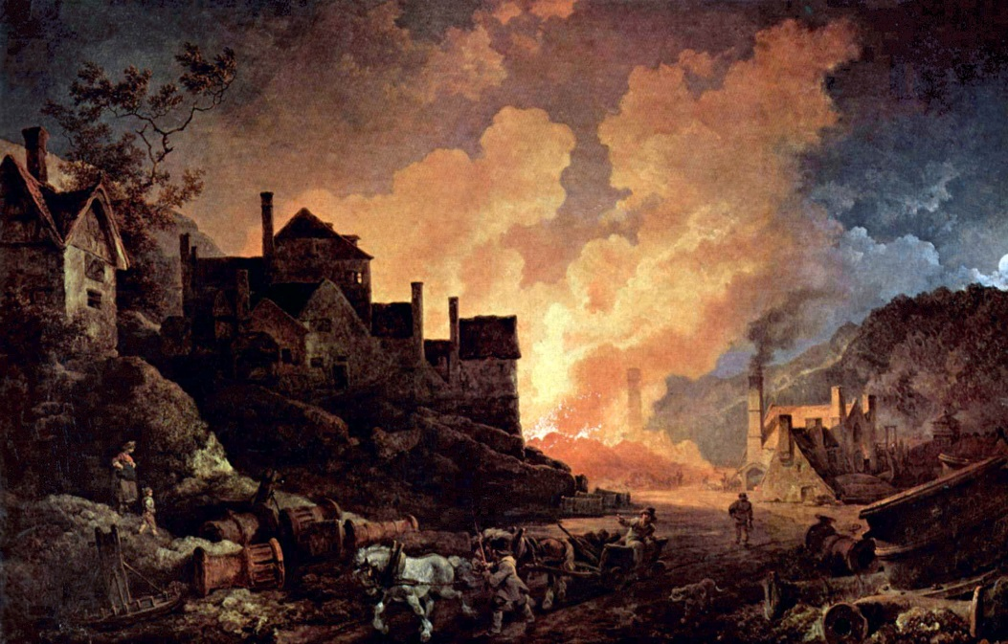
Europe benefited greatly from the Atlantic Slave Trade in that it was able to sell its manufactured goods for African slaves, while at the same time selling the slaves at plantations in the New World.
Finally, it was able to acquire cheap raw materials from the New World for its factories in Europe.

Slide 23
Some Africans benefited from the acquisition of European manufactured goods in trade for other African slaves.
In general, Africa was harmed because the slave trade saw the mass movement of people out of the continent.
This led to the social destruction of some African societies as they saw their people sold into slavery.
As well, Africa became economically dependent on slavery meaning that they didn’t perhaps develop other economic opportunities.

Slide 24
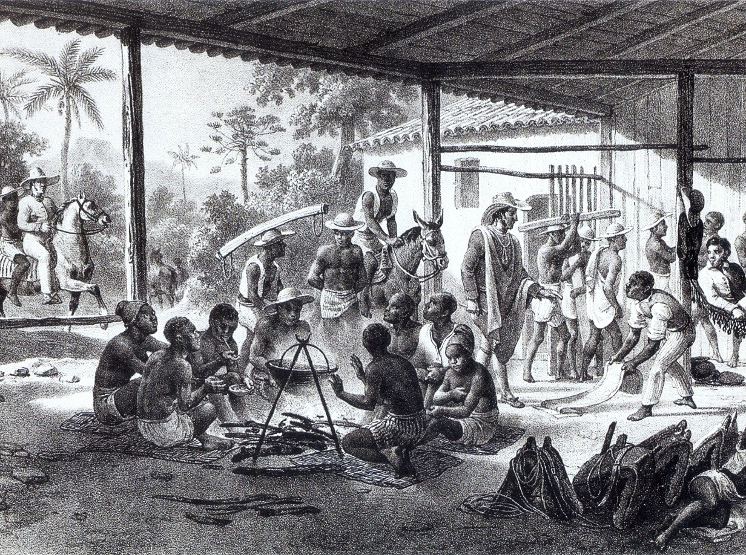

Slide 25
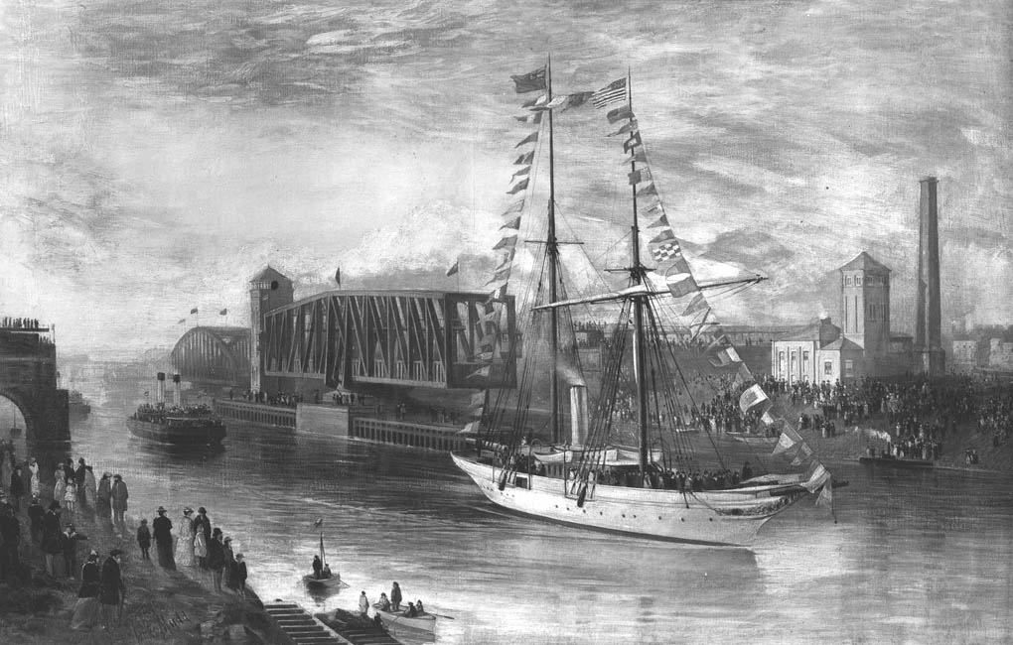
Another example of European influence in Africa is the creation and control of the Suez Canal in Egypt.

Slide 26
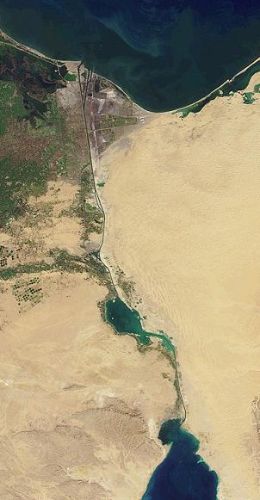
Europeans generally had little interest in Egypt until 1859 when the French began constructing the Suez Canal, which would connect the Mediterranean Sea with the Red Sea.

Slide 27
The European nations wanted to control the canal because it would allow for much shorter trips to Asia from Europe.
Previously, ships would have to travel the entire way around Africa in order to make the journey to the Far East.
Between 1859 and 1869 a French company built the Suez Canal.

Slide 28
As Britain sought a shorter route to its colony in India, it began to try to influence and control the canal.
Britain would come to view the Suez Canal as the “lifeline of the British Empire.”
Britain finally made Egypt a protectorate of the British Empire and placed its troops inside of Egypt in 1882.

Slide 29
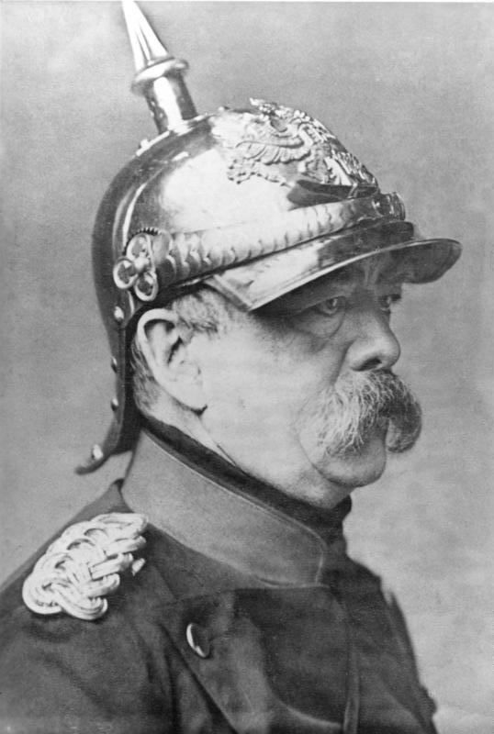
Another example of the impact that European imperialism would have on Africa is the Berlin Conference.
Held in 1884 in Berlin, Germany
Called by German Chancellor Otto von Bismarck

Slide 30
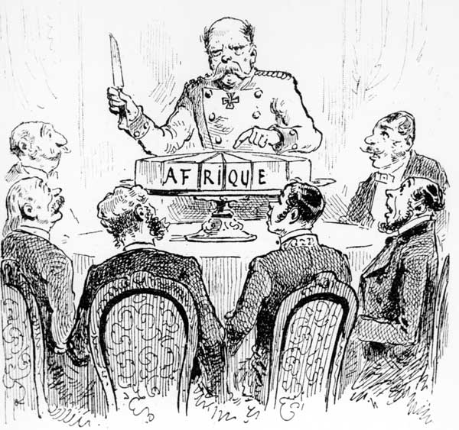
The goal of the Berlin Conference was to settle disputes the European nations had over territory in Africa.
Europe had nearly been brought to war over tensions in Africa and the conference was a means to settle these disputes.

Slide 31
The Berlin Conference resulted in the dividing up of Africa into many different nations.
African societies were not invited to this conference and had no say in the creation of these nations.
Sometimes, rival African groups were forced together and this created conflicts that have left a legacy to this day.

Slide 32
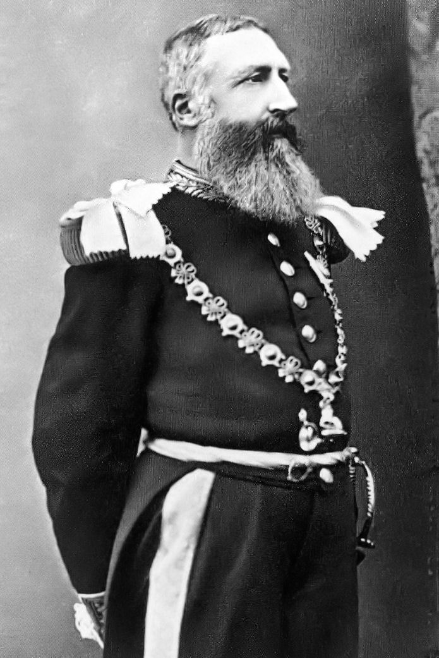
Another of the most significant events of this period was that of King Leopold II of Belgium and his role in the Congo.

Slide 33
In hopes of building Belgium’s global empire of colonies, King Leopold II helped lead efforts to colonize the Congo River basin, and officially formed the Congo Free State in 1885.

Slide 34
Leopold ruled over the Congo Free State as his own private possession and used his control over the region to amass a fortune for himself.
The area had valuable resources, such as rubber, which was an incredibly valuable resource at the time
The newly invented rubber tire was being used in bicycles and early automobiles.

Slide 35
Leopold II would oversee the brutalization of millions of Congo peoples in order to harvest and sell the rubber.
Company managers would force the Congo people to work long hours and punished them if they did not meet their quotas.
Punishments were brutal and involved: beatings, cutting of their hands, starvation, imprisoning women and children to force men to work harder and destroying entire villages.
The punishment that came to be best associated with the brutal reign of Leopold II is the cutting off of the hands of the Congo people.

Slide 36
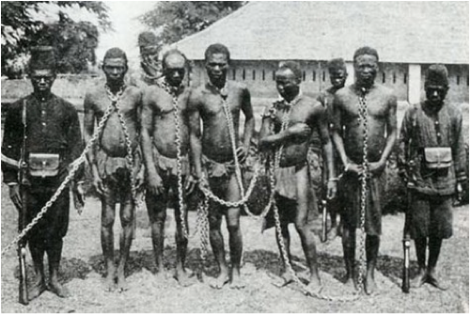
The atrocities eventually drew international attention and the intense pressure caused the Belgian government to investigate what was occurring in the Congo Free State.
Eventually, in 1908, the territory was taken over by the Belgian government and renamed Belgian Congo.

Slide 37
Finally, European imperialism in Africa also played a considerable role in the outbreak of World War I in 1914.
Imperialism was an important cause to WWI because as the Europeans nations began competing overseas in places like Africa and as tensions increased between the nations, the tensions came home to Europe and led to the European nations being more readily willing to go to war with each other.
One such example of this was the Morocco Crisis at the start of the 20th Century.

Slide 38
In 1904 the African country of Morocco had been given to France by Britain, but the Moroccans wanted their independence from colonial rule by the European nations.
In 1905, Germany claimed its support for Moroccan independence.
Germany was upset that it had largely failed to gain the colonies and imperial power that Britain and France had obtained, and used Moroccan independence as a means to increase its own prominence in Africa.

Slide 39
War between the European nations was narrowly avoided by a conference which allowed France to retain possession of Morocco.
However, in 1911, the Germans were again protesting against French possession of Morocco. Britain supported France and Germany was persuaded to back down for part of French Congo.

Slide 40
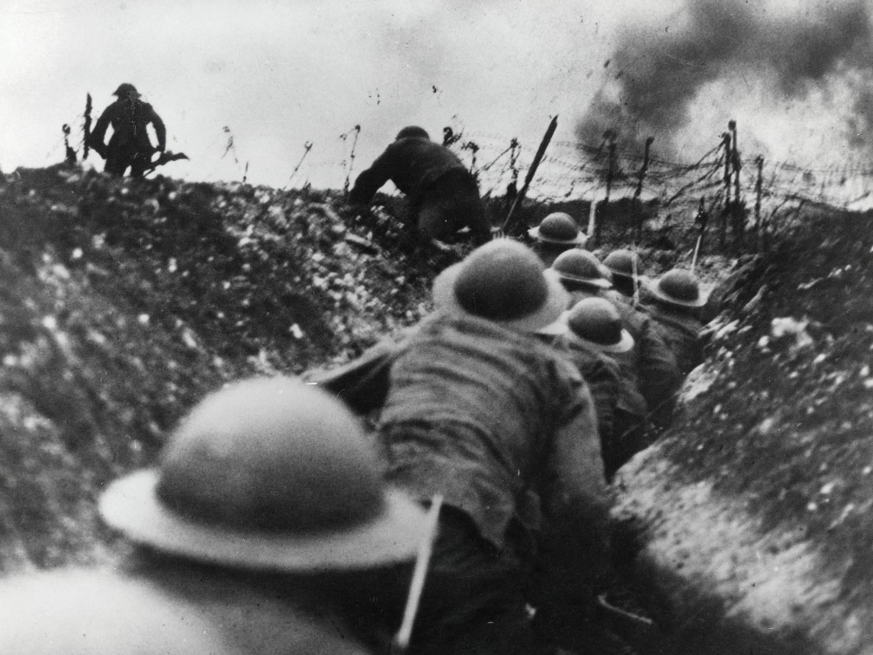
Both of the crises in Morocco highlighted how imperialism in Africa could increase the tensions between the European nations and bring the tensions from Africa back to Europe.

Slide 41
With the start of World War I and the aftermath of the war, the Age of Imperialism was essentially over.

