Slide 1
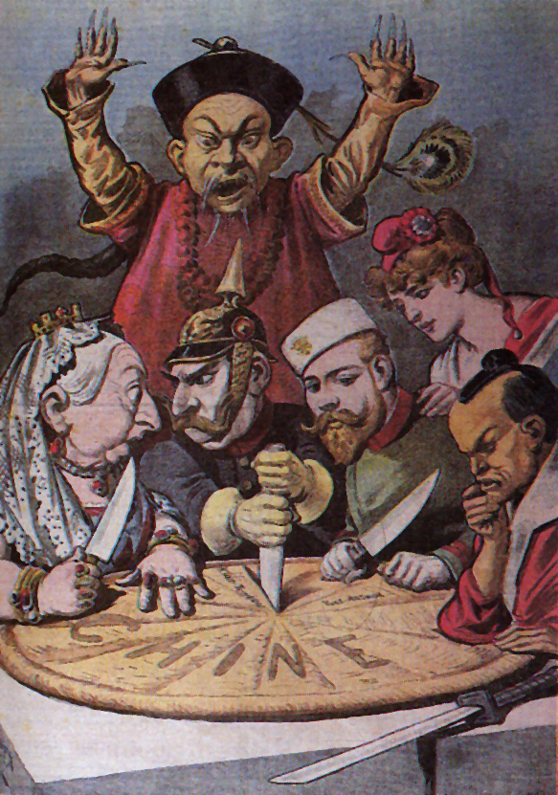
AN OVERVIEW OF IMPERIALISM IN CHINA

Slide 2
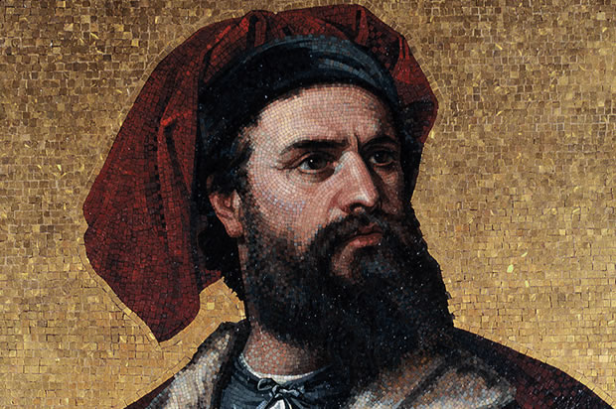
IMPERIALISM IN CHINA
European traders have long been interested in China.
European interest in Asia began with the journeys and writings of Marco Polo in the late 1200s.

Slide 3
IMPERIALISM IN CHINA
The Age of Exploration in the 16th century saw a rapid increase in Western influence into Asia and China in particular.
Britain, France, Spain, Holland and Portugal all established colonies in different areas of Asia and began to enforce their influence.

Slide 4
IMPERIALISM IN CHINA
At the same time, China was undergoing dramatic changes.
In the early 1600’s, invaders from Manchuria swept into China and overwhelmed the Ming dynasty.
The Ming dynasty had ruled over China since the 1300s.

Slide 5
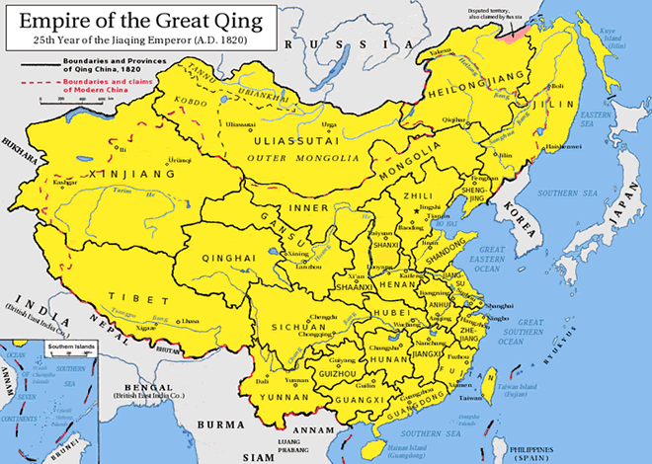

Slide 6
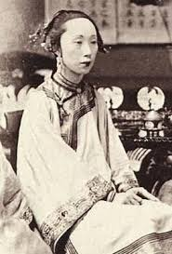
IMPERIALISM IN CHINA
The invaders established their government (Qing) in Beijing.
The Qing dynasty would rule over China from 1644 to 1911, during the height of European imperialism in China.

Slide 7
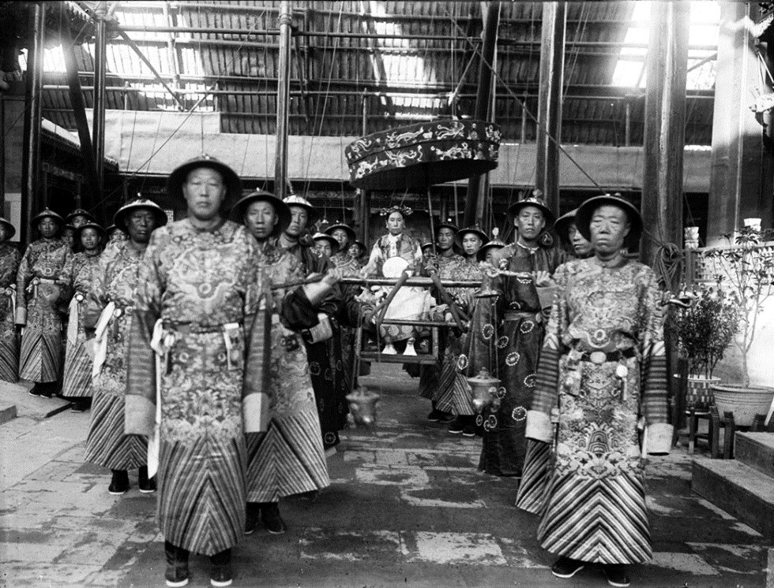
IMPERIALISM IN CHINA
The Qing dynasty ruled over a powerful Chinese empire.
Western merchants reached China in the 1600 and 1700s.
They were impressed with the splendor of the Chinese civilization.

Slide 8
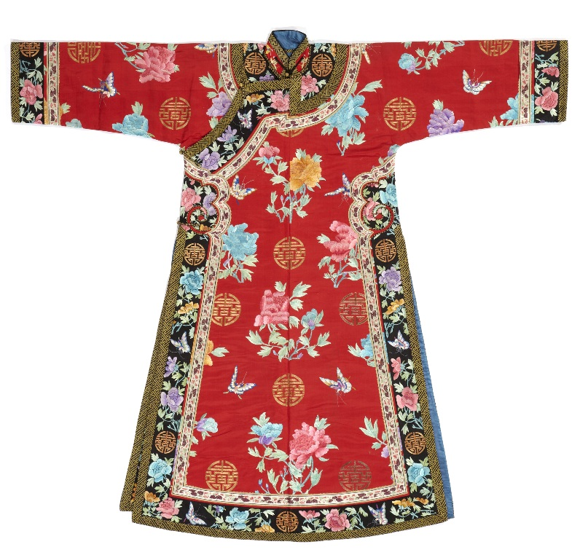
IMPERIALISM IN CHINA
The early European traders were seeking Chinese goods that they could make a profit from by selling them in Europe.
Ex. Chinese tea, silk, porcelain.

Slide 9
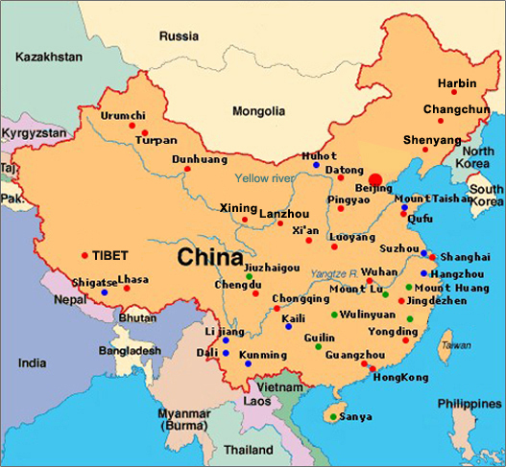
IMPERIALISM IN CHINA
The Chinese government attempted to restrict foreign traders.
Foreign traders were limited to trading with only one Chinese port, the city of Canton.
If European traders did not observe Chinese customs, they could be expelled from the port.

Slide 10
IMPERIALISM IN CHINA
While the restrictions annoyed the European merchants, they accepted them.
The merchants stood to make huge profits by selling Chinese goods in Europe markets.

Slide 11
IMPERIALISM IN CHINA
Soon, the British became China’s largest trading partner.
The British wanted Chinese goods, such as: tea, silk and decorative goods.
The Chinese wanted British gold, silver and jewelry.

Slide 12
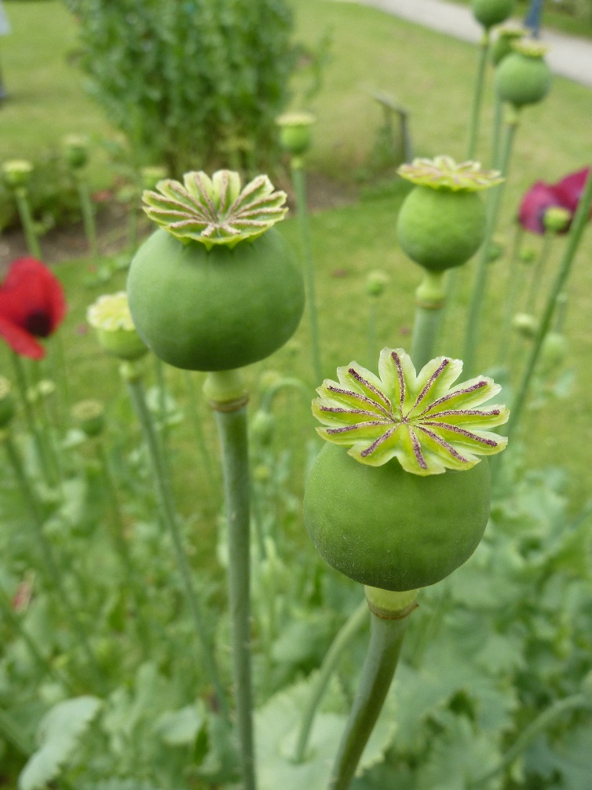
IMPERIALISM IN CHINA
Britain and other European nations began to pressure China to lessen its restrictions on trading in the late 1800s.
At the same time, Britain began to trade a new product in China: Opium.
Opium is a highly addictive drug that is prepared from the opium poppy.

Slide 13
IMPERIALISM IN CHINA
While the trade in opium made many merchants very wealthy, the Chinese government was upset as opium smoking spread across China.
All classes of Chinese people could smoke opium in “opium dens”.

Slide 14
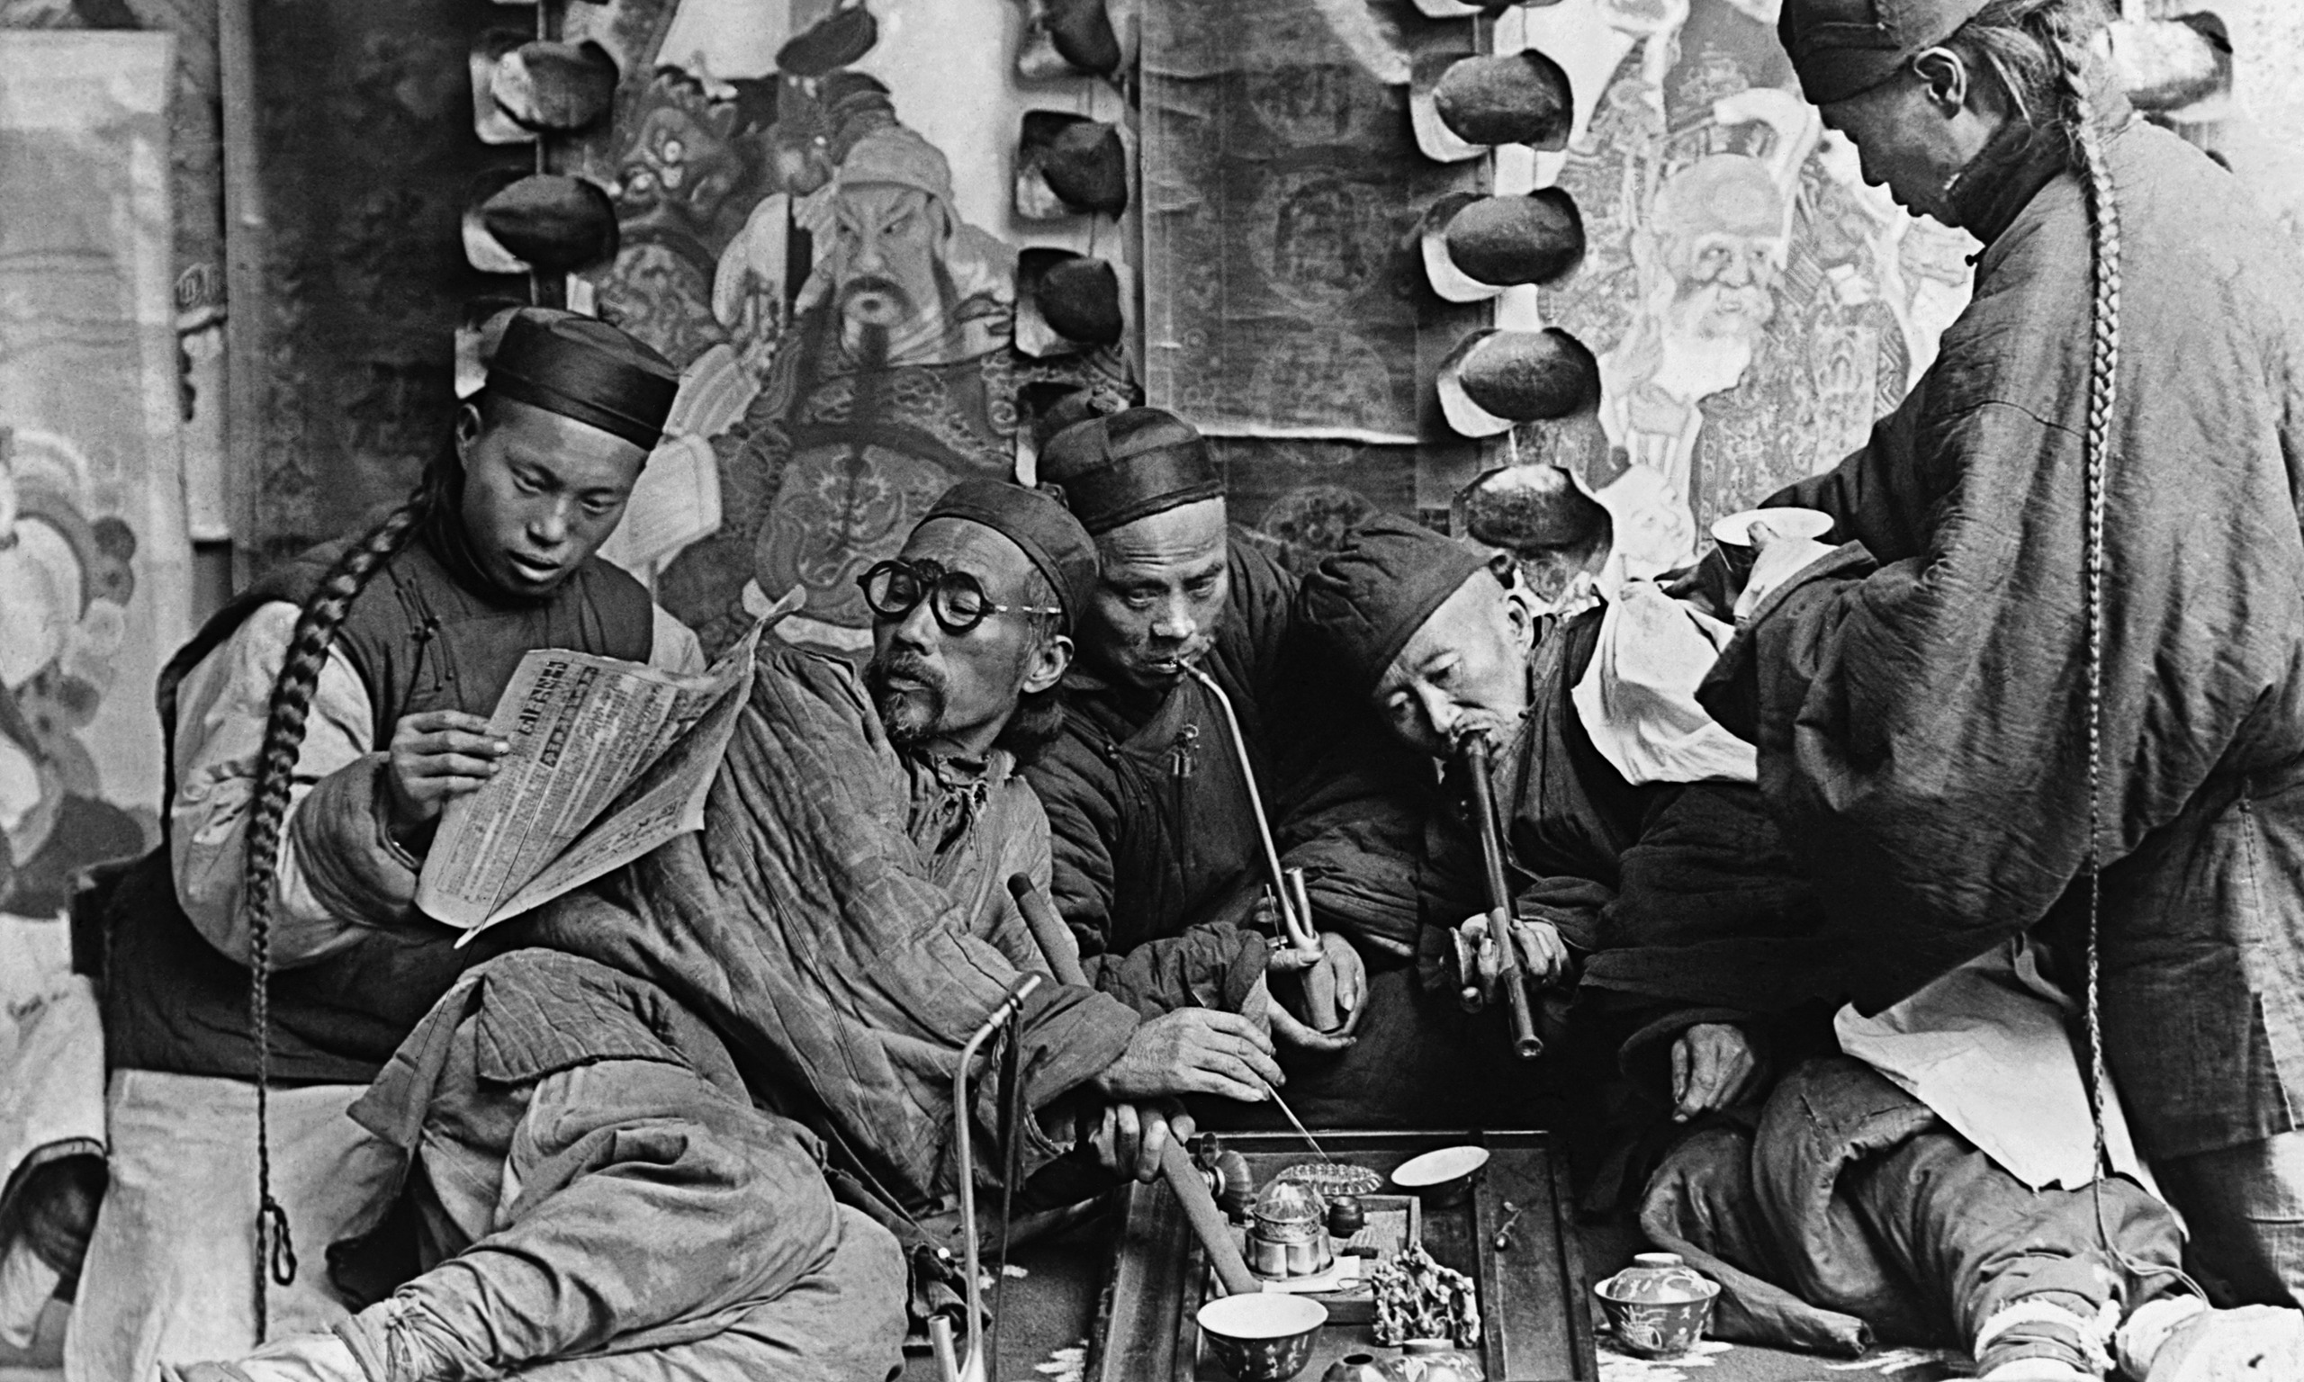

Slide 15
IMPERIALISM IN CHINA
The Chinese (Qing) government recognized the social and economic dangers of opium and attempted to ban its use.
In 1839, the government destroyed millions of dollars’ worth of British imported opium that had been brought to the city of Canton.
To the surprise of the Chinese, the British responded with military force.

Slide 16
IMPERIALISM IN CHINA
The First Opium War (1839-1842) saw the Chinese (Qing) military defeated by the overwhelming British forces.
While the Qing had many more troops, they were no match for the advanced military tactics and weaponry of the British.
In 1840, the British seized Canton and attacked Chinese forces along the coast.

Slide 17
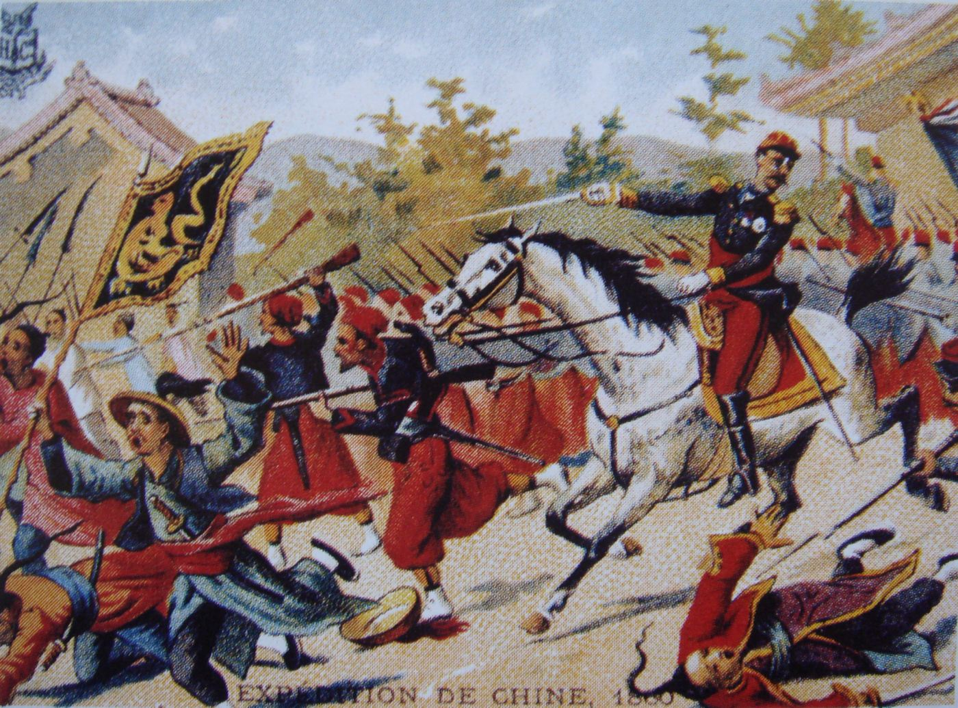
IMPERIALISM IN CHINA
The loss of the First Opium War resulting in the Chinese being forced to accept the humiliating terms of the Treaty of Nanking.

Slide 18
IMPERIALISM IN CHINA
Treaty of Nanking
The Chinese had to accept foreign diplomats and open more ports to foreign trade.
Britain took control of the island of Hong Kong and received compensation for the destroyed opium.
Britain also received special recognition under the terms of treaty and gained the control over aspects of Chinese trade and government.

Slide 19
IMPERIALISM IN CHINA
Second Opium War
Began in 1856.
Started from the conflict that erupted when Britain tried to force the Chinese government to accept more concessions.
One of these concessions included the legalization of opium which the British wanted so it could ensure further trade in China.

Slide 20
IMPERIALISM IN CHINA
Similar to the First Opium War, the Chinese were soundly defeated by the British military.
Again, the Chinese were forced to accept another humiliating treaty.
Treaty of Tientsin

Slide 21
IMPERIALISM IN CHINA
The Treaty of Tientsin was signed in 1860.
It removed more barriers to European influence in China.
The Chinese government had to open additional ports to European trade and make the opium trade legal.
Foreigners were allowed to live within China.

Slide 22
IMPERIALISM IN CHINA
The two Opium Wars resulted in China being heavily influenced by the imperial powers.
These imperial powers included: Britain, France, Germany, Russia and Japan.
Each of these nations successfully established its own “sphere of influence” within China throughout the remainder of the 1800s.

Slide 23
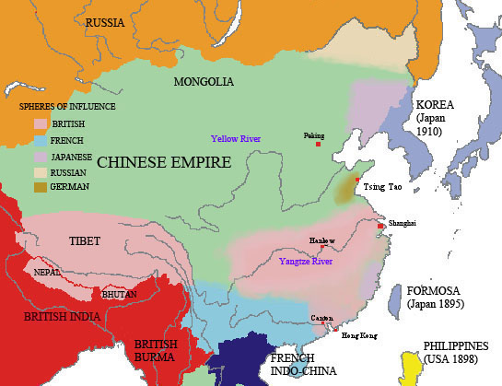

Slide 24
IMPERIALISM IN CHINA
In 1860, the Russians seized a large stretch of land in Northern China.
They built the port of Vladivostok on the Pacific coast.

Slide 25
IMPERIALISM IN CHINA
Japan also took advantage of a weak China.
It worked to increase its influence in Korea, a country that China had formally dominated.
The two countries eventually erupted into war over control of Korea.

Slide 26
IMPERIALISM IN CHINA
The First Sino-Japanese War
Japan was much more industrialized than China and much more prepared to fight a war.
The Japanese had spent the previous two decades embracing modern production methods and Western approaches to military command and organisation.
In contrast, the Qing had spent most of the century resisting modernisation.

Slide 27
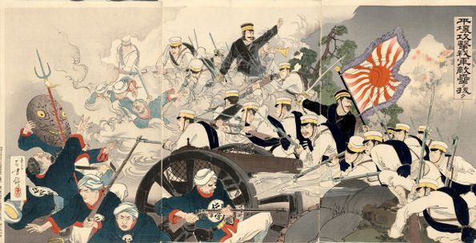
IMPERIALISM IN CHINA
The First Sino-Japanese War
The Sino-Japanese War proved to be another crushing defeat for the Qing dynasty.
China was forced to give control of Korea, the island of Taiwan and the Liaodong Peninsula to Japan.

Slide 28
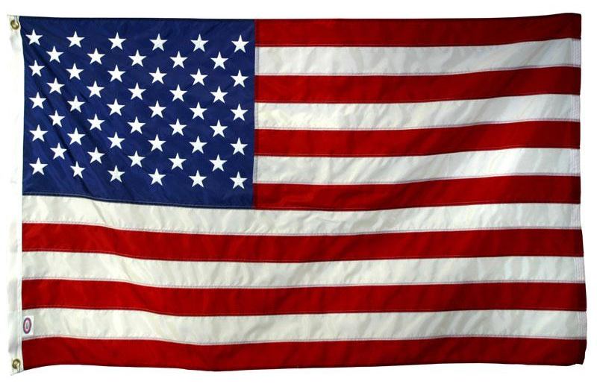
IMPERIALISM IN CHINA
The United States did not acquire a ‘sphere of influence’ in China.
However, the United States government argued that it should receive the same commercial and trading rights as other foreign powers.

Slide 29
IMPERIALISM IN CHINA
The United States established an “Open Door Policy” in China.
It demanded equal access to trade in China for all nations.
The policy was meant to prevent foreign powers from carving up China into colonies.

Slide 30
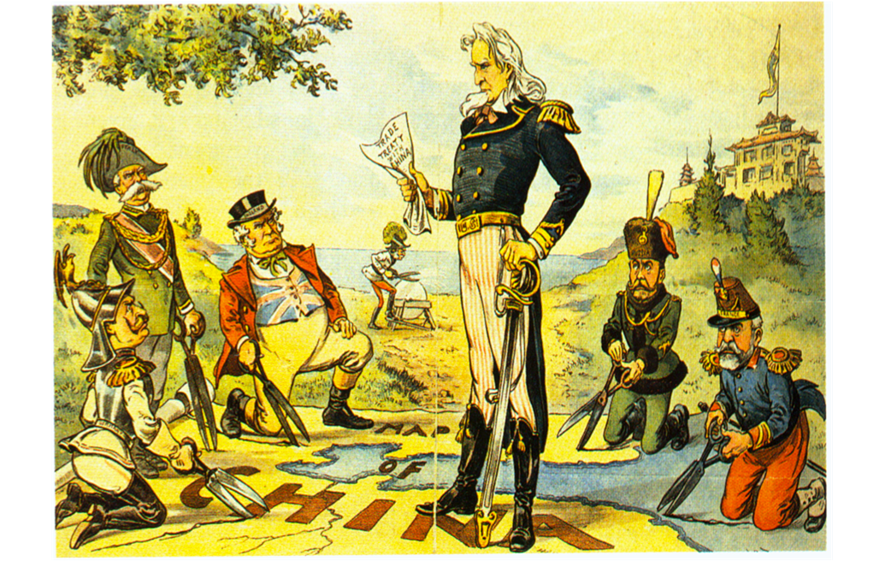

Slide 31
IMPERIALISM IN CHINA
The United States established an “Open Door Policy” in China.
It helped preserve an open door to trade in China, but did little to stop China from being dominated by foreign powers.

Slide 32
IMPERIALISM IN CHINA
Chinese leaders were outraged at the condition of their country and the control of foreign powers within their borders.

Slide 33
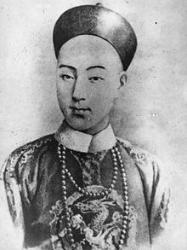
IMPERIALISM IN CHINA
In 1898, as foreign interference in China increased the Guangxu emperor attempted to propel China into modernity.
He sent diplomats and other officials abroad to study.
He issued decrees to reform schools.
These reforms were known as the “hundred days of reform”.

Slide 34
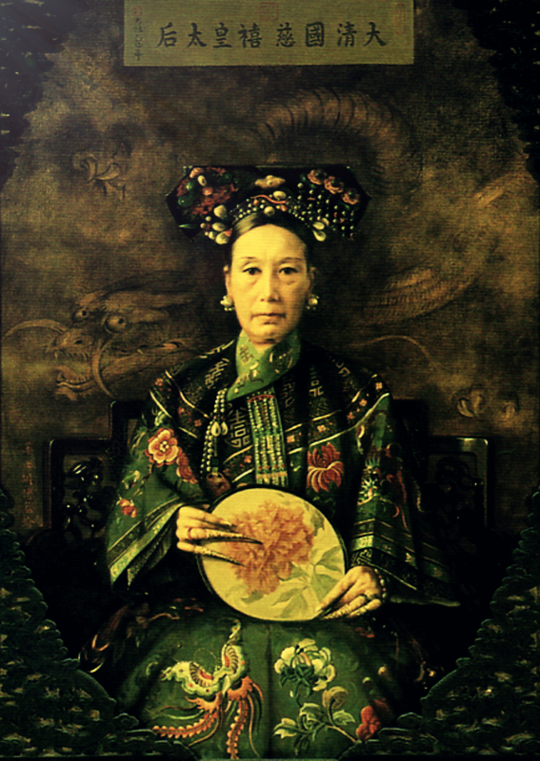
IMPERIALISM IN CHINA
Hundred Days of Reform
People (conservatives) who opposed the reforms turned to the dowager princess Cixi (Tzu-his).
She was the aunt and adoptive mother of the emperor.

Slide 35
IMPERIALISM IN CHINA
Hundred Days of Reform
Cixi (Tzu-his).
She strongly opposed the reforms.
In 1898, she ousted reformers and advisors of the emperor from power and had the emperor imprisoned.
She would rule for the next ten years and prevented any further reform.

Slide 36
IMPERIALISM IN CHINA
The dowager empress faced two serious problems.
Foreign imperialism
A growing belief among the Chinese people that the Qing dynasty had lost its legitimacy to rule.

Slide 37
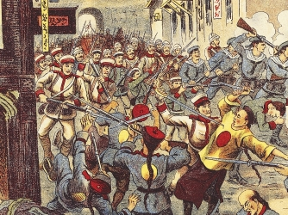
IMPERIALISM IN CHINA
The “Boxer Rebellion”
In 1899, a group of Chinese created a secret society called the “Fists of Righteous Harmony” or “Boxers”.
They wanted to expel the Qing dynasty and all foreigners from China.

Slide 38
IMPERIALISM IN CHINA
The “Boxer Rebellion”
Cixi negotiated with the Boxers and agreed to aid them secretly against foreigners.

Slide 39
IMPERIALISM IN CHINA
The “Boxer Rebellion”
In 1900, the Boxers moved through northern China attacking foreigners.
They attacked foreign diplomats in Beijing.

Slide 40
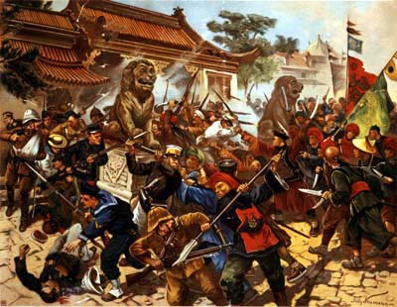
IMPERIALISM IN CHINA
The “Boxer Rebellion”
The foreigners responded by organizing their own international army to march on Beijing and rescue diplomats.
The army defeated the Boxers and forced Cixi to grant them concessions.
China was forced to allow foreign troops in China.

Slide 41
IMPERIALISM IN CHINA
The Revolution of 1911
In 1908, Cixi died.
She had named a two-year-old prince to succeed her.
Three years later the young emperor was overthrown by revolutionaries and a republic was proclaimed.

Slide 42
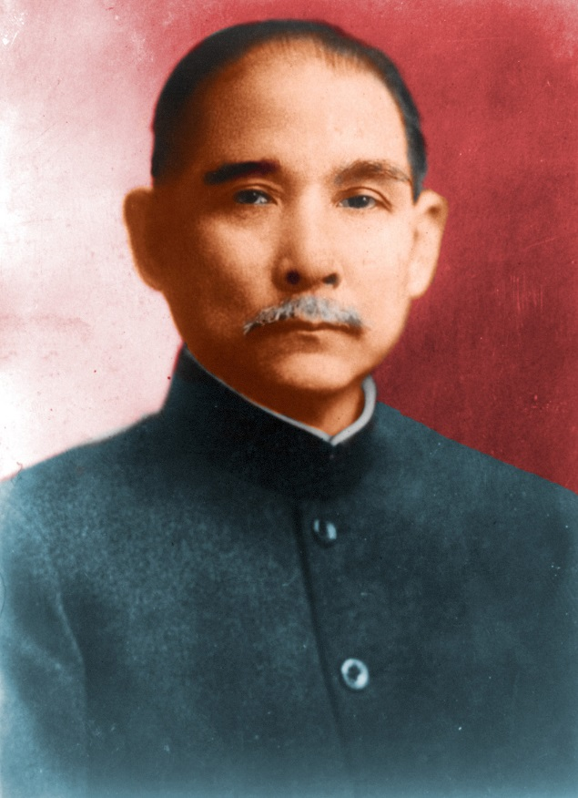
IMPERIALISM IN CHINA
The Revolution of 1911
The leading figure of the revolution was Sun Yixian (Sun Yat-sen).
He had lead earlier uprisings in China but at the outbreak of the 1911 Revolution he was living in the United States.
He returned to China and was named the first President of the Chinese Republic.

Slide 43
IMPERIALISM IN CHINA
The Revolution of 1911
Sun Yixian worked to build a united China even though there was unrest in the provinces.
He set out a revolutionary program called the “Three Principles of the People”
Political unity, democracy, and a basic living for all Chinese.

Slide 44
IMPERIALISM IN CHINA
The Revolution of 1911
Sun Yixian was heavily influenced by his travels in North America and Europe.
He wanted China to have the same standard of living.
He would struggle in the years to come to help China achieve this goal.

