Slide 1
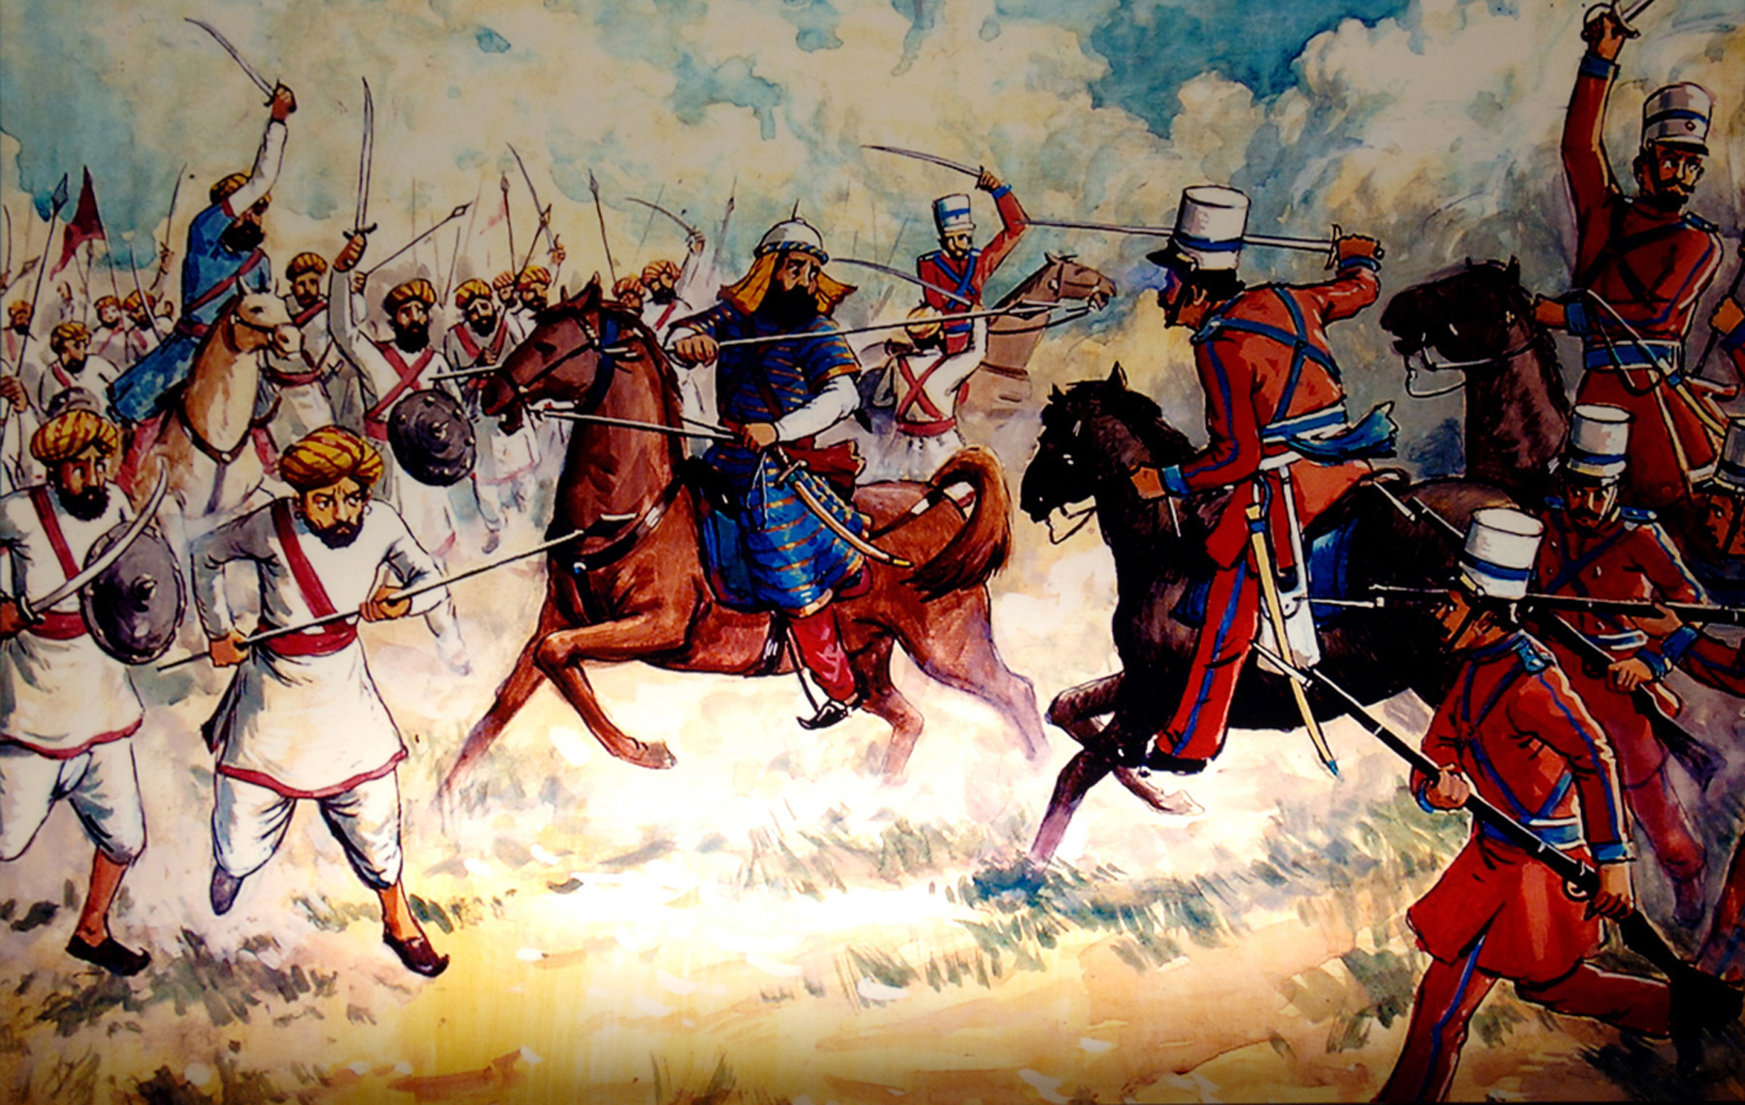
AN OVERVIEW OF IMPERIALISM IN INDIA

Slide 2
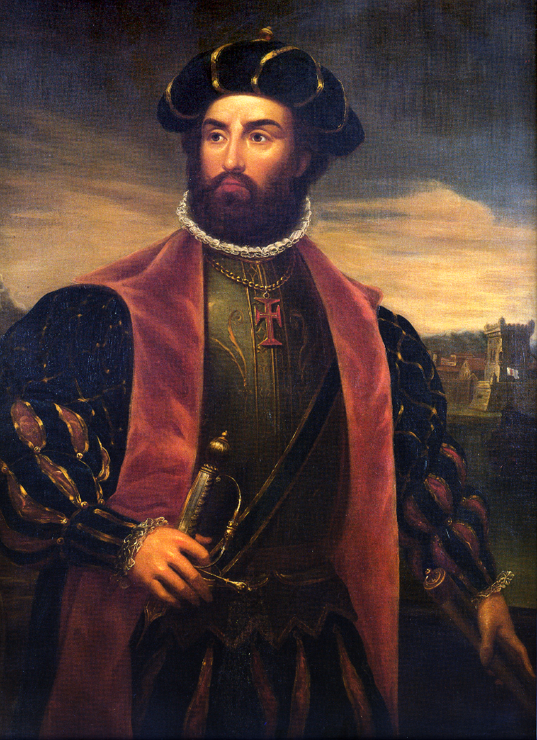
IMPERIALISM IN INDIA
European trade with India was established following the 1498 voyage of explorer Vasco da Gama.
British, French, Portuguese and Dutch merchants soon established trade routes.

Slide 3
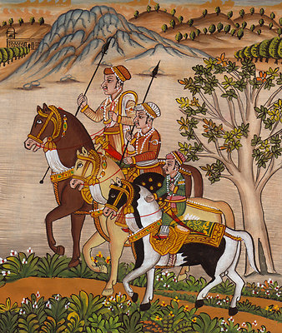
IMPERIALISM IN INDIA
At first, Europe did not pose a threat to India.
The Mughal Empire was at its height in India.
Notable for:
Its more than two centuries of effective rule over much of India
The ability of its rulers to rule effectively
Its administrative organization

Slide 4
IMPERIALISM IN INDIA
For almost 200 years the Mughal Empire ruled over India.
However, during the 1700s, the empire began to lose its hold over India.
It suffered a lack of strong leaders.

Slide 5
IMPERIALISM IN INDIA
During the rule of the Mughal Empire both Hindus and Muslims supported the emperor.
As time passed the prestige of the emperor faded.
The Hindus and the Muslims began to fight.
Europeans took advantage of the internal divide and began to advance in India.

Slide 6
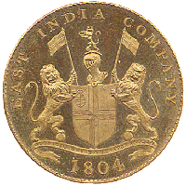
IMPERIALISM IN INDIA
As the Mughal Empire collapsed, French and British trading companies began to compete for control of trade with India.
The British East India Company would come to play an important role in India.

Slide 7
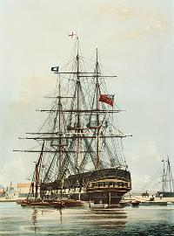
IMPERIALISM IN INDIA
During the 1700s, the British East India Company began to promote its interests in India.
Founded in 1600 to make profit by selling Indian products such as cotton, silk, sugar around the world.

Slide 8
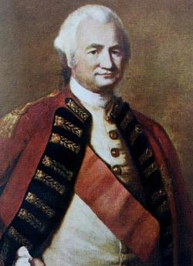
IMPERIALISM IN INDIA
As the Mughal Empire collapse, the British East India Company would begin to come involved the political and military affairs of India.
Robert Clive

Slide 9
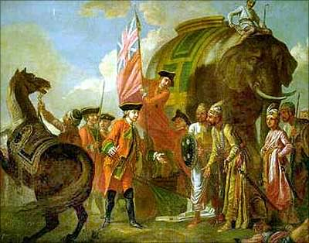
IMPERIALISM IN INDIA
Robert Clive was an employee of the British East India Company.
He raised an army and used it to help the British East India Company take control over India.
Ensured that a government was in place that was favorable to the company.
Ensured that the French were removed from India.

Slide 10
IMPERIALISM IN INDIA
The British East India Company used a technique called “commercial colonization”.
It controlled India’s foreign trade and used its armies to control local governments.

Slide 11
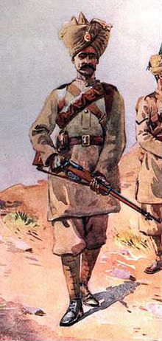
IMPERIALISM IN INDIA
The soldiers of the British East India Company were called “sepoys”.
Indian soldiers who served in the army of Europeans.
The British East India Company would use these sepoys to gain direct political control over some parts of India.

Slide 12
IMPERIALISM IN INDIA
Although officially regulated by the British parliament, the British East India Company generally had free reign over India until the mid-1800s.
In 1857, an uprising know as the Sepoy Mutiny ended the rule of the British East India Company and the British parliament began to play a larger role in control over India.

Slide 13
IMPERIALISM IN INDIA
Sepoy Mutiny began in 1857, as the sepoy soldier became angered with the British East India Company.
Rumors that the bullet cartridges of the sepoy soldiers were greased with the fat from beef and pork.
Sepoy soldiers were either Hindu or Muslim
Beef was considered untouchable by Hindus
Pork was considered untouchable by Muslims

Slide 15
IMPERIALISM IN INDIA
As well, the sepoys resented that the British were trying to convert them to Christianity and make them adopt European customs.
The Sepoy Mutiny spread across India.
It was supported by both princes and peasants, as many Indians saw it as an opportunity to free themselves from British control.

Slide 16
IMPERIALISM IN INDIA
However, British troops stopped the uprising in 1858.
The British parliament took over control of the colony in India.
While the British East India Company had lost its control, the Indian people were still controlled by the British.

Slide 17
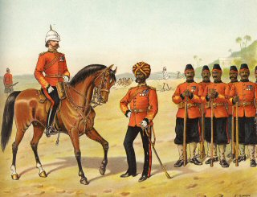
IMPERIALISM IN INDIA
In 1858 the British government established full colonial rule over India.
British government officials were directly in charge of controlling Indian affairs.
Controlling local laws, and policies.

Slide 18
IMPERIALISM IN INDIA
The part of India that was under direct British rule was called the Raj.
The term Raj referred to British rule over India from 1757 until 1947.
A cabinet minister in London directed policy, and a British governor-general in India carried out the government’s orders.

Slide 19
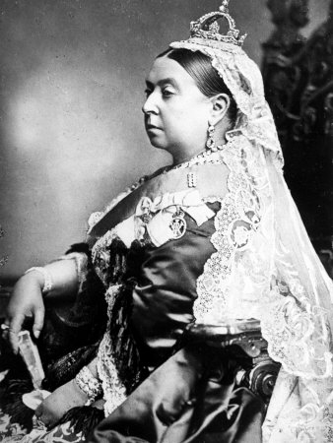
IMPERIALISM IN INDIA
In 1877, British Prime Minister, Benjamin Disraeli had Queen Victoria recognized as the ‘Empress of India’.

Slide 20
IMPERIALISM IN INDIA
In 1890, approximately 1,000 British officials ran a colonial government that ruled over 280 million Indian people.
India would be important to the British Empire as a source of raw materials and the British would famously refer to India as Britain’s “jewel in the crown”.

Slide 21
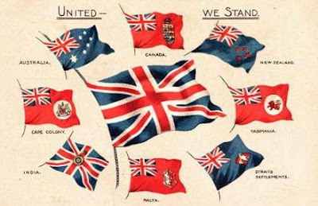

Slide 22
IMPERIALISM IN INDIA
During the Age of Imperialism the British government tried to impose British culture on India.
Indians were encouraged to speak, dress and live like Europeans.
British officials believed that Indians would improve their lives if they adopted the ways of Europeans.

Slide 23
IMPERIALISM IN INDIA
British rule in India impact life in India in several different ways.
The British would bring about major economic and social changes in India.

Slide 24
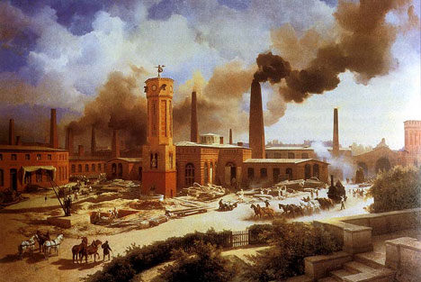
IMPERIALISM IN INDIA
Economic changes:
The Industrial Revolution created the factory system in Britain.
The British government viewed India as a source of cheap raw materials to feed its factories.
As well, the British viewed the large Indian population as a market for goods produced from the British factories.

Slide 25
IMPERIALISM IN INDIA
Economic changes:
The British discouraged local Indian industries, and instead pushed Indians to produce resources that would benefit Britain.
Indian farmers were encouraged to produce cotton instead of food crops so the cotton could be sent to Britain for production.
Some of the goods made from Indian cotton was then sold back to India.

Slide 26
IMPERIALISM IN INDIA
Social changes:
The Indian population grew rapidly.
The British introduced programs to improve healthcare in India, including the training of doctors and building of hospitals.

Slide 27
IMPERIALISM IN INDIA
Social changes:
The growing population of India led to India having some of the largest cities in the world.
In these cities, young Indians attended British-run schools and colleges.
They studied science, math, history, literature and philosophy.
The same courses that students in Britain studied.
These students became doctors and lawyers, professors, etc.
They became a new upper class of people in India and were counted upon to help ensure British rule in India.

Slide 28
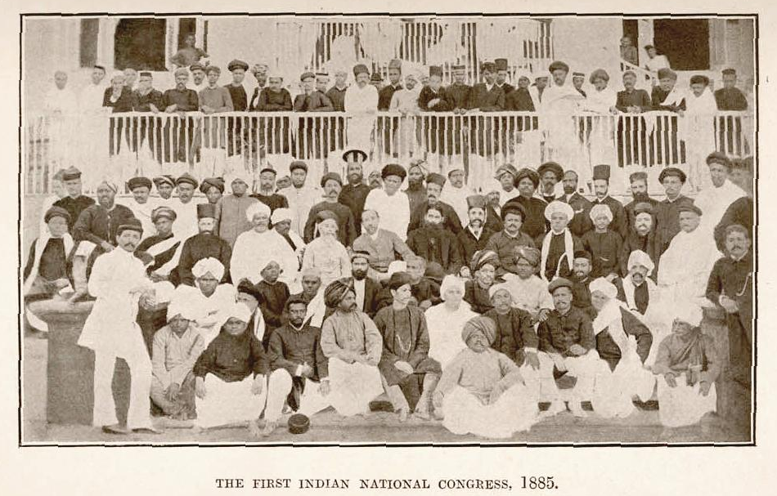
IMPERIALISM IN INDIA
As time passed, new opposition within India grew against British rule.
In 1885, a group of well-educated middle-class Indians formed the political party of Indian National Congress.

Slide 29
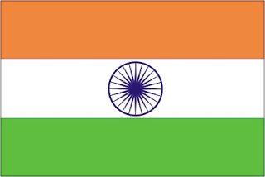
IMPERIALISM IN INDIA
Indian National Congress
Known as the Congress, the part led a nationalist movement in India.
In the early 1900s, these nationalists began calling for an end to British rule in India.

Slide 30
IMPERIALISM IN INDIA
Indian National Congress
They urged Indians to boycott (stop buying) British goods.
They hoped this would end British control over the lives of Indians.

Slide 31
IMPERIALISM IN INDIA
Indian National Congress
The best known nationalist leader was Mohandas Gandhi.
More commonly known as ‘Mahatma’ (meaning ‘Great Soul’)
He was born in North West India, on the 2nd of October 1869, into a Hindu family.

Slide 32
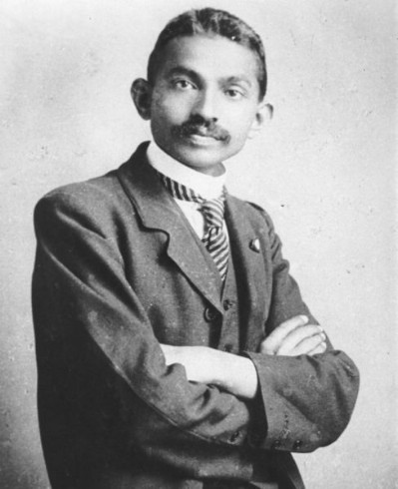
IMPERIALISM IN INDIA
Gandhi
Gandhi trained to be a lawyer in England at the age of 18
Accepted a one year contract with a law firm in South Africa in 1893.
Although not yet a law, the system of ‘apartheid’ was very much in existence in South Africa at time.

Slide 33
IMPERIALISM IN INDIA
Gandhi
Gandhi spent the next 21 years living in South Africa, and railed against the injustice of racial segregation.
On one occasion he was thrown from a first class train carriage, despite being in possession of a valid ticket.
Witnessing the racial bias experienced by his countrymen served as a catalyst for his later activism, and he attempted to fight segregation at all levels.

Slide 34
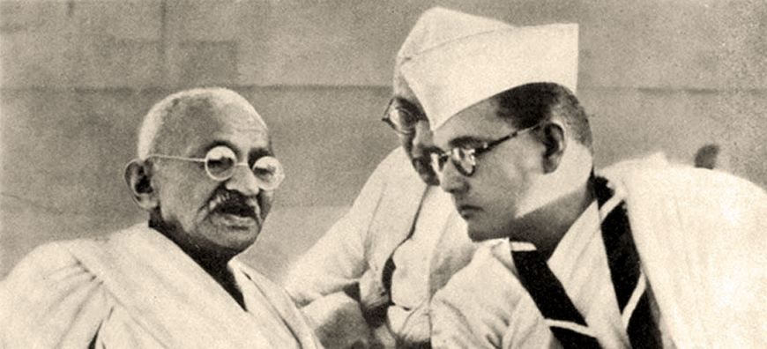
IMPERIALISM IN INDIA
Gandhi
On his return to India in 1916, Gandhi developed his practice of non-violent civic disobedience.
He rallied widespread support for India’s independence movement from British rule.
He eventually helped India claim its independence.

