Slide 1
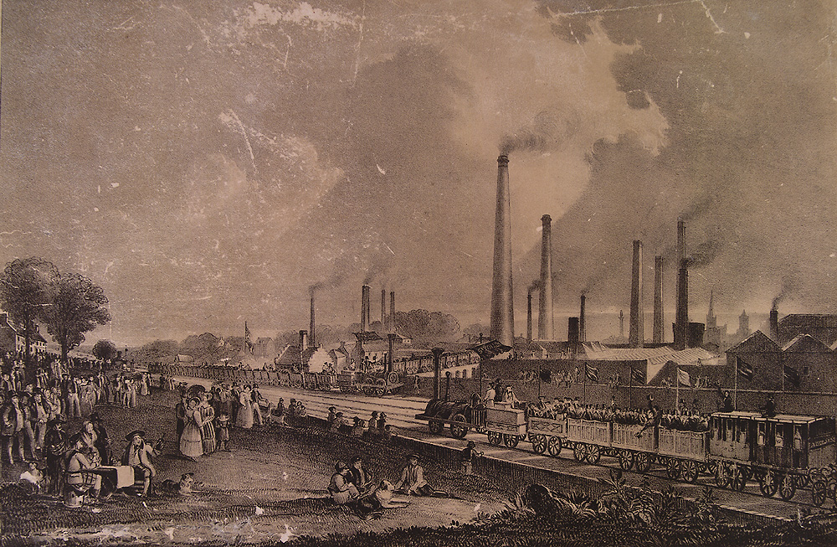
Why did the Industrial Revolution begin in England?

Slide 2
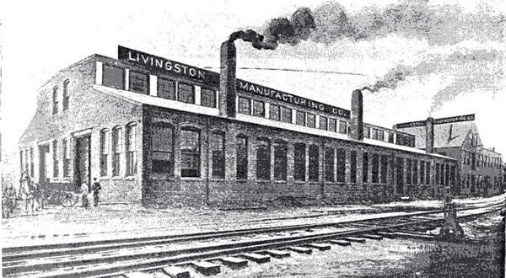
For thousands of years, people wove textiles by hand to create clothes. Pretty much all other objects were made this way as well. The Industrial Revolution refers to the increased output of machine-made goods that began in England in the mid 1700’s.
Building
Blocks
the Industrial
Revolution

Slide 3
USE CAUSES OF INDUSTRIALIZATION GRAPHIC ORGANIZER TEMPLATE
FILL IN GRAPHIC ORGANIZER AS YOU GO THROUGH POWERPOINT, UPLOAD YOUR FINISHED PRODUCT

Slide 4
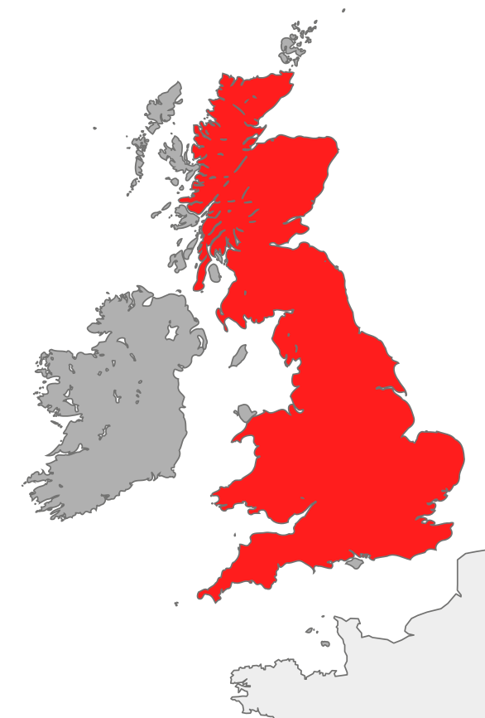
Industrial Beginnings
Began in England in the mid-1700’s
Mass production of machine made goods
Replaces old “cottage industries”
England had the 3 factors of production (land, labor, & capitol)
Notes:
Great Britain had the 3 factors of production: Land (Natural resources like coal, rivers, harbors, etc); Labor (growing population for a willing workforce); Capitol (money for investment from wealthy citizens). England also had colonies around the world to provide raw materials and also as new markets for finished goods

Slide 5
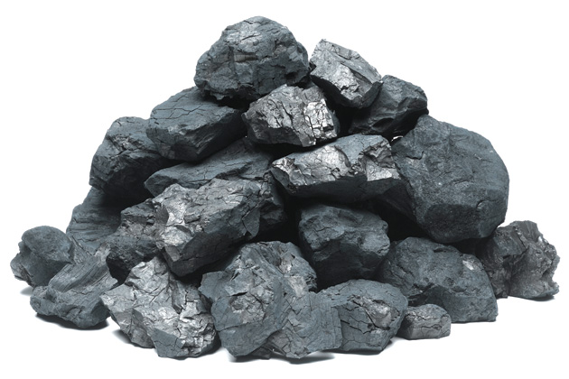
Natural Resources
England had abundant natural resources
Coal – burned for fuel
Iron ore – to build machines
Rivers for water power & transportation

Slide 6
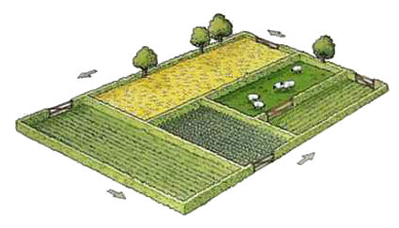
Agricultural Revolution
Crop Rotation – helps soil to stay healthy for growing
Enclosure Movement – wealthy landowners buy up and fence off huge pieces of land

Slide 7
Stable Government & Economy
Developed banking system, trade, & wealth
No recent wars or political revolutions in England
Parliament supports business
Notes:
the slave trade was abolished in 1807 and the Great Reform Act was passed by Parliament in 1832. After this Reform Act, manufacturing cities such as Birmingham and Manchester could be represented in Parliament for the first time, thereby substantially changing the character of parliamentary politics.
With the increase of capital and the need for credit, banking developed not only in London but also in the countryside. Industrialists, shipbuilders, merchants and other private manufacturers established provincial banks and issued paper money in the form of bills of exchange and notes, primarily in order to provide payment for labor and for the purchase of raw materials. The Industrial Revolution helped create opportunities for employment for all members of the family. Any improvement to the quality of life for the working class, however, came despite hard and bitter experiences among factory laborers.
Children in the mines suffered similarly. Both boys and girls would start working at the age of four or five. A sizeable proportion of children working in the mines were under 13 and a larger proportion were aged 13-18. Mines of the era were not built for stability, rather, they were small and low. Children, therefore, were needed to crawl through them. The conditions in the mines were unsafe, children would often have limbs crippled, their bodies distorted, or be killed. Children could get lost within the mines for days at a time. The air in the mines was harmful to breathe and could cause painful and fatal diseases

Slide 8
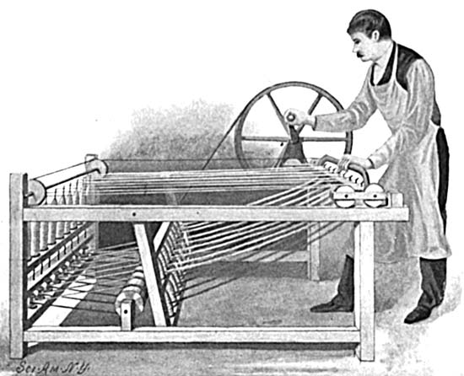
Inventions
Spinning Jenny by James Hargreaves to quickly spin thread
Steam Engine by James Watt to power machines
Steel Process by Henry Bessemer (stronger, cheaper steel)
Notes:
The spinning jenny is a multi-spindle spinning frame, and was one of the key developments in the industrialization of weaving during the early Industrial Revolution. It was invented in 1764 by James Hargreaves in Stanhill, Lancashire in England. The device reduced the amount of work needed to produce cloth, with a worker able to work eight or more spools at once. This grew to 120 as technology advanced. The yarn produced by the jenny was not very strong until Richard Arkwright invented the water-powered water frame, which produced yarn harder and stronger than that of the initial spinning jenny. It started the factory system
In 1769 James Watt developed the steam engine powered by coal that would run the machines of the Industrial Revolution. He improved on Thomas Newcomen's 1712 Newcomen steam engine with his Watt steam engine in 1776. He developed the concept of horsepower, and the unit of power, the watt, was named after him.
The Bessemer process was the first inexpensive industrial process for the mass production of steel from molten pig iron. The key principle is removal of impurities from the iron by oxidation with air being blown through the molten iron to burn off carbon. Related processes had been used outside Europe for hundreds of years, but not on an industrial scale. One such process has existed since the 11th century in East Asia, where the scholar Shen Kuo of that era described its use in the Chinese iron and steel industry. In the 17th century, accounts by European travelers detailed its possible use by the Japanese. The modern process is named after its inventor, the Englishman Henry Bessemer, who took out a patent on the process in 1856
* Pig Iron is also known as crude iron, which is obtained by smelting iron ore in a blast furnace. It very brittle and not useful directly as a material except for limited applications. The shape of the molds used for pig iron ingots was a branching structure formed in sand, with many individual ingots at right angles[3] to a central channel or runner, resembling a litter of piglets being suckled by a sow.

Slide 9
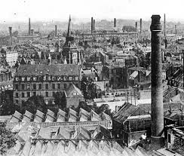
RESULTS
Larger food supply led to a population boom
Urbanization: movement of people from towns to cities
Changing class systems
New ideas about economics (laissez faire vs. socialism)
Notes:
I don’t include these on the cubes, obviously, since there’s no room. However, these are just hints of things to come that we will cover in greater depth as we move through the unit.

