Slide 1
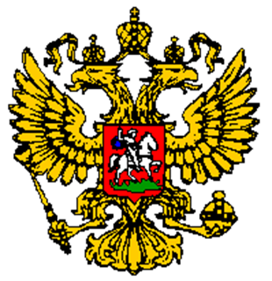
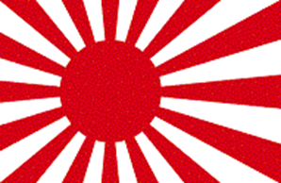
Russia & Japan: Industrialization Outside the West
Compare the role of Industrialization

Slide 3
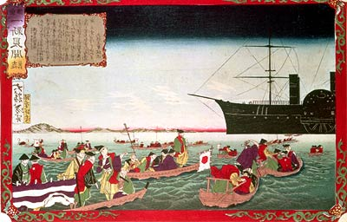
Analyze the Document…

Slide 4
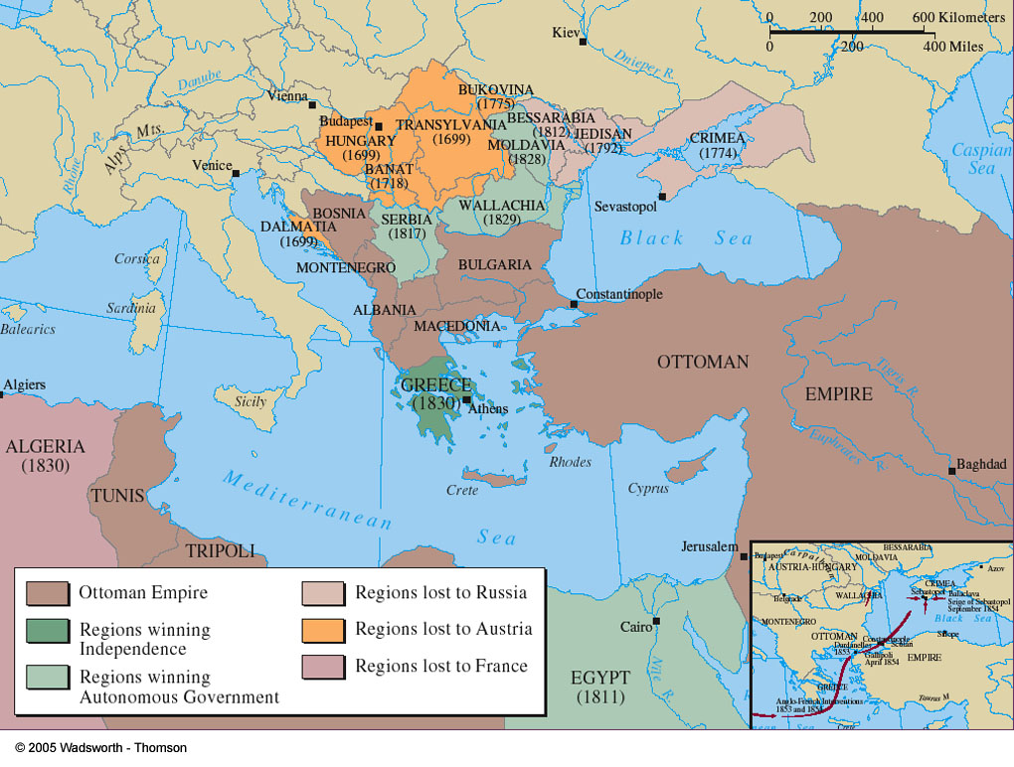
Crimean War( Russia’s on the Right)

Slide 5
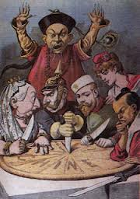
Similarities
Maintained economic and political independence during the West’s century of power
Prior experience of imitation
Knew that learning from outsiders could be profitable and need not destroy their native cultures
Improved their political effectiveness during the 17th & 18 centuries
Used the state to sponsor changes (in the West change was initiated by private businesses

Slide 8
Comp: Russian and Japanese Industrialism
Similarities | Differences
Both led by nationalism in response to embarrassments (Crimean War/Opening to U..S Matthew Perry in Edo) Both had prior imitation experience Both will develop industrial infrastructure( including militarism, imperialism, railroads, coal, textile factories) Both will wage wars of expansion ( Russo-Ottoman Wars, Sino-Japanese Wars and eventually Russo-Japanese war) Increased literacy for industrialization (including women) Both will establish political reforms ( Duma/Diet) Both will dissolve old feudal ties Both will have central authoritarian state-sponsorship of industry | Japan more homogeneous because of isolation, Russia more heterogeneous making pattern of nationalism more difficult Russia’s previous “westernization” under Peter the Great made it eventually dependent on foreign investment while Japan utilized zaibatsu to industrialize without much foreign help ( advisors and schooling but not investments) Japanese nationalism will solidify military power base after samurai wars while Russian reforms continue due to enlightened and communist ideas ( Decembrist uprising, 1905 rebellion and Russian Revolution 1917 due to unresolved social conflicts) Prior neo-Confucian ideology of Japan had social and economic benefits while the terrible conditions of serfdom and anti-Semitism in pale settlements slowed the pace of growth of Russification ( getting all of Russia to adhere to nationalistic homogeneity)

Slide 9
S.A.Q: Answer, Cite(Evidence), Explain ( analysis)
The Japanese and Russians were both embarrassed and shamed into industrialization through warfare. The Russians were soundly defeated after the Crimean War while the Japanese were opened up through American Admiral Matthew Perry at the port of Edo. Their seeming lack of industrial military technologies forced Russia and Japan to sign unequal treaties and force their consolidated governments into industrial reform movements.
Differences between Russian and Japanese industrialization was that Japans homogeneity facilitated nationalist consolidation and made industrialization more efficient while Russia’s heterogeneity created class struggles and hindered the development of nationalists industrialization. Japan’s Zaibatsu went to Western schools to learn about banking and industry and model during the Mejii restoration while Russia's attempt at nationalist reforms ( Russification) led to pogroms of Jewish populations and Marxist strikes in industrial towns. A united Japan had an easier period having been isolated since 1686 while Russia diversity hindered their development with different groups wanting different things from industrialism.
The “West” was different from Japan and Russian industrialization having both done it earlier and having private business holdings finance industrialization. The Mejii restoration and Romanovs were state sponsored industrialism while the West had business industries finance private monies into a competitive atmosphere. While Russia will be the 4th largest steel and 2nd in oil, the “West” was still drastically ahead of Russia and Japan in terms of economy and military industry with the U.S even brokering a peace agreement between Russia and Japan in the Russo-Japanese War 1904-1904

Slide 10
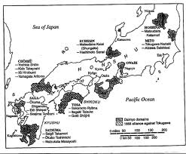
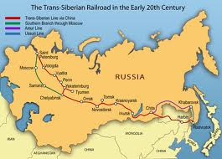
More similarities
Expansionist
Literacy increases
Not much reform or industrialization the first half of 19th century
Tensions between traditionalists and reformist intellectuals
Extensive railroad network created
New parliaments created
Imitated West but retained identity
Centralized authoritarian states

Slide 11
Female labor (Cultural similarities: Doc 3, and 7) Governmental Promotion of Manufacturing ( Political Similarities :doc,1,2,6) Differences in raising capital (national banks in Japan doc 2, “influx in foreign capital” doc 1 Differences in response to labor conditions: Russia Aggressively against and striking (doc 4 and 7) while Japan did not (3 and 5)

Slide 12
P.O.V: Document 1 with the secret nature of the letter and its reliability as evidence of the motivations and character of Russian industrialization. Document #3 the veracity (factual nature) of the evidence by a “foreign” photographer of Japanese working conditions. In Document #5 the reliability of evidence of oral histories recorded a half century after the period of investigation.
Synthesis linking
To another time, region
Or theme

Slide 13
Defying the Odds
Stories of Russia & Japan do not fit the patterns of Western imperialism
Common Characteristics—imitation, understood benefits of borrowing, political effectiveness
Result? Clashing global spheres
(Russo-Japanese War)

Slide 14
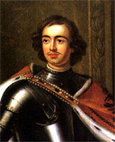
Russia Before Reform
Increasingly conservative to prevent Western revolutionary ideas
Alexander I @ Congress of Vienna
Nicholas I represses opponents, controls schools & newspapers
Western fascination remained among scholars & artists
Decembrist uprising
Territorial expansion continues, particularly toward Ottomans

Slide 15
Economic & Social Problems
Conservatism results in stagnant economy & growing gap w/ West
Profoundly agricultural & serf-based
Inferiority made clear by Crimean War
Russia defeated by British & French industrial arms
Reform becomes essential to allow for economic growth in order to maintain military strength

Slide 16
Reform Era & Industrialization
1 of 2
Reforms addressed needs but led to expanded grievances
Serfs emancipated in 1861
Land given to serfs, population & urban labor force grows
Tsar & aristocracy maintained w/ no new political rights, traditional farming & ties to land continued w/ redemption payments
Zemstvoes allow middle class to gain positions in local government, military begins to modernize, literacy increases although unevenly, women gain access to education & jobs

Slide 17
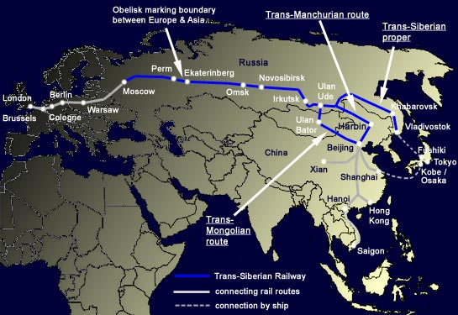
Reform Era & Industrialization
2 of 2
Limited construction of modern factories
Extended railroad network (trans-Siberian Railroad)
Coal, steel, oil, textile industries expand
Development largely result of foreign investment, protective tariffs, & size
Factories less technologically advanced

Slide 18
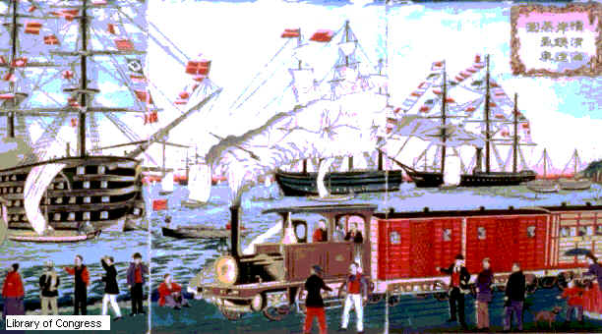
Japan: Change w/o Revolution

Slide 19
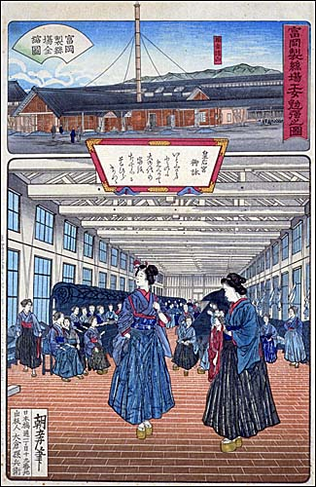
Final Decades of Shogunate
Economy is proto-industrial & increasingly commercial
Intellectually…
Neo-Confucianism adds secularism & literacy,
National studies add nationalism,
Dutch studies add science & Western ideas
Economy only stagnates toward mid-1800s w/ feudalism & rice-based finances intact
Inside Silk-reeling Mill

Slide 20
Challenge to Isolation
U.S. commodore Perry & superior military technology opened Japan to trade
Internal tension grew b/t factions appealing to emperor
Crisis peaks w/ samurai violence & Western response proving superiority

Slide 21
Political Change: Meiji Restoration
Crisis addressed with Meiji restoration of emperor in 1868 & deeper political changes
Reform based on Western imitation
Centralized power in imperial house
Replaced feudalism & daimyos w/ parliament & limited democracy, bureaucracy drawn from civil service exams, appointed district officials
Samurai class & tax system overhauled causing diverse effects

Slide 22
Industrial Revolution
Military reforms included in early efforts
State direction, private enterprise, & foreign advisors combine to create full-scale industrialization by 1900
Banking, railroads, shipyards
Zaibatsu
Despite industrialization, Japan still disadvantaged globally w/ lack of resources & machinery

Slide 23
Social & Diplomatic Effects
Socially attempt to balance Western & Japanese ideas
Rapid population growth, but slows w/ greater industrialization
Copied Western science & hygiene, while maintaining Japanese morality
Diplomatically aggressive following model of imperialism & fulfilling resource needs
Sino-Japanese War
Russo-Japanese War

Slide 24
Strain of Modernization
Strains evident in urban living standards, intellectual identity crisis, & parliamentary clashes w/ emperor
Nationalism promoted to ease strain

Slide 25
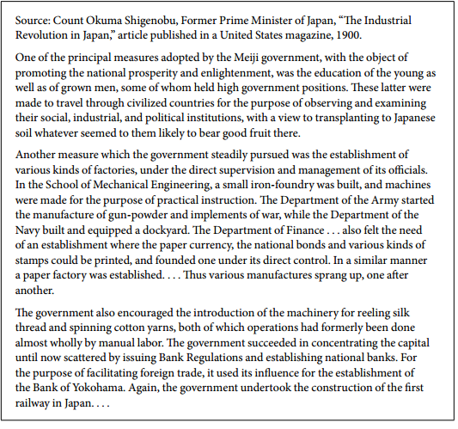
The purpose of this secret letter to Tsar Nicholas II about the type of industrialism in
Russia (Protectionist is government regulated vs free trade without government
Intervention) he is encouraging the government’s regulation to compete against
Europeans while in doc #2 while Count Okuma utilized governmental forces, they
Raised private capital under Mejii regulations.

Slide 26
Document #3 along with #5 illustrates the conditions to which workers produced
Various goods (like textiles here) and that there were no strikes (perhaps because
Of improved lifestyles or favorable working conditions)

Slide 27
Documents 4 and 5 illustrate different responses to the working conditions while
Workers in Russia (#4) engaged in strikes against the conditions in the factories, the
Japanese (Doc #5) had quite favorable impressions ( although the recounting of life
Among elderly workers may be tempered by time)

Slide 28
Document #6 (in response to Whittes’s secret letter in doc #1) is a quite favorable
Of the state sponsorship of industrialism in Russia (perhaps grouped with 1, 2 for
Japan about the improvements made.) . This is counter to Doc #7 illustrating the
Terrible conditions for women in Russian factories detailing the physical force of
Children and long working hours for women (reasoning for their strikes). This physician
Is justifying their reasoning coupled that women had to augment (help finance) their
Pay wit prostitution (this serves to shock the women’s suffrage organization perhaps
With communist or socialists leanings).

Slide 29
Global Connections
Russia already global player, but more fully so after industrialization
Japan enters global affairs w/ imperialism & complex relations
Russia, Japan, & U.S. add to atmosphere of competition by 1914
EX- Yellow Peril

Slide 30
Thesis
Russia and Japan defied the pattern of nineteenth-century European domination. By 1900, they launched significant industrialization and accomplished other changes that preserved their independence. Both achieved economic autonomy and were able to join in the imperialist scramble. There were differences between the two. Japan displayed more political flexibility than did Russia. Change in Russia increased internal strains and led to revolution. Japan, through its reforms, pulled away from the rest of east Asia; Russia continued expanding its influence in eastern Europe and central Asia. Among the characteristics common to the two nations in their maintenance of independence was their prior experience of cultural imitation, Japan from China and Russia from Byzantium and the West. They were able to learn without destroying their own cultures. Both also had improved their political effectiveness during the seventeenth and eighteenth centuries, a situation allowing the state to sponsor change

