Slide 1
MING AND QING DYNASTYS

Slide 2
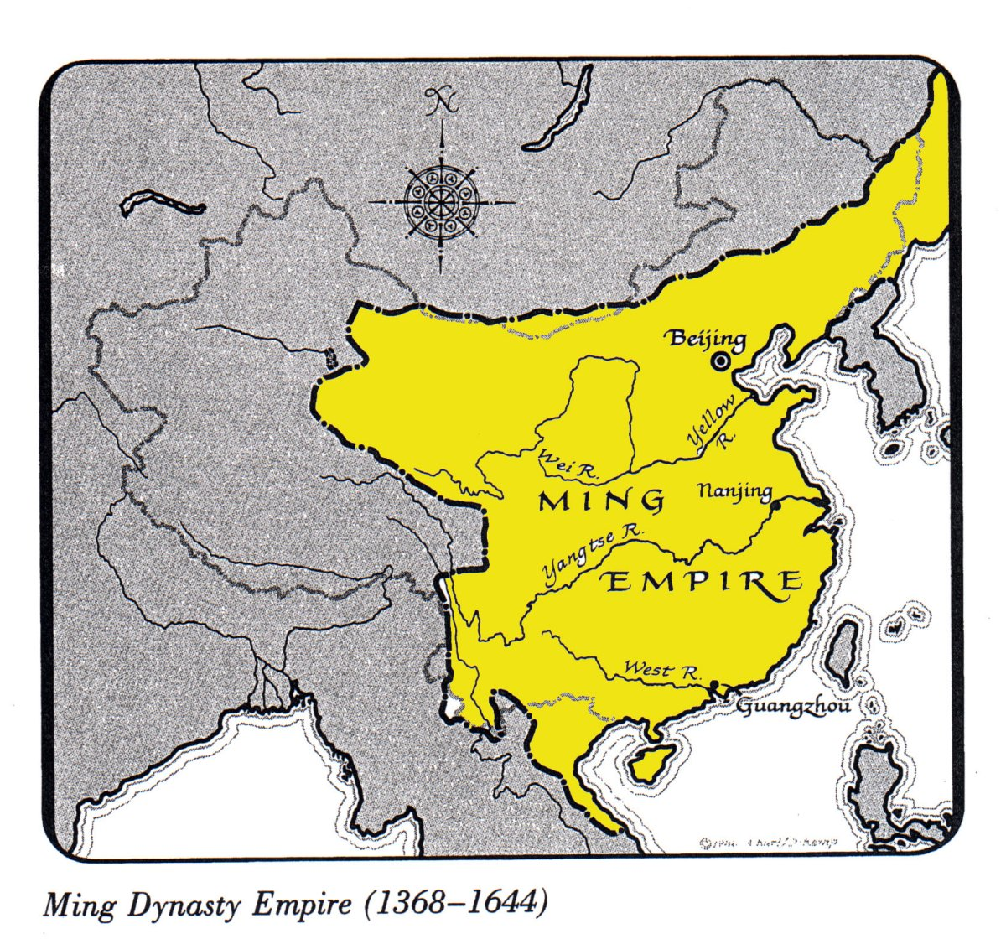
THE MING DYNASTY
The Ming Empire took over after the Mongol’s Yuan Empire in 1368 and lasted until 1644
The Ming will expand its rule into Mongolia, Central Asia, and Vietnam
They will add to the Great Wall of China, complete the Grand Canal, and reestablish the Scholar Gentry

Slide 3
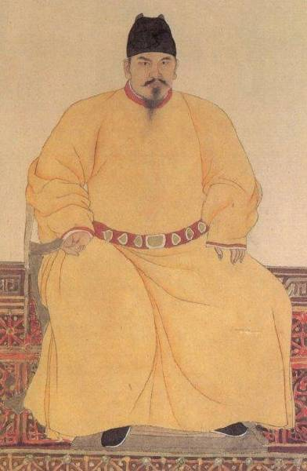
THE RISE OF THE MING
Began by Hongwu (Tai Zu), commanded the rebel army that drove the Mongols out of China in 1368
Reforms restored agricultural lands, increased rice production, returned to Confucian moral standards and scholar gentry
Later, to maintain power, killed thousands that “threatened” him

Slide 4
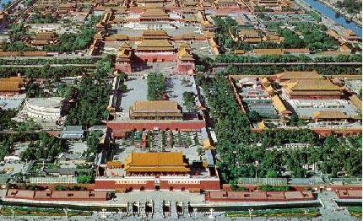
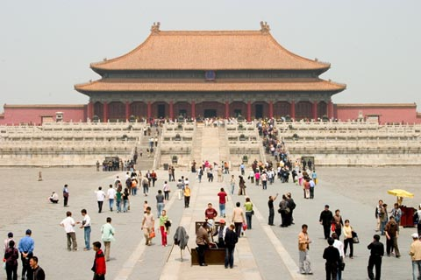
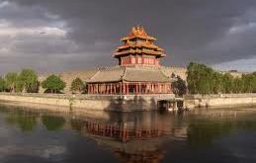
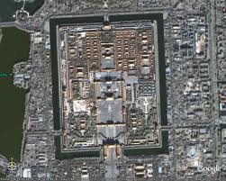
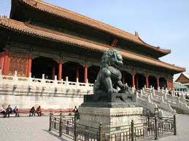
EMPEROR YONGLO
Moved the royal court to Beijing and began to build the Imperial City or Forbidden City
Reflects attitude of China by area being closed to all commoners (isolation, social classes) and extravagant lifestyle

Slide 5
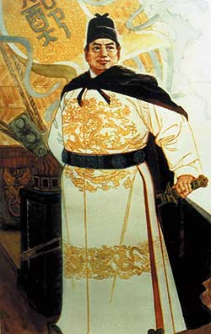
ADMIRAL ZHENG HE
Sponsored by Yonglo, Zheng He began Chinese exploration
He went on seven voyages between the years 1405 and 1433
Each voyage had at least 50 ships and 27,000 men

Slide 6
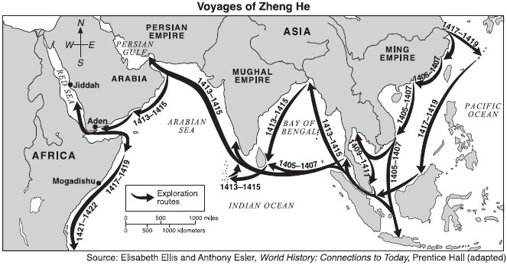
ADMIRAL ZHENG HE
Zheng He took gifts of gold, silk, and spices to each stop – to show Chinese superiority
This contact encouraged these places to send tribute to China hoping for trade

Slide 7
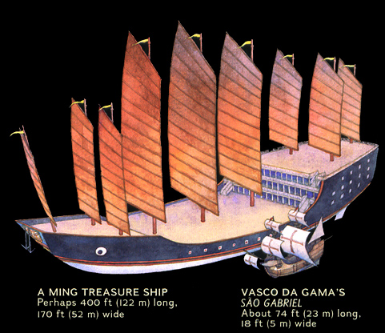
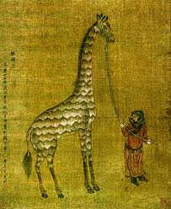
ADMIRAL ZHENG HE
Zheng He’s “Treasure Fleets” were huge
Ships were 400’ long and 160’ wide

Slide 8
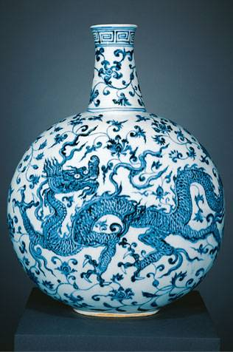
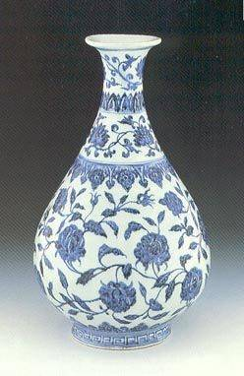
Ming Relations with Foreign Countries
China returned to a policy of isolation starting 1424 when Yonglo died and in 1433 when Zheng He died on the 7th and last voyage
China allowed for trade to take place in only 3 port cities and only the government can trade
Limited contact created a “Black Market” business which increased product prices

Slide 9
Ming Relations with Foreign Countries
China resisted foreign contact because it felt that their product was superior (doesn’t need European goods) and it wanted to limit cultural influence (Christianity)
China did not focus on industrialized because
1. The idea of commerce offended Confucian beliefs
2. Policies favored agriculture – taxed manufactured good to keep food prices low

Slide 10
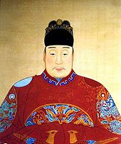
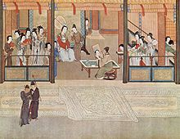
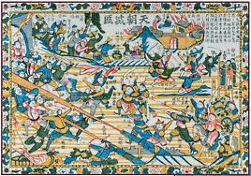
FALL OF THE MING
The Ming Dynasty started to decline in the late 1500’s
The Ming was weakened by a series of weak rulers, high taxes and corruption, and several years of bad crop yields – all of which created peasant uprisings
The last straw for the Ming was an epidemic that killed a large number of people

Slide 11
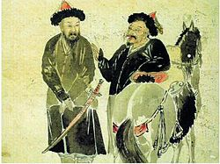
RISE OF THE QING DYNASTY
Li Zicheng led a revolt that overthrew the Ming
A group of people called the Manchus (from the far NE part of China) then conquered Beijing and led to the creation of the Qing Dynasty

Slide 12
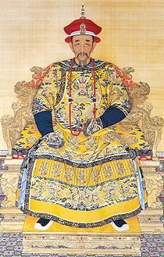
REIGN OF KANGXI
Seen as one of the greatest Chinese rulers
He was tolerant to Christians and missionaries began to work in China
He ended revolt in China, protected it from Russia, and expanded control to Taiwan

Slide 13
QING DYNASTY AND FOREIGN TRADE
The Dutch prospered in trade with the Chinese because they accepted the Chinese court rituals such as “kowtow” (kneeling in front of the emperor and touching their heads to the ground 9 times)
In a letter from England’s King George III, England wanted to increase trade with China but was denied because Lord George Macartney, who delivered the letter refused to “kowtow”

Slide 14
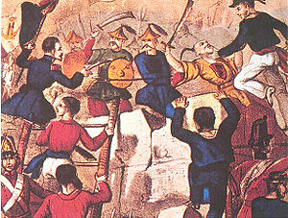
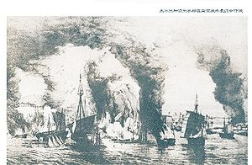
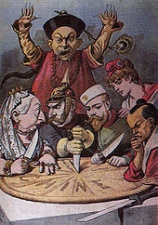
PROBLEMS IN THE QING DYNASTY
Problems included high taxes, corruption, secret societies, uprisings, backlash against Europeans, unequal trade, and European Imperialism
Opium
War
Hong Xiuguan &
Taiping Rebellion
European
Imperialism

Slide 15
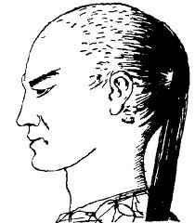
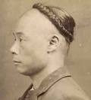
MANCHU CULTURE
To make it easier to identify people against the Manchus, they ordered all men to shave their foreheads and braid their hair into a pigtail
The Manchu adopted the Ming political system but made their people superior to the other Chinese – legally, politically, and economically

Slide 16
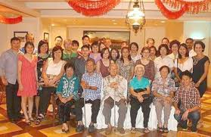
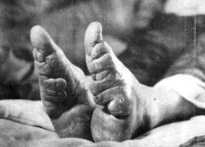
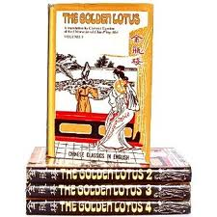
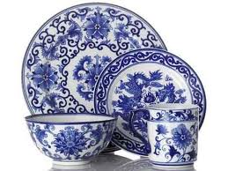
MING AND QING CULTURE
The ideal family was a large, extended family
Women were seen as inferior
Foot binding was seen as a status symbol
The Golden Lotus was considered by many to be the first realistic social novel (showed corruption and cruelty)
Blue and White porcelain was highly valued by Europeans

