Slide 1
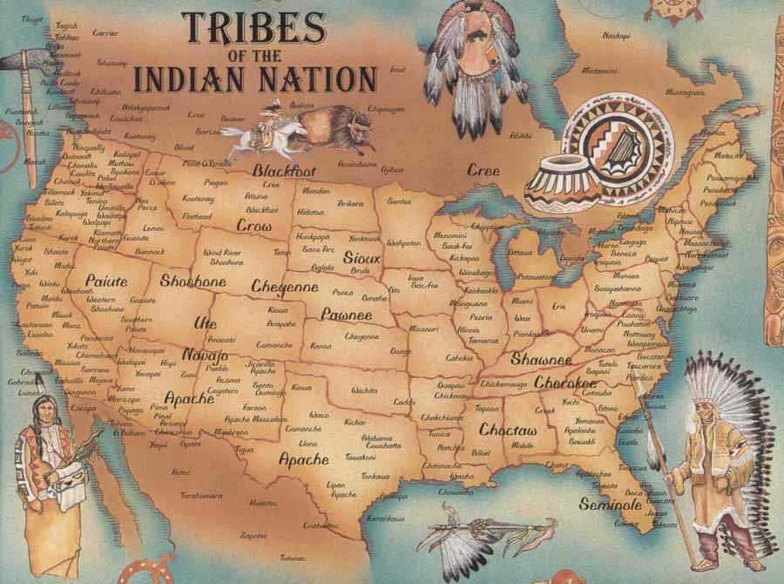
NATIVE AMERICANS

Slide 2
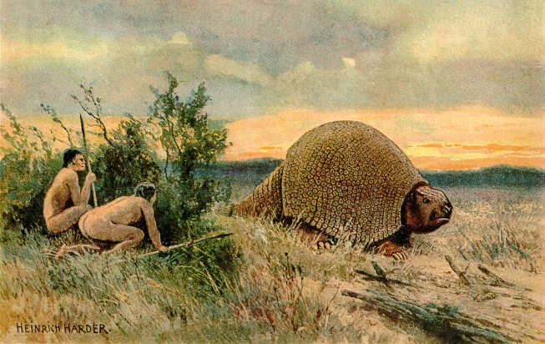
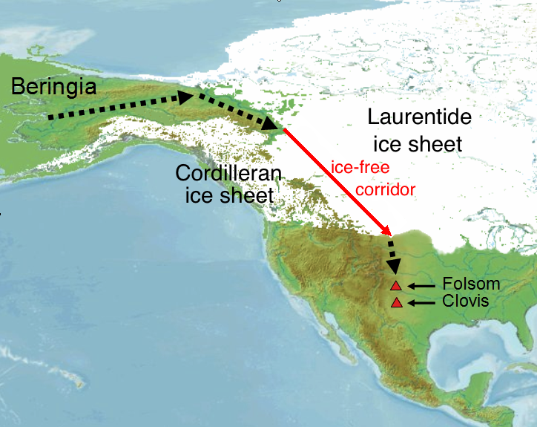
What is a Native American?
Native Americans are considered to be people whose ancestors were indigenous to the lands within the U.S.’s modern borders.
This groups may also refer to themselves as “American Indians”, “Indians”, “Indigenous (peoples)”, or “Aboriginal”.
Native American Origins
Pre-Columbian Native Americans are believed to have migrated from Asia over a land bridge at the Bering Strait during a period of glaciation. This bridge has been flooded for the past 12,000 years, isolating the groups that migrated.
A second theory is that groups migrated here from the Polynesian Islands up to 10,000 years ago.

Slide 3
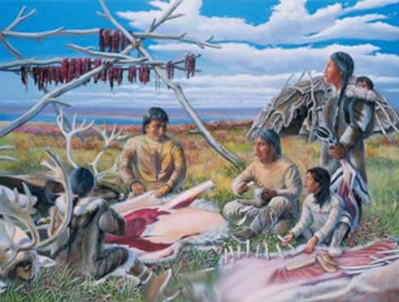
Early Native American Culture
Clovis Culture – The oldest organized culture dating back up to 13,200 years ago. They are considered to be the ancestors of most Native American cultures in the Americas
Folsom Traditions – This culture can date back to 9,000 years ago. They can be traced back to the Clovis and are seen as the start of the Plains and Great Lake Native American groups.
Na-Dene speaking peoples – They can be dated back to 7000 years ago in the Pacific Northwest. Their most successful migration was into the American Southwest and are seen as the ancestral group to the Navajo and Apache.
Mississippian Culture – They can be dated back 3,600 years and includes Native American groups from the Great Lakes, down the Mississippi River system, and the American Southeast.
Hopewell Traditions – This culture dates back 2,500 years age and is seen as the ancestral group to tribes in the Northeast and Midwest.
Hohokam Culture – This culture is about 2,000 years old and is part of the Southwest/Arizona Native American tribes.

Slide 4
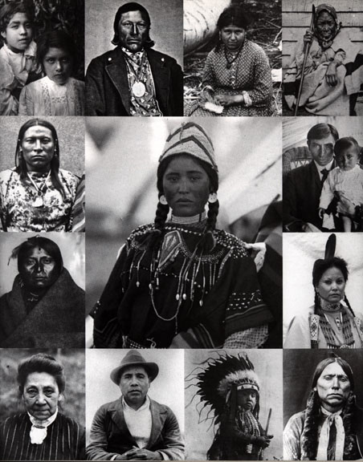
Native American Groups

Slide 5
Navajo

Slide 6
Navajo

Slide 7
Cherokee

Slide 8
Cherokee

Slide 9
Sioux

Slide 10
Sioux

Slide 11
Chippewa

Slide 12
Chippewa

Slide 13
Choctaw

Slide 14
Choctaw

Slide 15
Apache

Slide 16
Apache

Slide 17
Pueblo

Slide 18
Pueblo

Slide 19
Iroquois

Slide 20
Iroquois

Slide 21
Creek

Slide 22
Creek

Slide 23
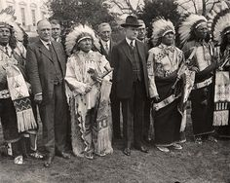
Native American and U.S. Government
US Constitution recognizes tribal nations as “domestic dependent nations”. This means that the states and federal government may pass laws that affect Native Americans (even on Reservations). This was re-enforced with the Supreme Court decision Cherokee Nation v. Georgia.
“The Marshall Trilogy” is three Supreme Court Cases that define the legal and political standing of Indian nations. They are:
Johnson v. M'Intosh (1823), holding that private citizens could not purchase lands from Native Americans.
Cherokee Nation v. Georgia (1831), holding that the Cherokee nation dependent, with a relationship to the United States like that of a "ward to its guardian."
Worcester v. Georgia (1832), which laid out the relationship between tribes and the state and federal governments, stating that the federal government was the sole authority to deal with Indian nations.
Indian Removal Act of 1830 began to forced exodus of Native populations away from European-populated areas. AKA Trail of Tears

Slide 24
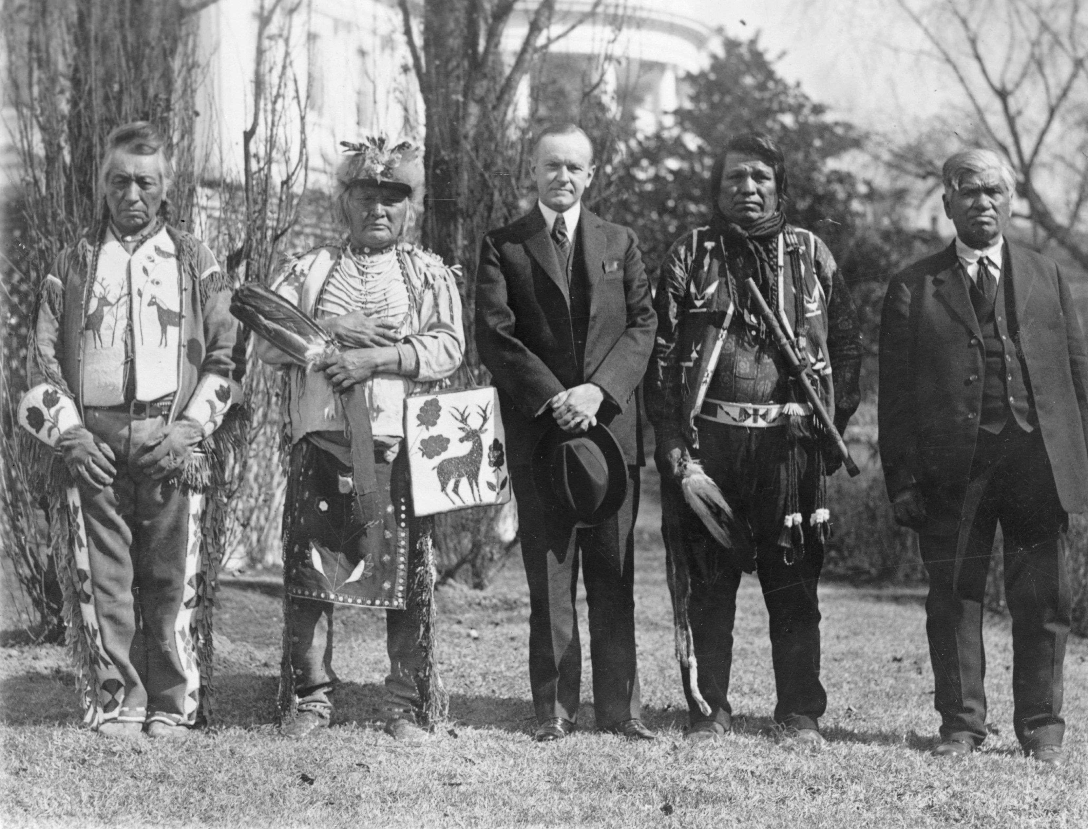
Native American and U.S. Government
Indian Appropriations Act of 1871 ended the US’s recognition of additional Native American tribes and prohibited additional treaties with Native groups (not seen as foreign or independent). This Act also expanded federal law into Indian Territory (Reservation).
US policies of forced assimilation started in 1868 and went to 1887. The policies allowed government officials of the Indian Service agency to be replaced by civilian/religious personal in an attempt to “Americanize” and “Christianize” Native Americans
The Dawes Act of 1887 allowed the government to divide up reservations into individual portions. Those who participated in the program would also gain US citizenship. “Excess” land could be sold to the general public.
Indian Reorganization Act of 1934 (Howard-Wheeler Act, Indian New Deal) identified new rights of Native Americans, allowed for common holdings of land, and tribal land management. The US government also began to invest in improving infrastructure, health care, and education of Native Americans

Slide 25
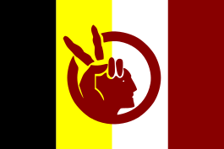
Native American Activism
American Indian Movement (AIM) is an American Indian advocacy group that started up in 1968. Its initial focus was on American Indian sovereignty, treaty issues, spirituality, and leadership. It has also organized itself against the harassment and racism of Native Americans.
General acts of defiance, protest, or activism:
1969 occupation of Alcatraz
1970 occupation of Mount Rushmore
1970 “National Day of Mourning” at Plymouth Rock
1972 Trail of Broken Treaties Caravan that occupied the Bureau of Indian Affairs in DC
1973 occupation of Wounded Knee
1978 the Longest Walk begins – San Francisco to DC to bring attention to issues
1992 National Coalition of Racism in Sports and Media forms

Slide 26
key Native American individuals

Slide 45
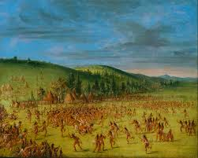
DID YOU KNOW THAT MANY OF THE GAMES YOU PLAY TODAY CAME FROM NATIVE AMERICANS?
Canoeing, snowshoeing, tobogganing, lacrosse, relay races, tug-of-wars
DID YOU KNOW THAT MANY WORDS WE USE EVERY DAY CAME FROM NATIVE AMERICANS?
Some of these include: barbecue, caribou, chipmunk, woodchuck, hammock, toboggan, skunk, mahogany, hurricane, and moccasin. Many towns, cities and rivers have names of Native American origin. Just a few of these include: Seattle, Spokane, Texas, Dakota, Nebraska, Milwaukee, Ottawa, Miami, Wichita, Wisconsin, and many others

Slide 46
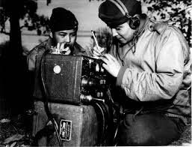
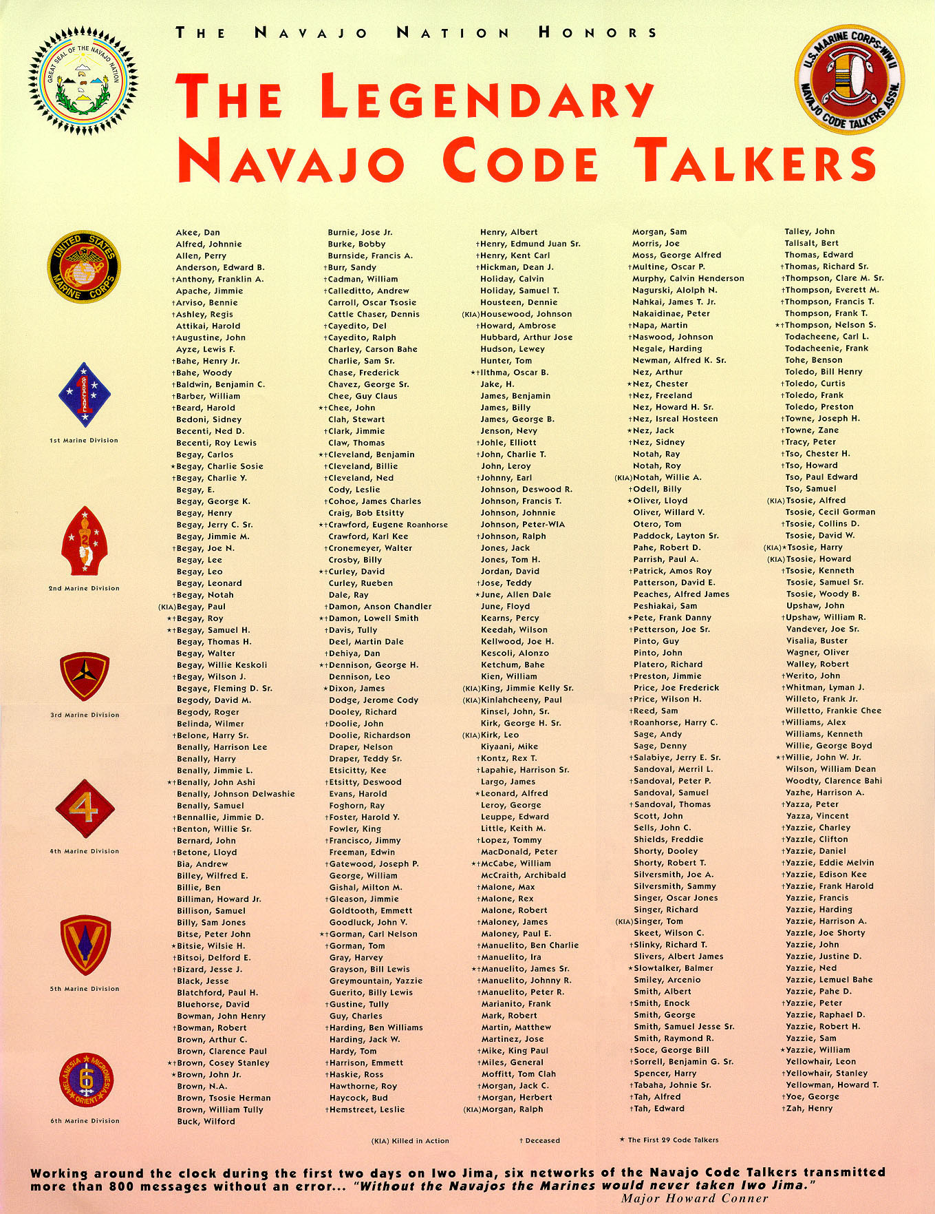
DID YOU KNOW THAT MANY NATIVE AMERICANS SERVED DURING WORLD WAR I, WORLD WAR II AND OTHER CAMPAIGNS?
Even though many of them were not even citizens, more than 8,000 Native Americans volunteered and served during World War I. Well over 24,000 served during World War II. One of the most notable contributions during World War II was the service of the Navajo Code Talkers, a special group of volunteers who did top-secret work using a secret code in Navajo that could not be broken.

