Slide 1
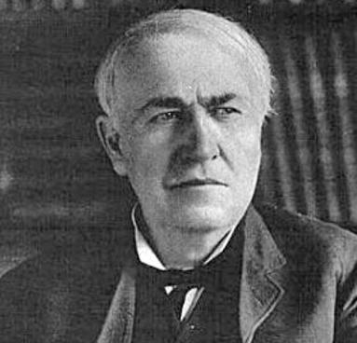
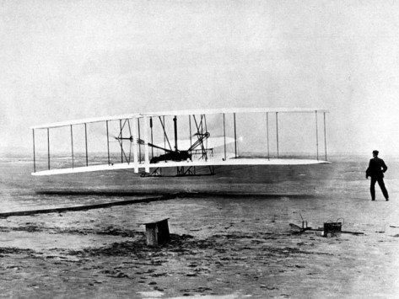
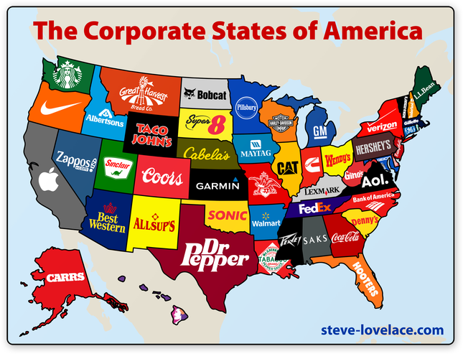
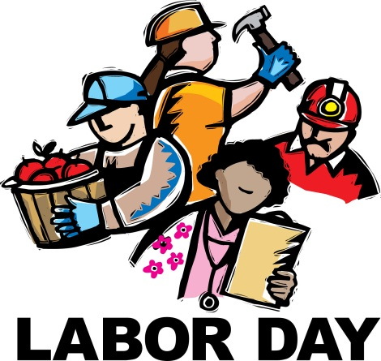
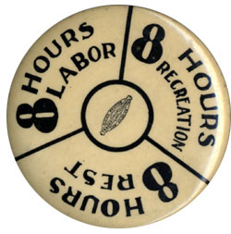
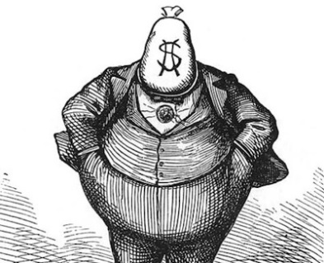
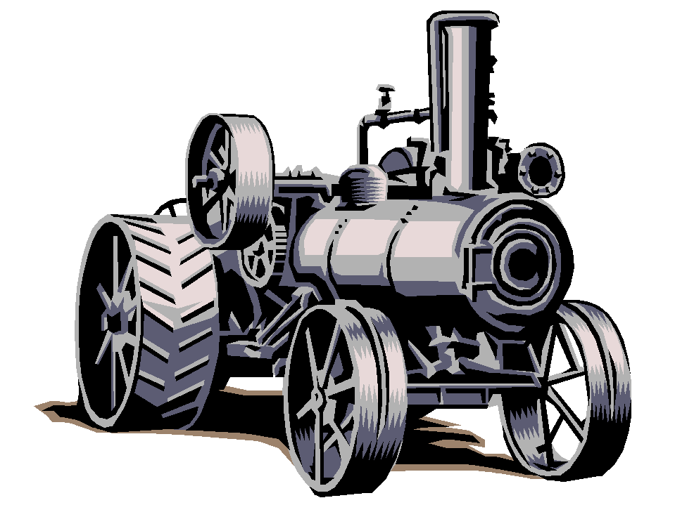
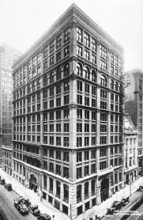
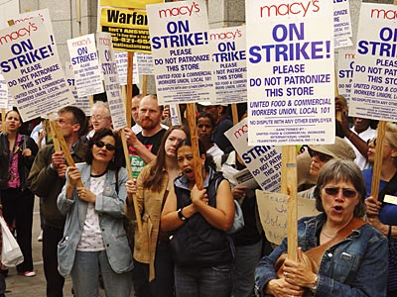
Industrialization
and the
“Gilded Age”
STAAR Review 2

Slide 2
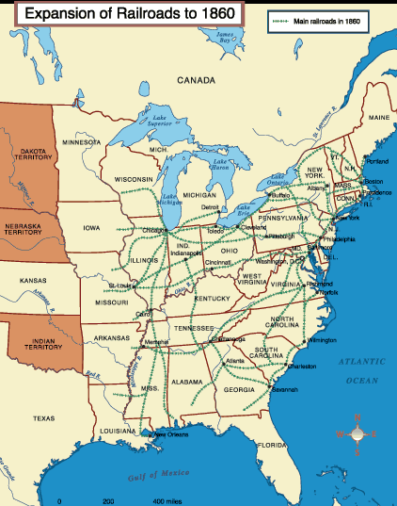
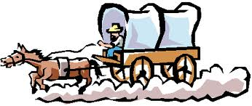
The Growth of Railroads
Before the Civil War, most of the railroad track in America had been built in the Eastern USA, especially in the Northeast.
Gold was discovered in the West and people slowly began migrating westward.
Travel was slow and difficult.
There was a desire to build a transcontinental railway that connected the East coast with the riches of California and the West.
But what route would it take?

Slide 3
The Transcontinental Railroad
Railroads would have a significant impact on the economic, cultural, and social development of the Western United States
Opinions differed as to which route to take.
Should it go through the North or along a southern route?
The resulting Civil War caused the Transcontinental Railroad to be built along a northern route from Omaha, Nebraska to Sacramento, California.
Travel time would decrease from months to a few days.

Slide 4
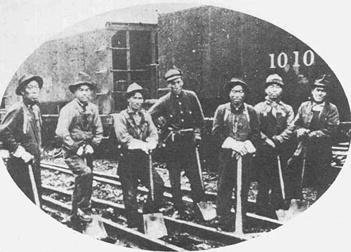
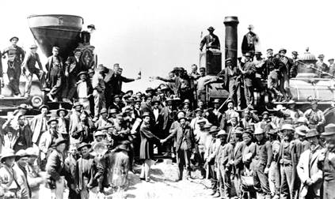
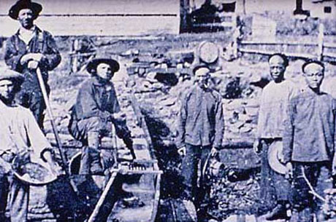
Building the Transcontinental Railroad
Civil War vets, Irish laborers, and free blacks started working westward from Omaha.
Chinese workers started eastward from Sacramento.
They met at Promontory Point, Utah.

Slide 5
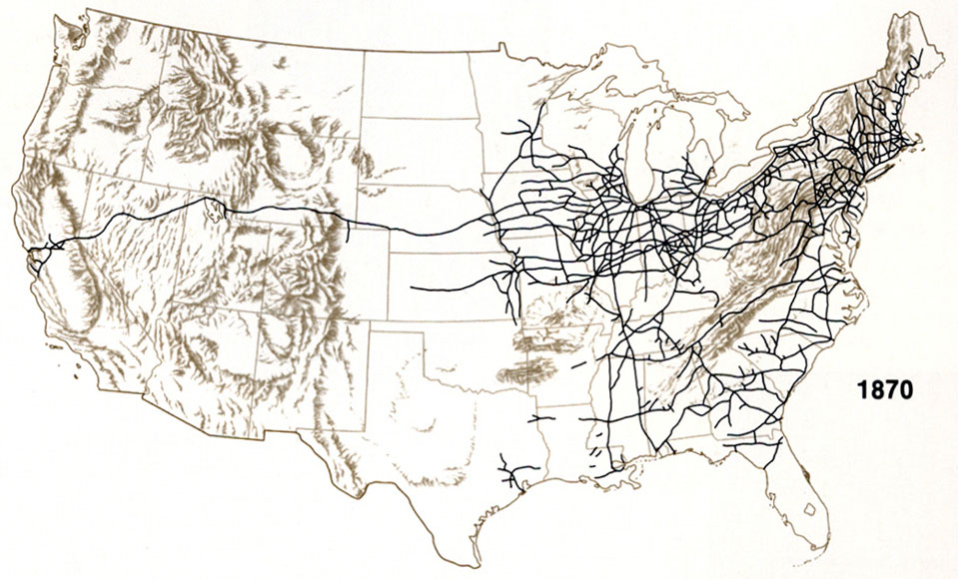
Transcontinental Railroad

Slide 6
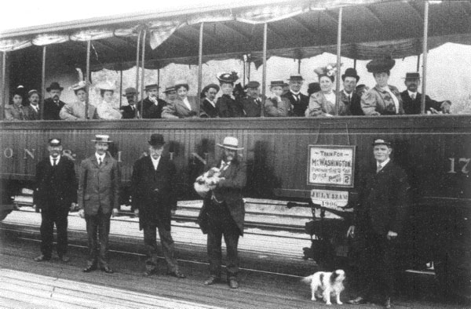
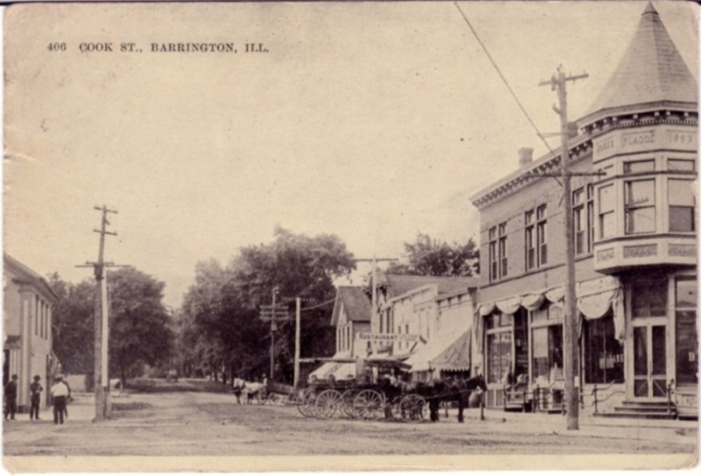
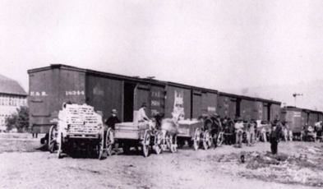
The Impact of the Railroads
The Transcontinental Railroad connected the different regions of the United States and Railroads became the lifeline to the West.
Trains brought the settlers and everything they needed to the West as towns sprang up.
Trains returned to the East with the products the West produced, beef, wheat, lumber, and gold.
Trains would also create a need for more natural resources, like coal, lumber and oil.

Slide 7
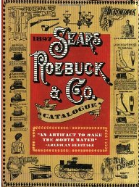
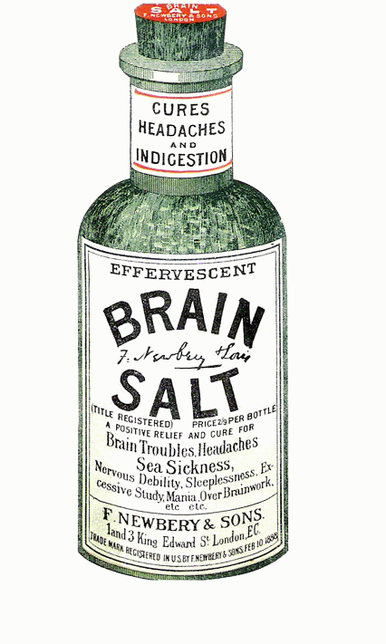
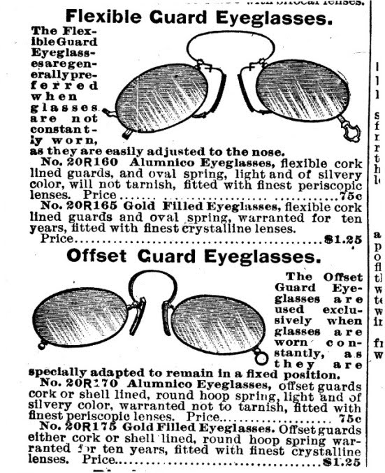
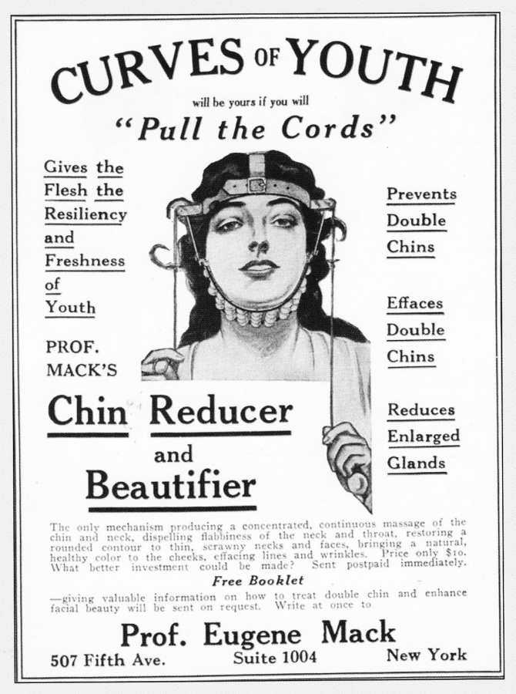
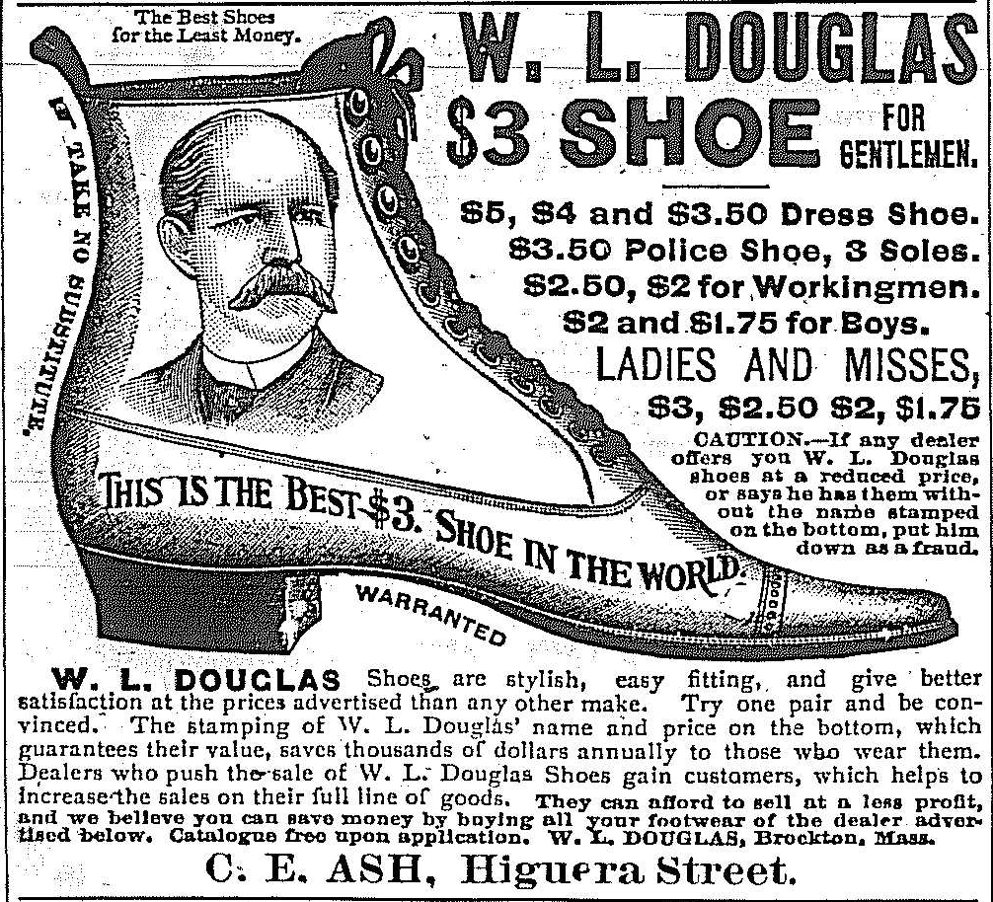
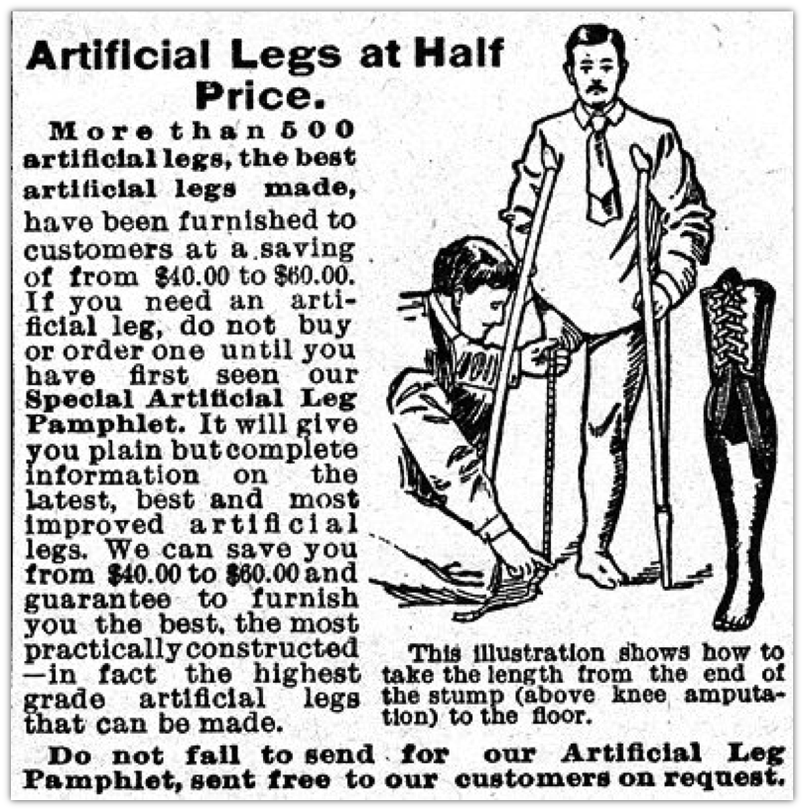
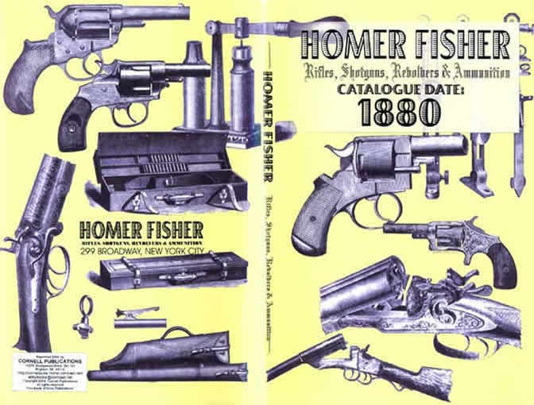
Development of a National Market
A new truly national market began to emerge as railroads, canals, the telegraph and telephone linked the country together.
National producers could ship their goods cheaper and would dominate sales in the West.
New methods of marketing and advertising gave manufacturers ability to expand across the nation.
Catalogs became “wish lists”
and when a new catalog came the old one served another purpose…

Slide 8
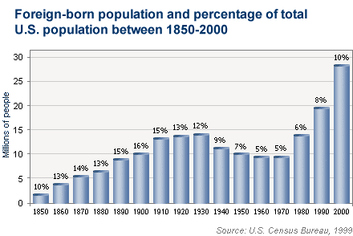
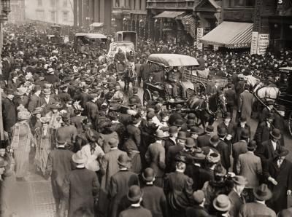
Impact of Population Growth
The USA experienced a rapid population growth, as the population jumped from over 2 million to 76 million in just 50 years, cities were crowded .
A high birth rate and a constant stream of immigrants created a rising demand for goods and the growing population was a steady supply of cheap labor.
This population growth favored business expansion.

Slide 9
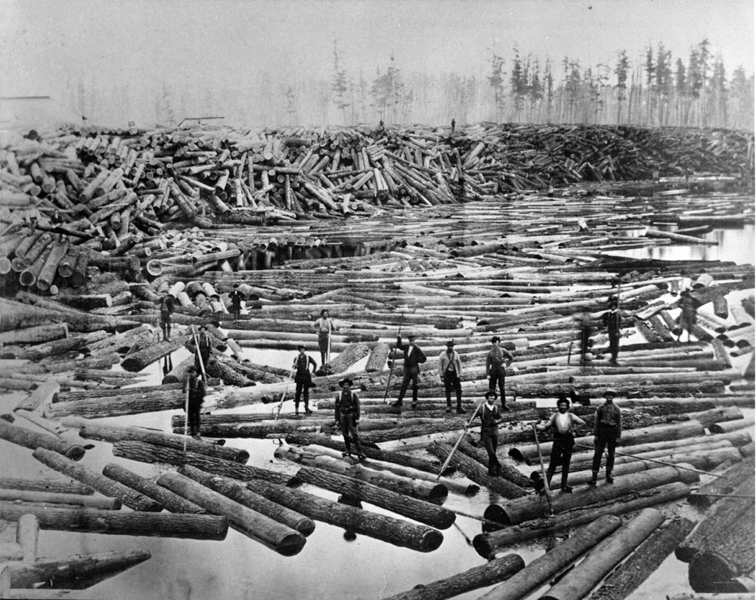
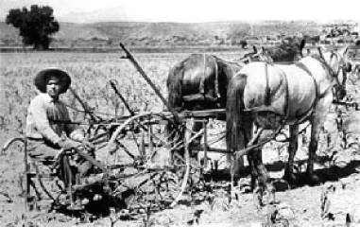
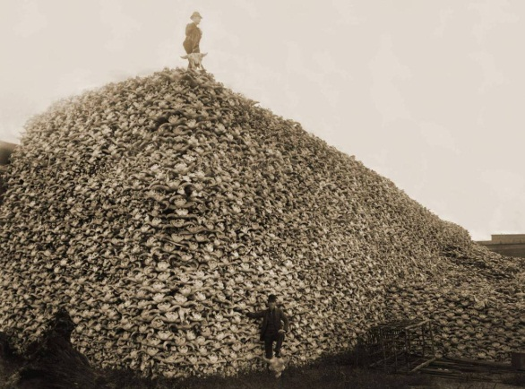
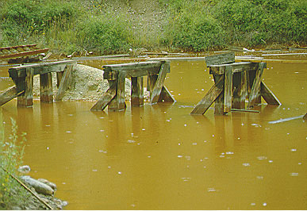
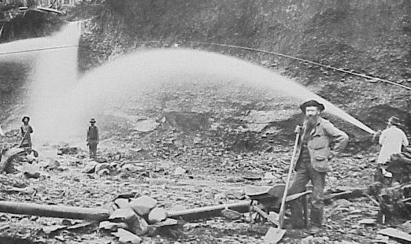
Impact of Population Growth
Lumbering depleted the forests.
Sodbusters would plow the Great Plains to plant crops.
Mining for gold and other precious minerals destroyed the land.
The Railroads and buffalo hunters would soon wipe out the buffalo.
Rivers and lakes would be polluted.

Slide 10
Growth of Cities Brings Problems
Did you here Joe coughing all night?
Boy this water sure smells funny
Look out below !
The toilet doesn’t flush again !
Wish we could afford to move
Billy Bob you shouldn’t smoke in bed
If they don’t shut up I’m going to kick their &#@!
Something sure stinks

Slide 11
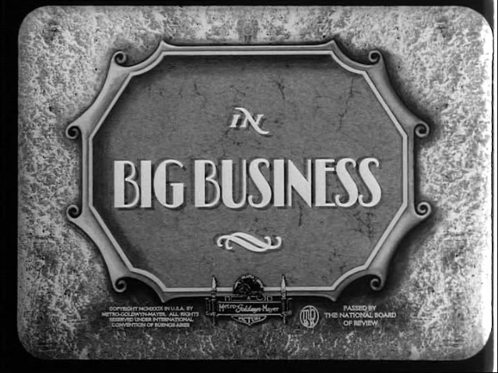
New Types of Business Organization
Before the Civil War, most businesses were owned by individuals or by a groups of partners.
After the war, corporations became more common.
A corporation is a company chartered by the state and recognized as a separate ‘person’.
Bam! BIG Business was born.

Slide 12
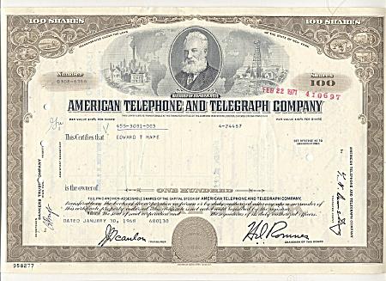
Corporations
Corporations issue and sell ‘stock’ or shares of a company.
A shareholder is a partial owner, and they receive a share of a corporations profits based on the amount of stock they own.
Shareholders were responsible only for the shares they own, not for losses and are protected from lawsuits.
Corporations allowed for people to pool their money to raise the huge sums needed to build railroads, factories, steel mill, etc.
Corporations made modern industrial production possible

Slide 13
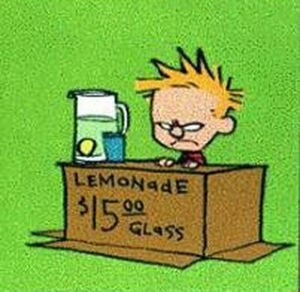
The Free Enterprise System
The Success of America’s industrialization was based on its free enterprise system.
Free Enterprise System is when people have the freedom to make their own choices in what to buy, where to work, and what to make.
People are free to use their money and time to start a business in hopes of making a profit. (Producers)
People are free to choose the type of product they wish to buy and how much they’ll pay. (Consumers)

Slide 14
The Free Enterprise System
People have unlimited wants but we have limited resources to satisfy these wants.
Businesses use their resources to compete with each other to satisfy these consumer desires.
Every society must answer three basic economic questions to determine how to use its resources to satisfy these wants.
What Should Be Produced ?
How Should It Be Produced ?
Who Should Get It ?

Slide 15
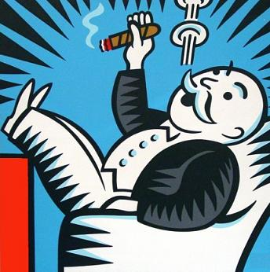
Entrepreneurs
An Entrepreneur is a person that invests their time, money, and skills on the chance of making a profit.
In the 1870s these entrepreneurs dominated America’s economic life.
Efficient large-scale production allowed them to sell goods at lower prices and Competition forced them to continually improve the quality.
Many of these entrepreneurs created monopolies and made huge fortunes.

Slide 16
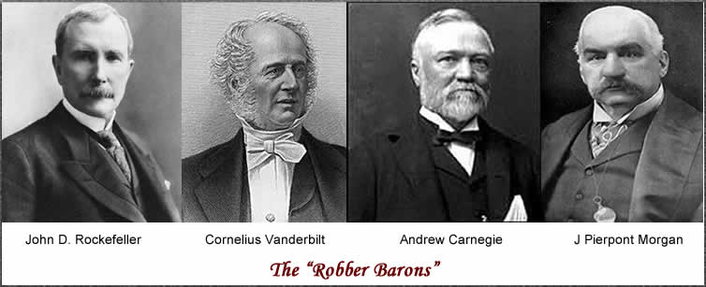
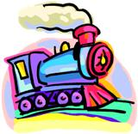
Captains of Industry
Many of the more successful entrepreneurs became known as ‘Captains of Industry’.
Some called them ‘robber barons’ because of the ruthless tactics they used to destroy their competition and methods used to keep workers wages low.
Some of the best known were:

Slide 17
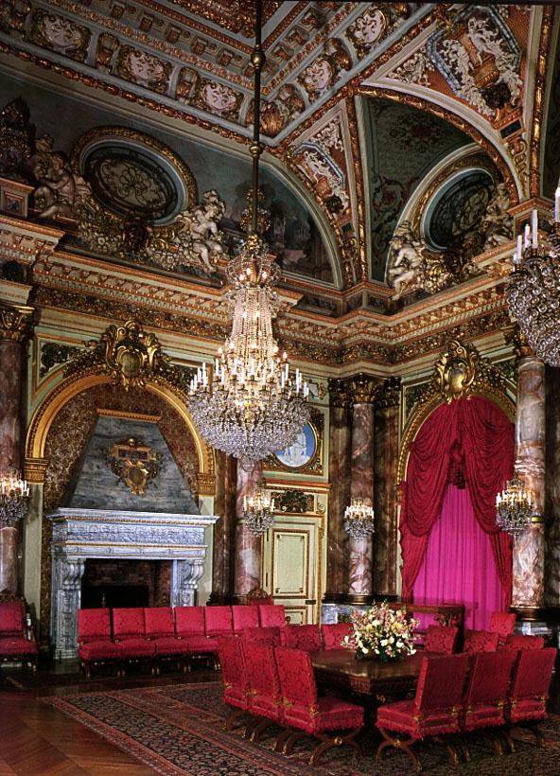
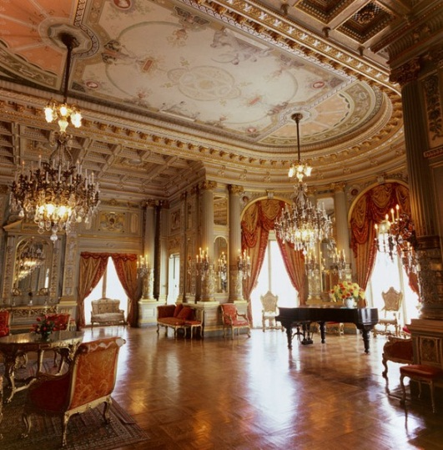
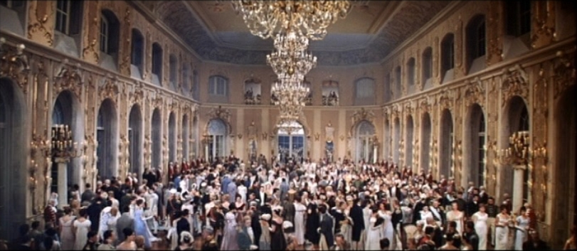
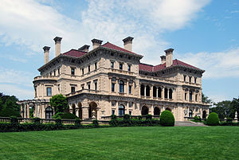
The Gilded Age
The time when these Captains of Industry ruled America became known as the Gilded Age.
They amassed fabulous wealth and lavishly spent it while the majority of Americans were poor.
These ‘robber barons’ were glorified and vilified.
Some became the richest men in the world.

Slide 18
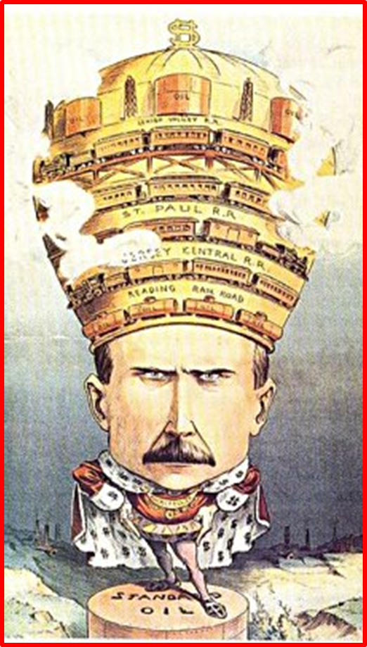
Political Cartoons on Robber Barons
Robber Barons were accused of
being just plain greedy
unfair business practices,
being above the law,
abusing labor with low wages and long hours,
having too much, influence on government,
simply not caring about the American public,

Slide 19
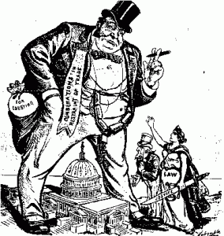
Above the Law

Slide 20
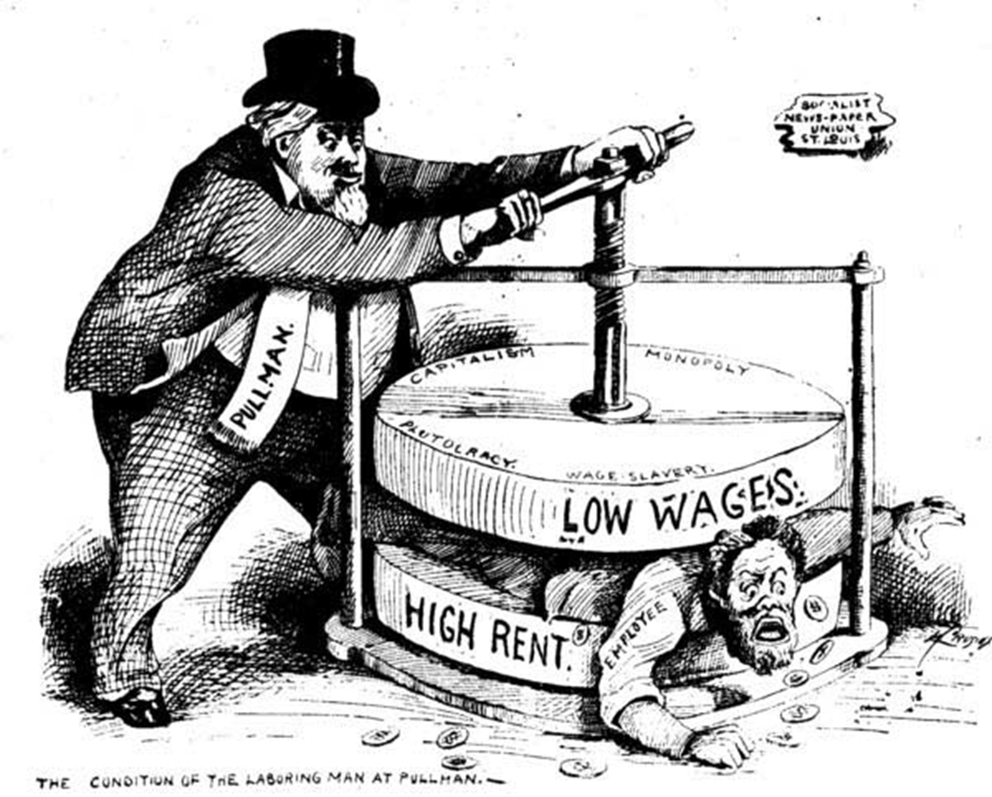
abusing labor with low wages and long hours

Slide 21
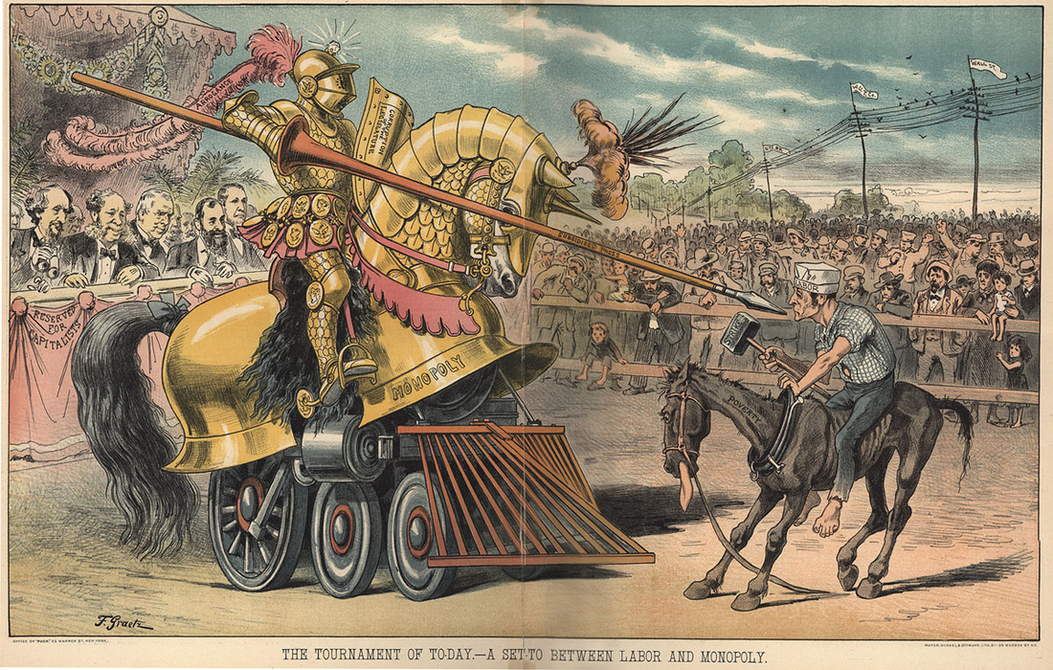
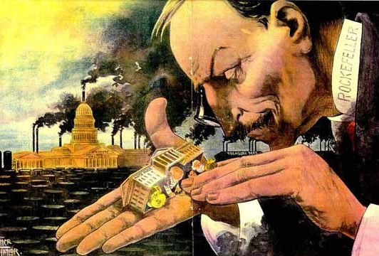
Simply not caring about the American public,
having too much, influence on government,

Slide 22
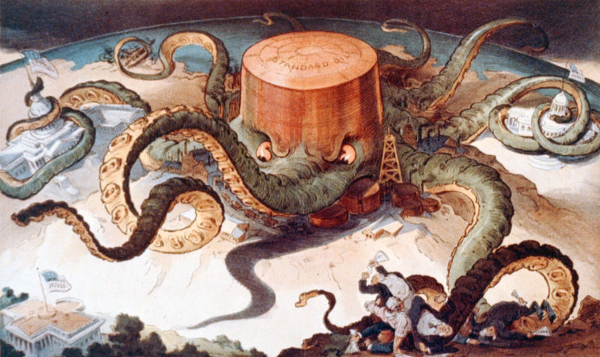
being just plain greedy

