Slide 1
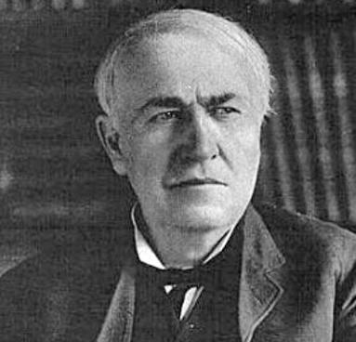
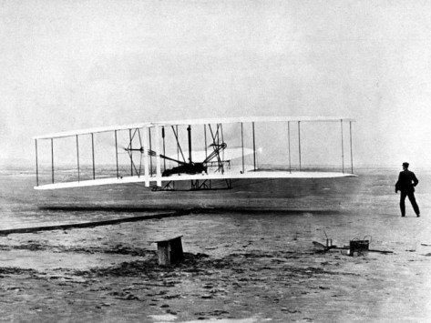
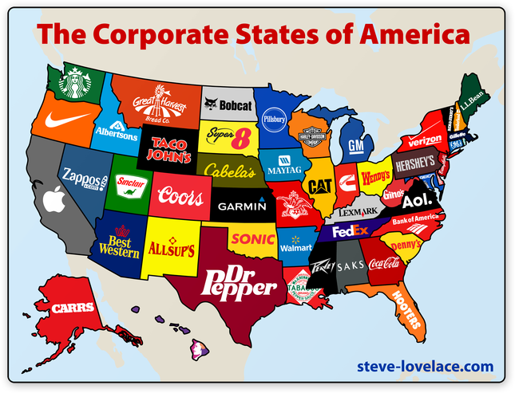
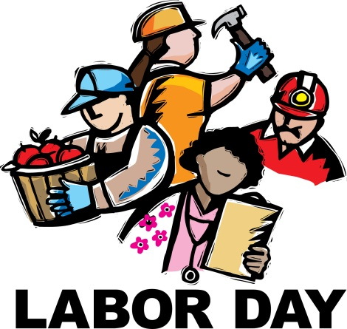
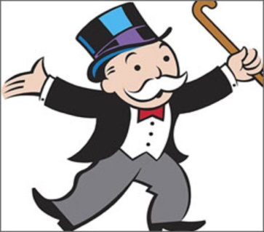
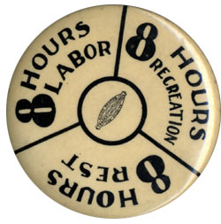
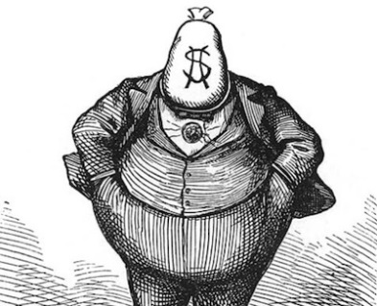
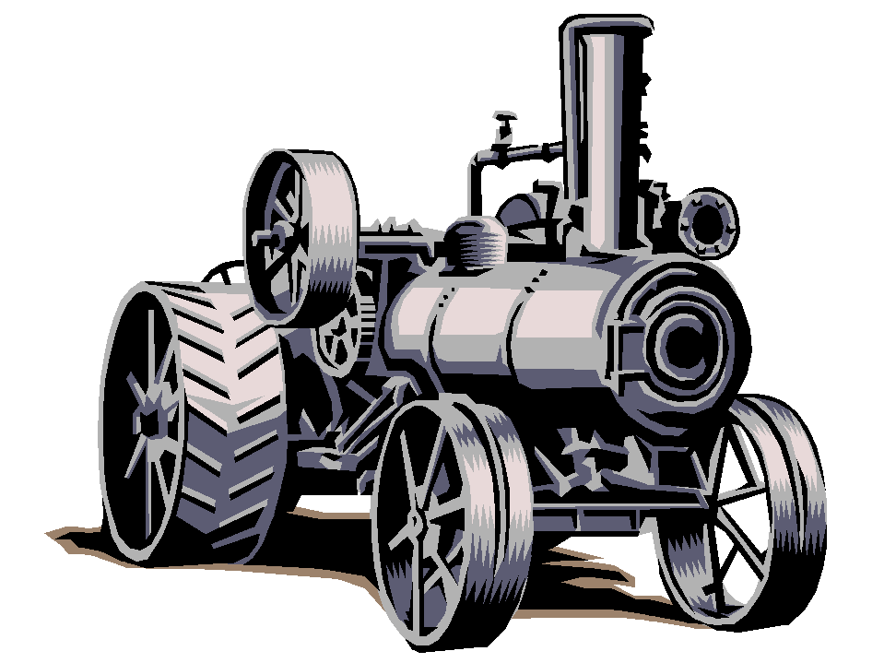
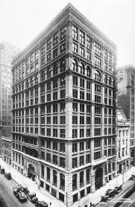
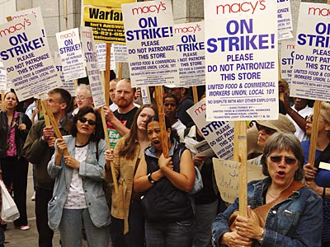
Industrialization
and the
“Gilded Age”
STAAR Review 2

Slide 2
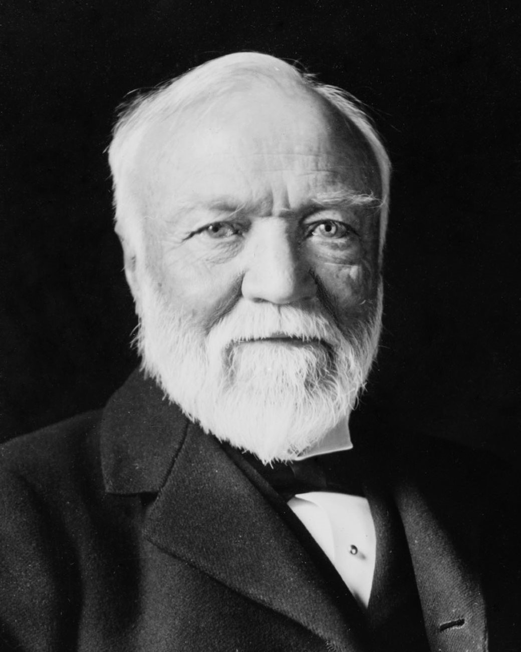
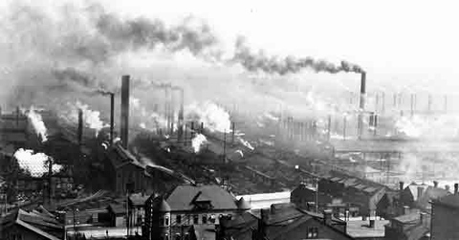
Andrew Carnegie
Carnegie started penniless, but he made his fortune in steel mills in the Pittsburgh, PA area.
He used vertical integration to undercut the competition.
He bought his own iron ore fields, coal mines and ships so he could control all phases of steel production.
He crushed attempts to form labor unions, paid low wages, and forced laborers to work 12 hour days.
The labor strike on Carnegie’s Homestead Steel Mill would be one of the eras most violent.

Slide 3
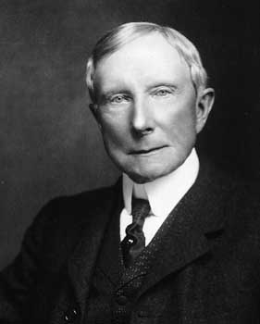
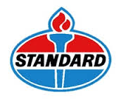
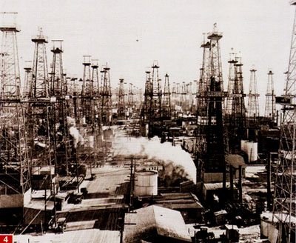
John D. Rockefeller
Rockefeller started out poor, but made his fortune in oil in Ohio.
Kerosene, for lighting, made him millions, later the gasoline industry, would make him even richer.
Rockefeller used horizontal integration and ruthless tactics to drive his competition out of business, then he would buy them out.
His Standard Oil Co. became a trust, with him owning most of the shares.
Later it would be a monopoly as he controlled 90% of all oil refined.

Slide 4
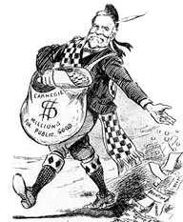
Philanthropy
Carnegie and Rockefeller both made millions at the expense of American pubic.
They paid low wages and demanded long hours of work.
As businessmen they didn’t believe in charity, their belief was;
‘help those who help themselves’
Later, both would lead the rich in philanthropy, they gave away millions of their dollars to the public.
They built libraries', museums, scholarships, and universities.
Here’s
a dime

Slide 5
Pros and Cons of Big Business
Large business is more efficient which leads to lower prices.
Hire large numbers of workers.
Produce goods in large quantities.
Have the resources for expensive research and to invent new items.
Unfair competitive advantage.
Often exploited workers.
Often unconcerned about pollution they may cause.
Have an unfair influence on government rules that affect them.

Slide 6
Laws Against Big Business
At first, the government did little to regulate big business.
Government and business leaders believed in laissez-faire
– the theory that government should not interfere in the operations of the free market.
Government did have some involvement in business, such as patent laws, enforcing contracts, laws protecting property, and tariffs to help American manufacturers.
Some of the anti-competitive practices of big business soon became so oblivious that reformers started calling for government intervention to remedy the problems.

Slide 7
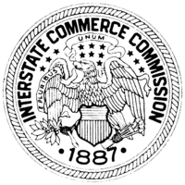
Laws Against Anti-Competitive Practices
Interstate Commerce Act (1887)
Railroads often charged small farmers more to ship goods than they did large companies.
States passed laws to stop this, but the Supreme Court ruled these laws were unconstitutional.
Congress finally passed the Interstate Commerce Act that prohibited unfair practices by the railroads.
The Interstate Commerce Commission was created to enforce these laws.
First time Congress had regulated big business.

Slide 8
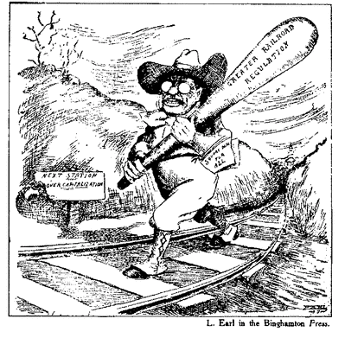
Teddy Roosevelt is carrying a club saying “Greater Railroad Regulation”.
Roosevelt felt there were ‘good’ trusts (those that didn’t harm the publics interests) and ‘bad’ trusts (those that created monopolies) and it was the governments responsibility to stop the bad trusts.
TR became known as the ‘Trust-busting’ president.

Slide 9
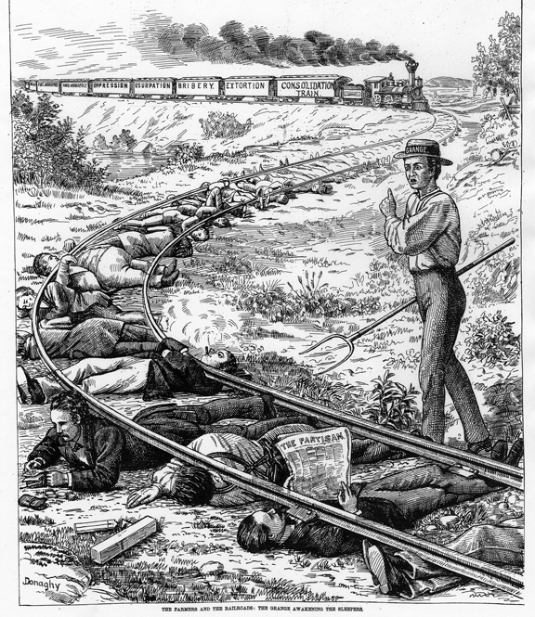
The railroad trains are labeled with words like : ‘bribery’, extortion, and lack of competition’.
This was to show that the railroads took advantage of the average American, particularly the small farmers.

Slide 10
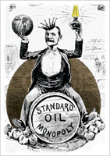
Laws Against Anti-Competitive Practices
Sherman Anti-Trust Act (1890)
Federal law aimed at stopping monopolies and trusts from engaging in unfair practices.
Attempted to prevent unfair competitive advantages.
Act marked a significant change in the attitude of government about the abuses of big business.
Standard Oil was the 1st monopoly the government attempted to stop.

Slide 12
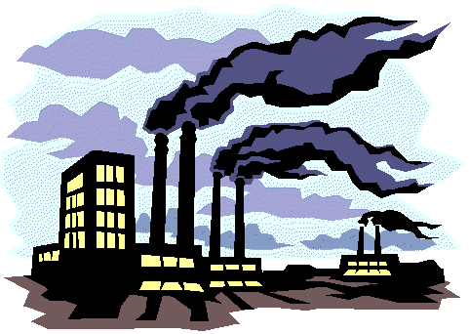
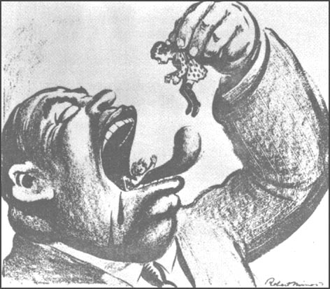
The Conditions of Labor
As America continued on it astonishing economic growth there was increasing exploitation of industrial workers.
The average workday was long by today’s standards;
10-14 hours a day
6 days a week
Wages ranged from $3 to $12 a week.
Women and children were paid less.
Conditions were dangerous.
Diseases often spread through the workplace.

Slide 13
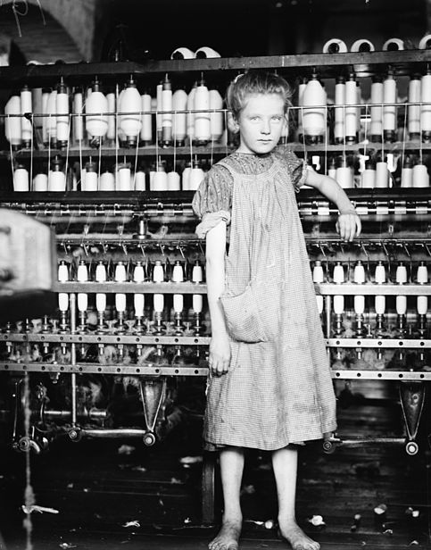
Factory Working Conditions
As factory owners grew richer, the conditions for the new working class worsened dramatically.
Early factories were appalling, unsafe places to work with no safeguards for workers.
Jobs were repetitive, boring, and monotonous.

Slide 14
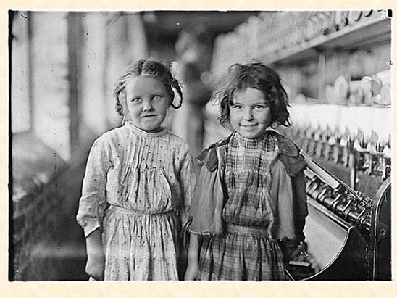
My name is Lil’ Cassie and I’m not a gansta
Hi, my name is Sally and I’m 8 years old
We work in a sweatshop for almost nothing
These are some images of what it was like to work in a factory
Factory Working Conditions

Slide 15
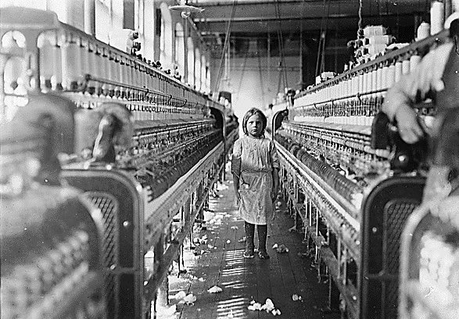
Managers like to hire children, they are cheaper to pay and argue much less

Slide 16
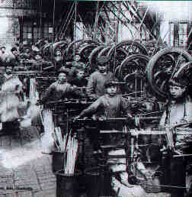
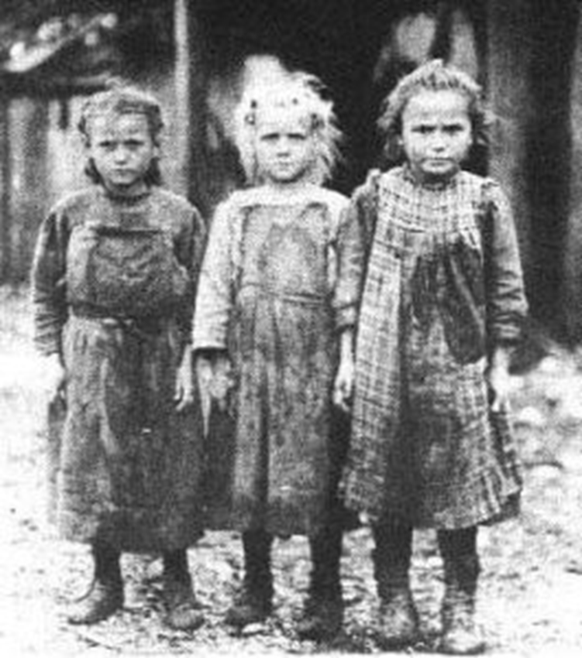
Child Labor

Slide 17
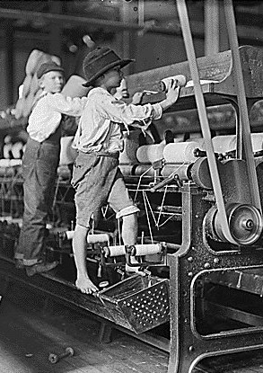
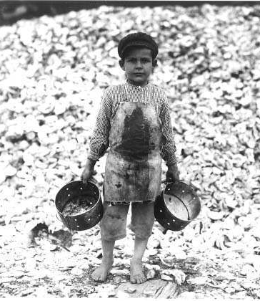
Child Labor

Slide 18
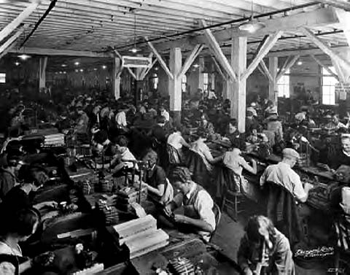
Boring, monotonous jobs as in this sweat factory were common….

Slide 19
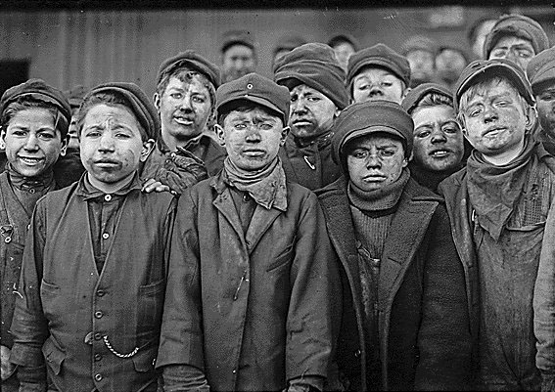
Jobs were dangerous, as these young boys who labor in a coal mine will tell you…

Slide 20
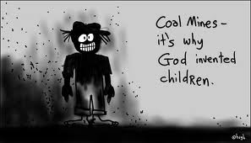

Slide 21
The Rise of Unions
As big business grew, workers lost all bargaining power with their employers.
Most work was unskilled and workers could easily be replaced.
Some worker began to form unions in order to act as a group, not as individuals.
Unions organized strikes and other forms of protest to get better working conditions.
Some owners refused to allow unions and would close a factory rather than negotiate with the unions.

Slide 22
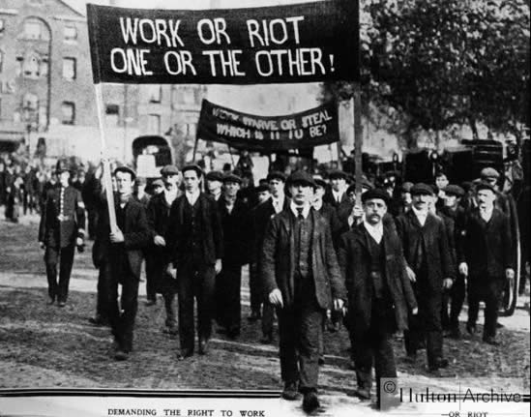

Slide 23
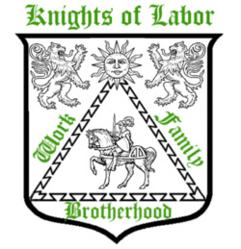
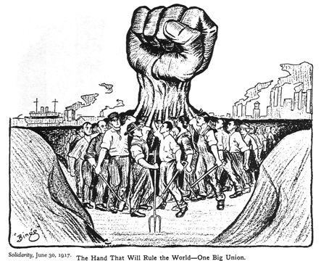
Major Unions
Knights of Labor created a single national union by joining together skilled and unskilled workers.
They supported equal pay for women and opposed child labor.
They also opposed immigration, as they saw immigrants as competition for their jobs.
But, skilled workers resented being in the same union as unskilled labor and the Union soon fell apart.

Slide 24
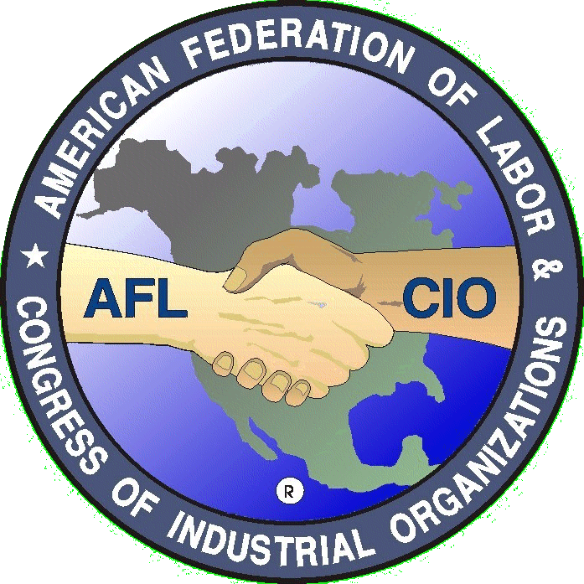
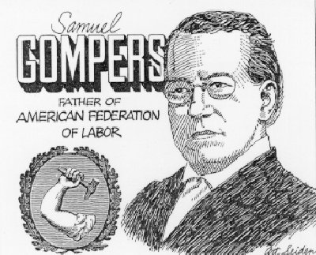
Major Unions
American Federation of Labor founded by Samuel Gompers hoped to create a union that united workers with similar economic interests.
The AFL consisted of separate unions made up of skilled labor.
Gompers wanted a closed shop, where workers had to join the union in order to work.
But the AFL failed because it excluded non-skilled workers.

Slide 25
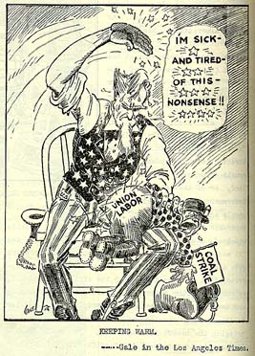
Government Attitude Towards Unions
Government leaders were critical towards unions, they favored business over labor.
More than 20,000 strikes occurred between 1880 and 1900, some were violent.
Government officials feared union strikes would have a negative impact on the USA’s economy.

Slide 26
Union Strikes and the Public
Public opinion also favored the idea of laissez-faire policies, of little government involvement.
Most believed that businesses had the right to hire and fire whoever they wanted.
They feared unions would lead to higher prices.
The Haymarket Affair of 1886 emphasized the violence that had become associated with union strikes.
Other infamous strikes included:
Pullman Strike
Homestead Steel Strike

Slide 27
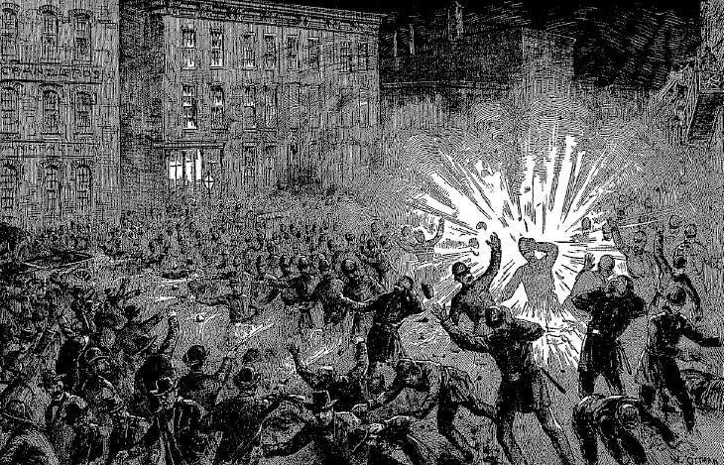
Strikes like the ‘Haymarket Affair were often associated with violence

Slide 28
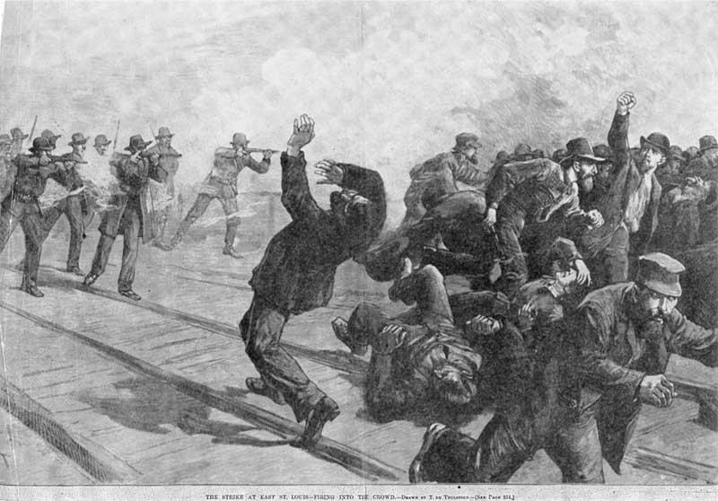
Owners and managers would hire private security to harass or injure workers that had gone on strike….
As in the case of the Homestead Steel Strike

Slide 29
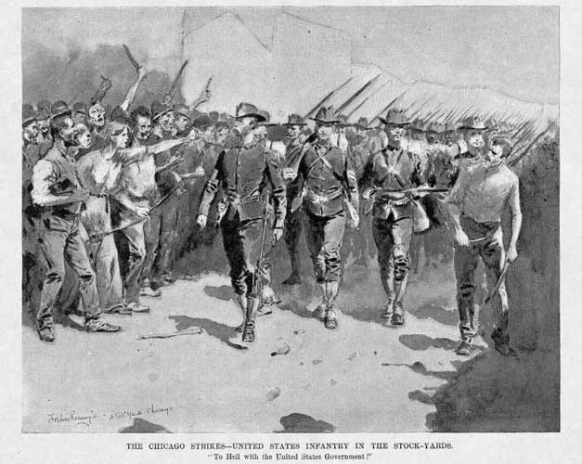
When things became to violent, the government would send in the military to take control of the situation

Slide 30
Free Enterprise System
Individuals are free to produce and sell whatever they chose to.
People go into business to make a profit.
Prices are set by supply and demand.
Inefficient companies that are unable to compete are driven out of business.
Government has a limited involvement in :
protection of property and contracts,
passing protective tariffs,
establishing a system of patents.

Slide 31
Growth of America’s Industry
The Transcontinental Railroad and other railways improved travel and trade.
The USA’s population exploded.
Development of a national market.
Technological Progress:
Bessemer Process in steel production
Electricity opened new industries
Oil industry boomed
Development of corporations to raise money and limit liability

Slide 32
Entrepreneurs
“Robber Barons” or “Captains of Industry”?
Robber barons used ruthless tactics to destroy competition and keep workers wages low.
Andrew Carnegie –
Dominated steel industry by owning iron ore fields, coal mines, and steel mills.
Became a philanthropist, gave away millions.
John D. Rockefeller –
Monopolized oil industry until Sherman Act.

Slide 33
Organized Labor
Problems of Workers:
Long hours, low pay, dangerous conditions.
Child labor and unequal pay for women.
Lack of job security.
Rise of Labor Unions:
Knights of Labor - Terrence Powderly
American Federation of Labor - Samuel Gompers.
Government attitude towards unions:
Anti-union bias, unions drove up cost of goods.
Violence associated with strikes, like Haymarket Riot brought negative attention to unions.

