Slide 1
Unit 12: 1980’s

Slide 2
Conservativism
Why?
Frustration on entitlement program spending
“over reaching” civil rights programs
School bussing
Affirmative action
New Right – opposed abortion, against the ERA, against school bussing, wanted to bring back school prayer
Conservative Coalition
Alliance of business leaders, middle-class voters, disaffected Democrats, and fundamental Christian groups
Goals – 1. shrink the size of the federal government
2. reduce government spending
3. stimulate business by reducing government regulations and lowering taxes
4. strengthen national defense
5. promote family values and patriotic ideals

Slide 3
The 1980 election: Carter vs. Reagan
Ronald Reagan vs. Jimmy Carter
Reagan –
movie star and spokesman
began as a New Deal Democrat but turned conservative Republican in the 1950’s
elected governor of California in 1966 and 1970
1980 – ran on the issues of Supreme Court decisions (abortion)
anti-pornography
against teaching evolution
for prayer in schools
Reagan was relaxed, charming, and likeable
Carter –
not effective president
Iranian hostage crisis
seemed stiff and nervous on TV

Slide 4
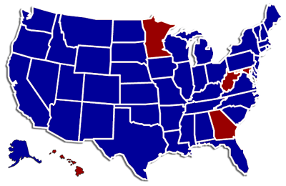
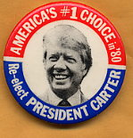
The 1980 election: Carter vs. Reagan

Slide 5
Ronald Reagan won

Slide 6
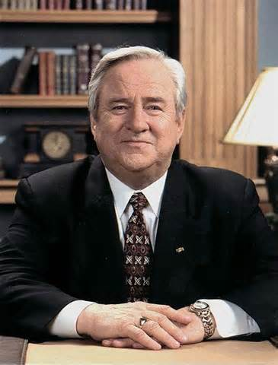
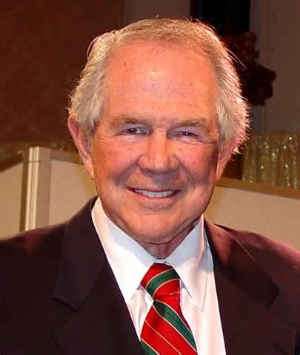
Religious Right – Moral Majority
Moral Majority formed by evangelicals Jerry Farwell and Pat Robertson
Believed in absolute wrong and right by the bible

Slide 7
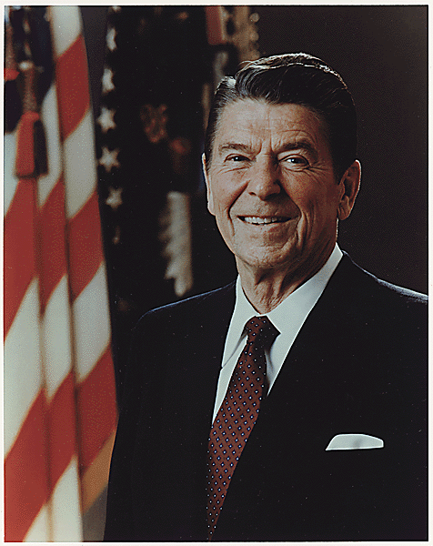
Ronald Reagan
Reaganomics or “trickle-down theory” of economics
Increased defense spending
Cut taxes
Reduced funding of social welfare programs
Tripled the debt
Iran-contra scandal
Helped end the Cold War

Slide 8
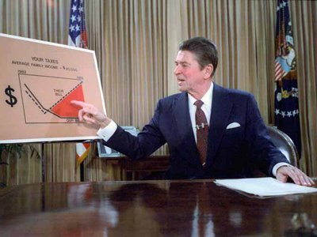
Supply-Side Economics (Reaganomics)
The Reagan administration advocated supply-side economics, arguing that tax cuts reduced government spending would increase investment by the private sector (more jobs, production, and prosperity)
Based on trickle-down theory, the idea is that with a lower tax burden and increased investment, business can produce (or supply) more, increasing employment and worker pay. (It did not work!)

Slide 9
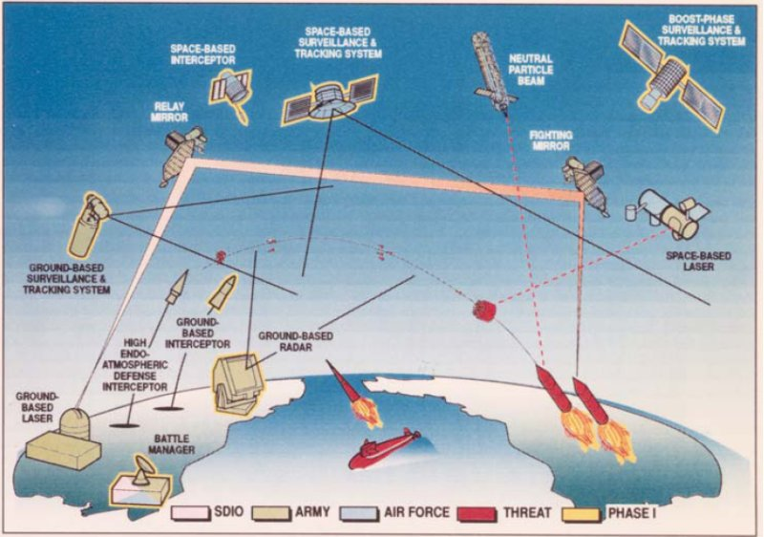
Space Shuttle Program and the Strategic Defense Initiative (SDI, Star Wars)
Space Shuttle Program lasted from 1972 – 2011
- 1st launch was Columbia in 1981
- goal was to create a less expensive form of space travel and revision of space travel and existence (space station, colonizing the moon and planets)
- disaster: Challenger exploded after liftoff on Jan. 28, 1986 and Columbia re-entry failure on Feb. 1, 2003
Strategic Defense Initiative
AKA – Star Wars
Proposed in 1983, it was a ground and space based system to protect the United States from missile attack.
Very ambitious but unrealistic and unscientific. Restarted the Cold War Arms race.

Slide 10
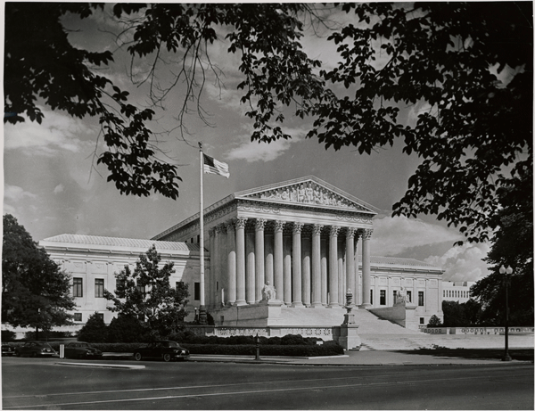
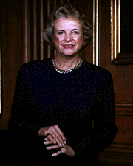
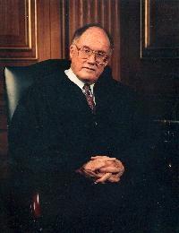
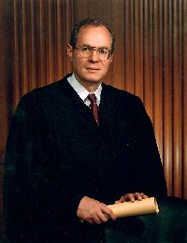
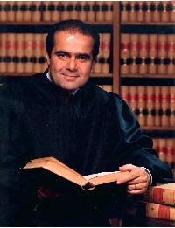
Reagan’s Supreme Court nominations
The first female Justice, Sandra Day O’Connor
September 25, 1981
William Rehnquist
Chief Justice,
September 26, 1986
Anthony Kennedy, February 18, 1988
Antonin Scalia September 26, 1986

Slide 11
Human Immuno-Deficiency Virus, HIV
Acquired Immune Deficiency Syndrome, AIDS
HIV is the virus that causes AIDS. Research suggested that HIV had "crossed over" into the human population from a particular species of chimpanzee, probably through blood contact that occurred during hunting and field dressing of the animals.
The virus has existed in the United States, Haiti and Africa since at least 1977-1978. In 1979, rare types of pneumonia, cancer and other illnesses were being reported by doctors in Los Angeles and New York. The common thread was that these conditions were not usually found in persons with healthy immune systems.
In 1982 the Centers for Disease Control and Prevention (CDC) officially named the condition AIDS (Acquired Immune Deficiency Syndrome). In 1984 the virus responsible for weakening the immune system was identified as HIV (Human Immunodeficiency Virus).
(Source: Centers for Disease Control - CDC)

Slide 12
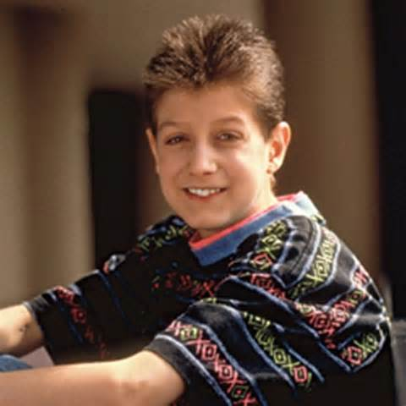
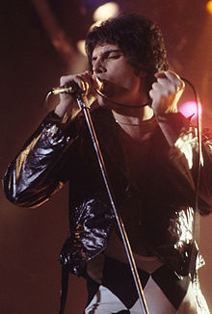
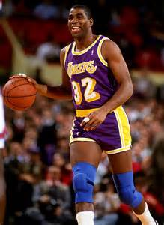
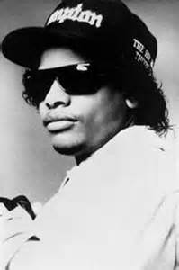
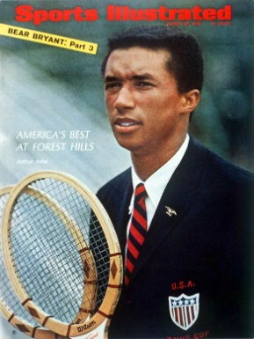
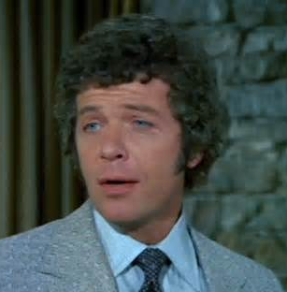
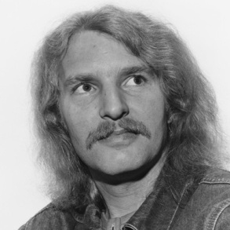
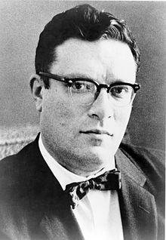
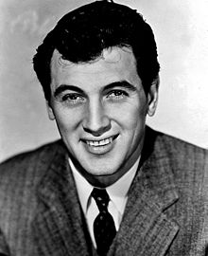
Human Immuno-Deficiency Virus, HIV
Acquired Immune Deficiency Syndrome, AIDS
Magic Johnson
LA Lakers
Freddy Mercury
Singer Queen
Eazy-E
Rapper NWA
Anthony Perkins
actor
Ryan White -Normal kid
Rock Hudson
actor
Arthur Ashe
Tennis Player
Robert Reed
actor
Tom Fogerty
Singer CCR
Isaac Asimov

Slide 13
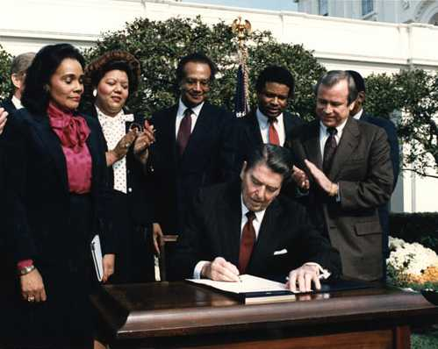
Martin Luther King, Jr. holiday was created in November, 1983 after 15 years of lobbying efforts. It was the first new federal holiday since Memorial Day was created in 1948.

Slide 14
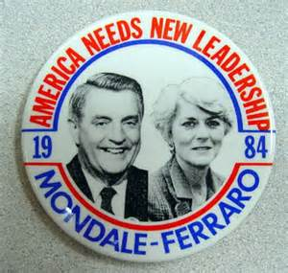
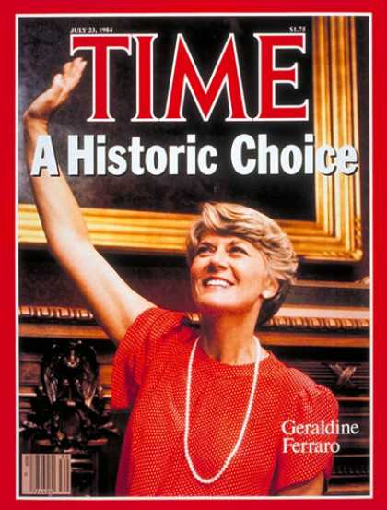
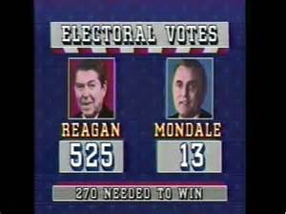
The Election of 1984
Democrats nominate Walter Mondale and Geraldine Ferraro in 1984.
Ferraro became the first women on a major party’s presidential ticket.
Reagan easily wins because of the strong and growing economy.
He also has the ability to attract non traditional Republican voters.
Reagan Democrats – Democrats that agreed on limiting the federal government and thought the Democratic Party had become too liberal

Slide 15
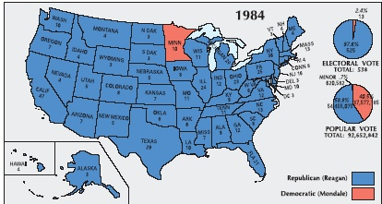
The Election of 1984
Ronald Reagan won in a landslide

Slide 16
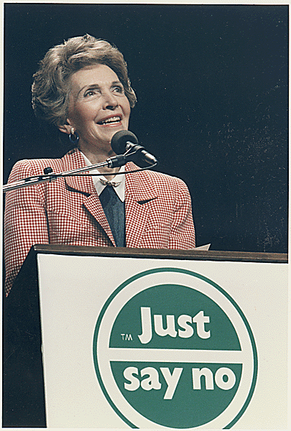
“War on Drugs”
President Nixon introduced the concept of a war against illegal drug use in the U.S. in 1971.
Reagan renewed the effort while president. He assigned Vice President Bush to a drug task force and First Lady Nancy Reagan toured the nation with her “Just say no” campaign.
In 1988 the Office of National Drug Control Policy was created as part of the Executive Office of the President.
The agency’s actions have centered around four areas: treatment, prevention, domestic law enforcement, and interdiction and international efforts.
Nancy Reagan

Slide 17
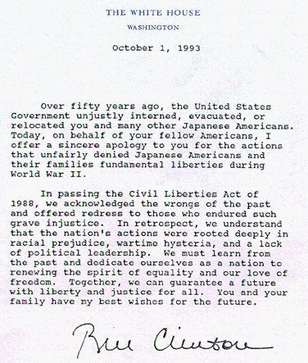
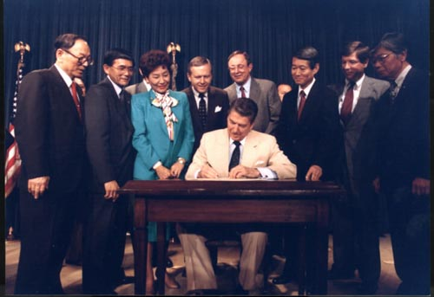
Congress approved a $20,000 reparation payment for each of the 60,000 Japanese surviving victims of the relocation centers in October of 1988.
President Reagan signed into law the Civil Liberties Act of 1988.
Apology letter sent with the checks.

Slide 18
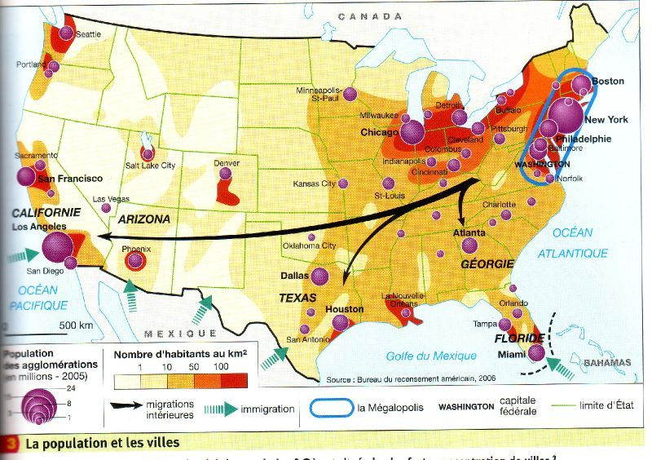
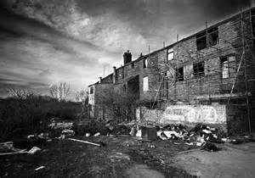
1980’s Migration and the Urban Crisis
Sunbelt, Rustbelt, Ecotopia
US population was moving out of the North Central and Northeast portions of the country, call the Rustbelt because of its aging factories
The South, Sunbelt, and the West, Ecotopia, gained population for the following reasons: highways opened the wide open west, dams and aquaducts brought water agriculture and the cities, air conditioning made the summers livable while the winters were not very harsh
Urban Crisis
Urban areas and there people (especially in the East) continued to deteriorate
Upper and Middle Class families (mainly white) continued to move to the suburbs leaving the poor and minorities in the cities.
These cities suffered from high unemployment, crumbling infrastructure, lack of a tax base to fund schools, sanitation, and health services

Slide 19
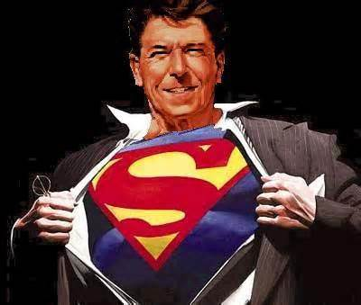
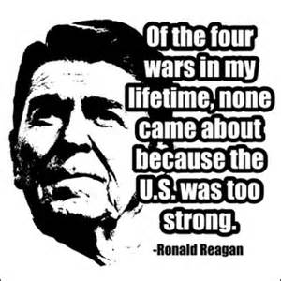
Reagan and The Cold War

Slide 20
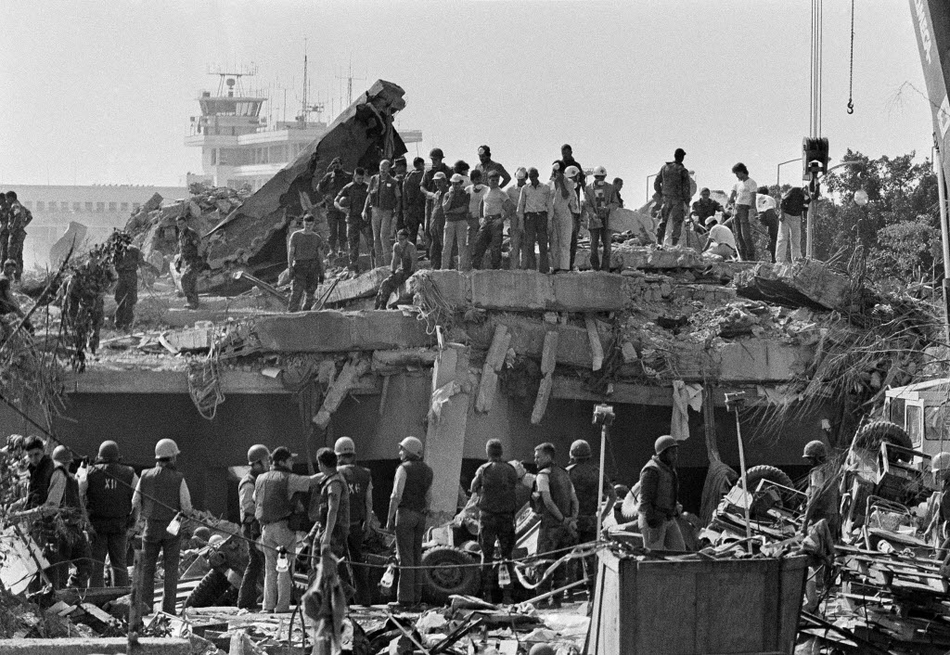
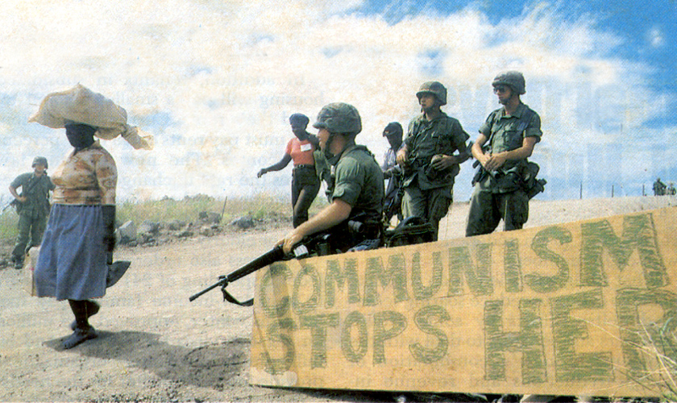
Reagan and The Cold War
Reagan escalated the Cold War ending the period of détente
Ordered massive build up of forces
Increase technology programs (Star Wars)
Denounced the Soviets as an “evil empire”
Funded rebels in Afghanistan to fight the Soviet invasion
Sent troops to Lebanon, Grenada, El Salvador, Honduras, and the Persian Gulf (Iraq-Iran War)
Bombed Libya – supporter of terrorism

Slide 21
Iran-Contra Affair
Reagan’s efforts to aid the Nicaraguan contras involved him in a serious blunder and scandal
Since 1980, Iran and Iraq had been engaged in a bloody war. Reagan’s aides came up with a plan that was kept secret from the American people
U.S. would sell U.S. antitank and antiaircraft missiles to Iran’s government for its help in freeing the Americans held hostage by a radical Arab group
In 1986, another Reagan staff member wanted to use profits from the sale of arms to fund contras in Nicaragua
Reagan denied involvement; Americans viewed him as uniformed and easily manipulated by his advisors

Slide 22
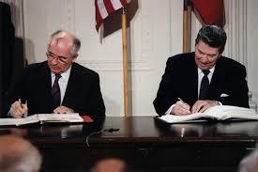
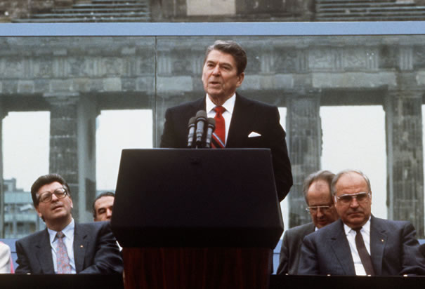
Reagan and Gorbachev:
End of the Cold War

Slide 23
Glasnost- A policy that called for increased openness and transparency in government institutions and activities in the Soviet Union.
Introduced by Mikhail Gorbachev in the second half of the 1980s.
The word was frequently used by Gorbachev to specify the policies he believed might help reduce the corruption at the top of the Communist Party and the Soviet government, and moderate the abuse of administrative power in the Central Committee.
Perestroika- A political movement for reformation within the Communist Party of the Soviet Union during the 1980’s.
The literal meaning of perestroika is "restructuring", referring to the restructuring of the Soviet political and economic system.

Slide 24
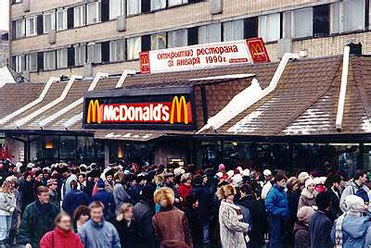
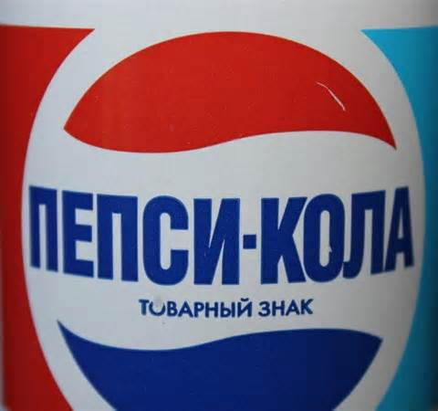
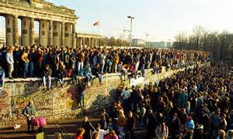
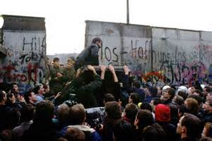
Reagan and Gorbachev:
End of the Cold War
Gorbachev Reforms
(Glasnost, Perestroika)
Nuclear Disarmament
Free market in USSR
Revolutions of 1989
(Poland, Baltic States,
Czechoslovakia)
Berlin Wall falls

Slide 25
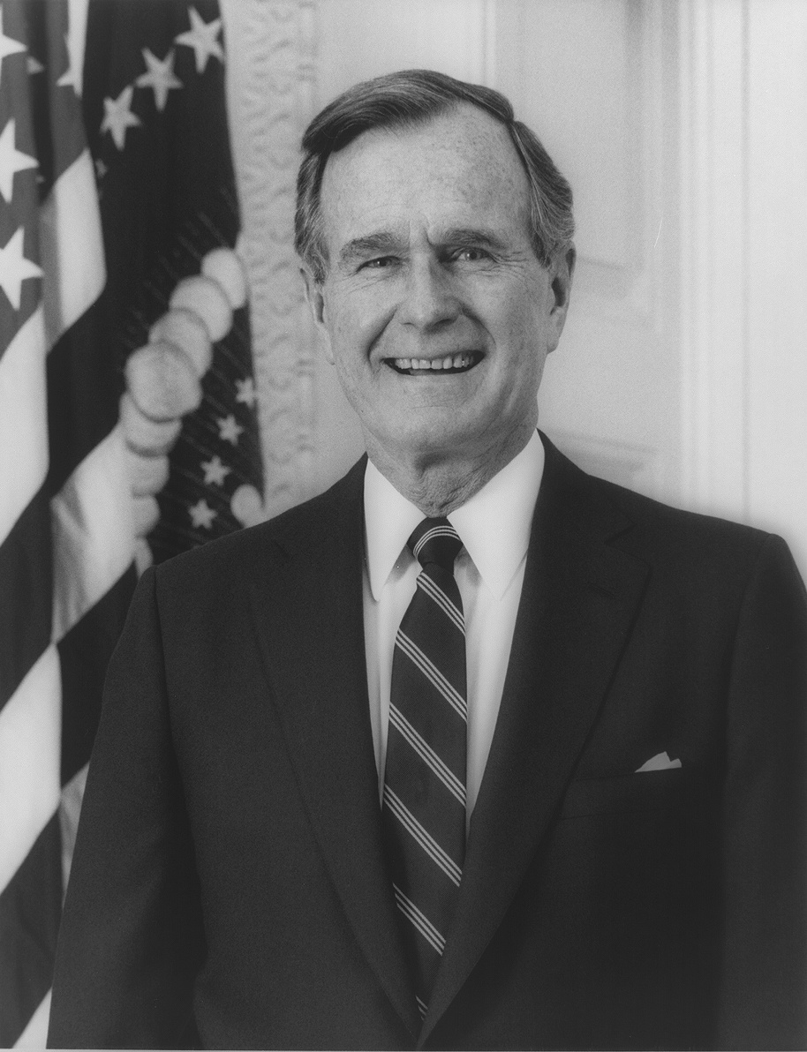
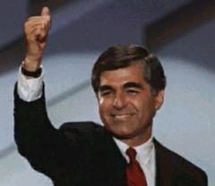
Candidates for the election of 1988
Republican Vice President George H.W. Bush
Democrat Massachusetts Governor Michael Dukakis
The majority of Americans were economically comfortable and saw little reason for change
Negative campaigning led to the lowest turn out since 1924
“READ MY LIPS: NO NEW TAXES”

Slide 26
Savings and Loan Crisis
The failure of 1.043 of the 3.234 savings and loans associations in the United States from 1986 to 1995.
Savings and Loans are financial institutions that have savings deposits and make loans only for members.
Caused by the deregulation of the Reagan Administration, Tax Reform Act of 1986, end of inflation, and bad decisions trying to regain lost wealth.
Lost over 400 billion dollars, over 130 billion paid by taxpayers to save industry

Slide 27
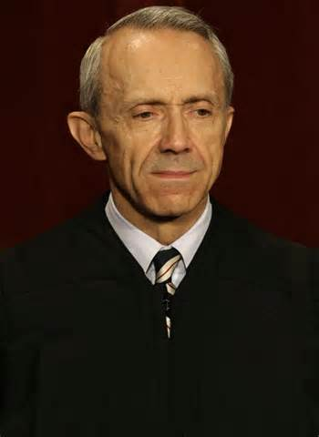
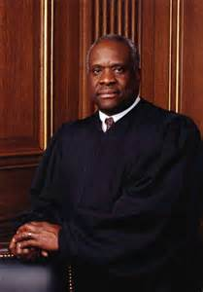
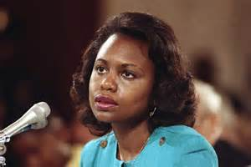
More Supreme Court changes
David H Souter
Clarence Thomas –
Controversy over sexual harassment
against Anita Hill

Slide 28
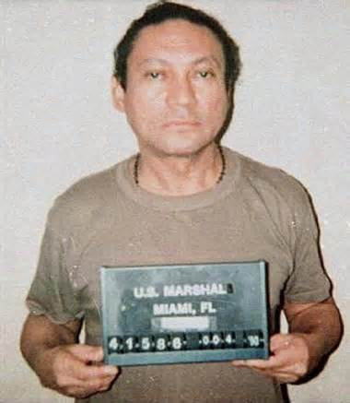
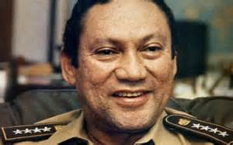
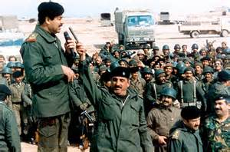
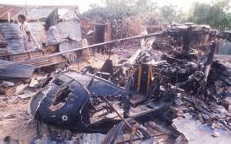
Bush’s Foreign Policy
Invasion of Panama – 1989
US forces were sent to Panama to capture Panamanian dictator and drug lord Manuel Noriega (still in a US prison)
The Gulf War – 1990
Response to Iraq’s invasion of Kuwait
Started with global pressure against Saddam Hussein
Ended with an invasion in 1991
Somalia – 1992
Humanitarian effort in Warlord controlled Somalia – Black Hawk Down

Slide 29
1980’s FADS

Slide 30
Movies and Television of the 1980’s

Slide 31
Election of 1992
Bush vs Clinton (vs H Ross Perot?)
George Bush lost the election due to a severe recession after the Persian Gulf War and the third-party candidate, H Ross Perot
Clinton 43%, Bush 38%, Perot 19% (most ever by a third party) of total votes
Clinton wanted to lower federal spending (balance budget), create Health Care reform, reform welfare but could not get Congress to help pass many of his bills.

Slide 32
NAFTA, WTO, & Contract With America
NAFTA – North American Free Trade Agreement – would create a free trade zone between Canada, the United States, and Mexico. Designed to strengthen the economy and create jobs, many opponents felt that it would move many jobs to Mexico because of lower wages and lack of environmental regulation.
GATT – General Agreement on Tariffs and Trade & WTO – World Trade Organization – establishes rules for global trade (like tariff levels) and helps settle trade disputes. Help accelerate the globalization of the world’s economies
Contract With America – created by Republican Newt Gingrich to attract voters. It was 10 promises made by the Republican Party is it won control of Congress. They include: congressional term limits, balance budget amendment, tax cuts, tougher crime laws, and welfare reform. Clinton and the Democrats voted against most bills. Created the 1st “shut down” of the government.
Marks the beginning of the lack of compromise in Washington DC

Slide 33
Clinton’s Impeachment
Clinton was investigated during the beginning of his 1st term for improper campaign funding while Governor of Arkansas through the Whitewater Development Company. During the investigation, matters unrelated to Whitewater became public – specifically sexual harassment claims and sexual affairs.
Impeachment was started in December of 1998 against President Clinton on two chargers – perjury and obstruction of justice.
Impeachment failed to get a 2/3’s majority vote but damaged the administration for the rest of his term.

Slide 34
Election of 2000
George W Bush vs Al Gore
Very close election that came down to one state: Florida. TV stations first predicted Gore to win Florida (and the Presidency) but later changed to “ too close to call”, then to Bush, and then back to “too close to call”.
Bush was declared the winner on the day after the election by a few thousand votes. The thin margin triggered an automatic recount which shrunk Bush’s victory to only a few hundred votes.
Democrats sued for a manual recount based on voting irregularities (butterfly ballot) and the fact that the governor of Florida, Jeb Bush, was George’s brother.
The Supreme Court ended the manual recount on a 5-4 decision based on the lack of uniform standards violated the equal protection of voters. (Hanging Chad)
Bush wins the electoral vote despite have less popular votes

Slide 35
The George W Bush Years
High tech industries make millionaires “over night” – dot.com
Service industry begins to dominate US economy
No Child Left Behind Act – required states to test all students in federal standardized tests
2008 Financial Crisis
Worst since the Great Depression
Housing Crisis caused by low interest rates to stimulate the economy in 2000 increased the number of buyers and raising prices. Overbuilding led to lower prices around 2007 and the rising of interest rates cause many foreclosures. Business became to fail when mortgages and other investments began to lose money creating the recession. In 2008, the federal government spent over $700 billion to buy distressed investments and fund failing banks, brokerage houses, insurance, and investment groups.

Slide 36
The George W Bush Years
Hurricane Katrina, 2005
Category 5 (strongest level), 3rd most intense ever to hit the US, 5th deadliest (could have been worse if 80% of New Orleans and the Gulf Coast region had not been evacuated), Most damaging at over $108 billion
Most damage occurred in New Orleans where the levees failed and flooded the city, trapping 20,000 people at the Superdome

Slide 37
War on Terror
War on Terror began after the 9/11/01 attack on the World Trade Center and the Pentagon by Islamic Fundamentalist who flew hijacked planes into the buildings destroying the World Trade Center and killing around 3,000 people.
The War on Terror focused on Osama bin Laden and al-Qaeda (responsible for 9/11), the Taliban in Afghanistan, and any country that sponsors terrorist activities (Iraq, Chad, Libya).
TSA – Transportation Security Agency created to protect security at US airports
Department of Homeland Security created to keep the US secure from all threats
USA Patriot Act, 2001 – expanded the government’s powers to protect citizens. Used to collect information, imprison suspected terrorists, detain and search with less “cause”, and monitor peoples activities.

Slide 38
Election of 2008 and Barack Obama
Barack Obama vs John McCain
Major difference was the support of the war in Iraq and Afghanistan.
Another major factor was Obama’s use of social media.
Barack Obama is the 1st African-American US President
Obama appointed Sonia Sotomayor to the Supreme Court in 2009, the 1st Hispanic Justice
Legacy?
American Recovery and Reinvestment Act
“Obama Care” – health care reform

