Slide 1
Unit 2 and Unit 3 Chapters 6, 7, 8
The Gilded Age
Captains of Industry, Immigration, Urbanization

Slide 2
The Gilded Age: (1870-1900)
Government:
Filled with scandal, corruption
Encouraged economic growth
Enacted weak regulation of business
Women:
Sought equal rights
Initiated growth in Suffrage Movement
Founded women’s colleges
African Americans:
Suffered wave of racism
Become disenfranchised
Segregated by Plessey vs. Ferguson
“Forgotten”

Slide 3
Gilded Age
The period or era from the end of the Civil War to the beginning of the twentieth century.
Mark Twain satirized this time period by stating this was an era of “serious social problems hidden by a thin gold gilding.”
The Gilded Age was a time of enormous growth, especially in the North and West.
This attracted millions of immigrants from Europe.
Railroads were the major industry, but the factory system, mining, and labor unions also gained in importance.
The South remained economically devastated; its economy became increasingly tied to cotton and tobacco production, which suffered low prices.
The political landscape was notable for its corruption. The dominant issues were cultural (prohibition, education, women’s suffrage, and ethnic and racial groups), and economics (tariffs and money supply).

Slide 4
Industrialization
The process in which a society or country (or world) transforms itself from a primarily agricultural society into one based on the manufacturing of goods and services.
Individual manual labor is often replaced by mechanized mass production and craftsmen are replaced by assembly lines.
Characteristics of industrialization include the use of technological innovation to solve problems as opposed to superstition or dependency upon conditions outside human control such as the weather, as well as more efficient division of labor and economic growth.

Slide 5
The Captains of Industry:
Social Darwinism + Gospel of Wealth+ Laissez Faire Economics =
“Survival of the Fittest”, “God’s Chosen People”, “To let one do”
Environment for economic growth
Formation of corporations and trusts
Boom and Bust Economy- Economic expansion ended dramatically by periods of depression.

Slide 6
Big Business
Business ruled during the years after the Civil War.
Just before the Civil War, Congress passed legislation allowing businesses to form corporations without a charter from the U.S. government.
After the Civil War, these corporations came to dominate much of American business, and, in the process, to define American life.
The era of Big Business began when entrepreneurs in search of profits consolidated their businesses into massive corporations, which were so large that they could force out competition and gain control of a market.
Control of a market allowed a corporation to set prices for a product at whatever level it wanted.
These corporations, and the businessmen who ran them, became exceedingly wealthy and powerful, often at the expense of many poor workers.

Slide 7
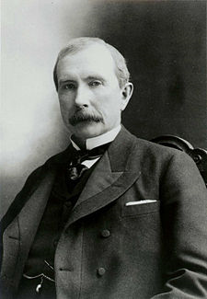
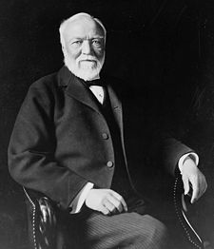
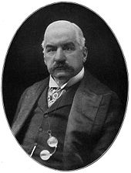
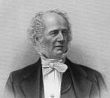
Robber Barons/Captains of Industry:
John D. Rockefeller- oil
Andrew Carnegie- railroad
JP Morgan- investment banker
Cornelius Vanderbilt- steamboat business

Slide 8
Andrew Carnegie
(1835-1919) Andrew Carnegie’s business sense made him one of the richest men in the world and one noted for his philanthropic endeavors.
Born in Scotland, Andrew Carnegie relocated with his family to Pennsylvania in 1848.
He was a telegraph messenger, personal telegrapher to the superintendent of the Pennsylvania Railroad’s western division, and eventually superintendent of the railroad’s western division during the Civil War.
Starting in 1856, Carnegie began investing in other companies.
By 1863 he was earning $40,000 a year from investments.
He turned to manufacturing in 1872 and established Carnegie, McCandless and Co. in Pittsburgh to manufacture steel using the Bessemer process.
In 1892 it became Carnegie Steel Co., Ltd. When he retired from business in 1901 he was one of the wealthiest men in the world.
He shared his wealth through a range of philanthropic causes, granting more than $350,000,000 to worthy causes aiding education, international peace, libraries, culture centers, research, and publications.

Slide 9
Spoils System: Winning candidates rewarded supporters by appointing them to government jobs.
Sherman Antitrust Act: Passed in 1890 by the U.S. Congress in an effort to control monopolies.
The act outlawed efforts to consolidate business under trusts which monopolized and restrained free trade.
The act had little impact on business practices.
More trusts were formed in the 1890s under President William McKinley’s administration than in any previous period, but the act did support the importance of public good over private gain.

Slide 10
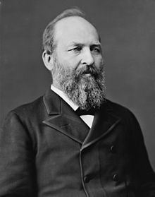
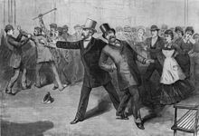
The “Forgettable Presidents”
Hayes (1876-1880) Garfield (1881) Arthur (1881-1885) Cleveland (1885-1889, 1893-1897) Harrison (1889-1893) McKinley (1897-1901)

Slide 11
Political Machines
Informal organizations that control formal processes of government, are created by elected officials to guarantee their power.
Leaders resort to bribery and force, if necessary, to hold office. Friends are rewarded with jobs within the government, a process called the spoils system.
At this time it challenged the near monopoly of government participation held by the upper classes.
Political machines also engage in gerrymandering by supporting the division of election districts unfairly to assure that the candidates favorable to the machine carry more districts than the opposition.
Political machines plant representatives in election districts, make deals with judges and other professions, and buy votes by offering services in exchange for support.
Political machines often exist in big cities. One of the most notorious, the Tweed Ring led by “Boss” Tweed, used bribes and fraudulent elections to wrest $200 million from New York City coffers. His undercover dealings were disclosed by The New York Times in 1871.

Slide 12
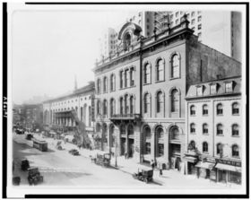
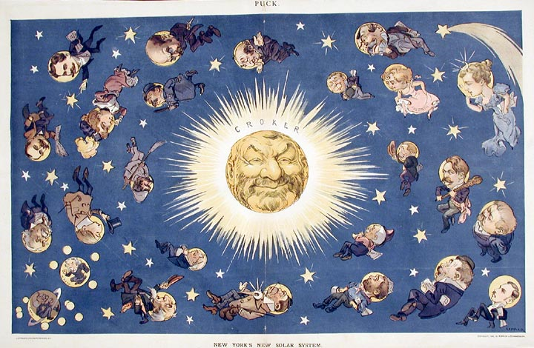
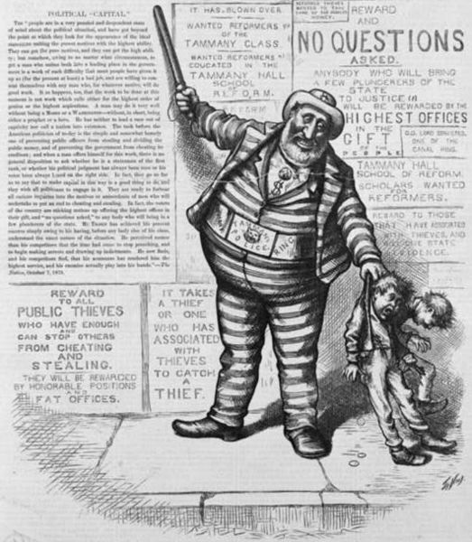
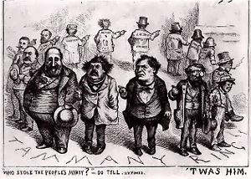
Tammany Hall and Tweed Ring

Slide 13
Urbanization
The rapid and massive growth of, and migration to, large cities.
Positive and negative consequences can result.
In U.S. urbanization, some of these issues are: employment, sanitation, housing, sewage, water, fire, social welfare, role of government, and political machines (controlling organizations).

Slide 14
Growth of Cities:
New Technology: bridges, mass transportation
New Construction Techniques: iron skeleton, elevator
Urban Political Machines
Social Services to poor, housing reforms
15% Urban in 1850
40% Urban in 1900
4 million city dwellers in 1850
30 million city dwellers in 1900
62 US cities over 10,000 in 1850
440 US cities over 10,000 in 1900

Slide 15
Push-Pull Factors
Push factors are factors or causes with which people tend to be pushed away or repelled from certain locations; while pull factors are those conditions that attract people to a particular location.
These factors may be due to economic, environmental, religious and even political conditions present in the concerned locations.

Slide 16
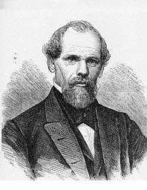
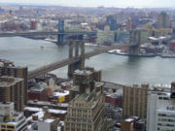
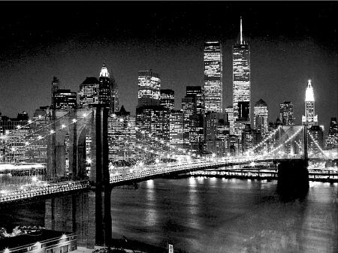
John Augustus Roebling: German/American engineer who designed suspension bridges that allowed cities by rivers or waterways to expand. Most famous bridge is the Brooklyn Bridge that linked Manhattan Island to Brooklyn, NY.

Slide 17
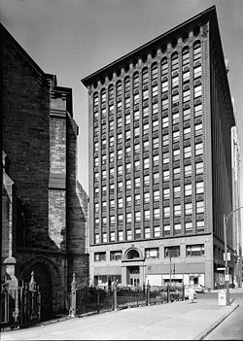
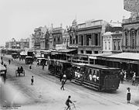
Streetcars pulled by horses were developed. Then underground cable streetcars. Transportation built cities even more, why?
Louis Sullivan: one of the 1st architects to use new technology to design sky scrapers.
Department stores and the “shopping district” emerged in mid 1800’s.

Slide 18
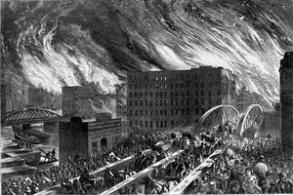
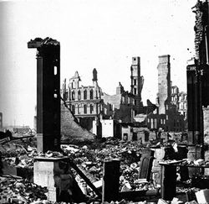
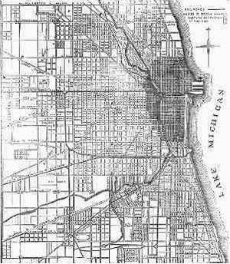
The Great Chicago Fire: October 8-10, 1871
How was it started?
What was the effect of Chicago after the fire?

Slide 19
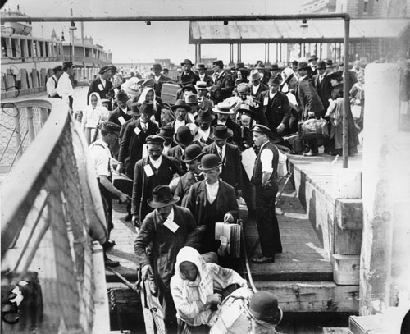
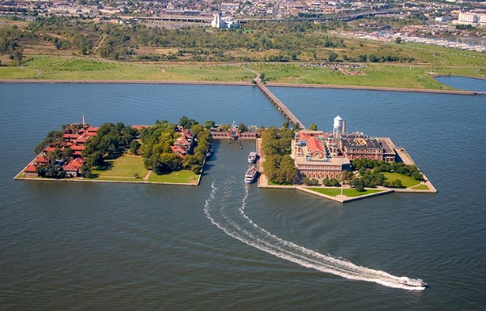
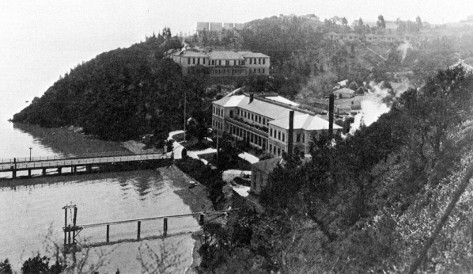
What fueled American Industries?
Ellis Island- Immigration Center in New York City1892 to 1943. Officially closed in 1954, the site was designated a National Monument in 1965, and the main building was opened to the public as a museum in 1990.
Angel Island- Immigration Center in
San Francisco (1910-1940)

Slide 20
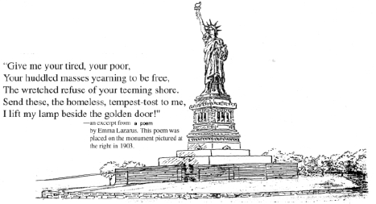
Emma Lazarus- Born in NY of Jewish parents, she wrote the sonnet that is now on the Statue of Liberty
Ironically she died in 1887 at the age of 38, one year after the Statue of Liberty was dedicated.
Her words were placed in 1903.
Nativism- Anti-Immigrant attitudes
Xenophobia- Fear or hatred of foreigners or strangers

Slide 21
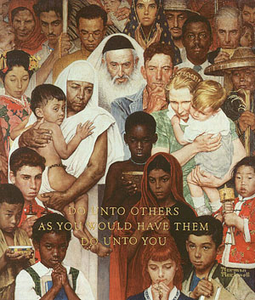
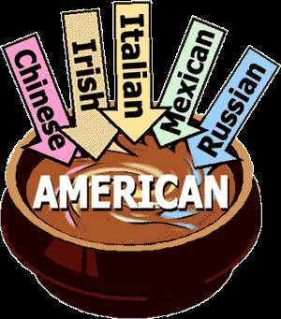
Melting Pot
“The term ‘Melting pot’ is often thought of as a good thing. New York is known as a melting pot because it has a variety of different people and different cultures all in one area. This helps create diversity and opens out minds up to other areas of the world and how they do things. Unfortunately not all people like the idea of a melting pot.”
http://www.dominiquemanzione.blogspot/2008/02/advertising

Slide 22
Old Immigrants- England, Ireland, France, Germany, and Scandinavia
White, mostly literate, Protestant, and somewhat familiar with Constitutional government
New Immigrants- Greece, Poland, Russia, Italy, Slavic countries
Mostly illiterate, Catholic or Jewish, unfamiliar with Constitutional government

Slide 23
Assimilation
Cultural assimilation is the process by which a person or a group's language or culture come to resemble those of another group.
The term is used both to refer to both individuals and groups, and in the latter case it can refer to either immigrant or native residents that come to be culturally dominated by another society.
Assimilation may involve either a quick or gradual change depending on circumstances.
Whether or not it is desirable for an immigrant group to assimilate is often disputed by both members of the group and those of the dominant society.

Slide 24
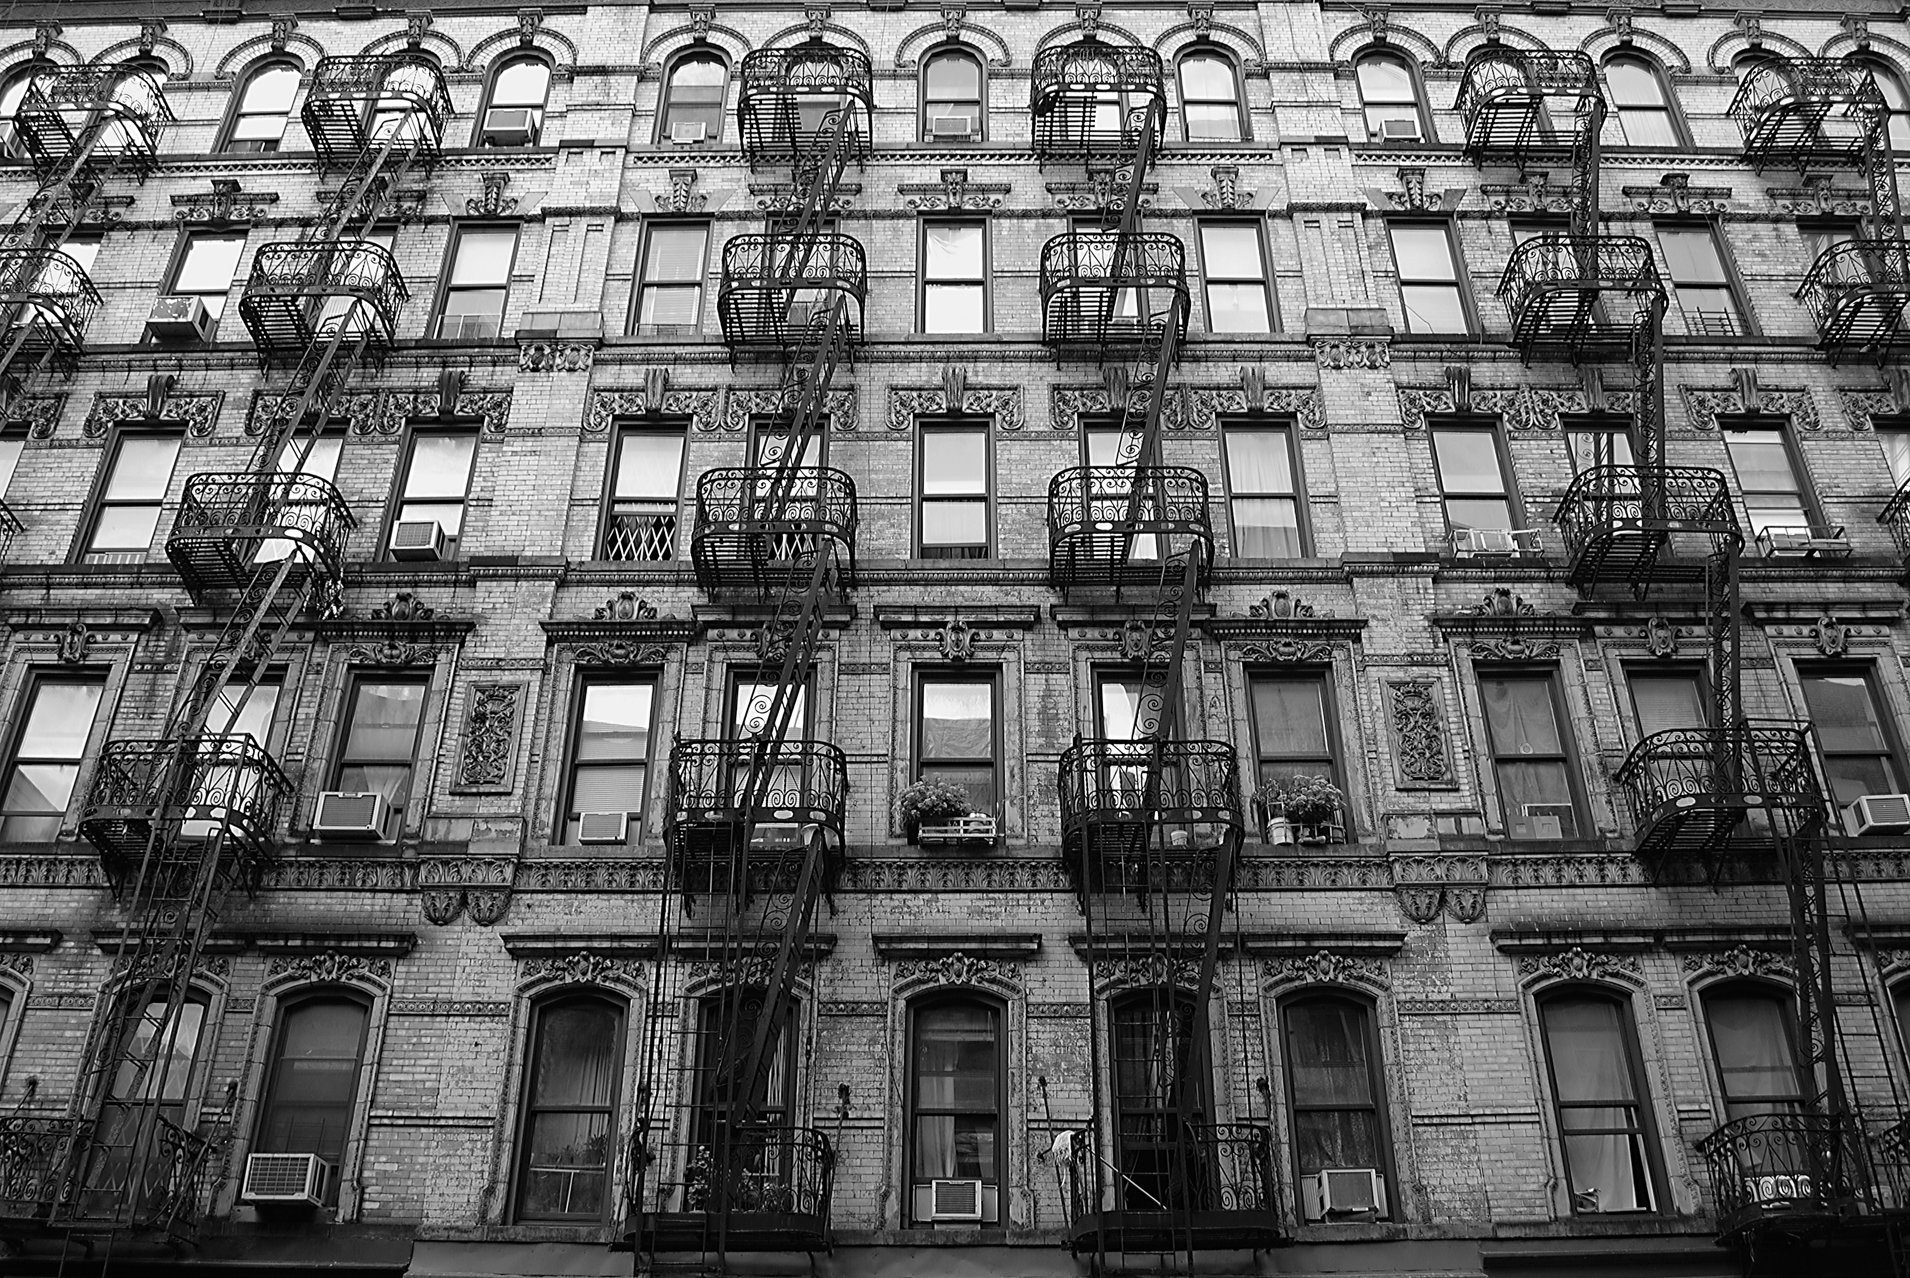
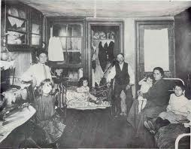
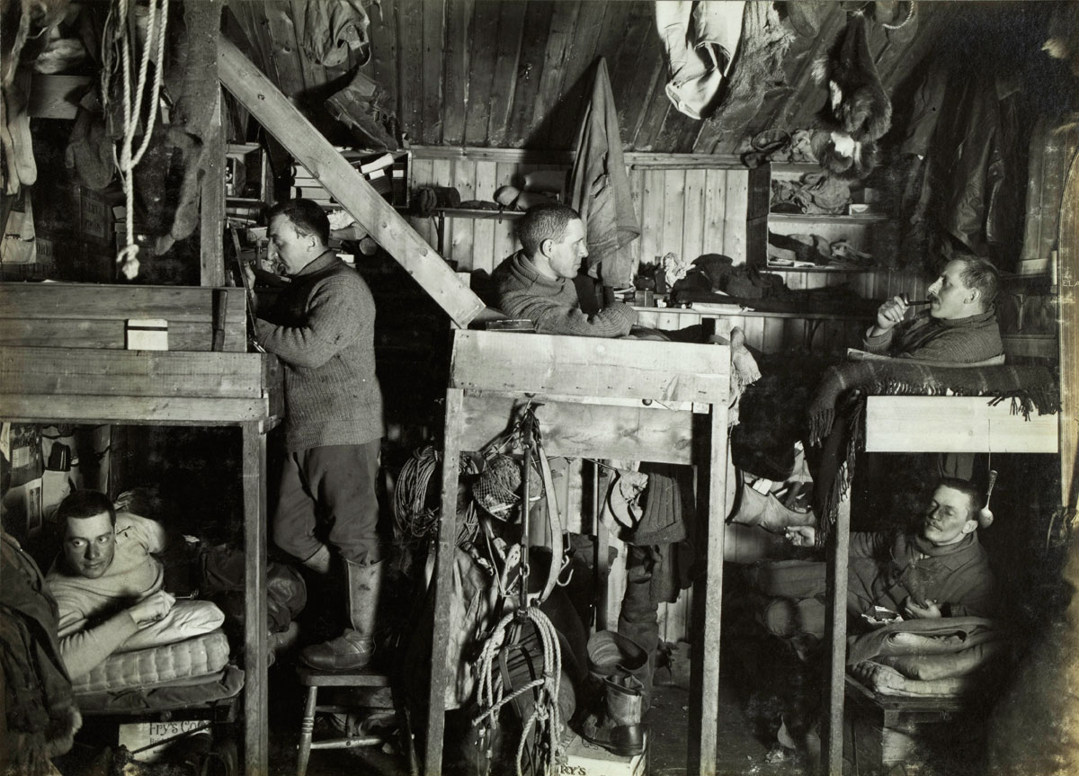
Tenements- Also called tenement house; a run-down and often overcrowded apartment house, especially in a poor section of a large city.

Slide 25
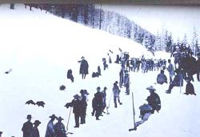
Chinese Exclusion Act- 1882 Suspension of immigrants from China for 10 years and declared Chinese immigrants ineligible for naturalization of American citizenship.
A federal law passed in response to complaints by workers on the West Coast that competition from Chinese immigrants was driving down their wages and threatening white “racial purity.”
The law was renewed in 1892 for another ten years, and in 1902 Chinese immigration was permanently banned.
Chinese immigrants did not become eligible for citizenship until 1943.

Slide 26
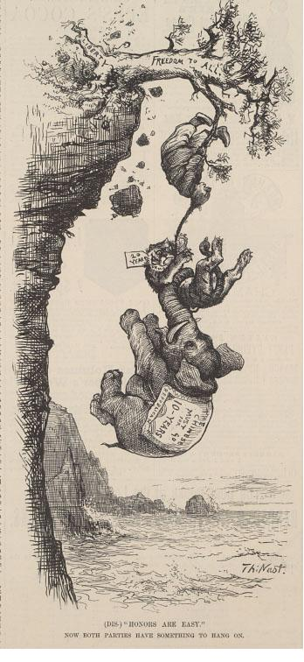
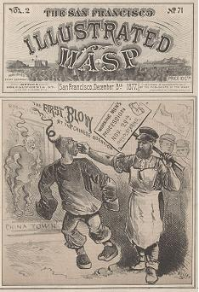

Slide 27
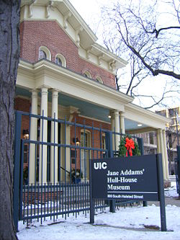
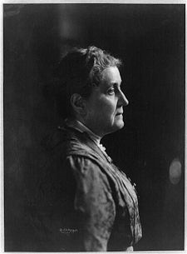
Jane Addams: founded Hull House, a settlement house in Chicago in 1889
By 1893 it offered medical care, legal aid, language classes, music, and drama to more than two thousand needy each week.
First woman to win the Nobel Peace Prize.

Slide 28
Today’s Workers Facts:
Minimum age to begin working: 16
Usual hours a week: 40
How are jobs regulated: Government agencies inspection
What if a worker gets hurt? Worker’s Compensation
What if a worker retires: Pension plans/Retirement fund
What if a worker gets laid off: Unemployment Benefits

Slide 29
Labor Unions:
Knights of Labor: Welcomed ALL labor workers
United Mine Workers: ( UMW) Included African Americans
American Federation of Labor: (AFL) Craft Union; excluded African Americans and Asians
Women and Minorities were largely excluded
Violence marked labor disputes
Government favored employers
Unions had little success

Slide 30
Eugene V. Debs
(1855-1926)
Debs supported unionization and labor reforms, opposed strikes, and favored negotiation as a means to improve the conditions for laborers.
He founded the American Railway Union (ARU) in 1893 to organize railroad workers, coal miners, and longshoremen employed in the industry, regardless of their skills.
Failure of the ARU in 1894 convinced Debs of the value of socialism as an economic system and he joined the Socialist Democratic Party (Socialist Party of America) in 1901.
He ran for president five times on the socialist ticket, once from prison. He used his campaigns to further the causes of women’s suffrage, the abolition of child labor, and shorter workdays.

Slide 31
Haymarket Riot
On May 4, 1886, a labor protest rally near Chicago’s Haymarket Square turned into a riot after someone threw a bomb at police.
At least eight people died as a result of the violence that day.
Despite a lack of evidence against them, eight radical labor activists were convicted in connection with the bombing.
The Haymarket Riot was viewed a setback for the organized labor movement in America, which was fighting for such rights as the eight-hour workday.
At the same time, the men convicted in connection with the riot were viewed by many in the labor movement as martyrs.

Slide 32
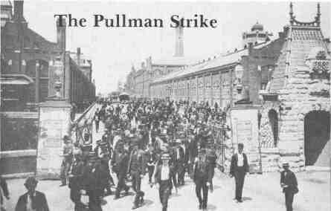
.
The Pullman Strike: During the Panic of 1893 the Pullman Company laid off more than 3,000 out of its 5,800 employees and cut housing. Eugene V. Debs organized a boycott on Pullman trains.

Slide 33
Unit 2 and 3 Gilded Age Study Guide 8 Matching 14 Multiple Choice
Matching:
Multiple Choice:
Darwinism
Gospel Of Wealth
Laissez Faire
Nativism
Chinese Exclusion Act
New Immigrants
Urbanization
Industrialization
Political Machines
Tenement
Gilded Age

