Slide 1
Unit 3 Chapter 9
The Progressive Era

Slide 2
Chapter 9-1
What were the goals of the Progressives?
Define: Progressive Movement.
Define: 17th Amendment.
Who were the Muckrakers?
Who was Eugene V. Debs? (may use internet)
Define: Child Labor Laws (may use internet)

Slide 3
Chapter 9-2
7. Define: Women’s Suffrage Movement.
8. Who was Susan B. Anthony (may use internet)?
9. What was the 1st state (or territory) to give women the right to vote? How long did it take other states?

Slide 4
Chapter 9-3
10. What was “The Jungle” about? Who wrote it?
11. What 2 health and environment Acts came out of “The Jungle”? Define them.
12. What was Conservation?
13. Who founded the NAACP and why (may use internet)?

Slide 5
Chapter 9-4
14. Who was Teddy Roosevelt?
15. Define Trustbusting.
16. What was the Bull Moose Party?
17. Who was President in 1912?

Slide 6
Chapter 9-5
18. Who was Woodrow Wilson?
19. Define: 18th Amendment.
20. Define: 19th Amendment. What year did it ratify?

Slide 7
1. Goals of the Progressives: Protecting social welfare, promoting moral improvement, creating economic reform, and fostering efficiency.
2. Progressive Movement is to return control of the government back to the people, restore economic opportunities, and correct injustices in American life.
3. 17th Amendment: direct election of senators; allowed ordinary citizens a say in government

Slide 8
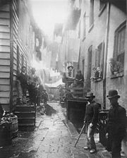
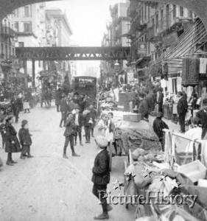
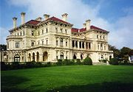
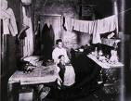

Slide 9
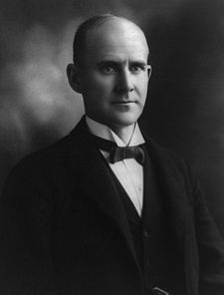
4. Muckrakers were magazine journalists who exposed the corrupt side of public life and business. (Ida Tarbell, Upton Sinclair)
5. Eugene V. Debs- social labor union leader; Socialist Party in 1901.
(1855-1926) Debs supported unionization and labor reforms, opposed strikes, and favored negotiation as a means to improve the conditions for laborers.
He founded the American Railway Union (ARU) in 1893 to organize railroad workers, coal miners, and longshoremen employed in the industry, regardless of their skills.
Failure of the ARU in 1894 convinced Debs of the value of socialism as an economic system and he joined the Socialist Democratic Party (Socialist Party of America) in 1901.
He ran for president five times on the socialist ticket, once from prison. He used his campaigns to further the causes of women’s suffrage, the abolition of child labor, and shorter workdays.

Slide 10
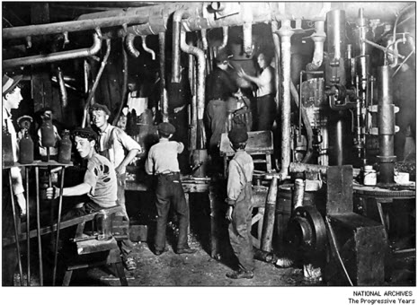
6. Children were viewed as laborers throughout the 19th century. They worked with their families on farms and in small businesses starting at a young age.
Though several bills were introduced throughout the 19th century to reduce the employment of children or at least improve the conditions under which they labored, business opposition remained strong because children often performed the same work as men but earned less.
In many families the mother and children in addition to the father worked as laborers to earn enough to survive. In 1880 at least one-fifth of the children in the United States between 10 and 14 years of age held jobs. Many were immigrants.
In the 1890s and early 1900s many states passed anti-child labor bills.

Slide 11
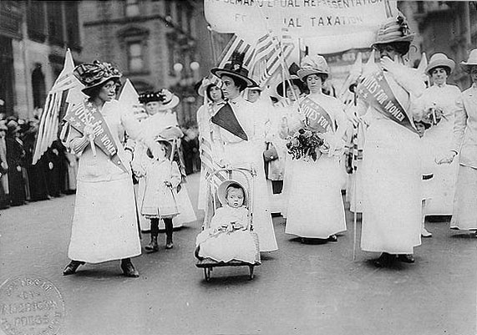
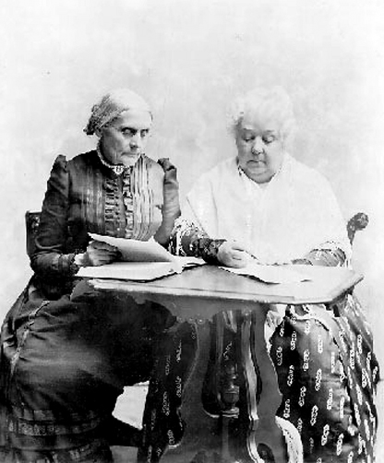
7. Suffrage Movement- women’s voting movement (1872 Seneca Falls Convention)
8. Susan B. Anthony was a leader in the Women’s Suffrage Movement along with and Elizabeth Cady Stanton and Carrie Chapman Catt
9. Wyoming; took states 41 years

Slide 12
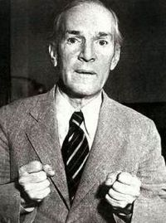
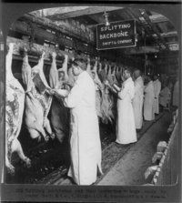
10. “The Jungle” by Upton Sinclair; the dangerous and inhumane conditions of the meat-packing plants
11. Meat Inspection Act and Pure Food and Drug Act

Slide 13
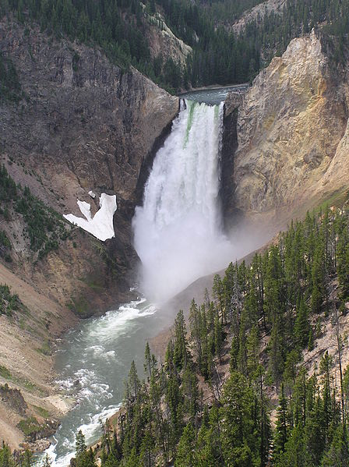
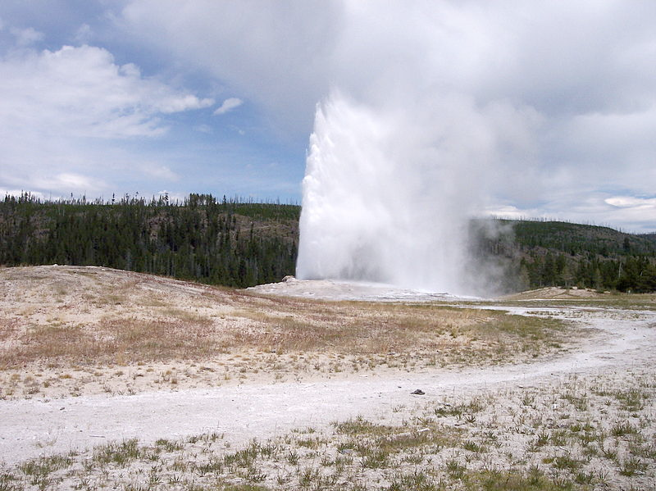
12. Conservation is preserving the wilderness.
“Yellowstone National Park, established by the U.S. Congress and signed into law by President Ulysses S. Grant on March 1, 1872,^{[3][4]} is a national park located primarily in the U.S. state of Wyoming, although it also extends into Montana and Idaho. Yellowstone was the first national park in the world, and is known for its wildlife and its many geothermal features, especially Old Faithful Geyser, one of the most popular features in the park.^{[5]} It has many types of ecosystems, but the subalpine forest is dominant.”
http://en.wikipedia.org/wiki/Yellowstone_National_Park

Slide 14
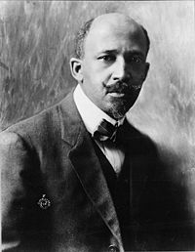
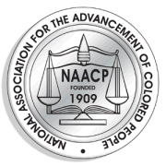
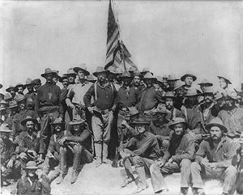
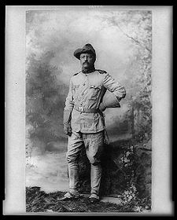
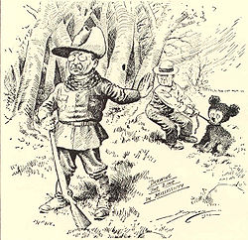
13. NAACP- WEB Du Bois
National Association for the
Advancement of Colored
People
14. Teddy Roosevelt

Slide 15
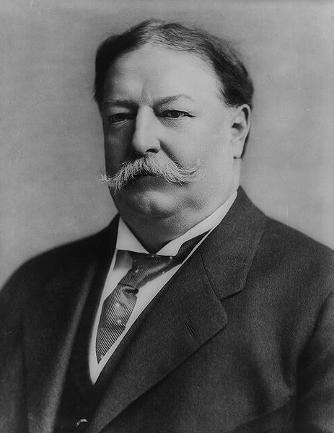
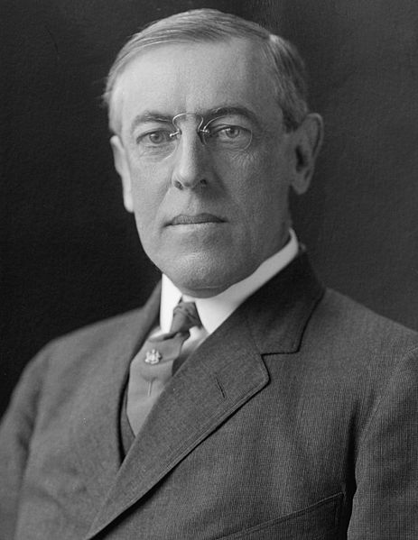
15. Trustbusting- Breaking of trusts and Monopolies
16. Bull Moose Party; Third Party
17. Presidential Election of 1912;
Wilson won (Progressive President)
18. Woodrow Wilson
Progressive President
Women’s vote
WWI

Slide 16
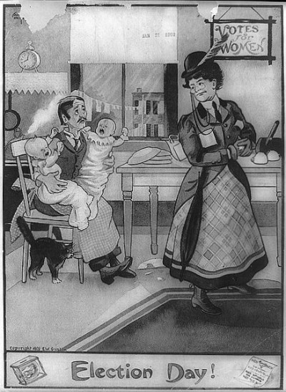
19. 18th Amendment- Abolished the sale, manufacture, and transportation of alcohol (Prohibition 1920-1933)
20. 19th Amendment- Gave women the right to vote, ratified in 1920.

Slide 17
Unit 3 Progressivism Study guide: 10 matching 15 multiple choice
Multiple Choice:
Pure Food and Drug Act
Meat Inspection Act
Susan B. Anthony
Conservation
Bull Moose Party
Teddy Roosevelt
WEB Du Bois
NAACP
William H. Taft
Matching:
17th Amendment
19th Amendment
Muckrakers
Prohibition
Progressivism
Trustbusting
Eugene V. Debs

