Slide 1
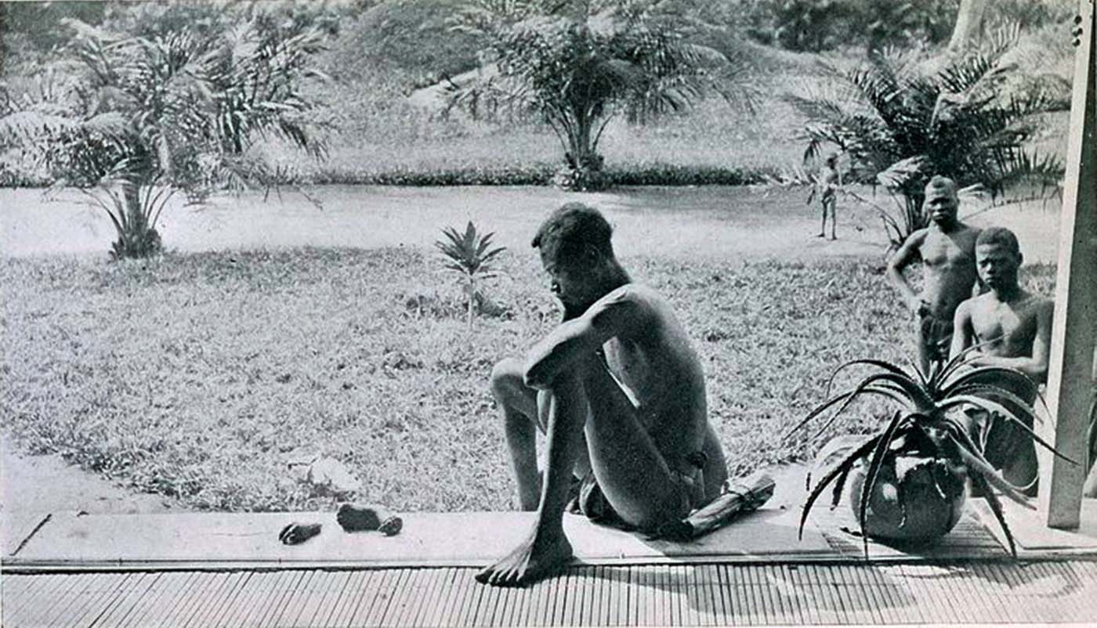
Unit 6: Consequences of Industrialization (1750-1900) part 1

Slide 2
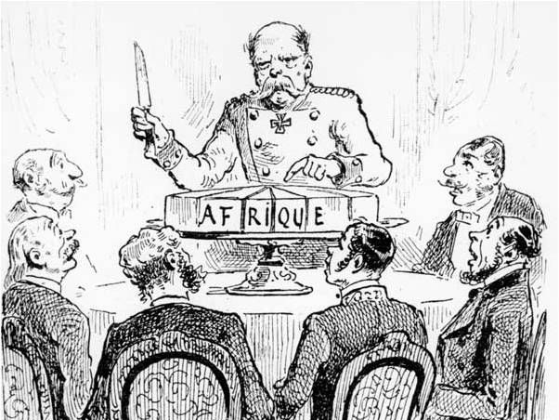
Rationales for Imperialism

Slide 3
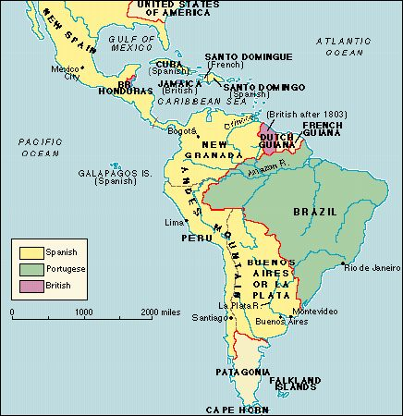
Rationales for Imperialism
Late 19th – 20th c.
Def: Domination of European powers – later USA & Japan – over subject lands in the larger world.
This was the 1st wave of imperialism (1450-1750).
PRE-INDUSTRIAL REVOLUTION & INDEPENDENCE MOVEMENTS

Slide 4
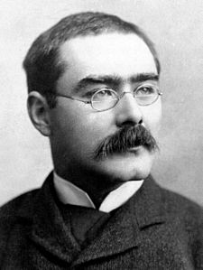
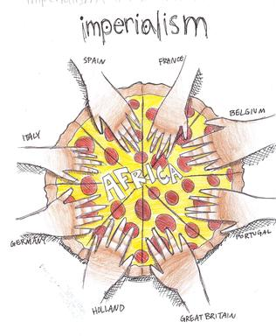
Rationales for Imperialism
Rudyard Kipling
Rationales:
Economic – need for raw materials & markets to sell manufactured items
Political – diffuse tensions at home (socialist challenge to the I.R.)
Social – Civilizing missions
Religious – convert indigenous populations

Slide 5
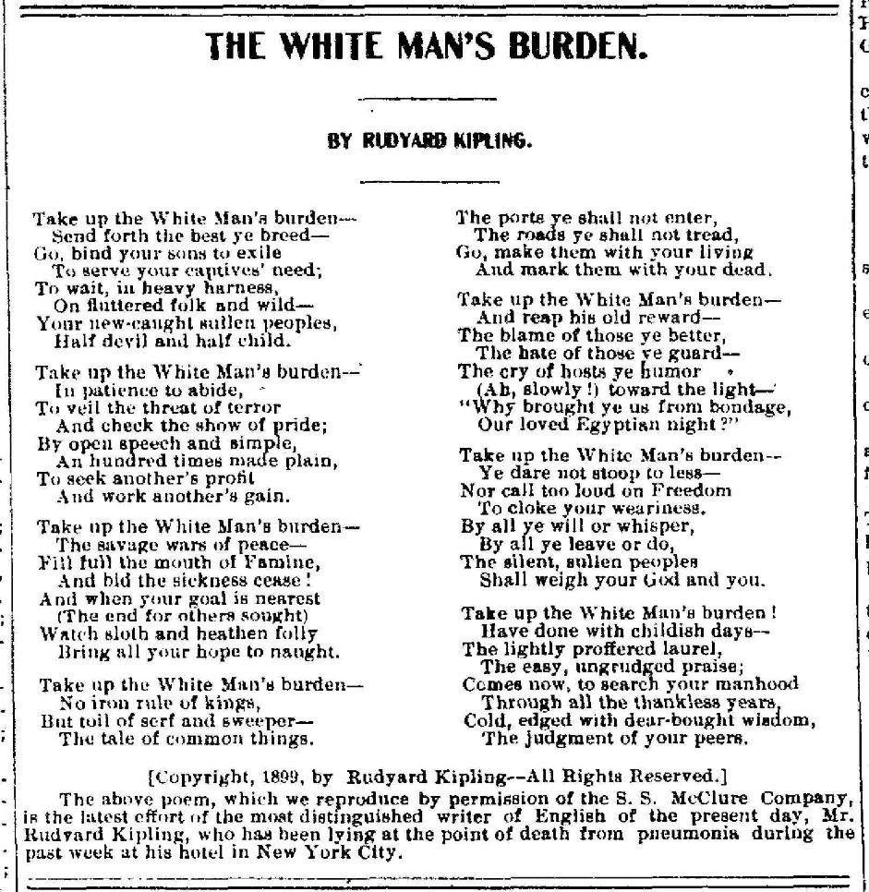

Slide 6
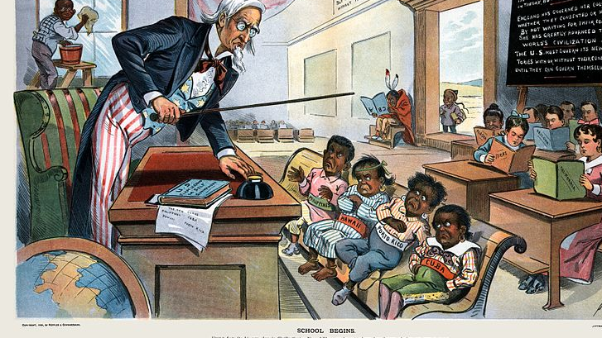
Rationales for Imperialism
Social Darwinism – racial and ethnic differences were the result of biology; white race was the most evolved (based on faulty science).

Slide 7
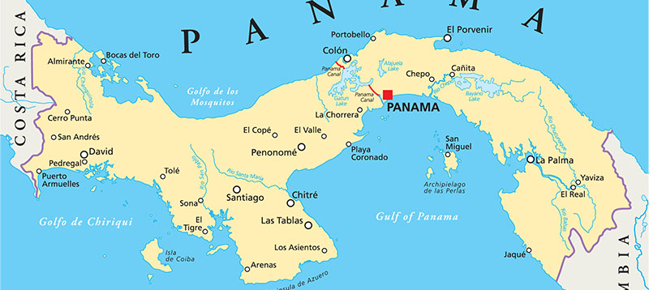
Rationales for Imperialism
Technologies of Imperialism
Quinine: used to treat malaria
Steamships: project power farther inland
Suez Canal: 1859-1869 (FR/BR)
Panama Canal: 1904-1914 (USA)
Railroads: consolidated empires Telegraph: exchange messages

Slide 8
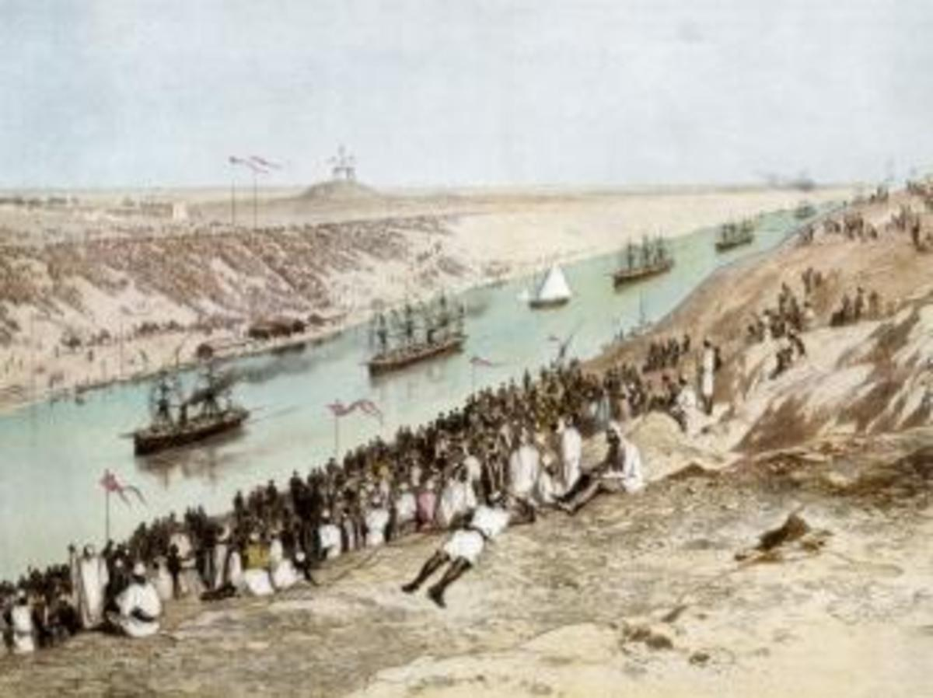
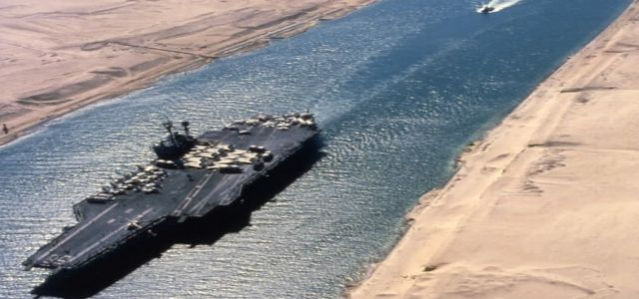
Rationales for Imperialism
Opening of the Suez Canal and the modern Suez Canal
Resource | Exported From: | Why?
Cotton | Egypt | Textiles
Rubber | Amazon & Congo basin | Tires, shoes, hoses, etc.
Palm oil | SS Africa | Lubricate industrial machines
Guano | Peru & Chile | Fertilizer
Meat | Uruguay & Argentina | Food
Diamonds | Africa | Luxury

Slide 9
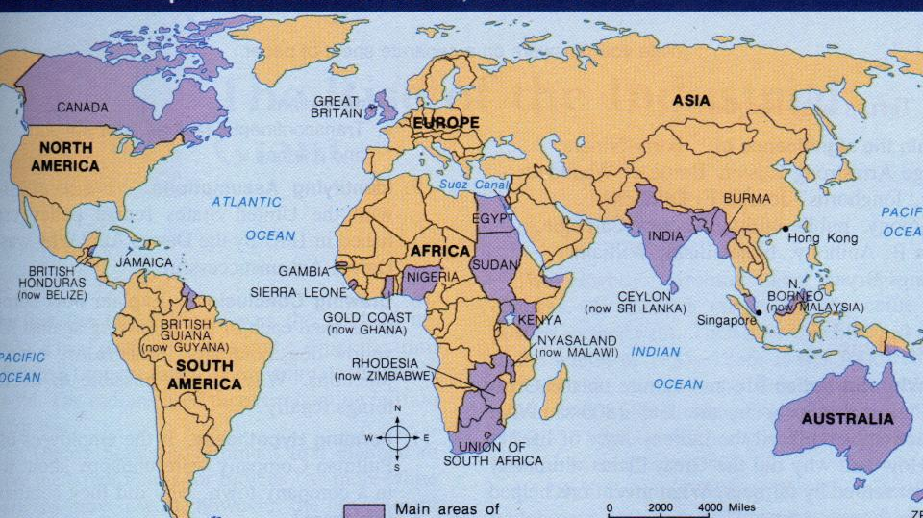
The British Empire
State Expansion (1750-1900)

Slide 10
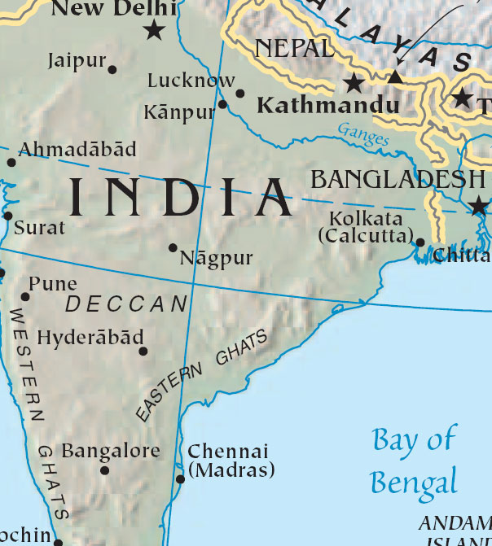
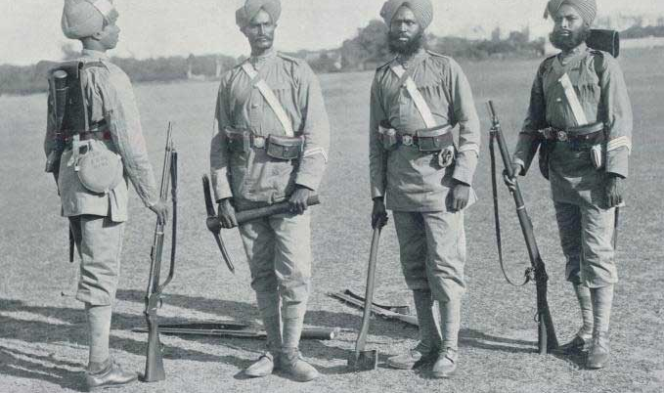
By 1700, Mughal power weakened.
British East India Company was making huge profits from opium, cotton, tea, and coffee exports.
Indian troops called sepoys enforced company rule.
State Expansion – British (India)

Slide 11
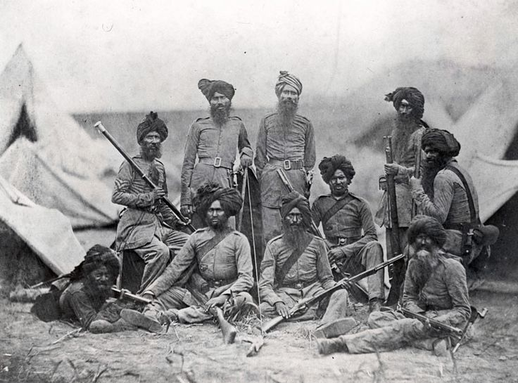
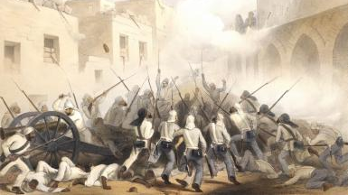
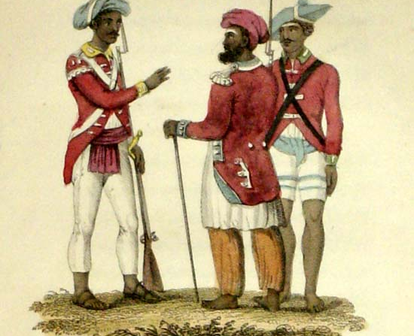
State Expansion – British (India)
SEPOY REBELLION (1857)
CAUSE: Cultural conflict; friction between sepoys and British
CONFLICT: Bullets for rifles were in cartridges protected by paper waxed with animal fat; had to tear it with teeth. Those who refused to use cartridges were convicted of mutiny.
EFFECT: Turned into a war for independence; British victory by 1858; direct imperial control was imposed on India.

Slide 12
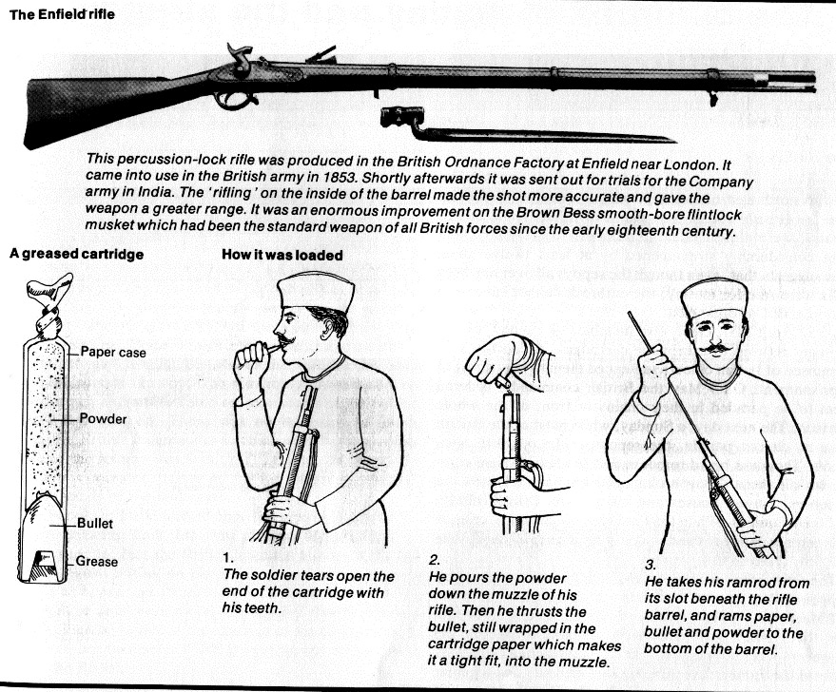

Slide 13
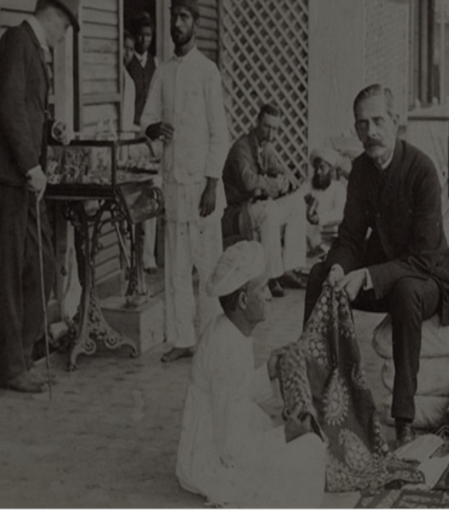
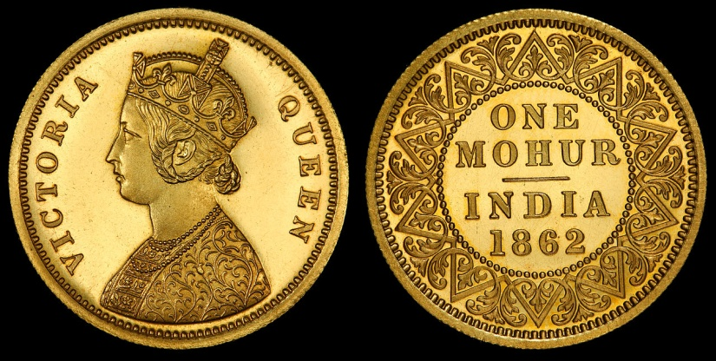
Indian currency with Queen Victoria on it
State Expansion – British (India)
India produced raw materials/food (export economy)
India was forced to purchase British finished goods (Indian textile industry destroyed).
Global economic trends!

Slide 14
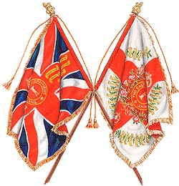
State Expansion – British (India)
Impact of British Rule?
British emphasis on cash-crop farming (cotton) led to food shortages & famine
Class system with British at the top
Railroads, sewer systems built (reduced cholera deaths)
Rise of nationalism → Ram Mohan Roy called for social reforms in colonial India

Slide 15
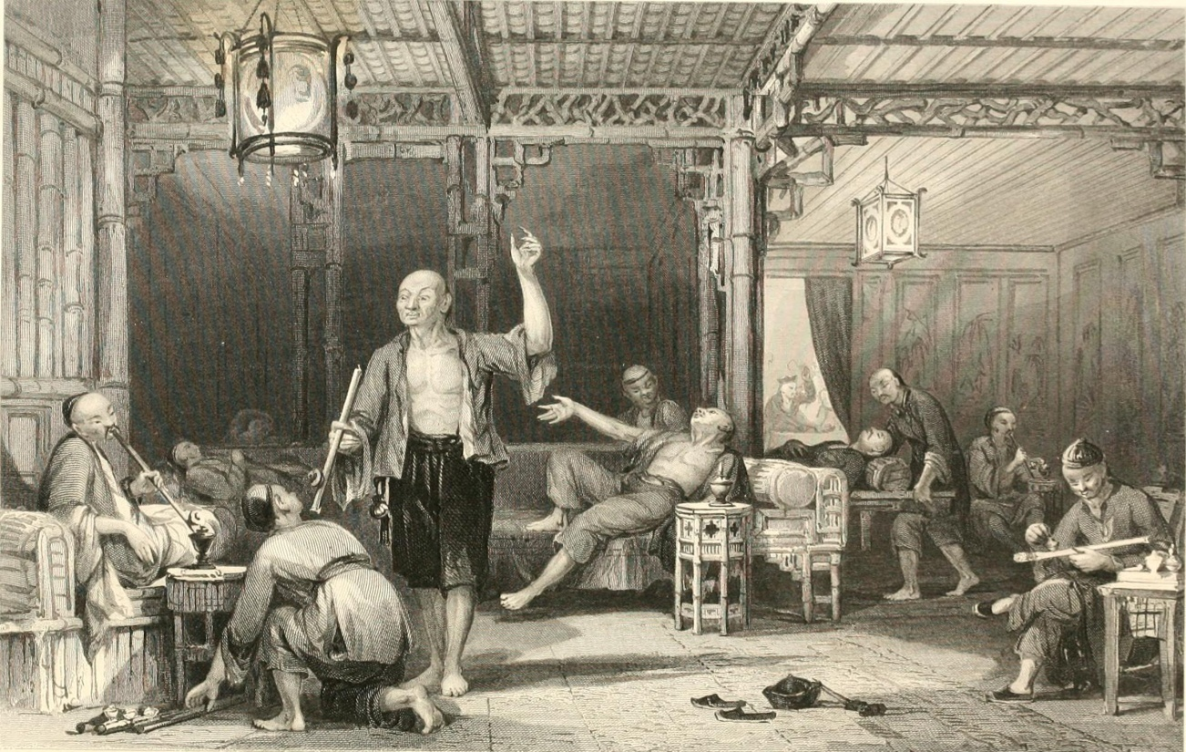
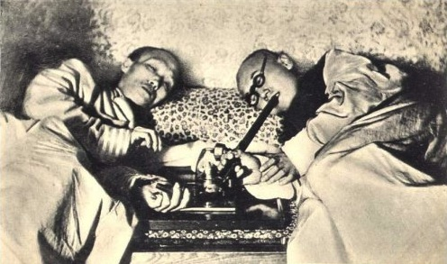
State Expansion – British (China)
Indian-grown opium was being sold to China, addicting millions.
British sold it for silver which was used to buy Chinese products (tea).

Slide 16
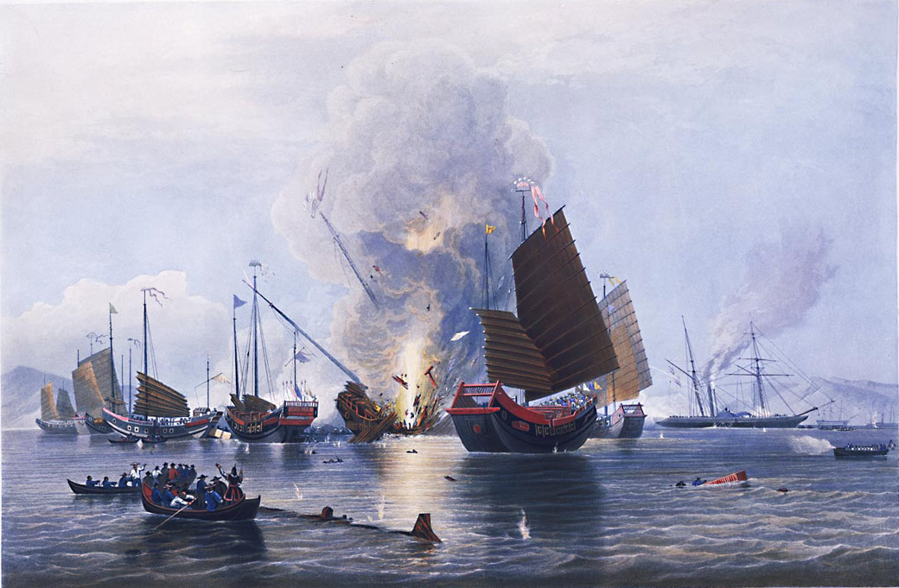
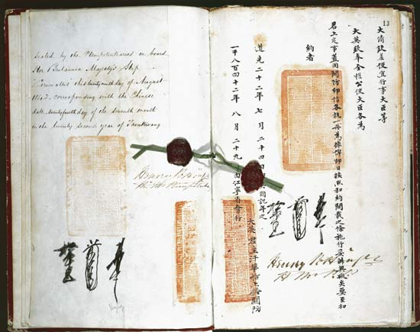
State Expansion – British (China)
The Treaty of Nanjing (right) ended the Opium Wars (left)
Efforts to stop the trade ignited war.
Opium War (1839-42) = Chinese defeat.
Result: Unequal treaties (Treaty of Nanjing) which curtailed Chinese sovereignty
France, Germany, USA, Japan all signed unequal treaties
By 1900, 90 ports were controlled by foreign powers

Slide 17
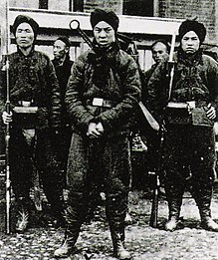
State Expansion – British (China)
Taiping Rebellion: led by Hong Xiuquan against the Qing; 20-30 million deaths.
Self-Strengthening Movement: China's program of internal reform 1860s-1870s; based on the application of Confucian principles & limited borrowing from the West.
Boxer Rebellion: Anti-imperialist, anti-foreign rebellion; many were Christians; failed → undermined Qing legitimacy.
Qing collapsed in 1911

Slide 18
Remember the Meiji Restoration!

Slide 19
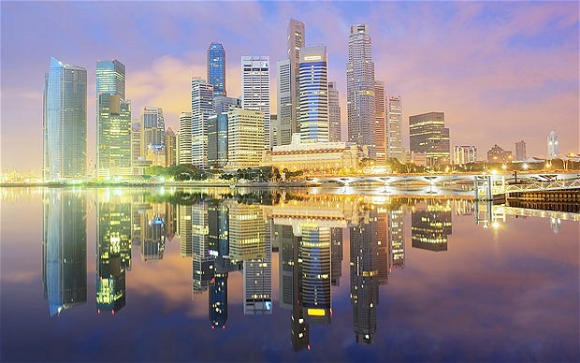
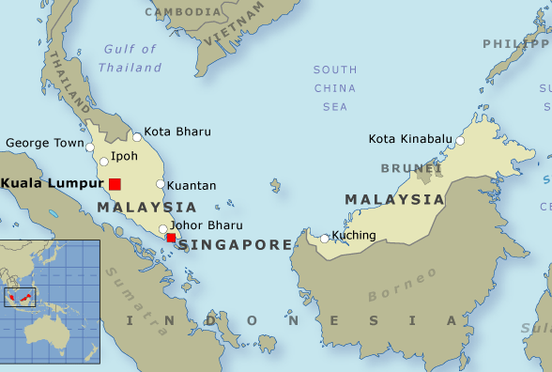
State Expansion – British (SE Asia)
Singapore – trade center in the Strait of Melaka
British conquered Malaysia 1870s-1880s (rubber export)
→ British controlled sea lanes from S. China Sea to Indian Ocean

Slide 20
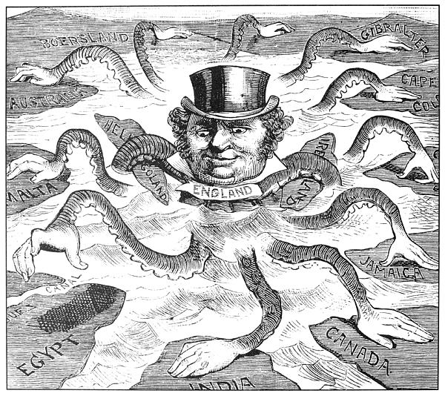
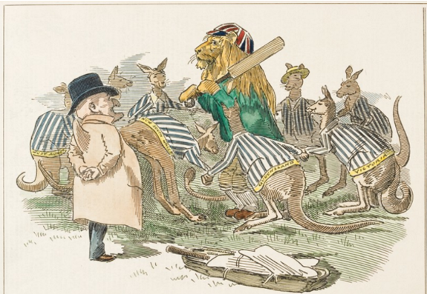
State Expansion – British (AUS/NZ)
SETTLER COLONIES
First permanent British settlers were convicts sent into exile in 1788.
Gold rush in 1851 brought many free settlers.
Many Chinese arrived, too.

Slide 21
State Expansion – British (AUS/NZ)
BRITISH AUSTRALIA
Aborigines suffered due to disease; others displaced to take land for hunting/herding
BRITISH NEW ZEALAND
Maori suffered due to disease
Voluntary migration of British (whaling, timber)
Maori battled the British but were similarly displaced

Slide 22
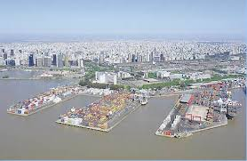
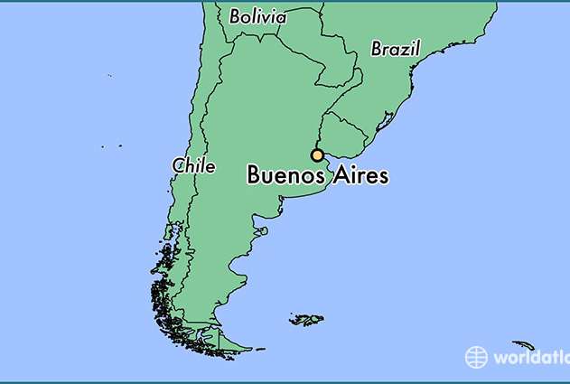
State Expansion – British (L. America)
Imperialism was not just in Asia, the British constructed to port of Buenos Aires, Argentina.
INDUSTRIALIZED STATES HAD DISTINCT ECONOMIC ADVANTAGE!

Slide 23
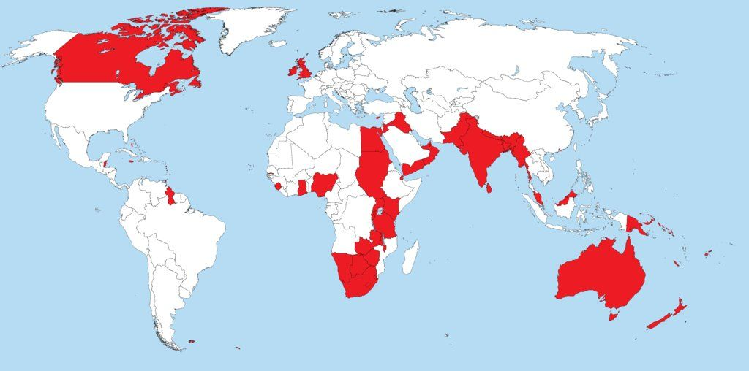
“The Sun Never Sets on the British Empire”

