Slide 1
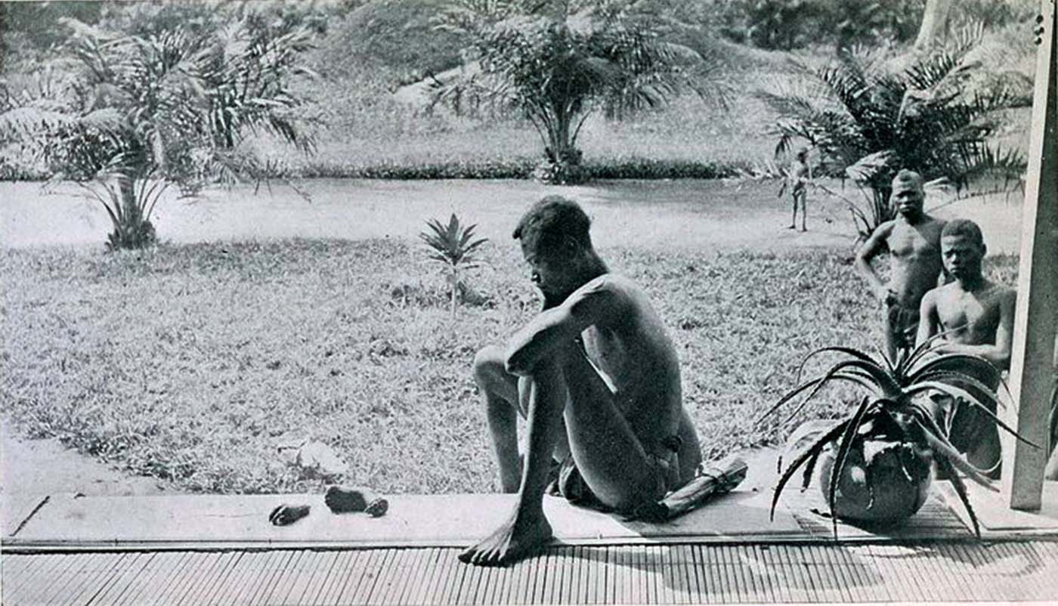
Unit 6: Consequences of Industrialization (1750-1900) part 2

Slide 2
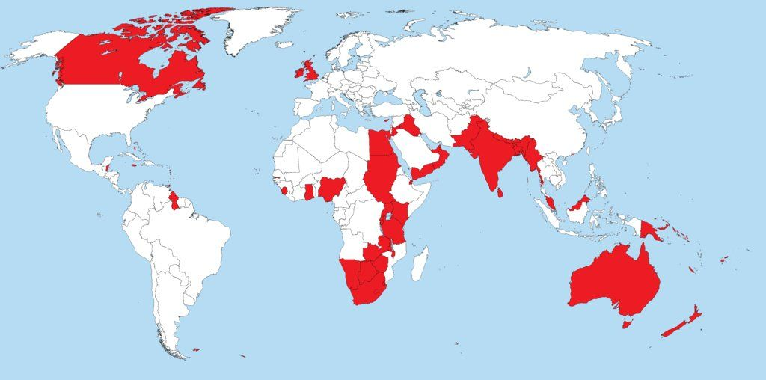
“The Sun Never Sets on the British Empire”

Slide 3
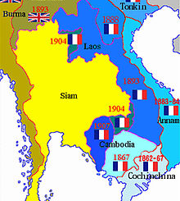
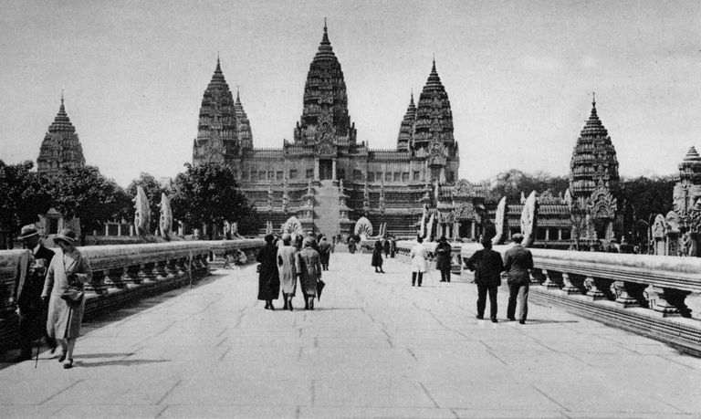
French built Indochina (Vietnam, Cambodia, Laos); also territory in West Africa
Siam (Thailand) remained independent as a buffer between British and French
State Expansion – French (SE Asia)

Slide 4
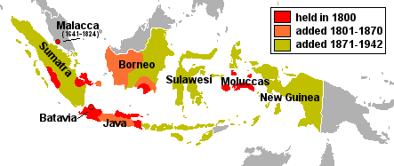
Shift from the Dutch East India Company (VOC) TO Dutch government control in Indonesia.
State Expansion – Dutch (SE Asia)

Slide 5
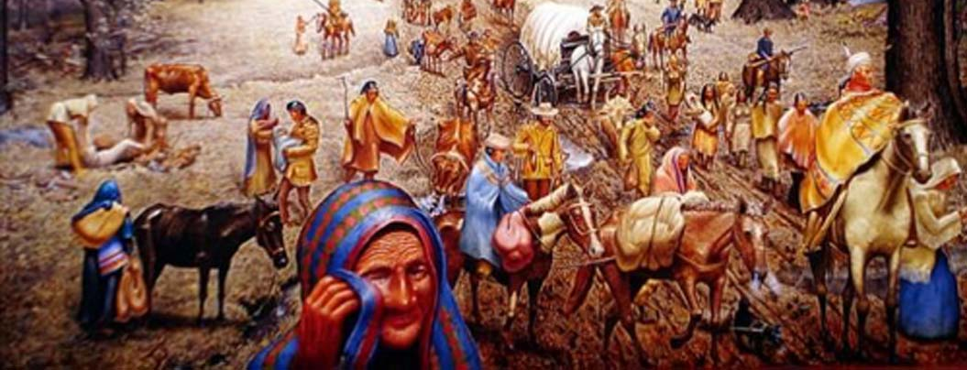
Trail of Tears: Forced migration of N. Americans from their homeland in GA into OK (under Andrew Jackson)
→ In the name of Manifest Destiny
State Expansion - USA

Slide 6
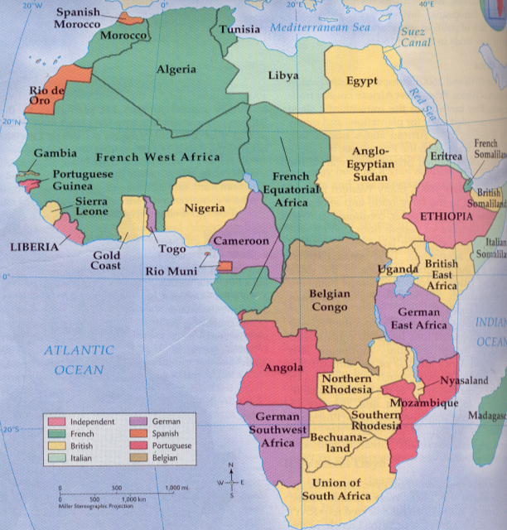
State Expansion - Africa

Slide 7
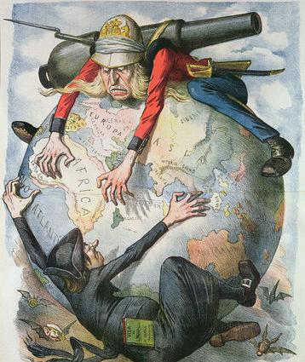
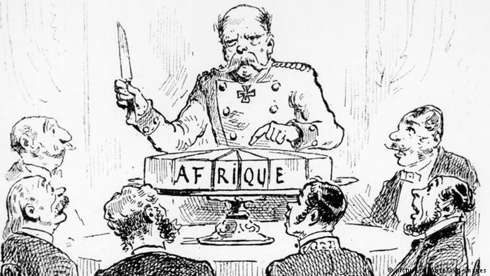
State Expansion - Africa
Berlin Conference (1884-1885)
“Effective occupation” of Africa (military conquest or signed agreement).
No African leaders invited, no regard for language, religious, tribal associations.
Public notice that Africa would be carved into colonies.

Slide 8
State Expansion - Africa
Congo Free State → Belgian Congo
King Leopold II organized it in 1878 as a private commercial company to exploit rubber resources.
Known for terrible working conditions, forced labor (4-8 million dead).
Eventually taken over by the Belgian government.

Slide 9
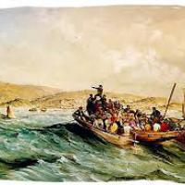
State Expansion - Africa
South Africa
Boers (Afrikaners): Dutch settlers in S. Africa
British sought to extend control in this area & conflict with Afrikaners ensured.
British arrive in S. Africa 1820

Slide 10
State Expansion - Africa
South Africa: THE BOER WARS
Afrikaners undertook the Great Trek eastward to move away from British rule.
Afrikaners overcame local resistance and set up Republic of Natal, Orange Free State, and the Transvaal (mid 1800s).
British discovered diamonds & gold! WAR breaks out.
Concentration camps were used to racially separate prisoners
Result? Afrikaners lost by 1902 and the British consolidated the Union of S. Africa; white society came to dominate black Africans.

Slide 11
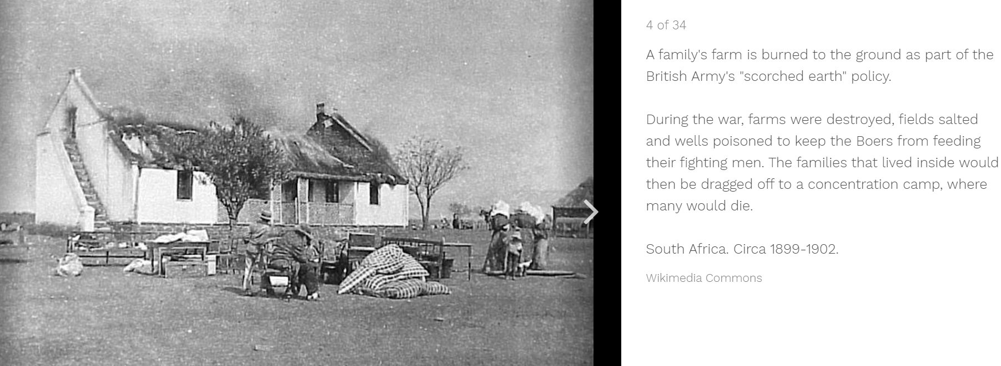
Human Toll of Imperialism

Slide 12
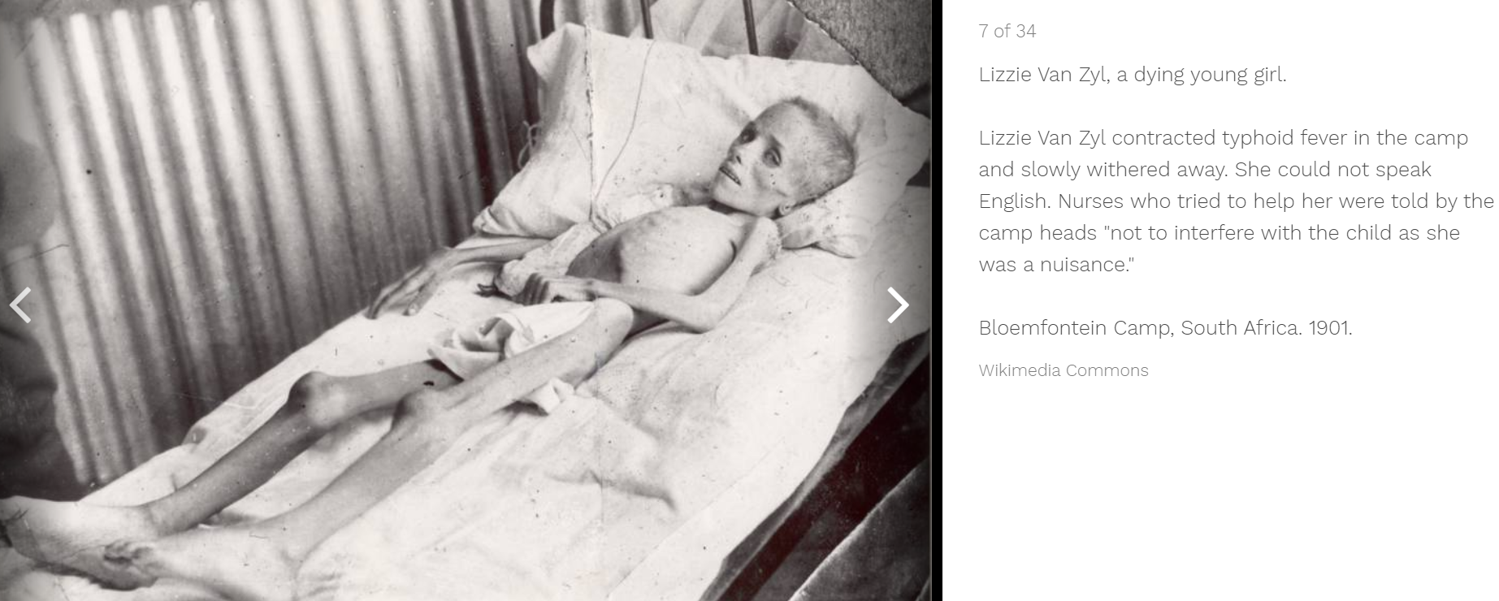
Human Toll of Imperialism

Slide 13
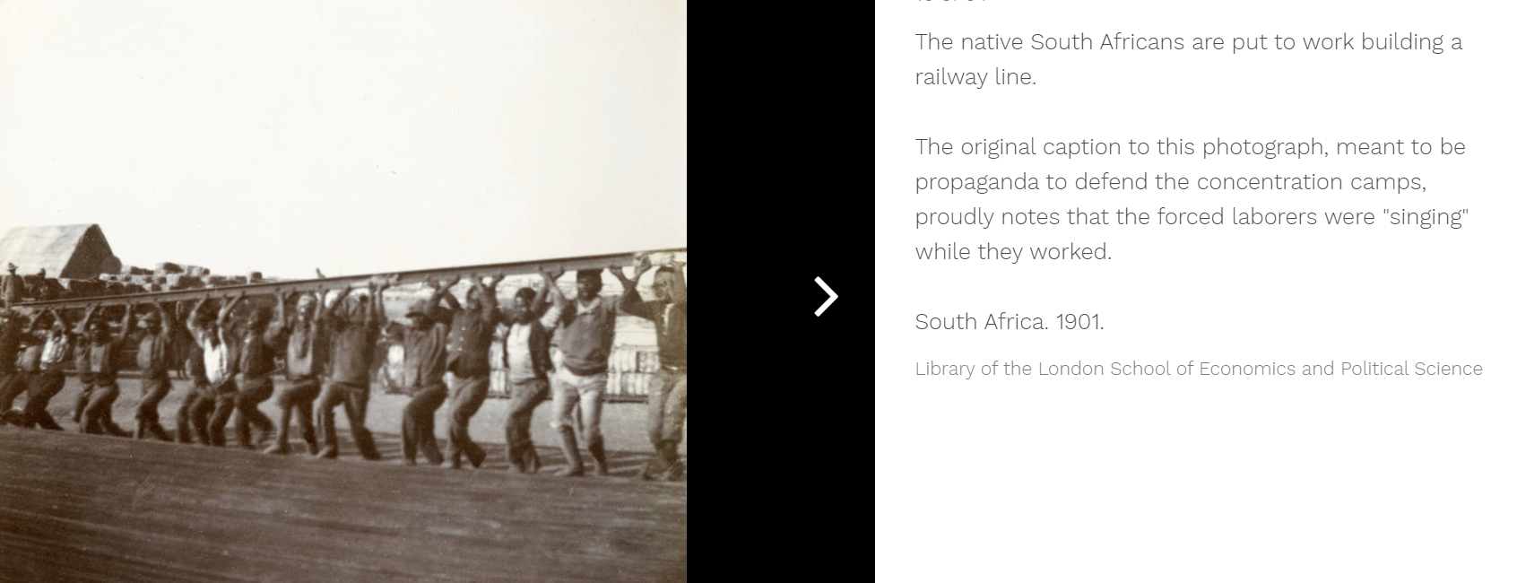
Human Toll of Imperialism

Slide 14
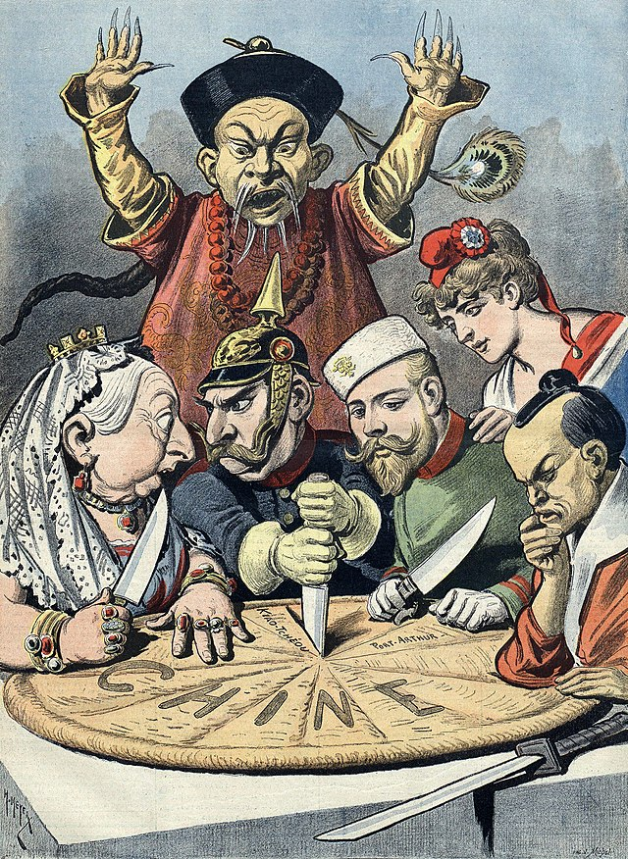
Imperialism Themes
Non-state to state colonial control (Congo, Indonesia)
European states expand in Africa (British, French)
Settler colonies (Australia & NZ)
Industrialized states practiced economic imperialism over non-industrialized states (China, Argentina)
Portugal and Spain lost ground (Indian Ocean, SE Asia)
USA, Japan gained ground

Slide 15
MIGRATION TRENDS
Population increased globally (food/medicine post-IR)
New modes of transportation
Most migrants relocated to cities (urbanization)
USA received the majority of the migrants
Some freely relocated
Indentured servitude & convict labor continued
Migration

Slide 16
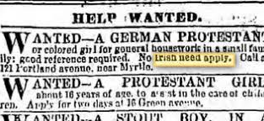
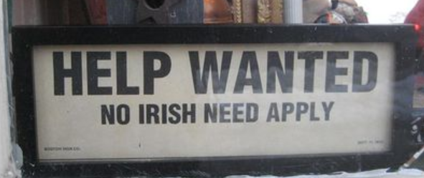
Migration
IRISH TO USA
Push: Potato Famine (1845-1850)
Pull: Economic opportunity
Anti-Catholic prejudice was strong (NYC, Chicago, San Fran.)
Took low-wage jobs such as laying rail lines

Slide 17
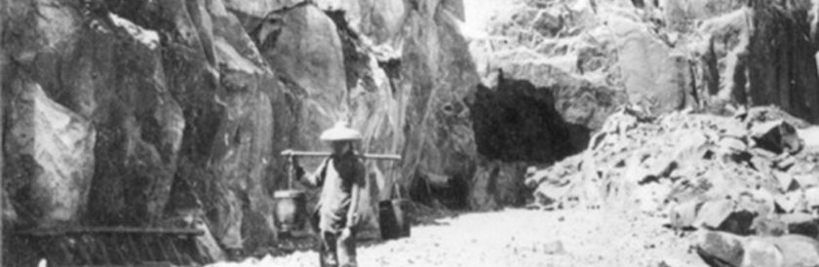
CHINESE TO USA
Push: Economic chaos in China
Pull: Economic opportunity, CA Gold Rush
Manual laborers (agricultural, Trans-Continental RR)
Anti-Chinese sentiment was strong, only group ever to be excluded
Migration

Slide 18
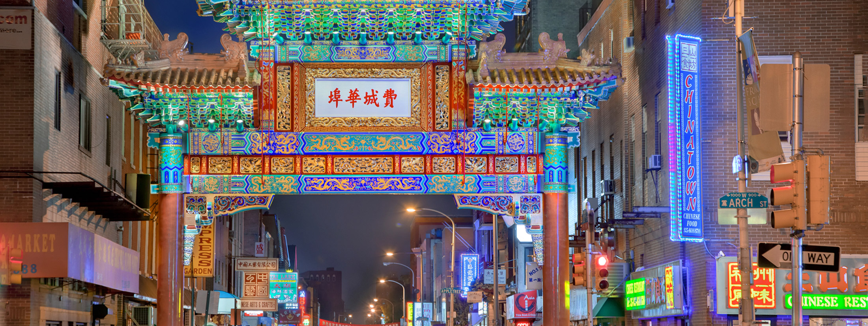
Migration
Effects of Migration:
Creation of urban ethnic enclaves (Chinatown)

Slide 19
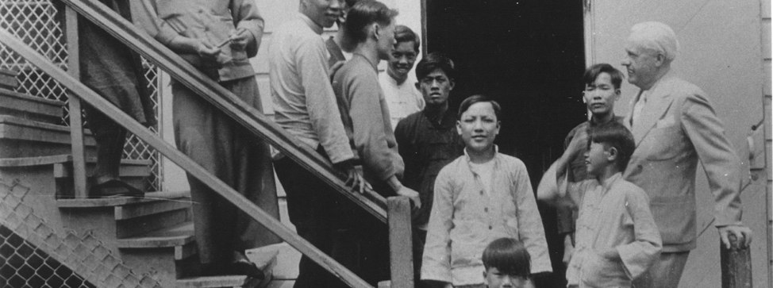
Angel Island Immigration Station
Migration
Effects of Migration:
2. Women took on new roles in the home society as most migrants were male.

Slide 20
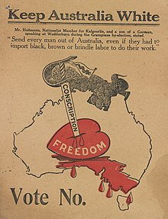
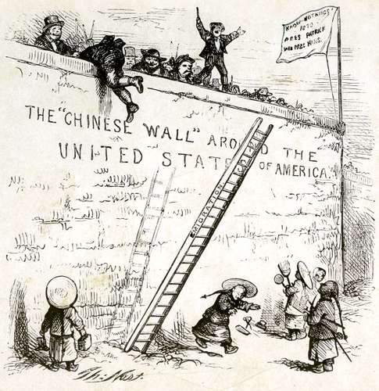
Migration
Effects of Migration:
Exclusionary Policies
Chinese Exclusion Act (1882) – Stopped Chinese immigration; prevented citizenship; lasted until 1940s.
White Australia Policy (1901-1973) – Immigration restricted to Europeans

Slide 21
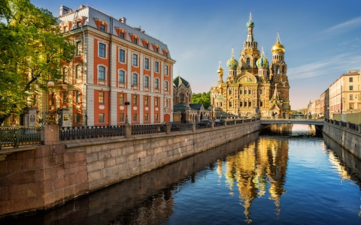
Societies at Crossroads

Slide 22
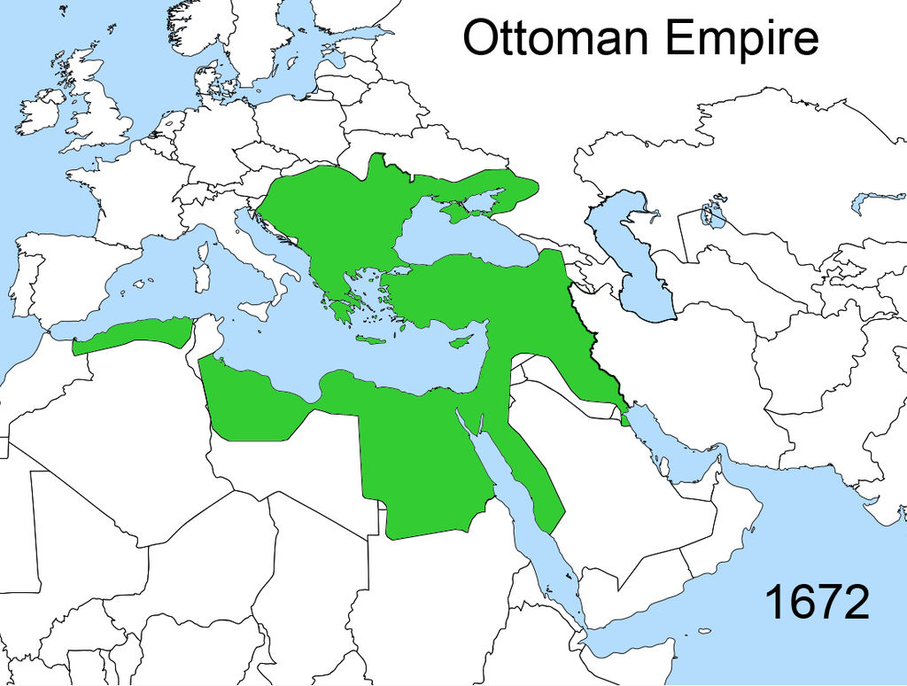
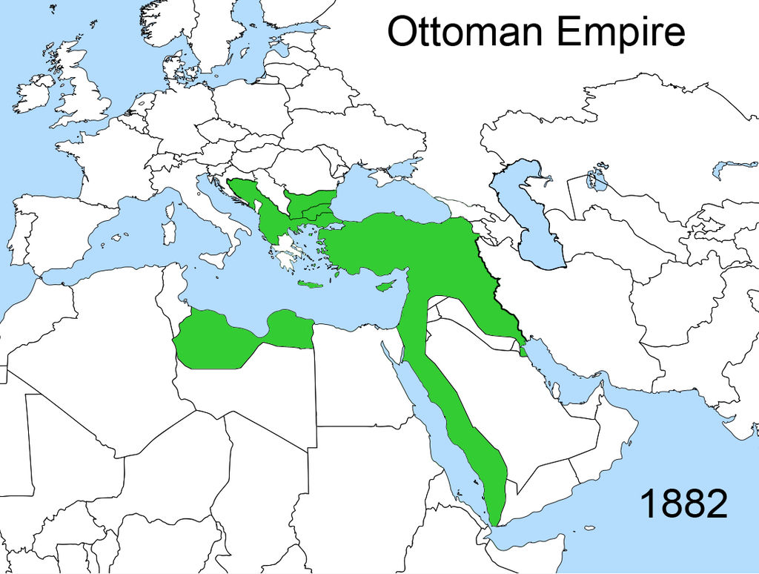
The Ottoman Empire

Slide 23
The Ottoman Empire
Slow decline since the 17th c → territory losses, janissary power increased, foreign manufactured goods flooded in
Tanzimat Reforms – 1830-1870 educational, political, legal reforms intended to modernize the empire and stop decline.
Secular schooling
Equality before the law, Muslim or not

Slide 24
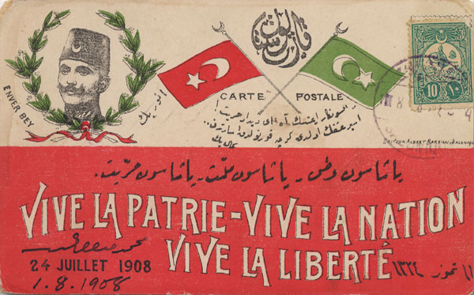
The Ottoman Empire
Young, educated citizens & religious conservatives hated the reforms (undermined Islamic foundations)
Abdul Hamid’s despotic rule generated liberal opposition groups
Young Turks – Seized power in a 1908 coup.
Wanted universal suffrage, religious freedom, emancipation for women
During their rule, sultans reigned but did not rule
Empire survived because European diplomats couldn’t agree on how to dispose the empire without upsetting the balance of power (“Eastern Question”).
Young Turks Flyer – “Long live the fatherland…

Slide 25
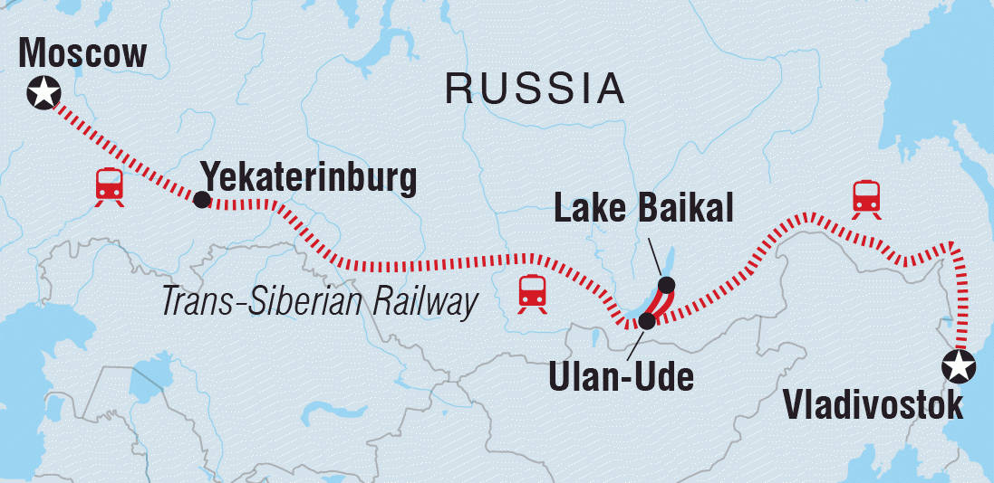
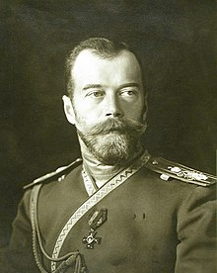
Alexander II abolished serfdom as a way to encourage industrialization.
Trans-Siberian Railway (steel, coal, petroleum attracted Europeans)
Nicholas II took power in 1894
Bloody Sunday – protesters in 1905 stormed St. Petersburg demanding representative government
Duma was established
Romanov dynasty was in trouble!
The Russian Empire

