Slide 1
Unit 7: WWII in Europe
“World War Looms”
Chapter 16

Slide 2
1. Who was the leader of the Soviet Union after Lenin died?
2. Define: “Totalitarian Government” (in own words)
3. Who was the leader of Italy during this time? AND what kind of government did he have?
4. What was Hitler’s book called? What was it about?
5. What land did Japan take from China?

Slide 3
6. Who was the leader of Spain? AND What kind of government did he have?
7. Define: “Neutrality Acts” (in own words)
8. What country was the 1st ally of Germany? What piece of land did this ally want to take?
9. Who was the British prime minister at the beginning of WWII? At the end of WWII?
10. What two leaders signed a Nonaggression Pact and what did it mean?

Slide 4
11. Define: “Blitzkrieg” (in own words)
12. Who was Charles de Gaulle?
13. What does Kristallnacht mean and what happened?
14. Define Hitler’s “final solution” (in own words)
15. Define: “Cash and Carry” (in own words)

Slide 5
16. Define: “Lend-Lease Plan” (in own words)
17. What happened to Stalin and Hitler? Pg. 553
18. Who were the Axis Powers? The Allies (not all of them, the 4 major countries)?
19. Who was Hideki Tojo?
20. Give the date of Pearl Harbor. What did the U.S. do after the attack?

Slide 6
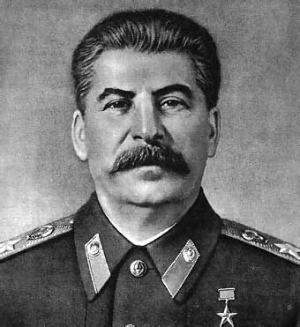
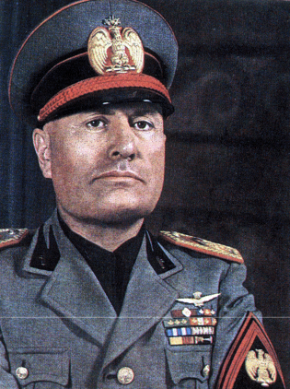
Answers:
1. Stalin
2. Total complete control of government.
3. Benito Mussolini; Fascist government (Extreme Nationalistic government, the interests of the state are before the individual, strong leader and small group devoted to party members.)

Slide 7
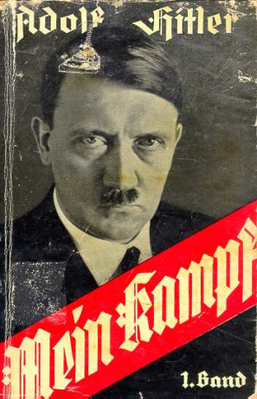
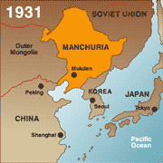
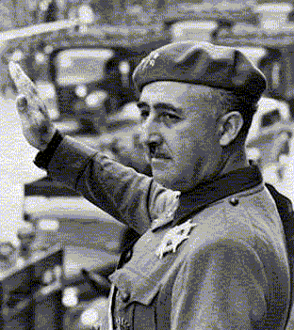
4. Mein Kampf (My Struggle); Basic beliefs of Nazism, extreme Nationalism, racial “purification”, Aryans are the “master race”, national expansion.
5. Seized Manchuria
6. Francisco Franco; Fascism
7. Congress passed in 1935; keep out of all wars. Outlawed arms sales or loans to nations at war.

Slide 8
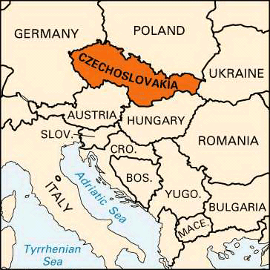
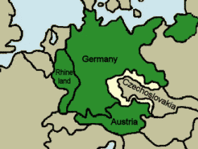
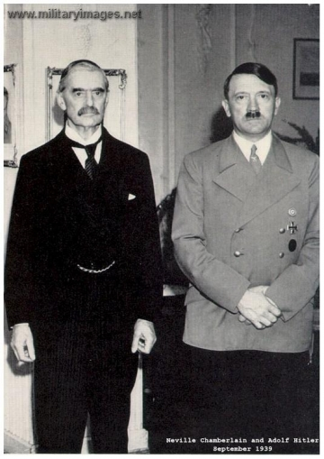
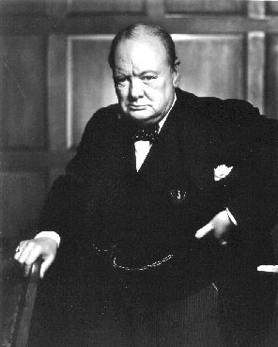
8. Austria; Sudetenland (Czechoslovakia) because they were “abusing” Sudeten Germans.
9. Beginning: Neville Chamberlain
End: Winston Churchill

Slide 9
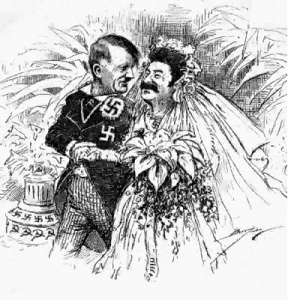
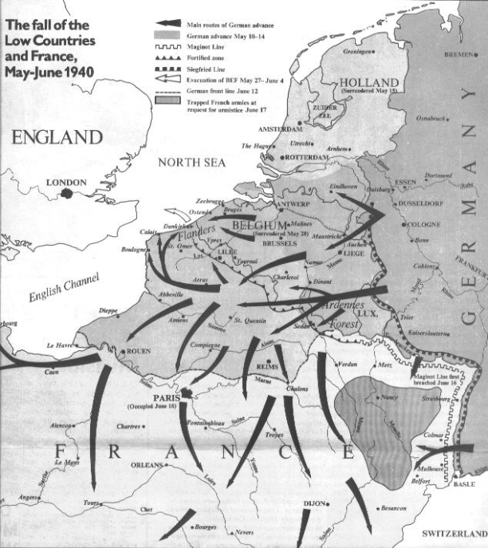
10. Stalin and Hitler
11. Lightning War; Germany’s military strategy to take Paris, France then turn around to Soviet Union

Slide 10
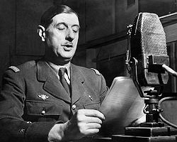
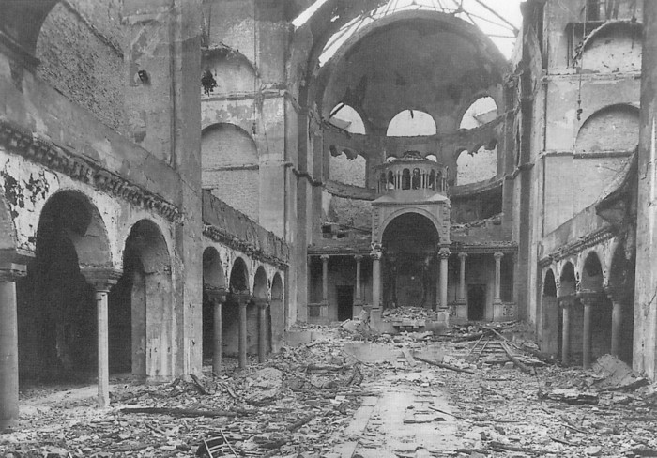
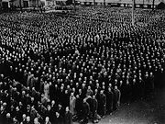
12. France’s General; set up Free French government in exile in Britain (will be President of France later in 1958)
13. November 9-10, 1938; “Night of Broken Glass”; storming of Jewish businesses and synagogues in Germany

Slide 11
14. To rid of “untouchables”; Genocide
15. Cash and Carry- Allowed warring nations to buy US arms as long as they paid in cash and transported them in own ships.
16. Lend-Lease Plan- Lease arms and supplies to countries
17. Hitler invaded Soviet Union

Slide 12
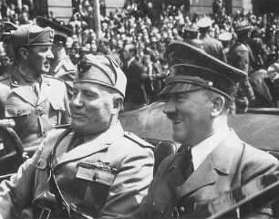
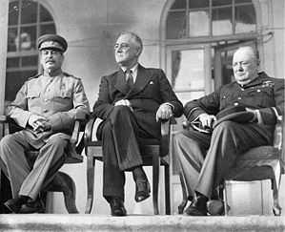
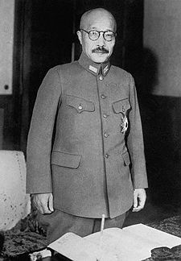
18. Axis Powers: Germany, Italy, and Japan
Allies: Britain, France, Soviet Union, U.S.
19. Chief of staff of Japan’s army

Slide 13
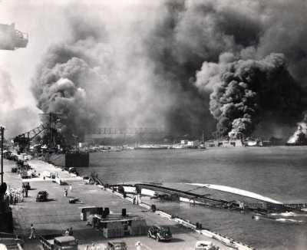
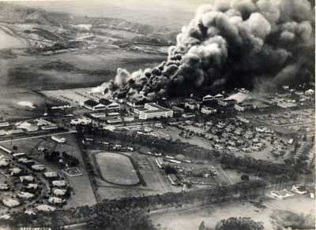
20. December 7, 1941; The US declared war on Japan
“A date which will live in infamy” FDR

Slide 14
