Slide 1
Imperialism in the Modern Era

Slide 2
Today…
We’ll be reviewing where we’ve been and previewing where we’re going
You’ll work in small groups to answer some big questions on a few sheets of poster paper
Every group member needs a marker and a willingness to participate & contribute

Slide 3
Think about the Short Answer Question from your midterm!
Why?
More people knew about them due to global trade
Widespread appreciation for Llamas
What changed about the world from 1450-1750?

Slide 4
Write this question in the center of the big paper.
Think about Unit V: Revolutions in the Modern Era!
What had changed about Europe since 1750?

Slide 5
Add your responses to the paper in front of you
How did those changes affect Europe’s motivations and goals?
What had changed about Europe since 1750?

Slide 6
Unit V: Revolutions in the Modern Era (1750-1914)
Unit VI: Consequences of Industrialization (1750-1914)
Revolutionary (and not-so-revolutionary) changes
Government, ways of thinking, place of mankind in society and the universe
Rise and role of nation-states
Technological changes and innovations
European (and American) imperialism across the globe
Indigenous responses and resistance to expansion
Begins to look like the world we exist in today (for better and for worse)

Slide 7
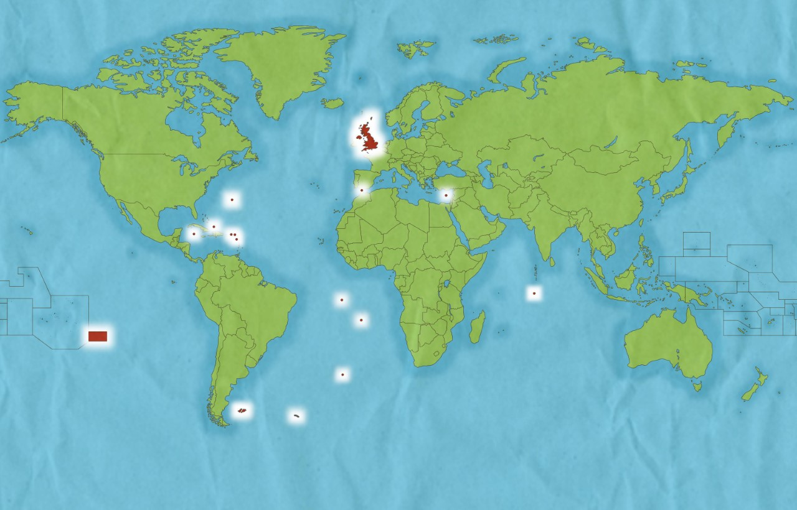
What is Imperialism?
A policy of conquest and domination of foreign lands and populations in order to form an EMPIRE

Slide 8
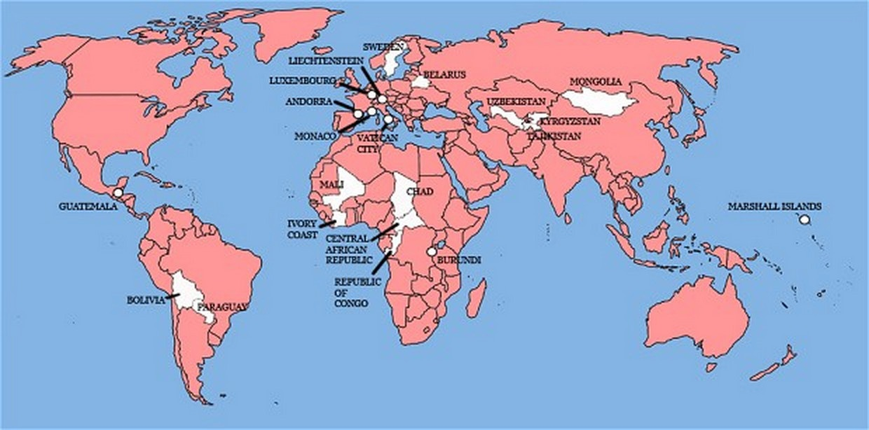
Countries the British have invaded

Slide 9
What’s the difference between an Empire and a Nation?
Nations have buy-in from their people and some shared characteristic (language, race, culture, etc.)
Empires have an element of force and are made up of many types of people
Is the US a nation or an empire?
Notes:
Empires have an element of force
Nations have buy-in from their people

Slide 10
Add to the paper in front of you
How did those changes affect Europe’s motivations and goals?
What had changed about Europe since 1750?
What are some potential causes of European IMPERIALISM?

Slide 11
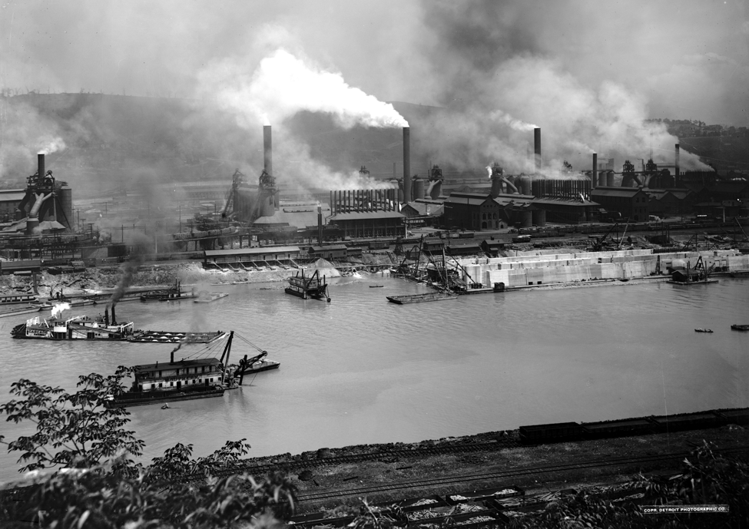
Five Rationales for Imperialism
1. Economic
Need to acquire raw materials
Open new markets for goods (need people to sell your products to!)

Slide 12
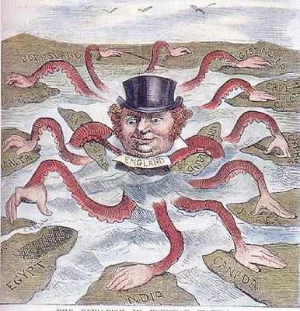
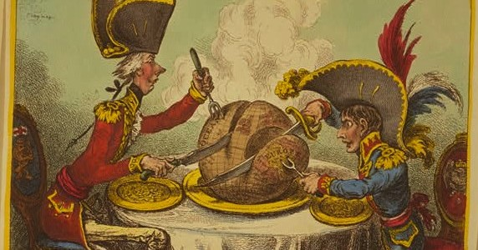
Five Rationales for Imperialism
2. Nationalism
Secure land, wealth, and markets for your country before others get there
Demonstrate power on a global stage

Slide 13
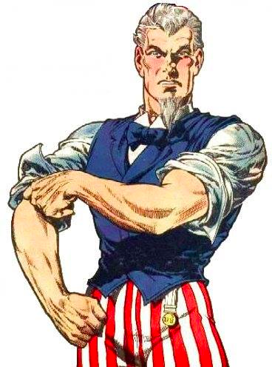
Five Rationales for Imperialism
3. Cultural Superiority
Social Darwinism=Strong should rule the Weak
Belief that Western ideals were the best (and should be shared with the world!)

Slide 14
Five Rationales for Imperialism
4. Religious
Drive to convert others to Christianity, destroy “heathen” religions, provide humanitarian relief
Imperialism is your holy duty

Slide 15
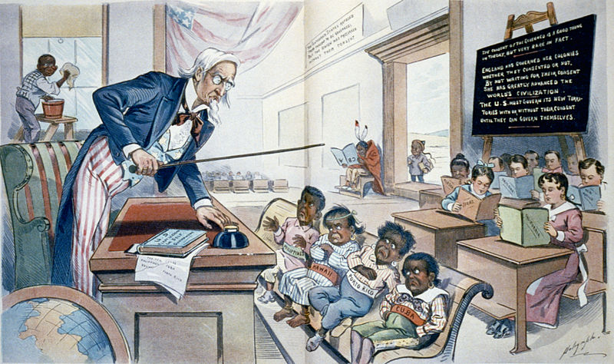
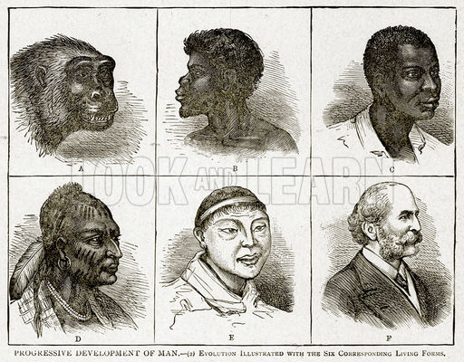
Five Rationales for Imperialism
5. Racism
Scientific Racism—certain races are scientifically superior and should rule others
Imperialism is inevitable and humane

Slide 16
What’s left to take?

Slide 17
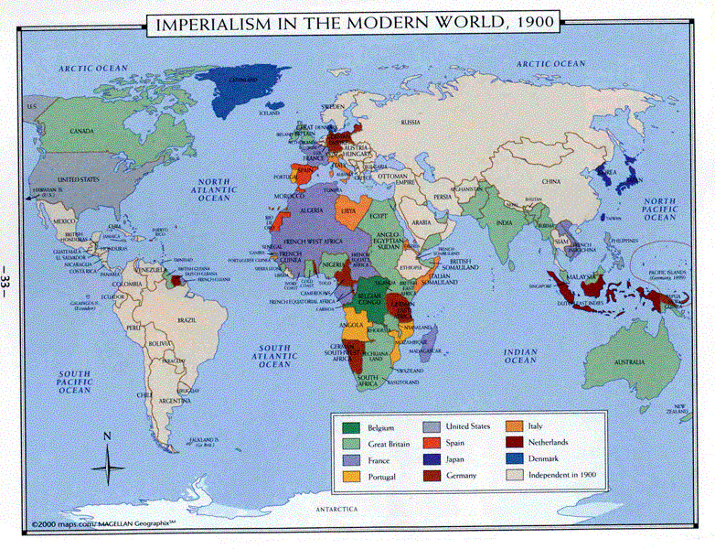
How did we get here?

