Slide 1
P
Political
I
Innovation
E
Environment
C
Culture
E
Economic
S
Social
AP Modern World History
Themes

Slide 2
P
Political
I
Innovation
E
Environment
C
Culture
E
Economic
S
Social
AP World History is organized around six themes that serve as unifying threads throughout the course.
By studying history and relating it to the themes we can see how events, individuals, empires, etc. fit together in a puzzle to reveal a “big picture” of history in each time period and across them.
The themes provide a way to organize comparisons and analyze change and continuity over time.
Consequently, virtually all study of history done in this course will be viewed using “PIECES” and theses themes as lenses to help understand history.

Slide 3
I
Innovation
E
Environment
C
Culture
E
Economic
S
Social
P
Political
Theme: Governance (GOV)
Governments maintain order through a variety of Administrative institutions, policies, and procedures. Governments obtain, retain, and exercise power in different ways and for different purposes.
Analyze what internal and external factors contribute to state formation, expansion, and decline.
Guiding Questions: Who is in charge and who gives that person or group power? What is power based on? Is there a contract? What is the government structure? Are there any significant wars, treaties, courts or laws?

Slide 4
P
Political
E
Environment
C
Culture
E
Economic
S
Social
Theme: Technology and Innovation (TEC)
Human adaptation and innovation have resulted in increased efficiency, comfort, and security.
Analyze how technological advances have shaped human development and interactions with both intended and unintended consequences.
Guiding Questions: How have people adapted to their surroundings? How do they get from place to place? What tools or machines have they developed? Are there any significant achievements or innovations in technology, math, or science?
I
Innovation
Notes:
AP World History Theme: Technology and Innovation (TEC)

Slide 5
P
Political
I
Innovation
E
Environment
C
Culture
E
Economic
S
Social
Humans and the Environment (ENV)
The environment shapes societies, and as populations grow and change, these populations in turn shape their environments.
Analyze how populations impact their environment and are effected by their environment.
Guiding Questions: In what geographic region is the society/civilization located? What makes up the geographic landscape of this region? How are people/events affected by the geography?
How do the people interact with the environment? How does the environment define the society/civilization?
E
Environment

Slide 6
P
Political
I
Innovation
E
Environment
C
Culture
E
Economic
S
Social
Theme: Cultural Developments and Interactions (CDI)
The development of ideas, beliefs, and religions illustrates how groups in society view themselves, and interactions of society and their beliefs often have political, social, and cultural implications.
Analyze how a peoples unique way of life impacts their history.
Guiding Questions: What is the meaning of life for people in the society/civilization? How do they live their daily lives? What are the basic religious beliefs? Are there leaders or documents that define religion? What groups are given the chance to learn and how do they learn? Do they have forms of philosophy? How do they express themselves?
C
Culture
Notes:
AP World History Theme: Technology and Innovation (TEC)

Slide 7
P
Political
I
Innovation
E
Environment
C
Culture
E
Economic
S
Social
Theme: Economic Systems (ECN)
As societies develop, they affect and are affected by the way that they produce, exchange, and consume goods and services.
Analyze how economies and economic pursuits shape the history of different societies.
Guiding Questions: Is there a currency present in this society? How do the people earn their money (or food)? What commodities are valued and traded? Is the economy based on agriculture or commerce (small trades & professions)? Is the economy based on industry (manufacturing & technology)?
E
Economic

Slide 8
P
Political
I
Innovation
E
Environment
C
Culture
E
Economic
S
Social
Theme: Social Interactions and Organizations (SIO)
The process by which societies group their members and the norms that govern interactions between these groups and between individuals influence political, economic, and cultural institutions and organization.
Analyze what groups have power and standing over others, how it is manifested, and why. Analyze who is the “other” in the society.
Guiding Questions: How does the group relate to one another? How do people communicate? What do people do together? How is the group organized? What are the family and gender relations? Are there social classes? How do they live? Are there inequalities within the society?
S
Social

Slide 9
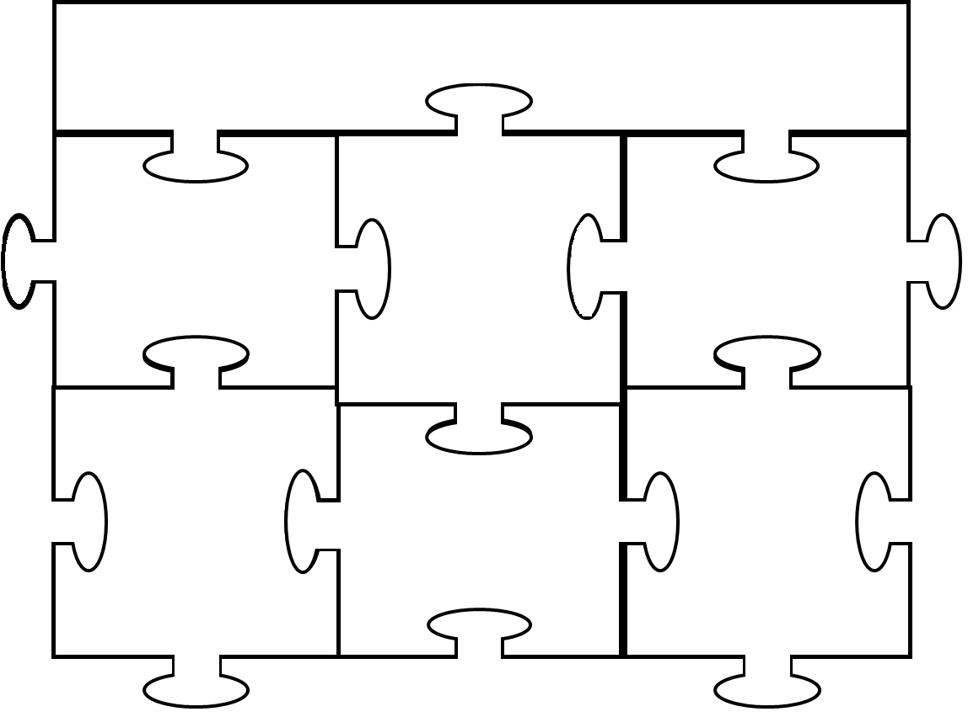
Mrs. Martin P.I.E.C.E.S. Name______________________
AP World :

