Slide 1
Chapter 25: America moves to the city

Slide 2
Growth of Cities:
New Technology: bridges, mass transportation
New Construction Techniques: iron skeleton, elevator
Urban Political Machines
Social Services to poor, housing reforms
15% Urban in 1850
40% Urban in 1900
4 million city dwellers in 1850
30 million city dwellers in 1900
62 US cities over 10,000 in 1850
440 US cities over 10,000 in 1900

Slide 3
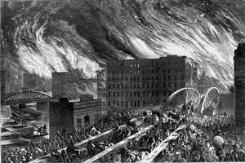
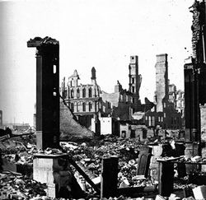
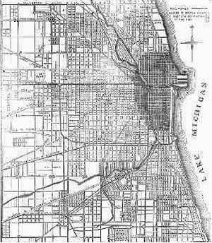
The Great Chicago Fire: October 8-10, 1871
How was it started?
What was the effect of Chicago after the fire?

Slide 4
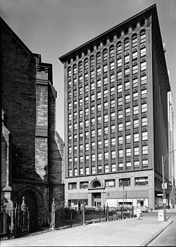
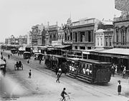
Streetcars pulled by horses were developed. Then underground cable streetcars. Transportation built cities even more, why?
Louis Sullivan: one of the 1st architects to use new technology to design sky scrapers.
Department stores and the “shopping district” emerged in mid 1800’s.

Slide 5
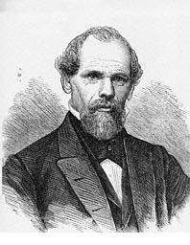
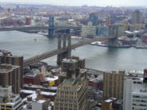
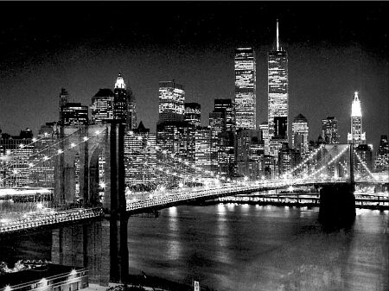
John Augustus Roebling: German/American engineer who designed suspension bridges that allowed cities by rivers or waterways to expand. Most famous bridge is the Brooklyn Bridge that linked Manhattan Island to Brooklyn, NY.

Slide 6
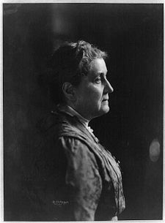
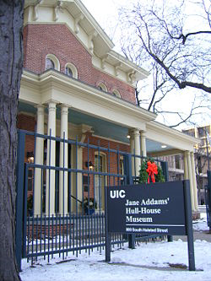
Jane Addams: founded Hull House, a settlement house in Chicago

Slide 7
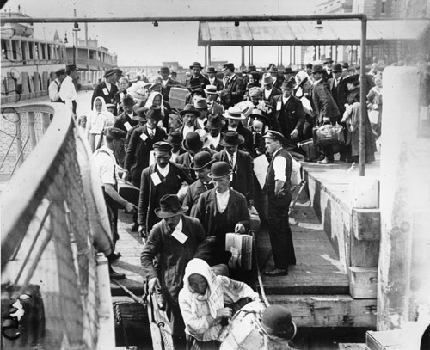
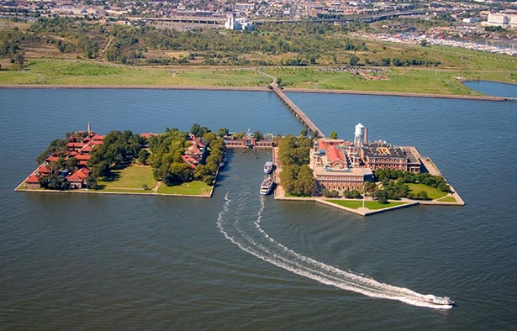
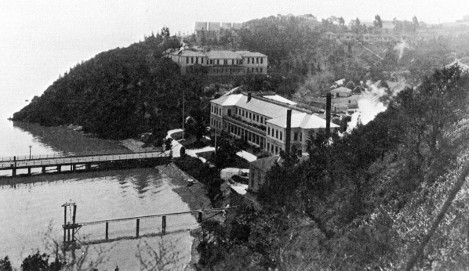
What fueled American Industries?
Ellis Island- Immigration Center in New York City
Angel Island- Immigration Center in San Francisco

Slide 8
Old Immigrants- England, Ireland, France, Germany, and Scandinavia
White, mostly literate, Protestant, and somewhat familiar with Constitutional government
New Immigrants- Greece, Poland, Russia, Italy, Slavic countries
Mostly illiterate, Catholic or Jewish, unfamiliar with Constitutional government

Slide 9
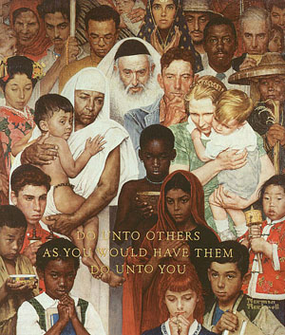
Melting Pot
“The term ‘Melting pot’ is often thought of as a good thing. New York is known as a melting pot because it has a variety of different people and different cultures all in one area. This helps create diversity and opens out minds up to other areas of the world and how they do things. Unfortunately not all people like the idea of a melting pot.”
http://www.dominiquemanzione.blogspot/2008/02/advertising

Slide 10
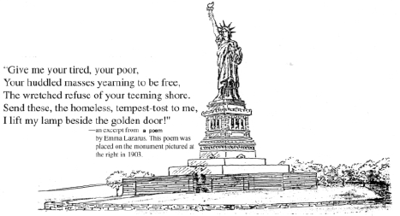
Emma Lazarus- Born in NY of Jewish parents, she wrote the sonnet that is now on the Statue of Liberty
Ironically she died in 1887 at the age of 38, one year after the Statue of Liberty was dedicated.
Her words were placed in 1903.
Nativism- Anti-Immigrant attitudes
Xenophobia- Fear or hatred of foreigners or strangers

Slide 11
Immigration Settlement Patterns – 1910 Census

Slide 12
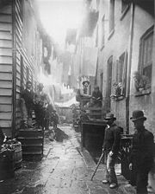
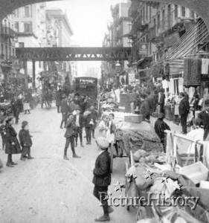
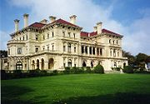
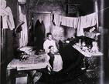

Slide 13
Mulberry Street, New York City, ca. 1900

Slide 14
“Street Arabs” – Jacob Riis Photo of Boys Sleeping in the Streets

Slide 15
Urban Children Play Next to a Horse Carcass

Slide 16
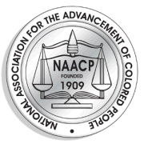
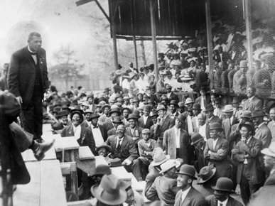
Social Equality

Slide 17
Intellectual Frontiers A. Public Education & Education for Black Americans (cont.)
In the South, Booker T. Washington, head of the ‘Tuskegee Institute’, championed black education and a self-help approach to developing the economic and educational resources of the black community
Washington was criticized as ‘accomodationist’ by W.E.B Du Bois because he avoided challenging white supremacy
Du Bois, the first black American to earn a Ph.D. from Harvard University, demanded full and immediate equality for blacks – particularly for the ‘talented tenth’ of the black community
In 1910, Du Bois became a founder of the ‘National Association for the Advancement of Colored People’ [NAACP]

Slide 18
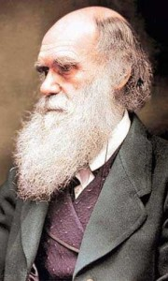
Christian Science
Mary Becker Eddy- 1879 founded the Church of Christ, Scientist
Darwinism- Evolution

Slide 19
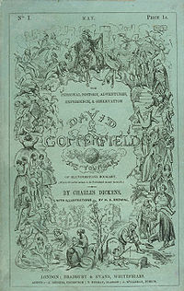
Education and Literature
Carnegie and Libraries
Old Literature:
New Literature: Emily Dickinson, Walt Whitman, Mark Twain, Jack London

Slide 20
Cartoon Character ‘Mickey Dugan’ from Joseph Pulitzer’s ‘New York World’ – Inspired the Term ‘Yellow Journalism’

Slide 21
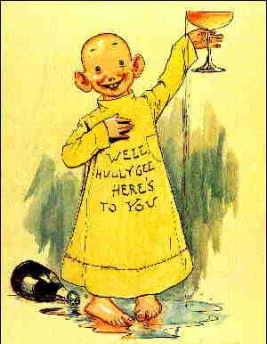
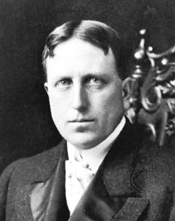
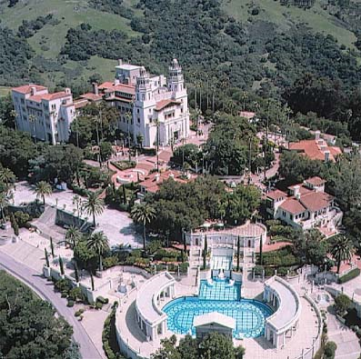
Yellow Journalism
Joseph Pulitzer- “Yellow Kid”
William Randolph Hearst-

Slide 22
Feminism & Families Families & Women in the City
In the ‘Gilded Age’ the family and home became centers of refuge from the stresses of modern industrial life – places to enjoy leisure activities as well as for intimate companionship and emotional support
At the same time, the ‘family’ underwent changes as the demands of work and city life led to (1) families having fewer children and (2) rising divorce rates as women grew more independent
Charlotte Perkins Gilman, author of ‘Women and Economics’, was one such independent-minded feminist leader

Slide 23
Feminism & Families Families & Women in the City (cont.)
Gilman’s book encouraged women to (1) become productively involved in the economy and abandon their traditional dependency on men, and (2) advocated government establishment of centralized children’s nurseries and cooperative kitchens to aid working mothers
In 1890, Elizabeth Cady Stanton and Susan B. Anthony helped to found the ‘National American Woman Suffrage Association’ [‘NAWSA’] – a feminist organization formed to fight for women’s right to vote
By 1900, Carrie Chapman Catt led a new generation of women in a different direction to win the right to vote

Slide 24
Feminism & Families Families & Women in the City (cont.)
Ida B. Wells, a black activist who began a nationwide anti-lynching campaign, also helped promote the establishment of black women’s clubs – a reaction to discriminatory practices of many other women’s clubs of the era

Slide 25
Feminism & Families The Prohibition Movement & Other Crusades
In 1869, the short-lived ‘National Prohibition Party’ was organized with the goal of closing down saloons and outlawing the manufacture, distribution, and consumption of alcoholic beverages – its candidates polled very few votes in national elections
By 1874, the ‘Woman’s Christian Temperance Union’ [‘WCTU’] had formed with Frances E. Willard as its president – it too championed prohibition and total abstinence from drinking
Among the more militant feminist prohibitionists was Carrie A. Nation – the so-called ‘Kansas Cyclone’
Nation began a prohibition crusade in which she entered saloons to smash bottles with her hatchet – an extreme reaction to her alcoholic husband’s death which brought bad publicity to the movement

Slide 26
Frances E.C. Willard – Modernized the Women’s Christian Temperance Union’

Slide 27
Dramatic ‘Anti-Saloon League Poster’ - ‘The Overshadowing Curse’

Slide 28
Feminism & Families The Prohibition Movement & Other Crusades (cont.)
In 1893, the ‘Anti-Saloon League’ was established – a very well organized and powerful organization which succeeded in winning passage of a national prohibition amendment in 1919
In 1866 the ‘American Society for the Prevention of Cruelty to Animal’ [‘ASPCA’] was established
Lastly, in 1881, Clara Barton launched the ‘American Red Cross’ – the result of her battlefield nursing experiences during the ‘Civil War’

Slide 29
Advance Poster for ‘Buffalo Bill’s ‘Wild West Show’ - ca. 1880s-1890s

Slide 30
The Connecticut Bicycle Parade, Hartford, 1885

Slide 31
Luna Park at Coney Island

