Slide 1
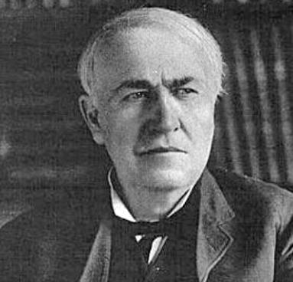
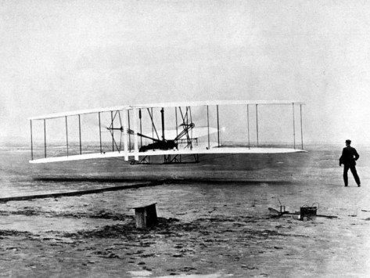
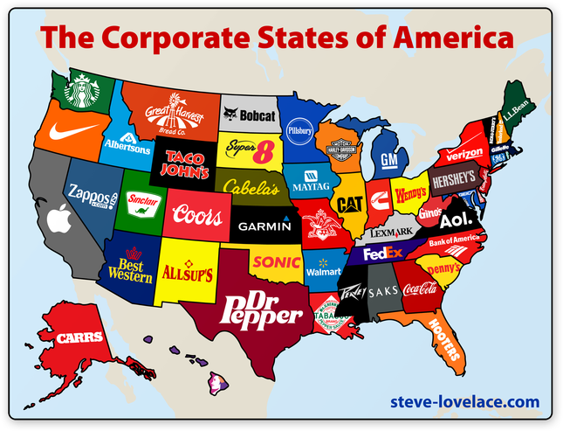
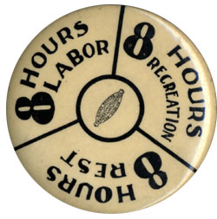
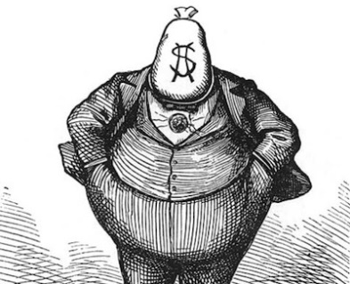
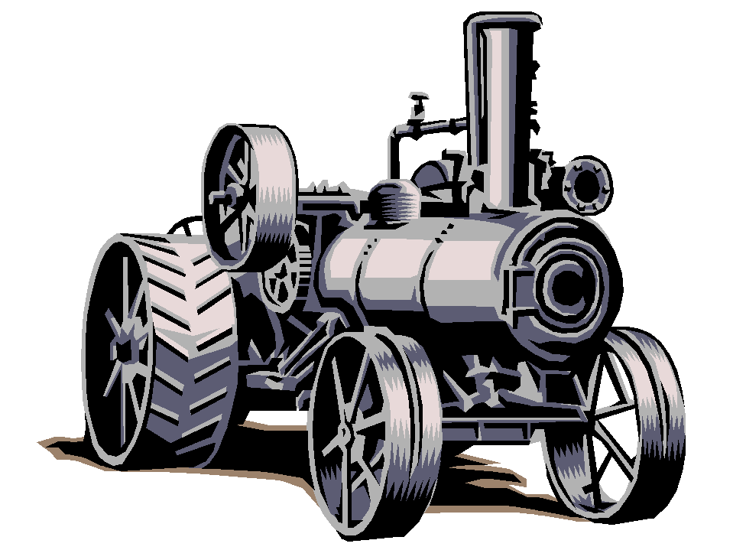
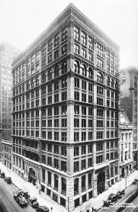
Industrialization
and the
“Gilded Age”
STAAR Review 2

Slide 2
Industrialization continued at a rapid pace in the years following the Civil War.
The Bessemer Process for making steel, allowed for a boom in industry.
New inventions – like the telegraph, telephone, typewriter, and the sewing machine made America more productive.
Natural Resources – like oil and electricity became important sources of energy.
Entrepreneurs – like John D. Rockefeller and Andrew Carnegie establish new business techniques.
Labor – workers would organize to gain higher wages, better working conditions, and an 8 hour workday.

Slide 3
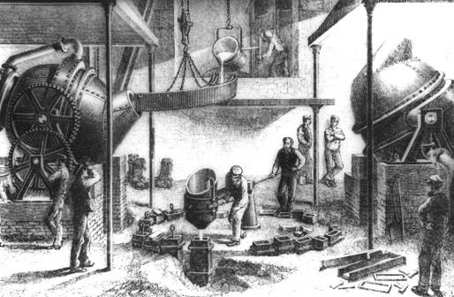
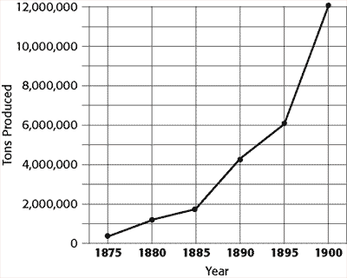
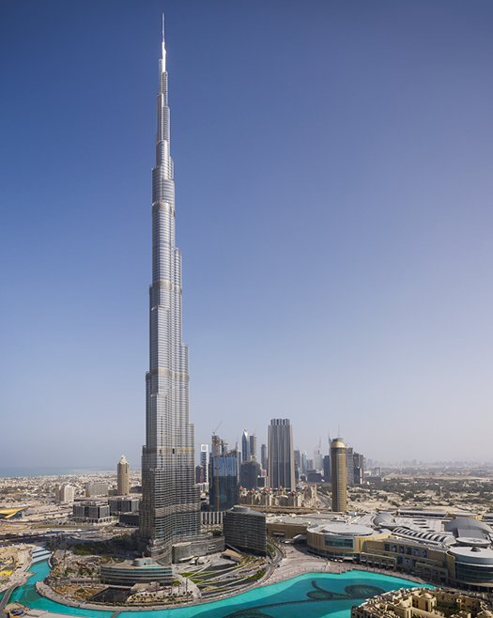
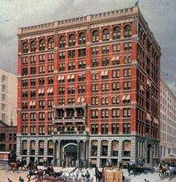
Technological Innovations
Bessemer Process – increased the amount and the quality of steel being produced.
This new steel was used to lay more miles of railroad track, to build the world’s 1st skyscrapers, and to make better machinery.
World’s 1st built in 1885 it was 180 feet tall
Dubai
World’s tallest built in 2010 it is 2,722 feet

Slide 4
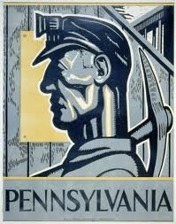
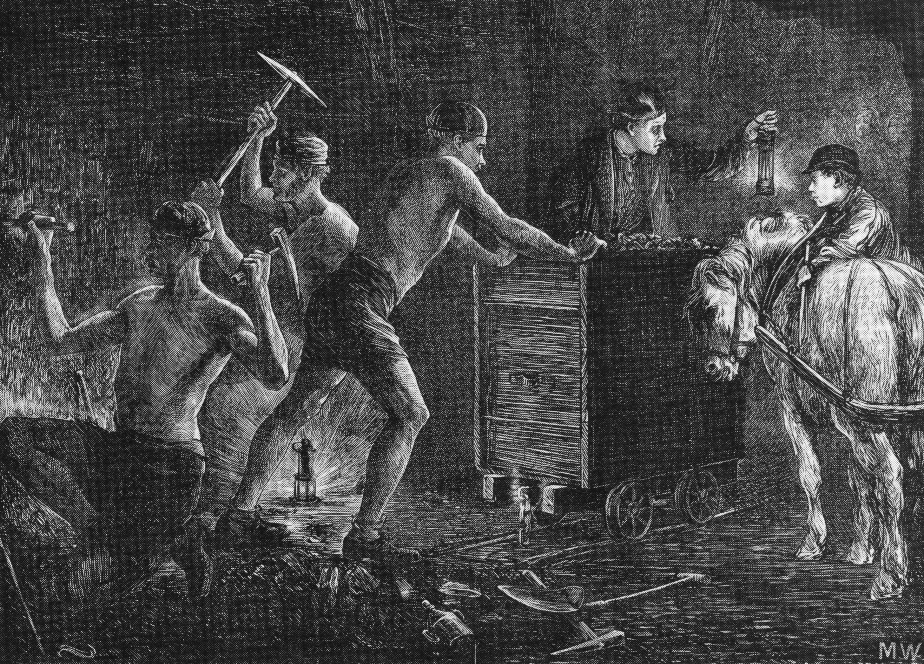
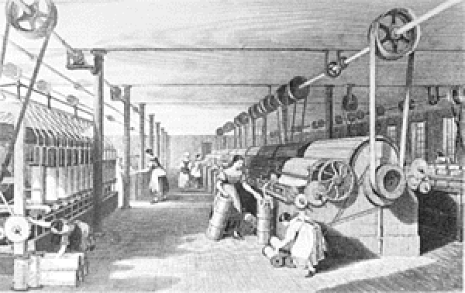
Technological Innovations
After the Civil War, human and animal strength were replaced by steam and electricity.
Steam engines, powered by burning coal to heat water, drove the textile mills, factories, and trains.
During the late 1800s the center of coal mining was in the Appalachian Mountains of western Pennsylvania.

Slide 5
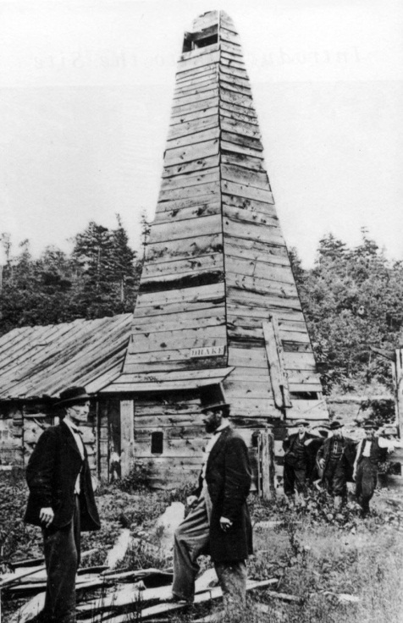
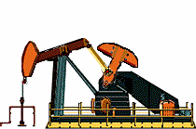
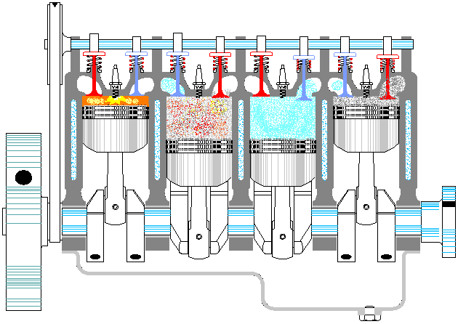
Technological Innovations
America’s first oil well was drilled in Titusville, Pennsylvania in 1859.
At first, oil was just used as a lubricant, later it was refined into kerosene for lighting.
It wasn’t until the internal combustion engine and the development of the car, that the demand for oil skyrocketed.
New sources of energy and transportation technologies have improved our mobility and our production capabilities.

Slide 6
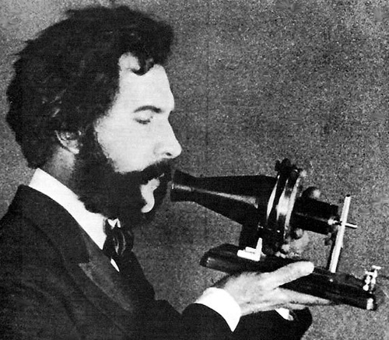
Electricity
Electricity
The use of electricity was another of the era’s most significant developments.
Electricity was first used as a means of communication with the telegraph.
The telegraph dramatically changed the speed at which we communicated over great distances and made the Pony Express obsolete.
Alexander Graham Bell would later perfect the telephone in 1876, it hasn’t stopped ringing since then.
Later communication improvements, like the IPhone would also make land line telephones obsolete.
Communications have never been the same!

Slide 7
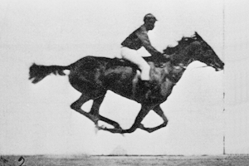
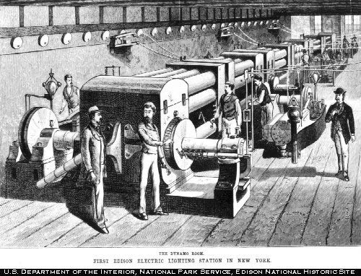
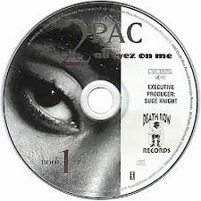
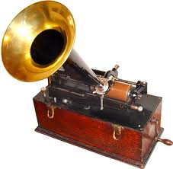
Technological Innovations
Thomas Edison would also use electricity to produce amazing results.
Edison designed a way to get electricity into homes and businesses, having electric appliances isn’t much good if you don’t have electricity.
Edison was able to create:
Motion pictures, (entertainment)
The light bulb, (world went 24/7)
The phonograph, (which later gave way to other forms of recordings)

Slide 8
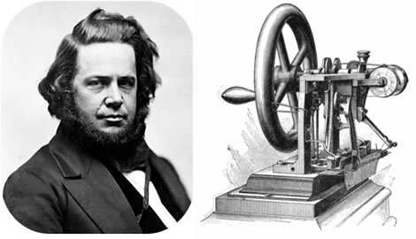
Other Inventors & Innovations
This was a time period of many inventions that improved the lifestyle and standard of living of many Americans.
Elias Howe – sewing machine, clothing could be made cheaper, faster, and now at home. (1846)
Elisha Otis – passenger elevators, the new technique of making steel allowed for skyscrapers, this created a need for elevators to carry people between floors. (1852)

Slide 9
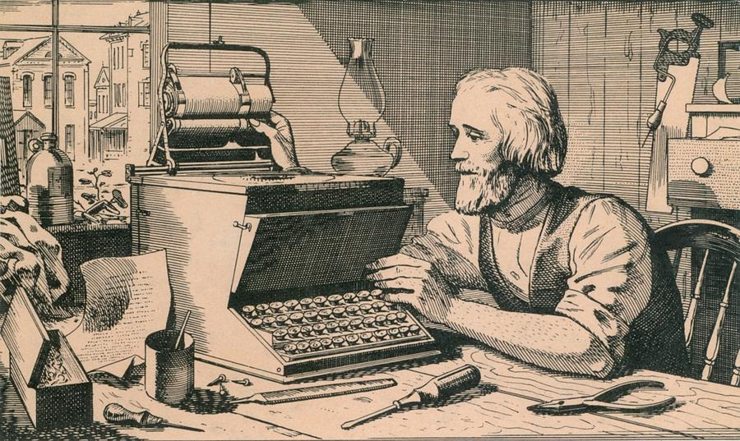
Other Inventors & Innovations
This was a time period of many inventions that improved the lifestyle and standard of living of many Americans.
Christopher Sholes – typewriter, made businesses more productive and helped improve communications. Eventually led to computer keyboards. (1867)
Wright Brothers – Orville & Wilbur first successful manned flight. Although their first flight lasted only seconds, it opened way for air travel at a dramatically increased speed and distance travelled. (1903)

